Slide 1

IMS Standards: Digital Assessment
Colin Smythe
Chief Architect (IMS Global)
csmythe@imsglobal.org

Slide 2
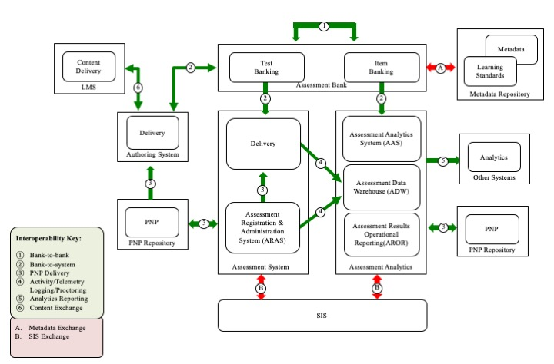
Assessment Architecture

Slide 3
Relevant IMS Specifications
Question & Test Interoperability (QTI)
Accessible Portable Item Protocol (APIP)
Portable Custom Interaction (PCI)
Computer Adaptive Testing (CAT)
Proctoring
Access for All Personal Needs & Preferences (AfA PNP)
Content Packaging/Common Cartridge/Thin Common Cartridge
Learning Tools Interoperability (LTI)
LTI Resource Search
Competency & Academic Standards Exchange (CASE)
Caliper
OneRoster
Metadata (LOM) & AfA Digital Resource Description (DRD)

Slide 4
Adoption in Europe
Deployed solutions
  Netherlands
    Schools delivery deployed since 2014
  Norway
    Schools delivery now under development
Certified Vendors (QTI)
  TAO (Luxemburgh)
  BPS (Germany)
  Itslearning (Norway)

Slide 5
Questions & Comments

