Slide 1
OER pilot results
March 2014 – January 2015

Slide 2
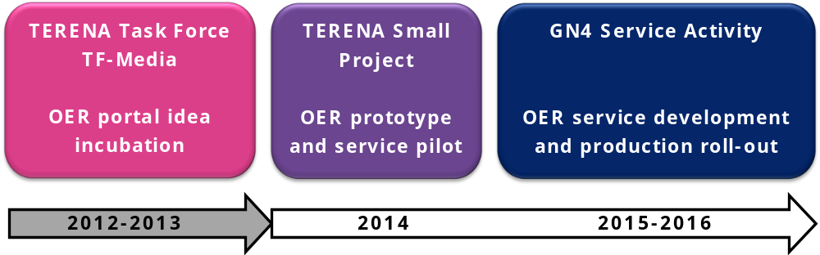
Aim
The primary aim of the TERENA small project is to develop the first working prototype of the OER service (including the metadata aggregation engine and the web portal front-end) and pilot a service for the broader TERENA/GÉANT Community in 2014.

Slide 3
Objectives
Connect the yet scattered institutional/national OERs within the TERENA/GÉANT community (facilitate them to reach the critical mass) and unlock the deep-web by enabling structured searching and reuse of content.
Create a one-stop-shop broker/aggregator (i.e. the TERENA/GÉANT OER) for institutional/national learning resource organizations, each of them managing and/or federating one or more learning object repositories within the country (such as Nordic OER alliance [14] for instance)
Finally, TERENA/GÉANT OER joins the Open Course Ware Consortium [8] and/or the GLOBE federation [9] that already has repositories around the globe such as:

Slide 4
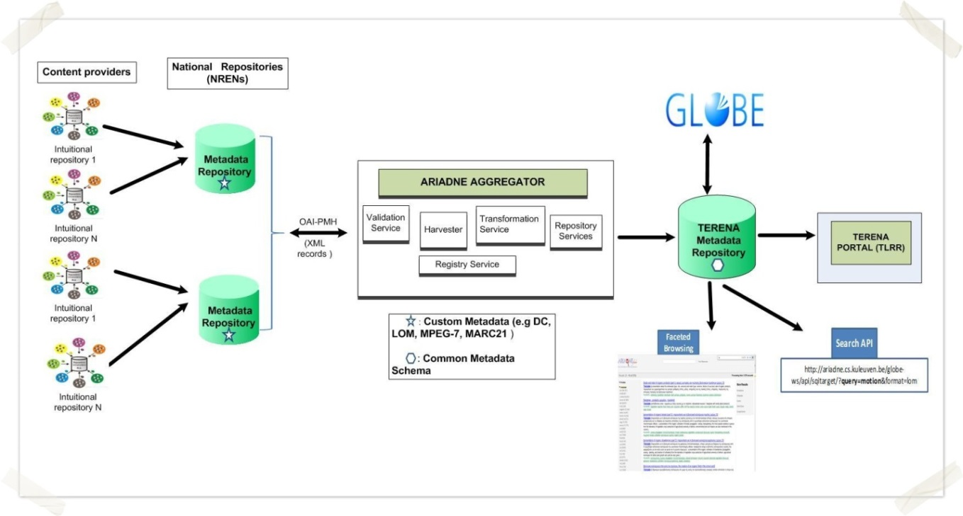
Architecture concept

Slide 5
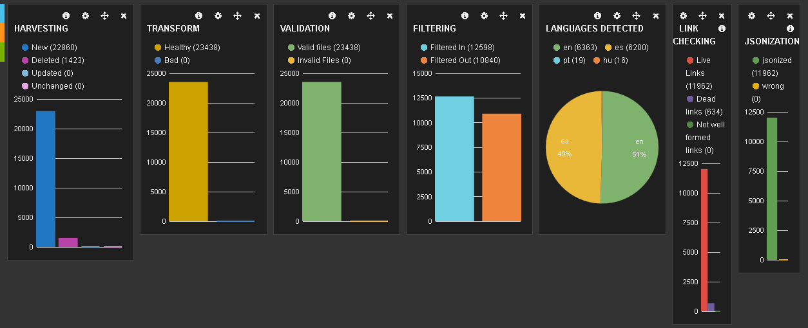
Results
Back-end (metadata harvesting and aggregation)
http://terenaoer.grnet.gr/index.html#/dashboard/elasticsearch/Terena%20Aggregation
http://terenaoer.grnet.gr/index.html#/dashboard/elasticsearch/Terena%20Metadata%20Analysis

Slide 6
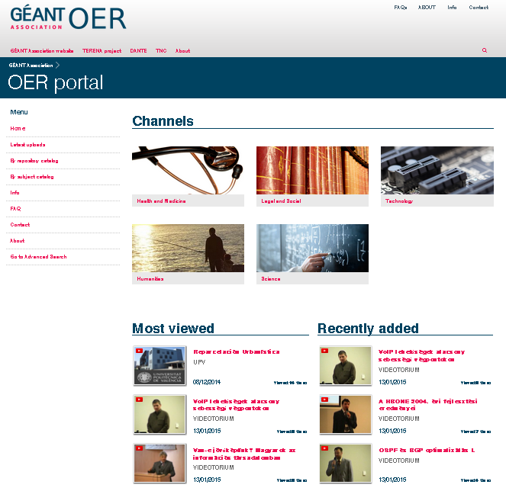
Results
Front-end web portal (demo)
http://terenatv.media.uvigo.es/
optical

Slide 7
Position Paper to EC
GÉANT Association NRENs and Open Education
  NREN Community Statement on Open Education
https://www.terena.org/activities/oer/GEANT_Association_NRENs_And_Open_Education-final.pdf

Slide 8
KPIs
Indicator name | Expected progress | Results
Number OER content providers to be invited | 15 | ~15
Number of content providers that will share their OER through TERENA OER | 5 | 7+
Number of OERs shared through the OER TERENA portal | 10.000 | 22.860 / 12.590
Connection with global OER initiatives e.g. GLOBE | 1 | 0
Number of languages supported at the TERENA OER portal | 2 (EN and ES) | 4 (EN, ES, PT, HU)
Number of defined metadata compliance levels | 3 (Mandatory, Recommended, Optional) | 3
Dissemination activities (Presentations and publications) | 3 | 4 (Position paper, Deliverables, Symposium, TNC’15)

Slide 9
Finances
Tasks | Estimated efforts | Estimated cost | Real cost
1. Information model and metadata schema development and recommendations (reference repository) | 2PM | 12.000 EUR | 10.000 EUR IUCC
2. ARIADNE harvesting engine deployment and testing with “friendly repositories” | 3PM | 10.000 EUR | 12.000 EUR GRNET
3. PuMuKit-based web front-end development according to the requirements of a state-of-the-art OER | 2PM | 6.000 EUR | 8.000 EUR Uvigo
4. Software integration and pilot service development | 2PM | 6.000 EUR | 4.800 EUR f2f meeting
5. Project management | 1PM | 9.000 EUR | 4.500 EUR Sigita & Peter
TOTAL | 10PM | 43.000 EUR | 39.300 EUR

Slide 10
Next steps
Publish the final deliverable
Symposium demo
GN3 SA8 Task 3 (GRNET) + pilot team
TNC’15 demo
Taking the GÉANT OER to the next level...

