Slide 1
Building the Greenhouse
Nicole Harris and Licia Florio
Project Development Officers
30th September 2015
Amsterdam

Slide 2
Greenhouse?
A place to cultivate;
A place for support and growth;
A transparent structure.

Slide 3






NREN Software Projects

Slide 4
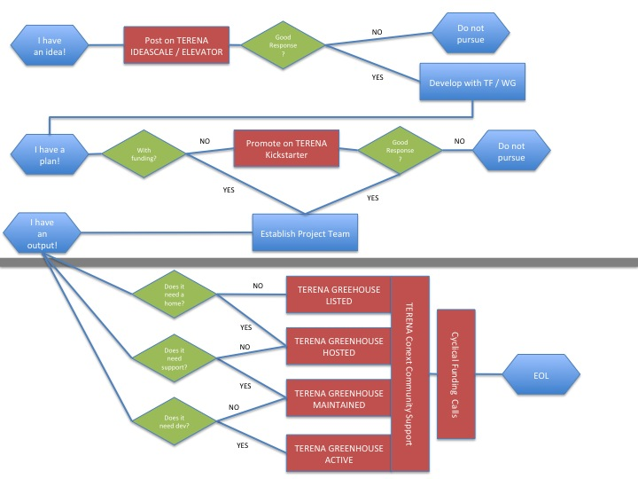
Initial Brainstorming

Slide 5
Why GÉANT?
We ALREADY do most of this, in various forms.
(e.g.) REFEDS participants agreement and sponsor model.
(e.g.) TCS support processes for Djangora and Confusa.
It’s something we do that is not codified as a GÉANT offer.

Slide 6
What?
Trusted intermediary;
Known jurisdiction;
Light-touch;
Community appropriate;
Socialised.
https://wiki.terena.org/display/GREEN/Differentiating+the+TERENA+Greenhouse

Slide 7
Product Need Assessment
Funding and Finances;
Legal Agreements;
Technical Requirements;
Promotion and Coordination;
User-base;
Positioning.

Slide 8

Help!
What’s the
Business Model?
(people in glasshouses shouldn’t throw stones)

Slide 9
GÉANT as a Conservancy
Legal set up of GÉANT Association means we are not well structured to support projects in this way – we are an association for the members.
Need to look for a partner to support conservancy aspects.
HOWEVER…
We do have the ability to provide support, advice and community sharing.
Greenhouse-SIG??

Slide 10
Greenhouse SIG?
Helping groups define charter / bylaws of the specific project.
Sharing ideas / pain / issues.
Supporting communication / engagement with conservancy role.
Supporting GÉANT in helping promote projects.
Discussions on approaches to code management (see Brook’s presentation).

Slide 11
Aim of this workshop

Slide 12
What we hope to achieve
Introduce NLnet and their proposed model to implement the Greenhouse
  To gain acceptance by the potential users;
Define how best to offer the advisory function to the Greenhouse as well as detail the exact role of GÈANT.
  i.e. shaping the framework, supporting GEANT community process to get into the Greenhouse

Slide 13
Timeline
Spring 2015 - Talked to Apereo and Nlnet before the summer to seek a partnership
May 2015 - Findings presented to GEANT community during TNC
  No objections
  Some NRENs very supportive
Phase 1
End Oct – Have a consolidate proposal on how to implement the greenhouse
End of Nov – Result from initial testing with one project (i.e. Filesender)
Phase 2
Open the Greenhouse to other projects

Slide 14
nicole.harris@geant.org

