Slide 1
I can’t code…and so can you!
Brook Schofield
GÉANT
Greenhouse Kickoff, Amsterdam
Wednesday 30th September 2015

Slide 2
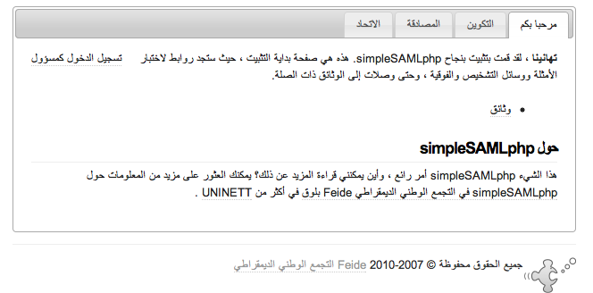
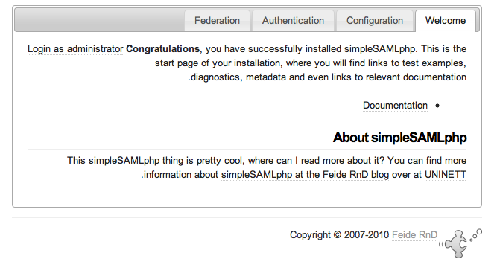
Mono-Lingual Programmer joins translation effort!
Can’t speak another language, but added right-to-left support to simpleSAMLphp

Slide 3
I’m crap and coding… ...but that doesn’t stop me.
“A trio of auth sources for simpleSAMLphp” was my 1st attempt – I received a reply from Olav
- The 'stage' namespace should match your module name, please use
'authwindowslive' instead of 'windowslive'. So long as all places
follow this rule, there is little risk of collisions.
- I see you didn't include a attributemap for authwindowslive?
- You forgot to update the author line in
modules/authmyspace/lib/Auth/Source/MySpace.php and in LinkedIn.php.
- The regular expression checks in finalStep for MySpace - I am not
sure of the purpose of them, but I think the first one (for matching
digits in $userdata['person']['id'] should be written as '/(\d+)/',
and then extracted using $matches[1] instead. I find that a bit
easier to read.
- Feel free to remove old debug code, like:
#echo '<pre>'; print_r($requestToken); exit;
- I see that you change the calls to from_consumer_and_token to using
an empty array as the default last parameter instead of NULL. Does
this cause any changes in behaviour of that function?
- I think that the SimpleSAML_Error_UserAborted class should just
subclass SimpleSAML_Error_Exception instead. I think we made a
mistake when trying to classify errors as "user errors", and would
like to get rid of the SimpleSAML_Error_User class at some point in
time.

Slide 4
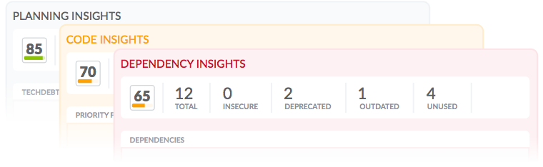
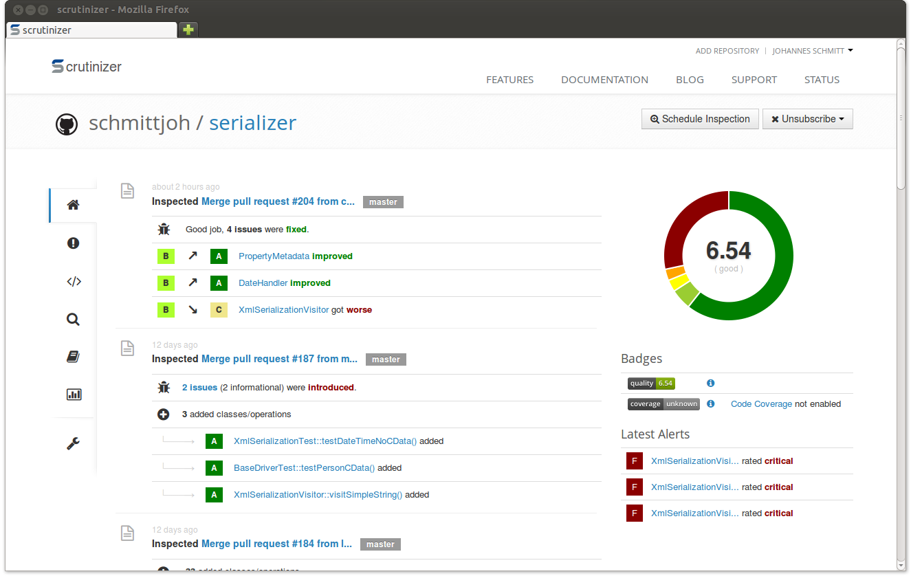
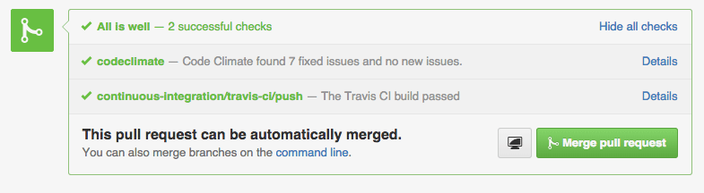
Raft of code quality tools
JS: bitHound, Code Climate
PHP, Python, Ruby/Rails:
Scrutinizer-CI, Codacy,
Code Climate
Scala, CSS: Codacy
…and more!

Slide 5
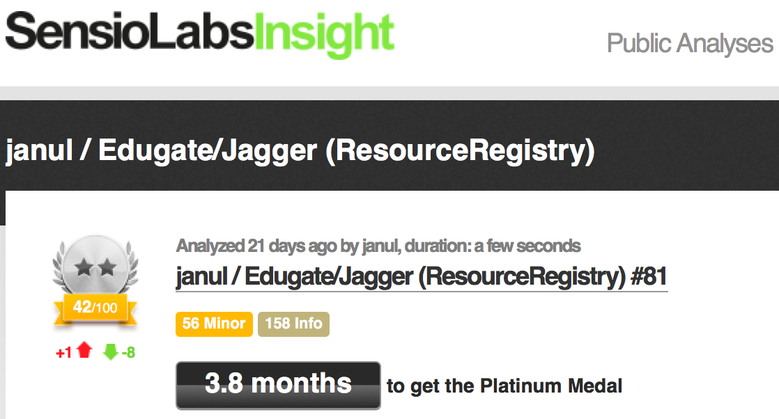
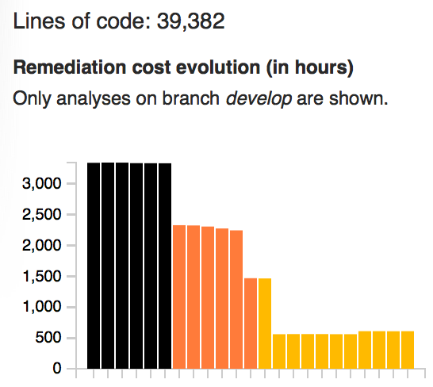
Gamification to prove your progress
Edugate/Jagger doesn’t have a unit testing framework

Slide 6
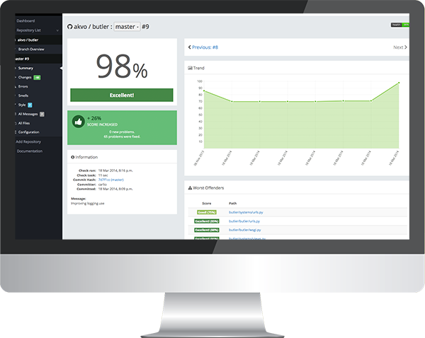
Gamifed LeifJ to see if it works!
Convinced LeifJ to
use landscape.io
landscape.io now
dead :-(
Improved code
coverage of pyFF
Other tools to
choose from

Slide 7
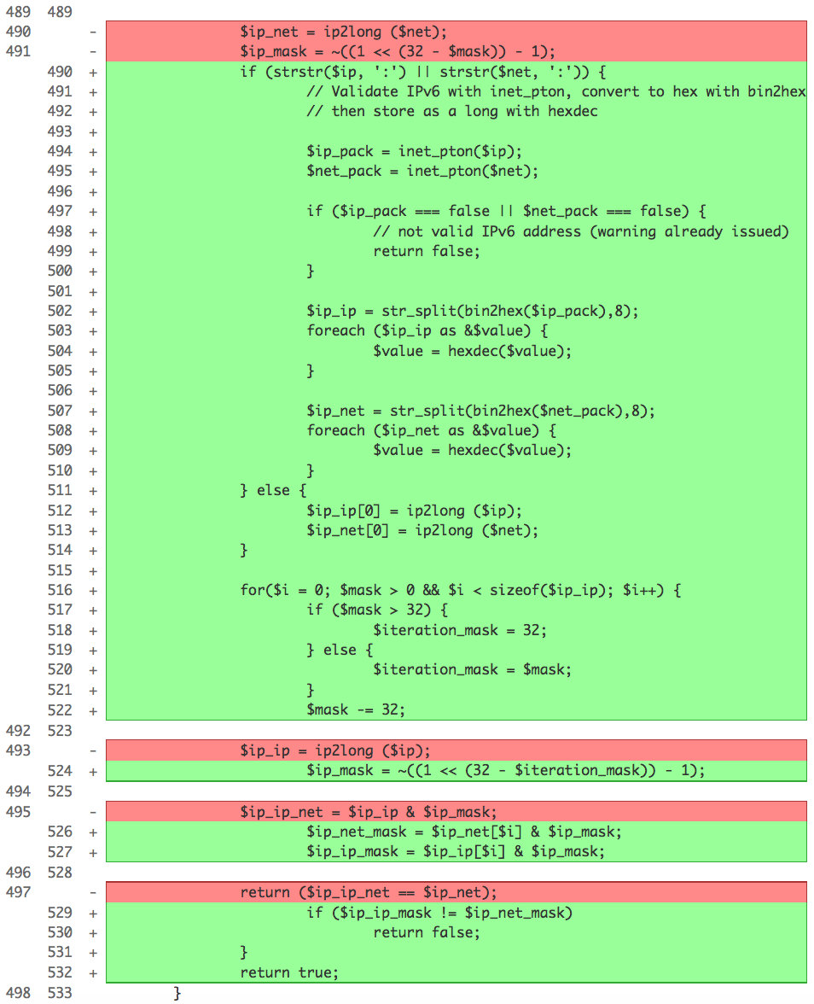
Prove your code works with this 1 simple trick
Added IPv6 support to the simpleSAMLphp CIDR (without using a library)
Code is very short. Builds on IPv4 code
but now deals with 3 more octets.
Does this code work?
No unit testing framework in simpleSAML
at that time :-(
Wrote a 13k test script for 1.5k patch!

Slide 8



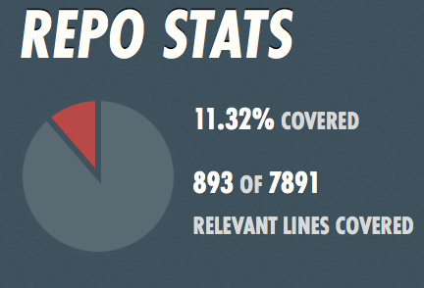
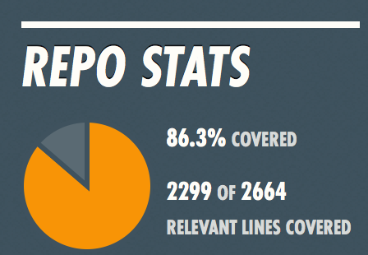
Visibility of your code isn’t good enough anymore
Use of Git, SVN and the public hosting equivalents allow your code to be visible.
  Social coding is a step change in broadening a community
Unit testing makes the life easier for the project owner(s)
Also for contributors… ...if we could get people to write tests
Coveralls.io and Code
Coverage shows how
proven the code is.

Slide 9



UI and Functional Testing…
Selenium and PhantomJS for UI testing
Automate on top of Travis-CI or SauceLabs
Function Testing… so far away!
  ...FileSender use Se so it’s not unknown

Slide 10
What else? …what next?
Deployment, Packaging and Docker
  Quay.io for building Docker images
  A “better” way to get people using your code
Finding those in the community that can help drive using these tools in our environment.
It’s easy to poke fun (and holes) in other peoples work!
Much better working together.

