Slide 1

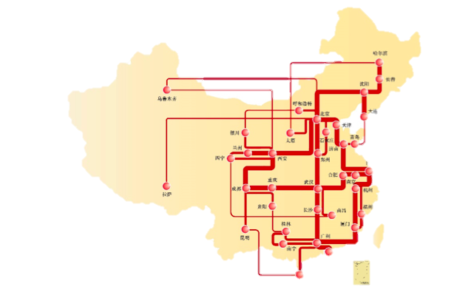

CERNET TNE Perspective
William Wan
CERNET TNE Program Coordinator
Washington D.C.
2017.4.25

Slide 2
TNE in China
Overview
1979 projects, in which 930 were approved by the Ministry of Education of China, 1049 by provincial governments^{(*)}.
349 China’s universities involved one or multiple projects.
Types (Host) 3+1
  Campus Site (Nottingham@Ningbo, DKU@Kunshan, NYU@Shanghai)
  Campus-in-Campus
  Office-only
CERNET TNE Program can tailor the services and serve all types
*Data from Ministry of Education of China website in Nov. 2016.

Slide 3
CERNET Facts
CERNET is the largest NREN and connects to research and educational networks worldwide, widely supports educators, researchers, faculties, and students.
CERNET2, the largest IPv6 network in the world, connects to huge educational, research, and commercial resources.
CERNET has dedicated academic routes to the US (Internet2, 10G), Europe (GEANT, 10G, AsiaConnect) and Asia Pacific Region (APAN, 10G). The connections are built with resilience consideration to ensure the stability of the connectivity. Currently these routes are not congested and the quality is very good.
CERNET is built with 100G backbone and has 38 regional POPs, which serves about 2000 universities and institutions in China.
National wide support team – 29 branch offices.

Slide 4
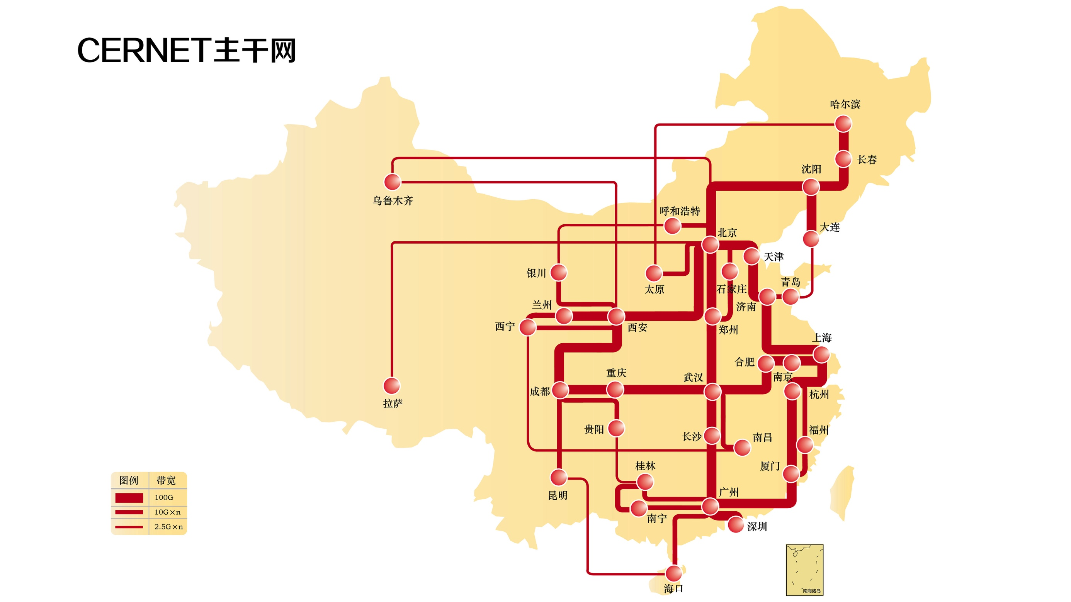
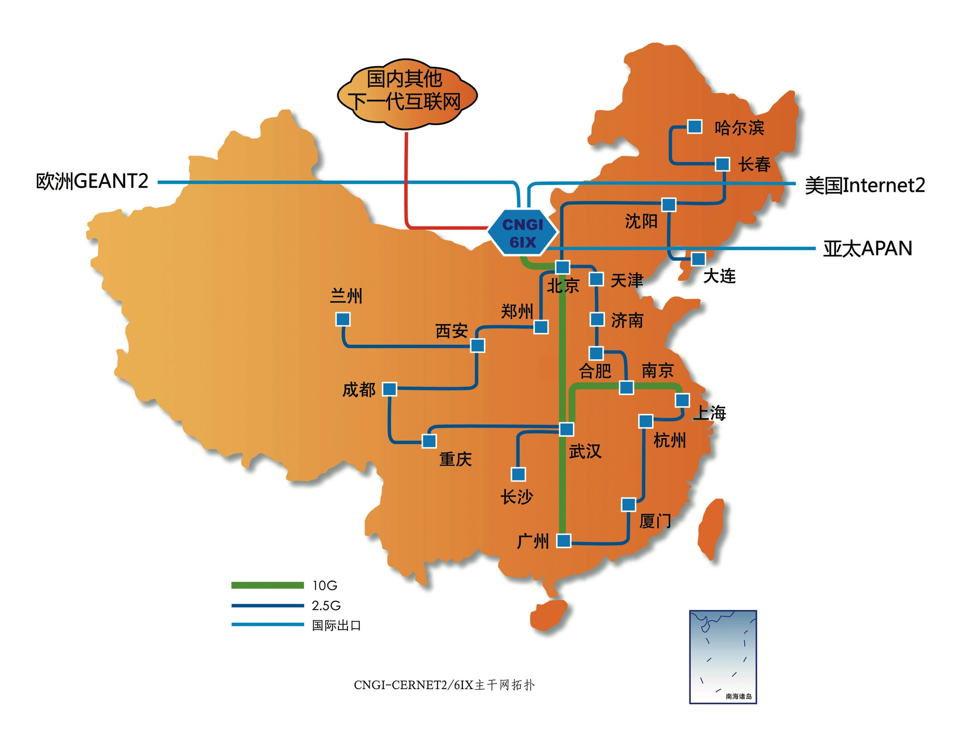
CERNET Topology

Slide 5

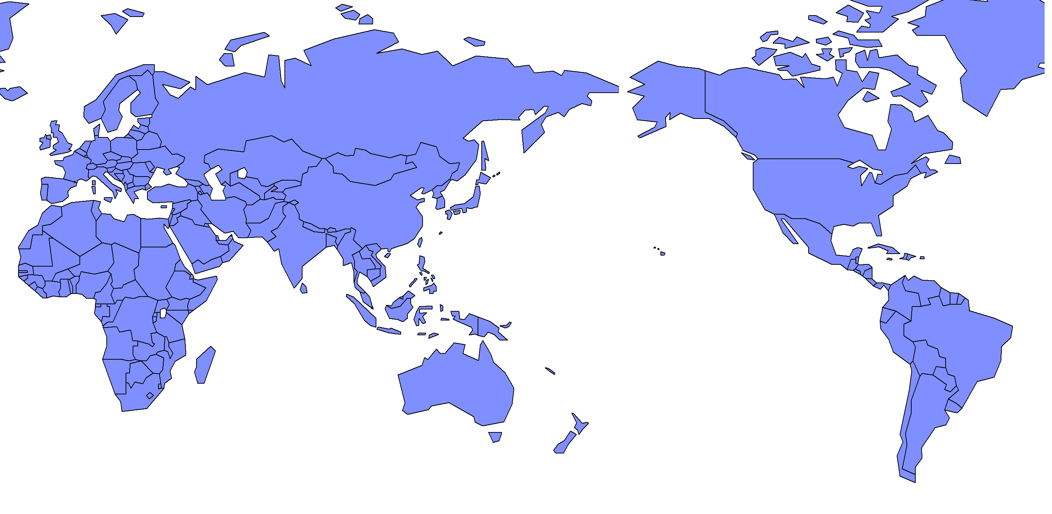


















National LambdaRail
NORDUNet

Slide 6
Services
Link to CERNET / CERNET2 and beyond
VPN Tunnel
VIP Services
  Network monitoring
  Support team provides 7x24 services
  Network Health Report (monthly)
  SASM3 Probe
  Post-sales services
  Monthly tele-conference for status update
Fault Reporting and Escalation System
Team
  Customer Services, CERNET NOC, CERNET2 NOC, Sales (HQ and Branches)

Slide 7

Q&A

Slide 8

Thank You !

