Slide 1
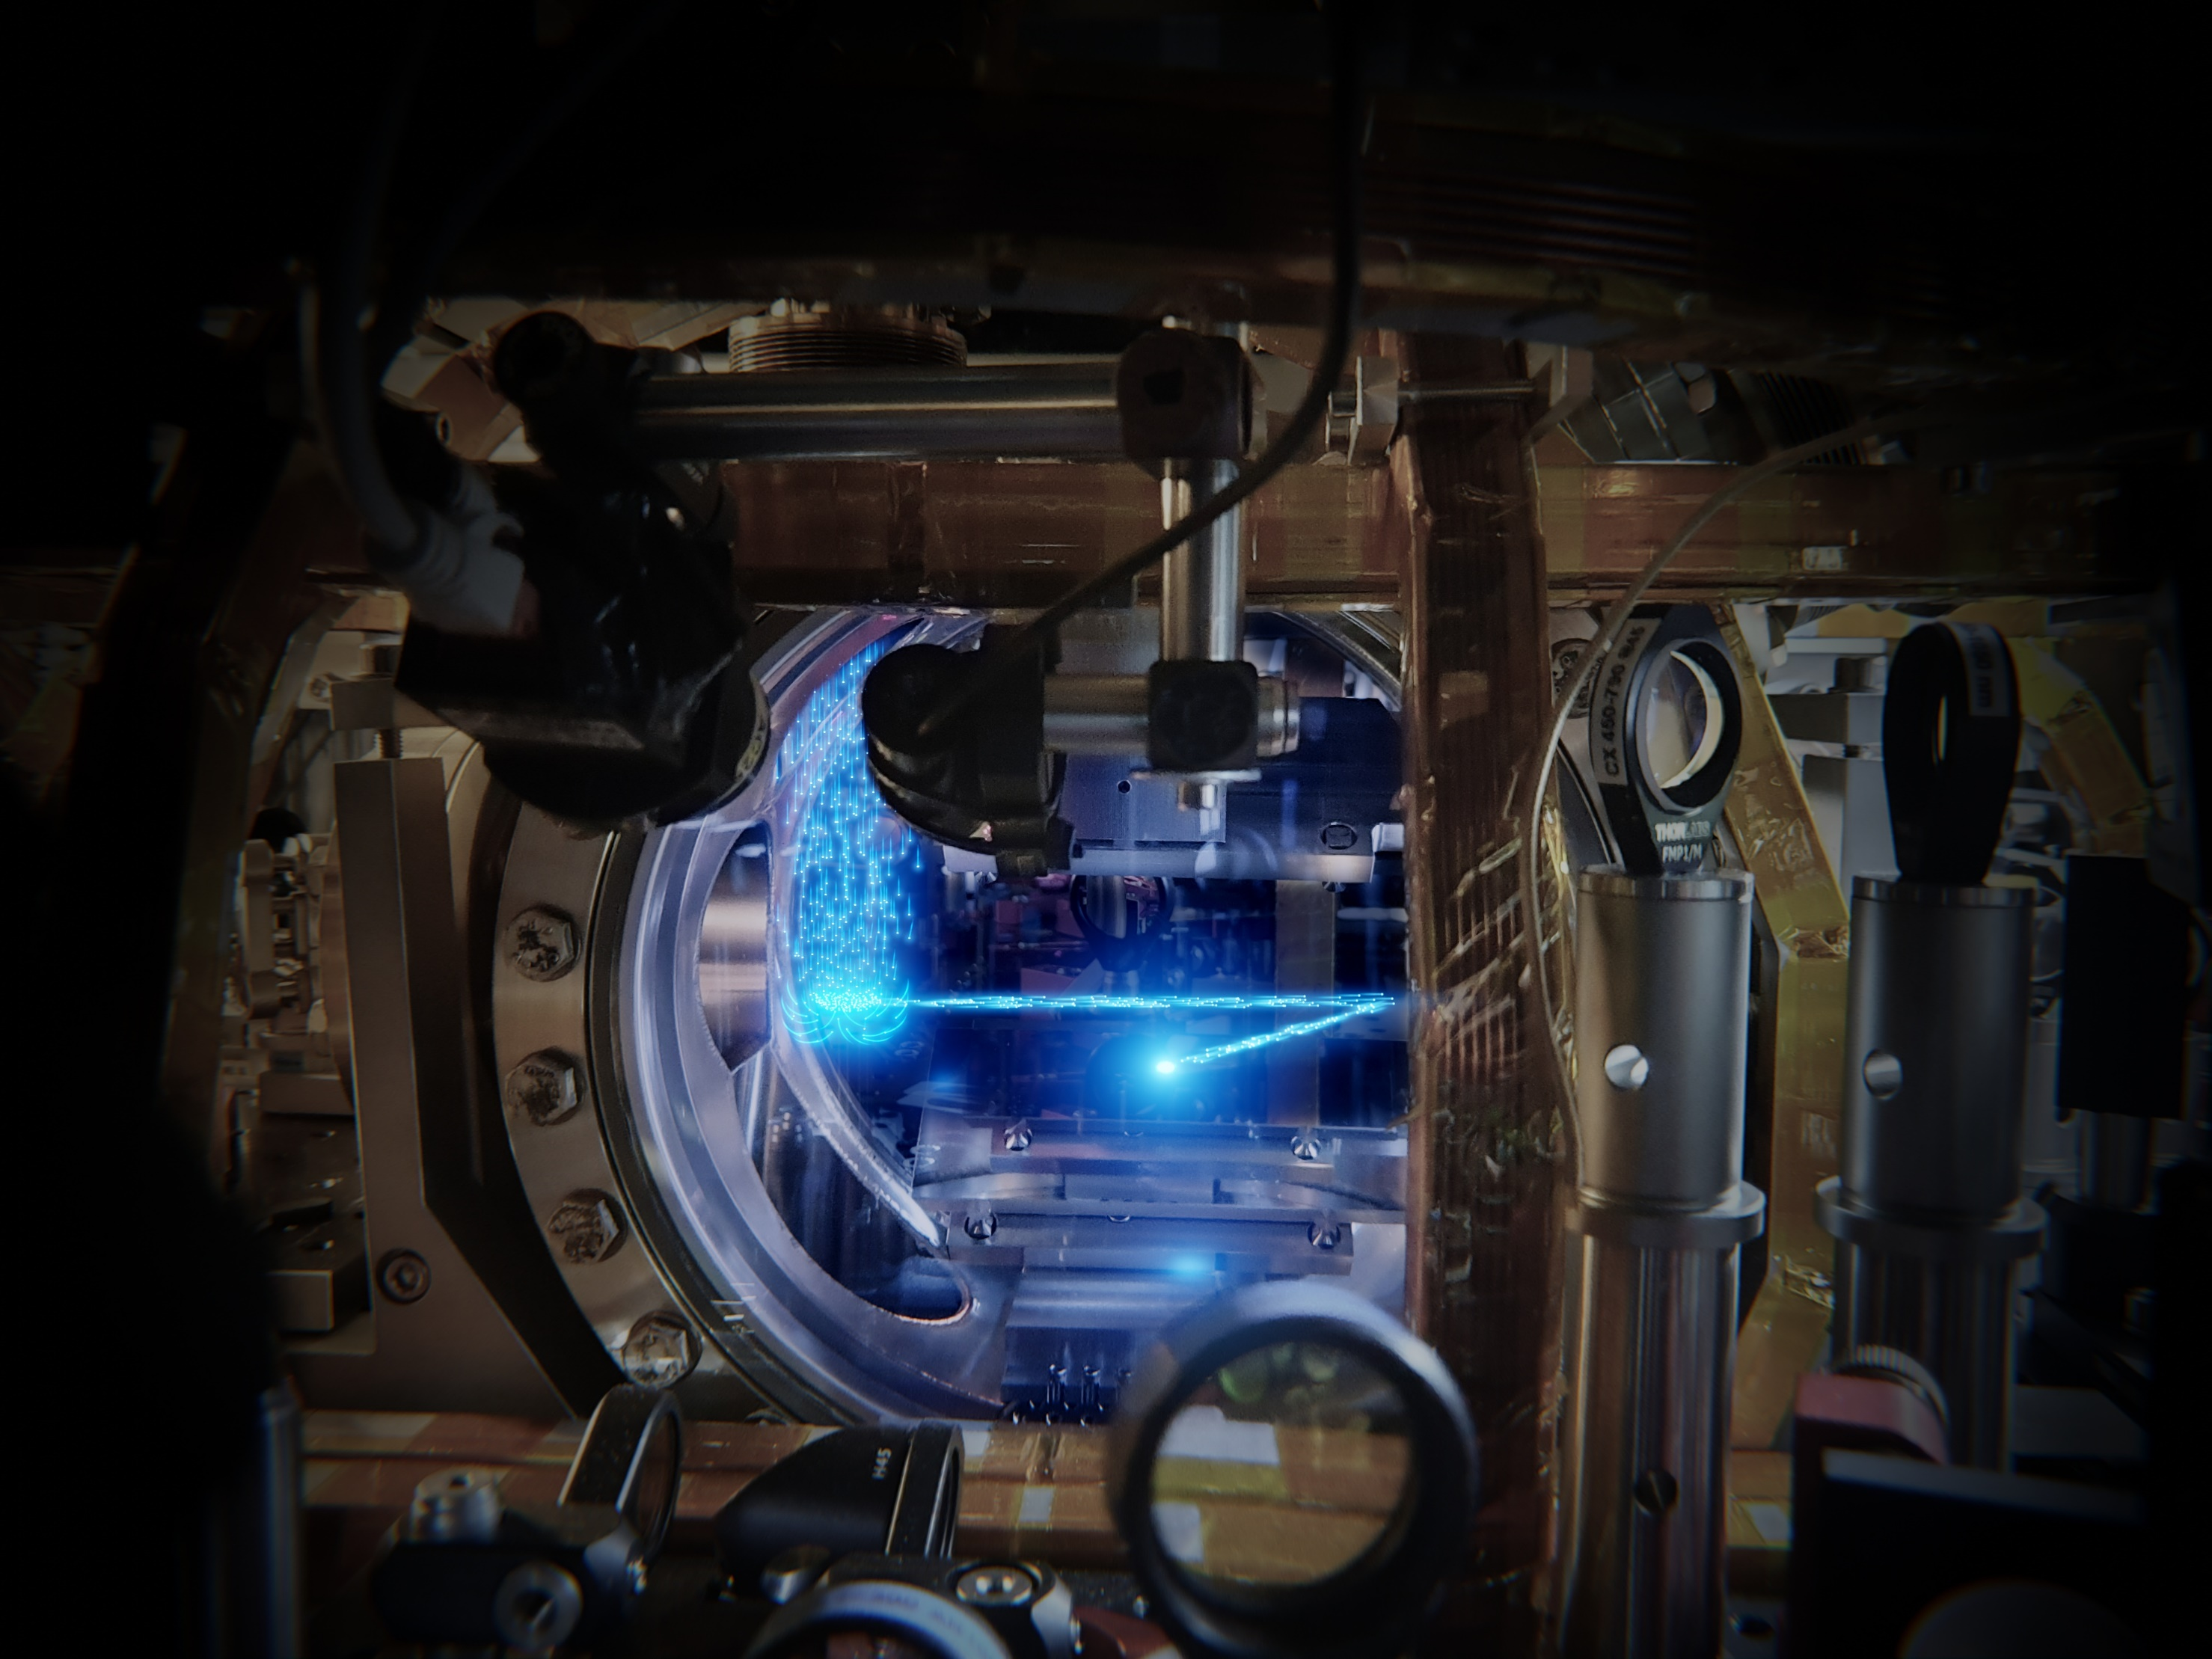

Continuous Bose-Einstein condensation & continuously operating clocks
Continuous Bose-Einstein condensation & superradiant clocks
Florian Schreck
Florian Schreck
Florian Schreck
University of Amsterdam
University of Amsterdam
University of Amsterdam

Slide 2

Optical clocks
Frequency reference:
atomic transition
Highest accuracy
High transition frequency optical transitions
Narrow transition mHz linewidth
Large signal use many atoms
Undisturbed by other atoms use gas of atoms
No Doppler shift cool atoms to standstill

Slide 3
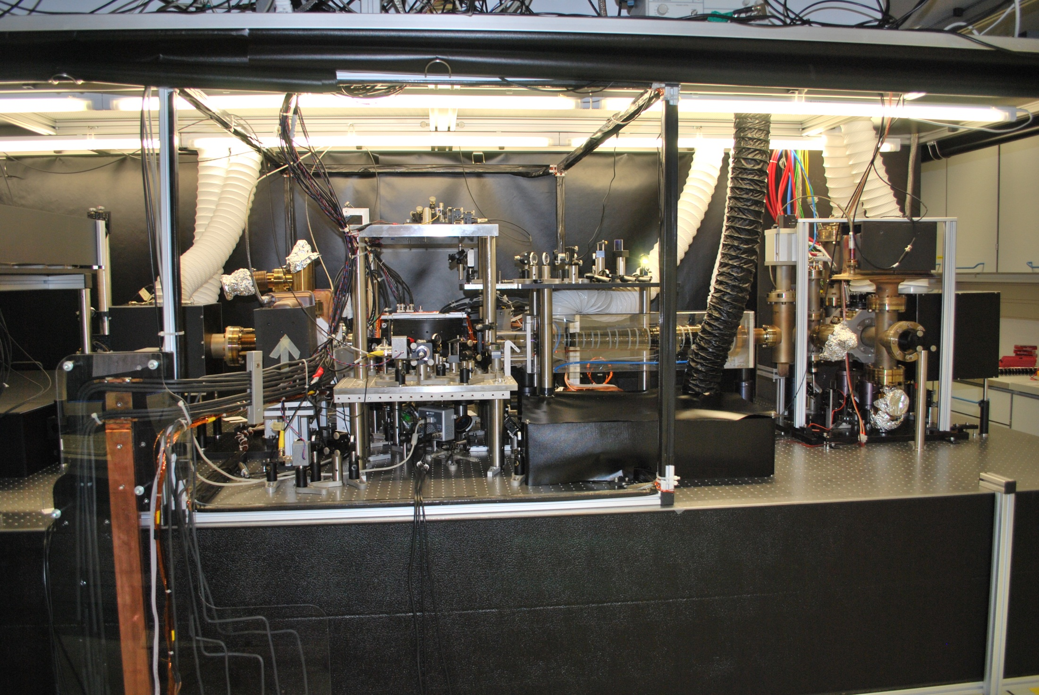
Ultracold fridge
atomic beam
from oven
slowing laser
Zeeman slower
laser cooling

Slide 4
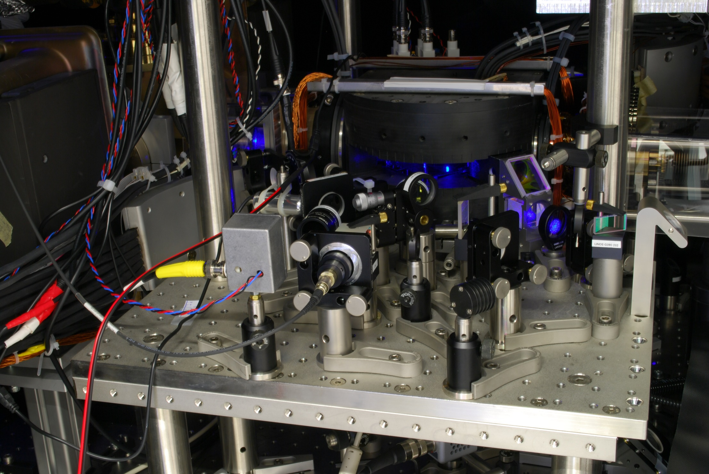
Magneto-optical trap of strontium
MOT

Slide 5
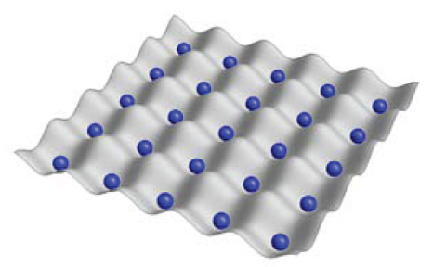

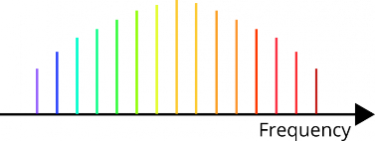
Optical clock scheme
Frequency reference
ultracold Sr atoms in lattice
Clockwork
optical frequency comb
translates optical frequency into microwave frequency
laser

Slide 6
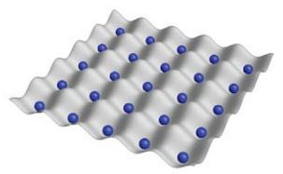

Improving clocks: from pulsed to continuous operation
Frequency reference
ultracold Sr atoms in lattice
Blue laser cooling
Red laser cooling
Interrogate
Blue laser cooling
Red laser cooling
Interrogate
…
time
Flywheel
Clockwork
optical resonator
optical frequency comb
keeps frequency while ultracold atoms are prepared
translates optical frequency into radiowave frequency
laser

Slide 7
Improving clocks: from pulsed to continuous operation
Frequency reference
ultracold Sr atoms in lattice
Blue laser cooling
Red laser cooling
Interrogate
Blue laser cooling
Red laser cooling
Interrogate
…
measure continuously
time
Flywheel
Clockwork
optical resonator
optical frequency comb
keeps frequency while ultracold atoms are prepared
translates optical frequency into radiowave frequency
make do with less stable resonator
laser

Slide 8
Challenge: measurement deadtime
Ultracold atoms only intermittently available
Blue laser cooling
Red laser cooling
Interrogate
Blue laser cooling
Red laser cooling
Interrogate
…
time
Measure fluctuating quantity
Result
True average
Error!
measurement time
dead time
Solution for inertial sensors: combine classical high-bandwidth sensor with atomic high-accuracy sensor

Slide 9
Challenge: measurement deadtime
Ultracold atoms only intermittently available
Blue laser cooling
Red laser cooling
Interrogate
Blue laser cooling
Red laser cooling
Interrogate
Challenges
…
Continuous ultracold atom source
time
High atom flux
Measure fluctuating quantity
High density
Result
True average
The ultimate source
Error!
A continuous atom laser
measurement time
dead time
Solution for inertial sensors: combine classical high-bandwidth sensor with atomic high-accuracy sensor

Slide 10

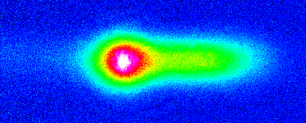
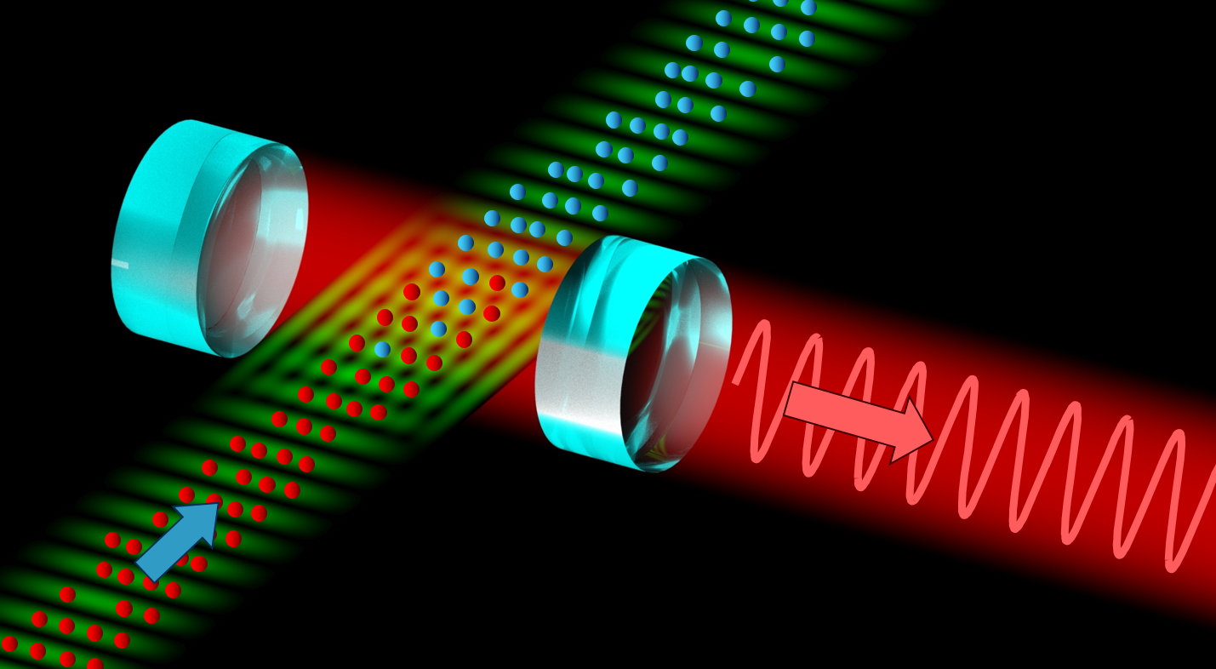
Outline
µK Sr beam in the dark
Continuous BEC
100µm
Continuous clocks
Continuous-wave atom laser
frequency & time
acceleration & rotation

Slide 11
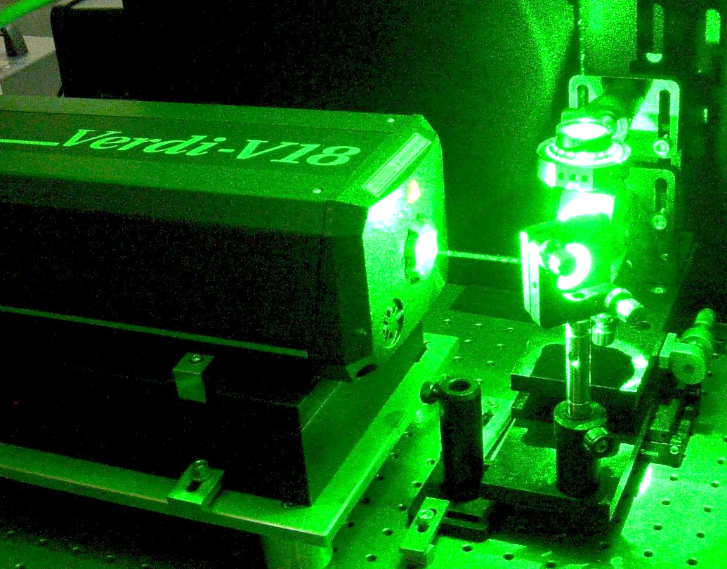
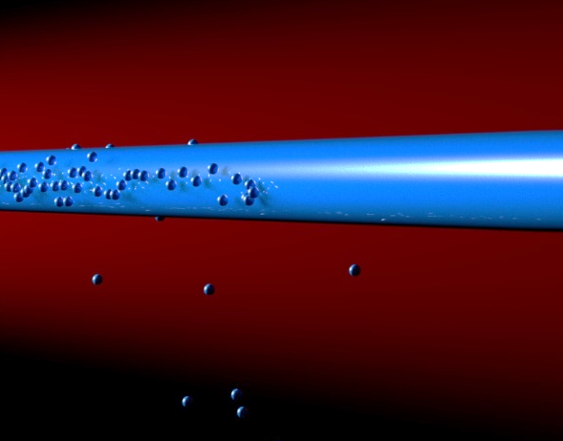
Optical and atom laser beams
Laser beam
Advantages of laser beams
Better
brightness
divergence
spatial mode structure
coherence
Light
Matter
Optical laser
Atom laser
Laser interferometer
Atom interferometer
N.P. Robins et al., Atom lasers: Production, properties and prospects for precision inertial measurement, Phys. Rep. 529, 265 (2013)

Slide 12
Continuous Bose-Einstein condensation
Optical laser
Atom laser
Optical cavity
Atom cavity (trap)
Pumping
replenish atoms
laser cooling
Pumping
Gain
(e.g. stimulated emission)
Gain
(e.g. Bose-enhanced scattering)
BEC
Outcoupler
Outcoupler
(e.g. transfer to
untrapped state)
N.P. Robins et al., Atom lasers: Production, properties and prospects for precision inertial measurement, Phys. Rep. 529, 265 (2013)

Slide 13


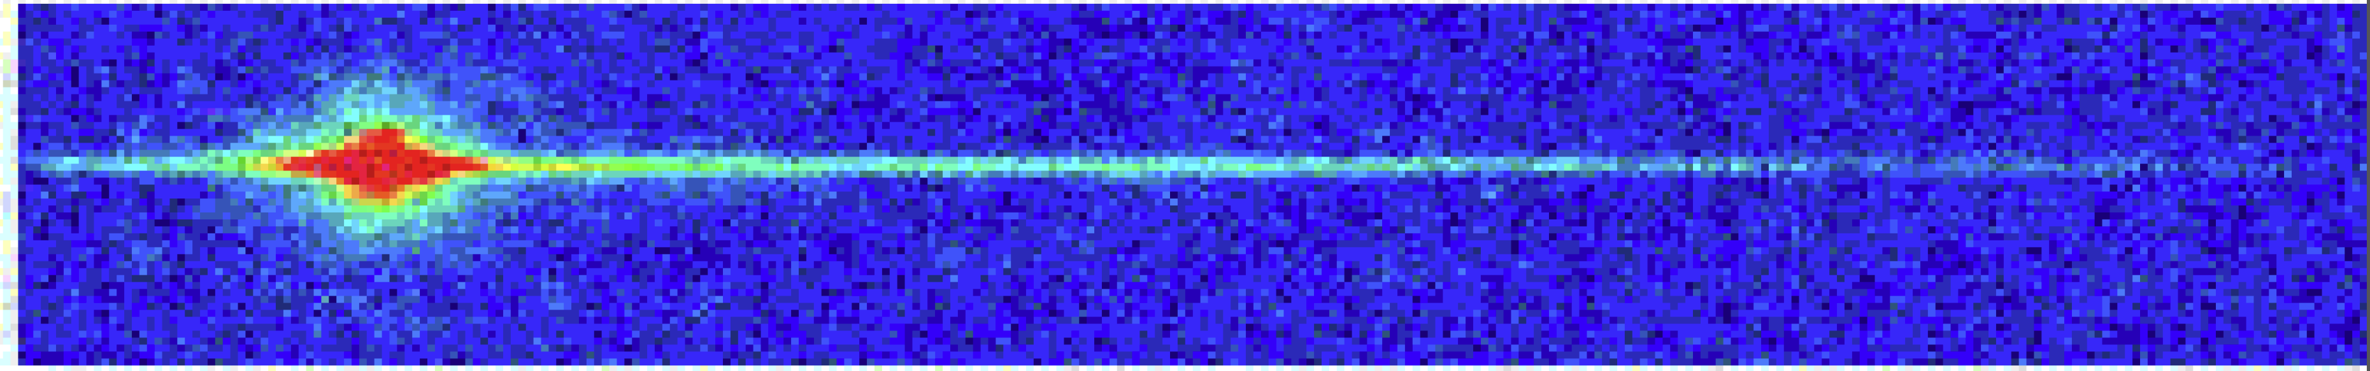
State-of-the-art: pulsed atom laser
Laser
cooling
Evaporative
cooling
Bose Einstein
condensation
Outcoupling
Depletion
time
Free falling atom lasers
Laser emission
Only pulsed operation
MIT
1997
LMU
1999
NIST
1999
Guided atom laser
Institut d’Optique 2006

Slide 14
Our goal: continuous atom laser
Laser
cooling
Evaporative
cooling
Bose Einstein
condensation
Challenges
outcoupling
Poor laser cooling performance of alkalis and chromium
space
BEC incompatible with laser cooling
Steps towards goal
Periodically replenish BEC
Ketterle group, Science 296, 2193 (2002)
Continuous evaporation
Guéry-Odelin group, PR A 72, 033411 (2005)
Raithel group, PR A 73, 033622 (2006)
Pumping mechanism
Close group, nature physics 4, 731 (2008)
Continuous trap loading
Pfau, Griesmaier group, New J. Phys. 15 093012 (2013)
Klempt group, J. Phys. B 48, 165301 (2015)

Slide 15
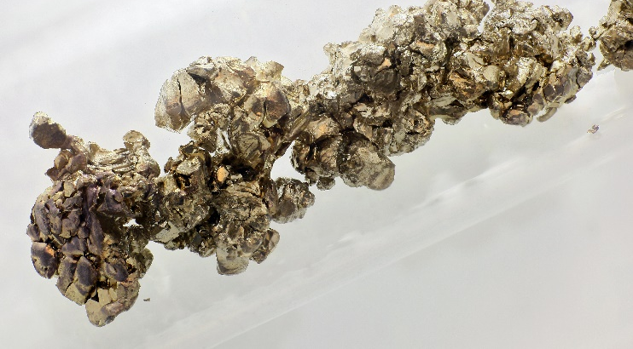
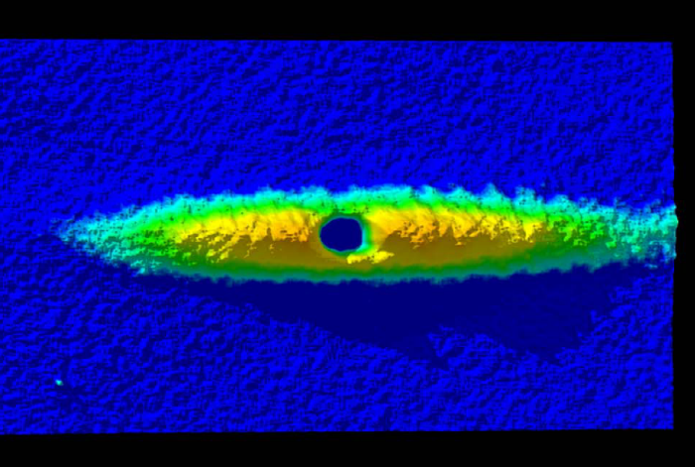
Our tricks
Strontium
Laser cooling
on narrow transition
Transparency beam
Cool to BEC
Protect BEC from photons

Slide 16
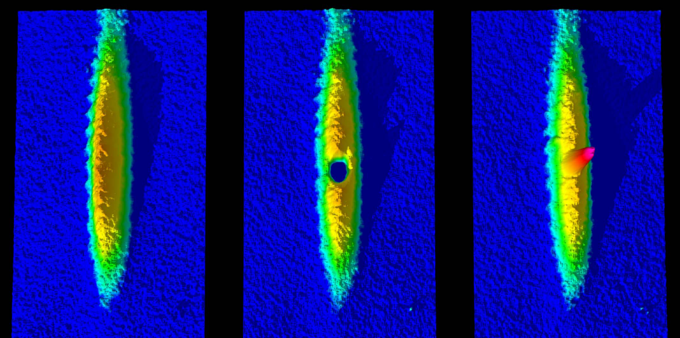

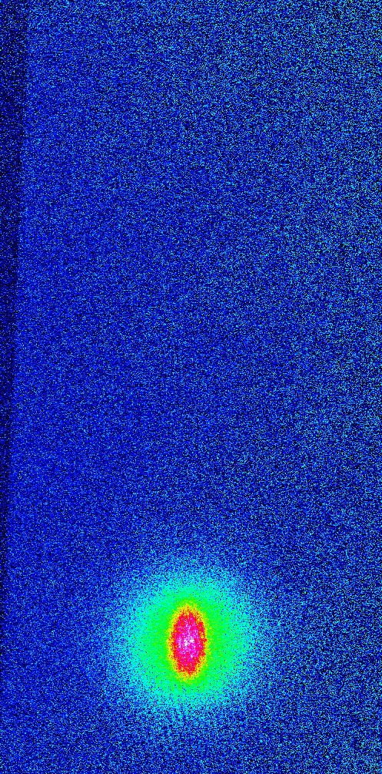
BEC in laser cooled cloud
Combine three techniques
Laser cooling
on narrow transition
Dimple trick
Transparency beam
BEC
Phase-space density = 0.1
Increase phase-space density
Protect BEC from laser cooling light
Sr gas in dipole trap
BEC in laser cooled cloud
Phys. Rev. Lett. 110, 263003 (2013)

Slide 17
Continuous atom laser
New requirements
1) Pumping: replenish atoms
BEC
2) Outcoupling
Challenge: BEC not protected from blue photons

Slide 18
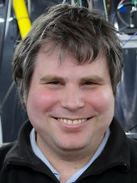
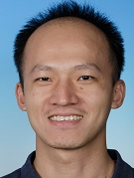
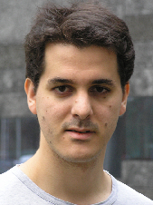
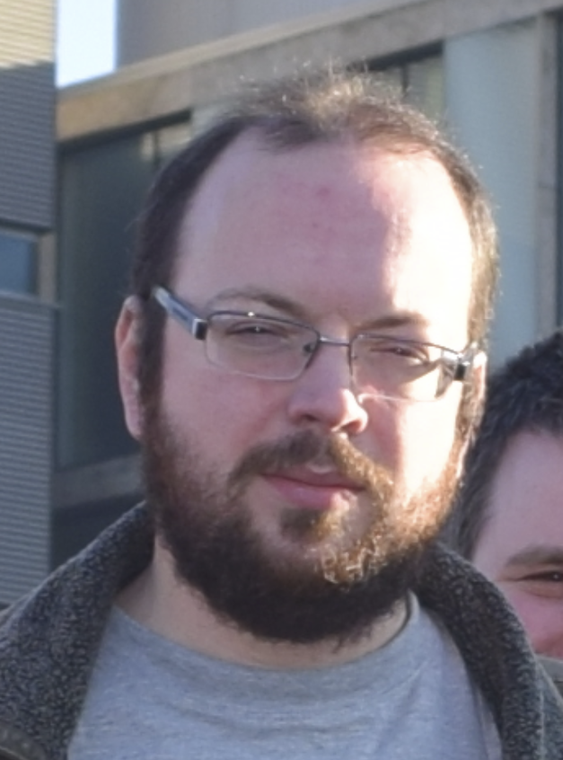
Blue stray light protection
Sr beam
source
blue Zeeman slower
blue 2D MOT
Shayne Bennetts
Chun-Chia Chen
Rodrigo González Escudero
Benjamin Pasquiou
red 2D molasses
atomic beam
continuous-wave BEC
red MOT
dipole guide
future atom laser
red Zeeman slower
Challenge: BEC not protected from blue photons

Slide 19
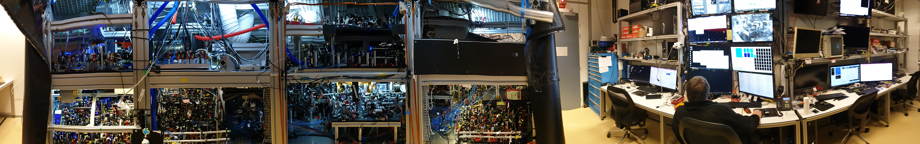
Design and construction
Sr beam
source
Zeeman slower
blue 2D MOT
Shayne Bennetts
Chun-Chia Chen
Rodrigo González Escudero
Benjamin Pasquiou
red 2D molasses
atomic beam
continuous-wave BEC
red MOT
dipole guide
future atom laser
red Zeeman slower

Slide 20


Slide 21
In situ
1mm

Slide 22
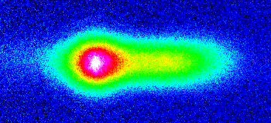
In situ
1mm
18 ms expansion
cw BEC
Nature 606, 683 (2022)

Slide 23
Outline
µK Sr beam in the dark
Continuous BEC
100µm
Continuous clocks
Continuous-wave atom laser
frequency & time
acceleration & rotation

Slide 24
Challenge: measurement deadtime
Ultracold atoms only intermittently available
Blue laser cooling
Red laser cooling
Interrogate
Blue laser cooling
Red laser cooling
Interrogate
…
time
Measure fluctuating quantity
Result
True average
Error!
measurement time
dead time
Solution for inertial sensors: combine classical high-bandwidth sensor with atomic high-accuracy sensor

Slide 25





Fast increase of measurement precision
Measurement precision over time
With dead time
total measurement time
Uninterrupted measurement time
dead time
Fourier limited precision
Precision after averaging
Continuous measurement
measurement time t
Fourier limit
Precision
Opportunity to reach 10⁻¹⁸ precision in 100 s instead of 10 000 s !
Need high signal-to-noise to work, i.e. high atom flux

Slide 26
Challenges
Continuous ultracold atom source
High atom flux
High density
A very good source
Continuous ultracold beam

Slide 27
Continuous superradiant clock
Continuous ultracold strontium beam in
Clock laser beam out
See also James Thompson group, JILA
Pulsed superradiant emission on Sr clock line
Science Advances, 2, e1601231 (2016)

Slide 28
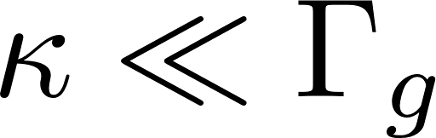
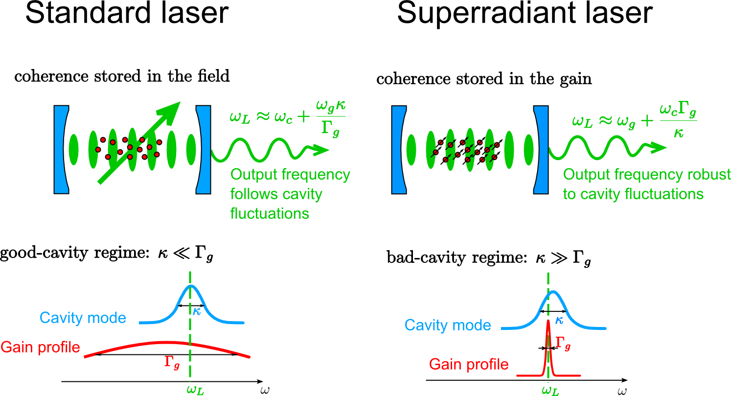
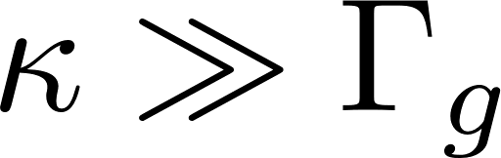
Comparison to standard laser
Standard laser: frequency stability from length of cavity
good-cavity regime:
cavity mode
gain profile
Superradiant clock laser: frequency stability from ensemble spin of atoms
bad-cavity regime:
cavity mode
gain profile

Slide 29
Active optical clock
Goal: photons from mHz linewidth transition
Challenges:
minutes of excited state lifetime
emission into 4π
Solution: enhance emission into single mode by superradiance
Proposals:
Jingbiao Chen, arXiv:physics/0512096 (2005), Chinese Science Bulletin 54, 348 (2009)
D. Meiser, J. Ye, D. R. Carlson, M. J. Holland, PRL 102, 163601 (2009)
Pulsed demonstration:
M. A. Norcia, M. N. Winchester, J. R. K. Cline and J. K. Thompson, Science Advances, 2, e1601231 (2016)

Slide 30
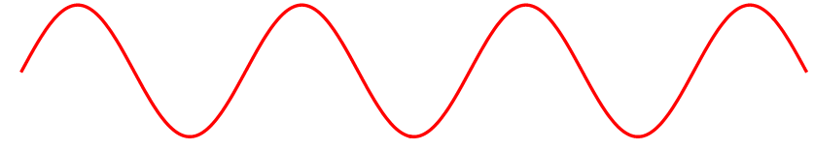
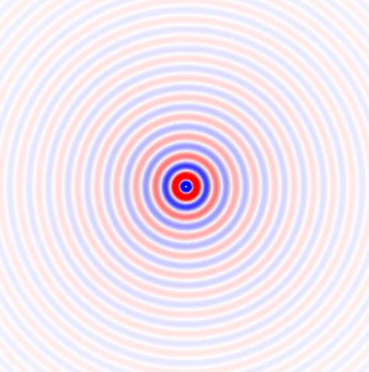
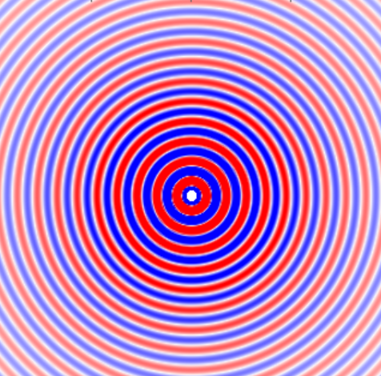
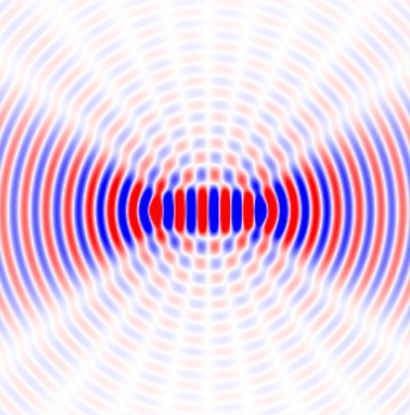

Phased array of N emitters
Closer spaced than wavelength
Random phase
Closer spaced than wavelength
Same phase
Spaced wavelength/2 along axis
Alternating phase
Electric field
Electric field (arb. units.)
Random interference
Constructive interference
Constructive interference along axis
E-field ~ Sqrt(N)
E-field ~ N
Power ~ N
Power ~ N²
Power along axis ~ N²

Slide 31
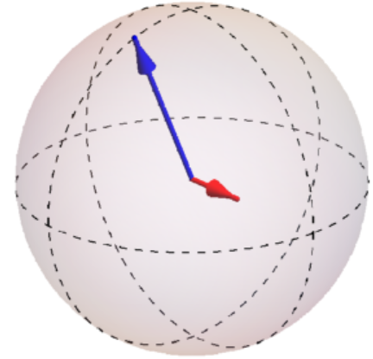
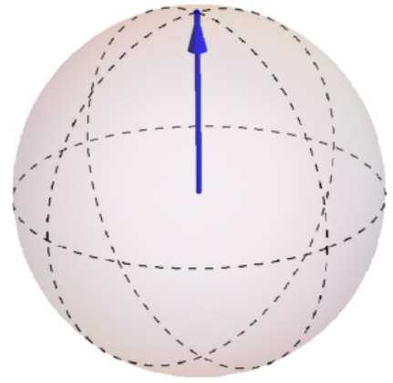
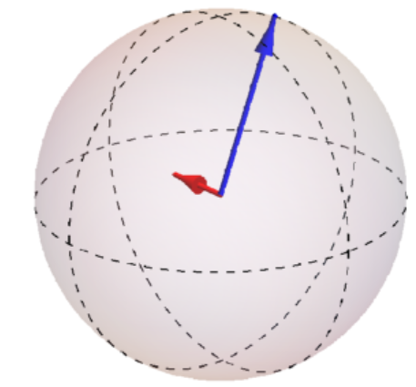
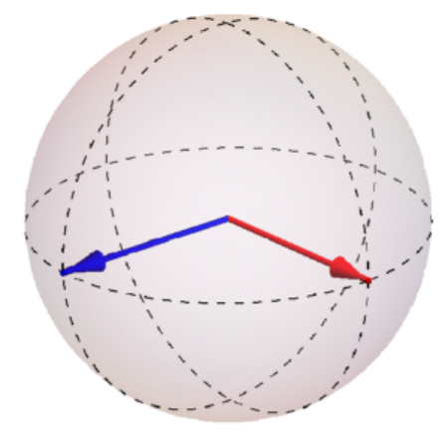
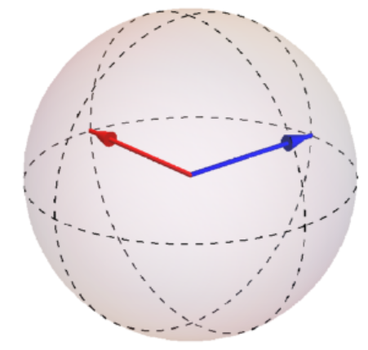
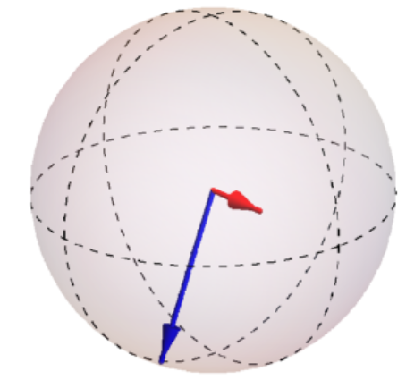
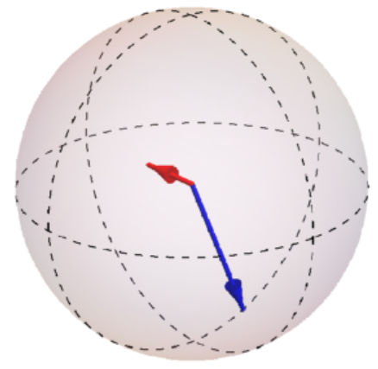
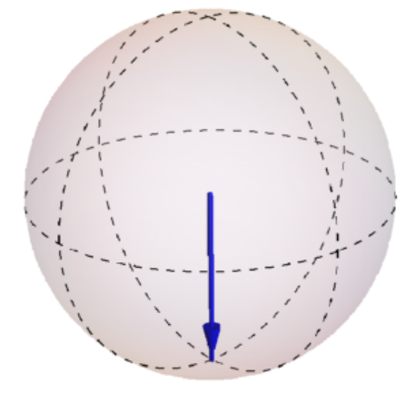
How is superradiance established?
Bloch vector
E-field

Slide 32
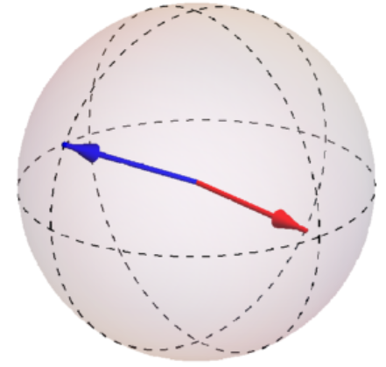
How can superradiance be maintained?

Slide 33
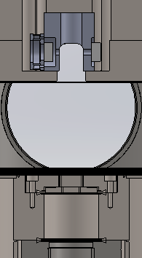
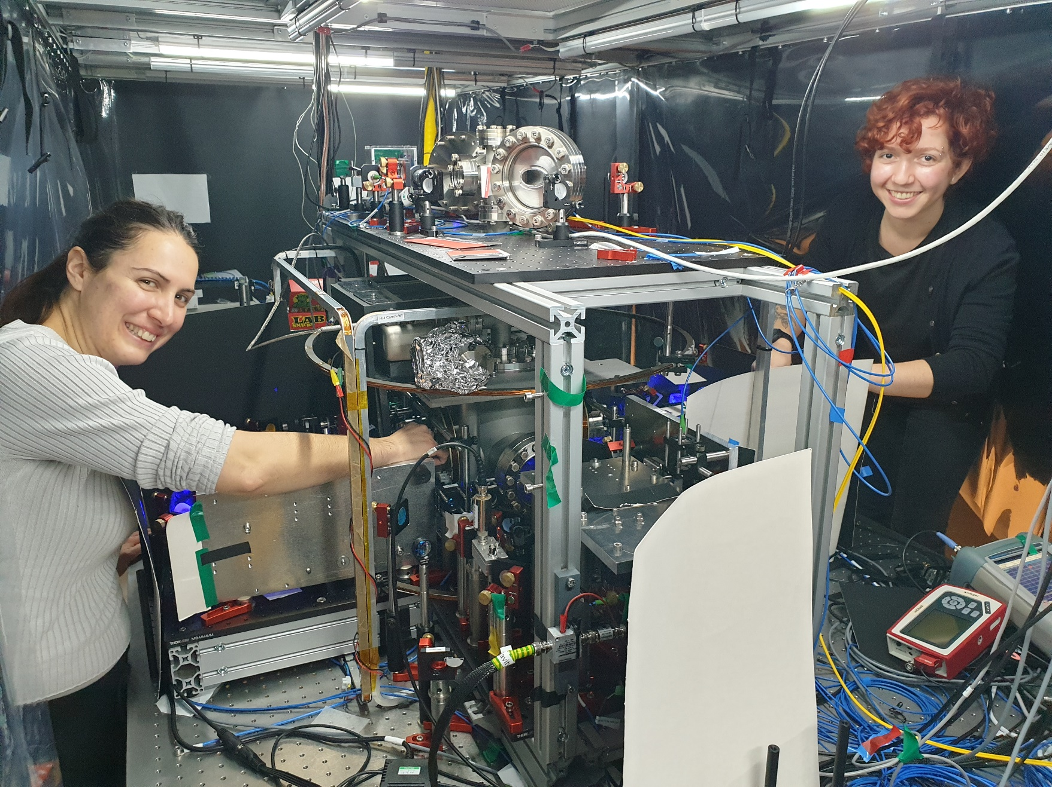
V1: kHz-transition superradiant Sr laser
H. Liu, S. B. Jäger, X. Yu, S. Touzard, A. Shankar, M. J. Holland, and T. L. Nicholson
Rugged mHz-Linewidth Superradiant Laser Driven by a Hot Atomic Beam
PRL 125, 253602 (2020)
Cavity
Laser output
Pump to lasing state
Camila
Beli-Silva
Velocity selective pump to metastable state
Push
Francesca Famà
Sr oven

Slide 34
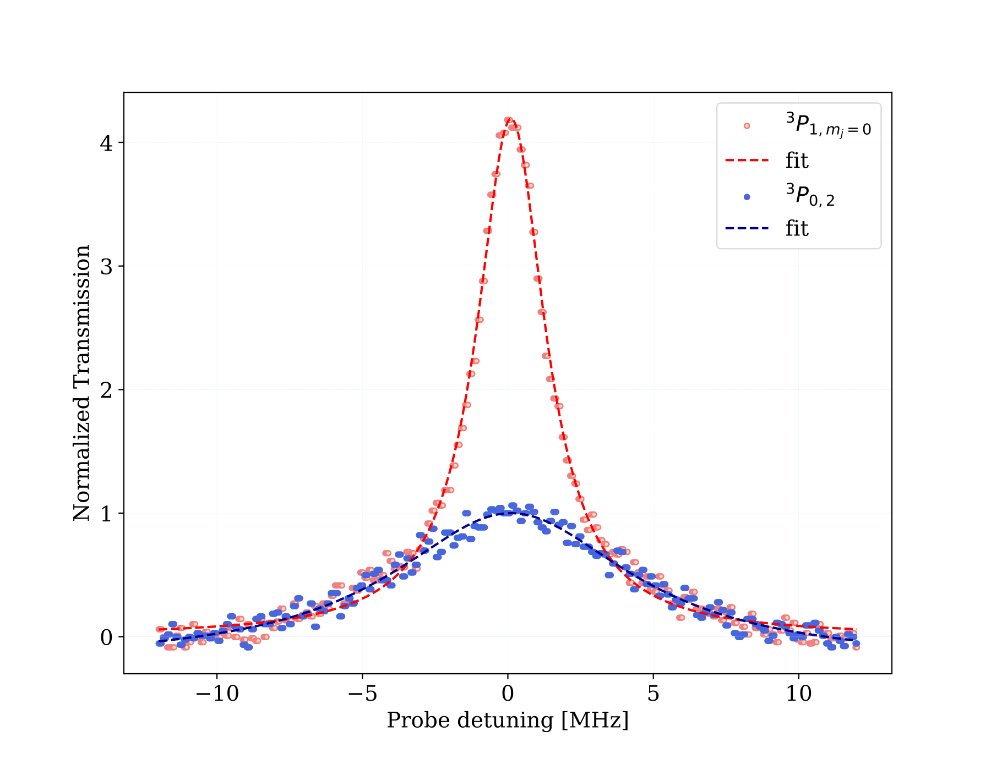
V1: kHz-transition superradiant Sr laser
4
Cavity
amplified
by 4
Probe in
Amplifier output
3
~10 nW
Pump to lasing state
Atoms in excited state
Output power (arb. units)
2
Velocity selective pump to metastable state
Push
1
Bare cavity
resonance
0
-10 -5 0 5 10
Sr oven
Probe detuning from cavity mode (MHz)

Slide 35
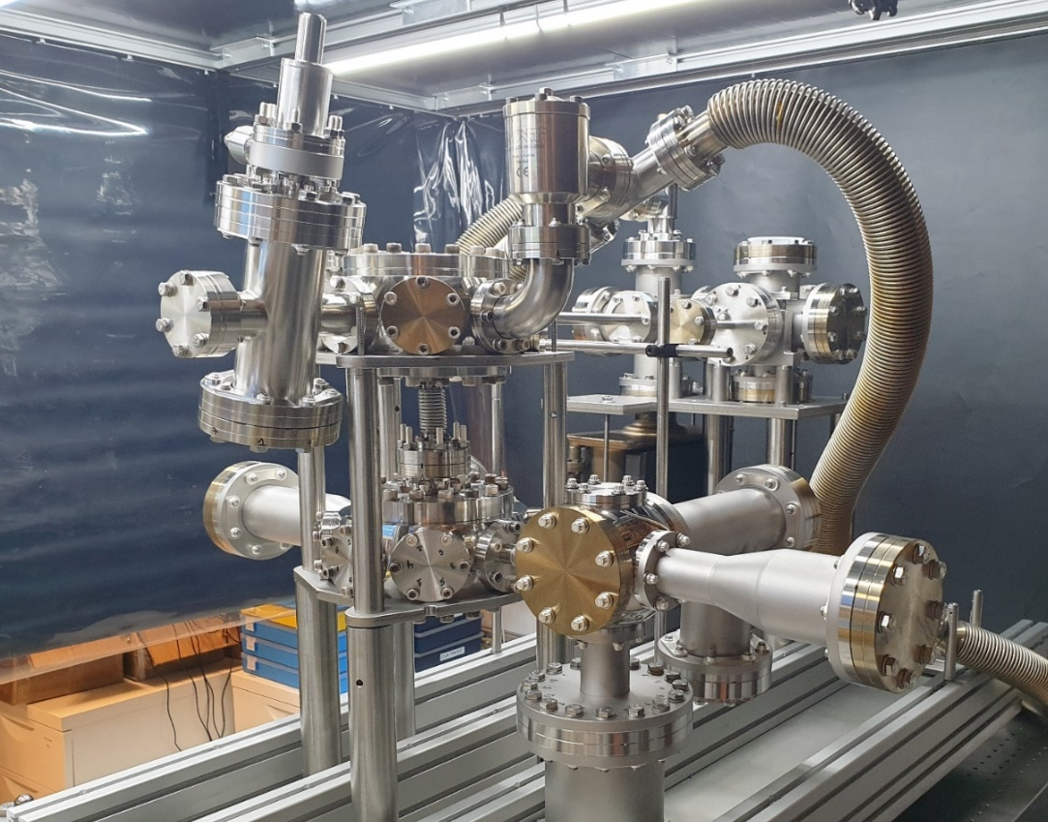
V2: Continuous superradiant mHz clock
Continuous ultracold strontium beam in
Clock laser beam out
Pulsed superradiant emission on Sr clock line
James Thompson group, JILA, Science Advances, 2, e1601231 (2016)

Slide 36
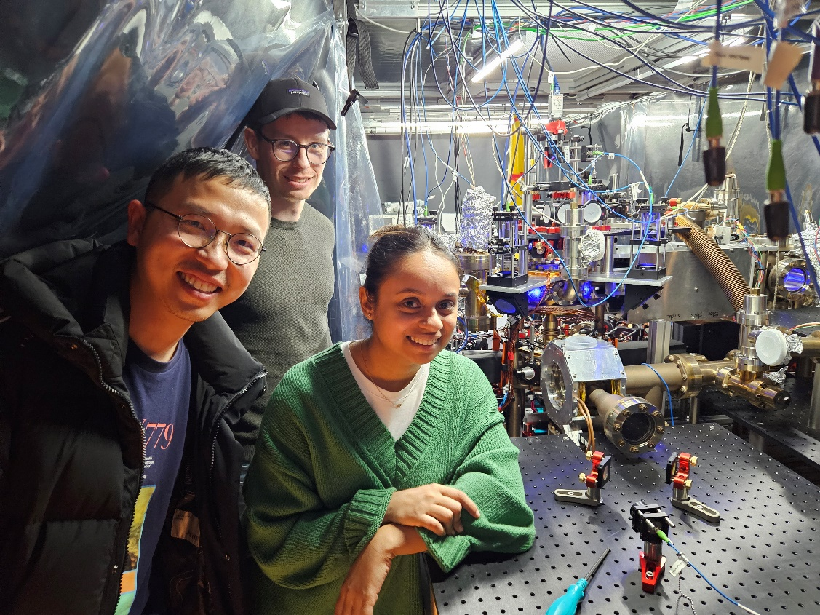
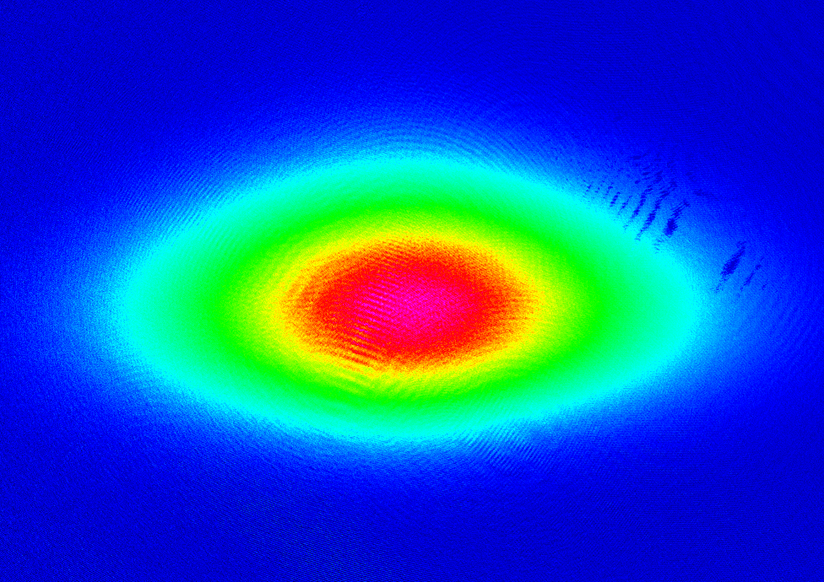
V2: Continuous superradiant mHz clock
Continuously operating red ⁸⁸Sr MOT
Benedikt
Heizenreder
5 mm
Sheng Zhou
Flux = 3 x 10⁸ atoms/s
Atom number = 5.5 x 10⁸
Ananya Sitaram

Slide 37
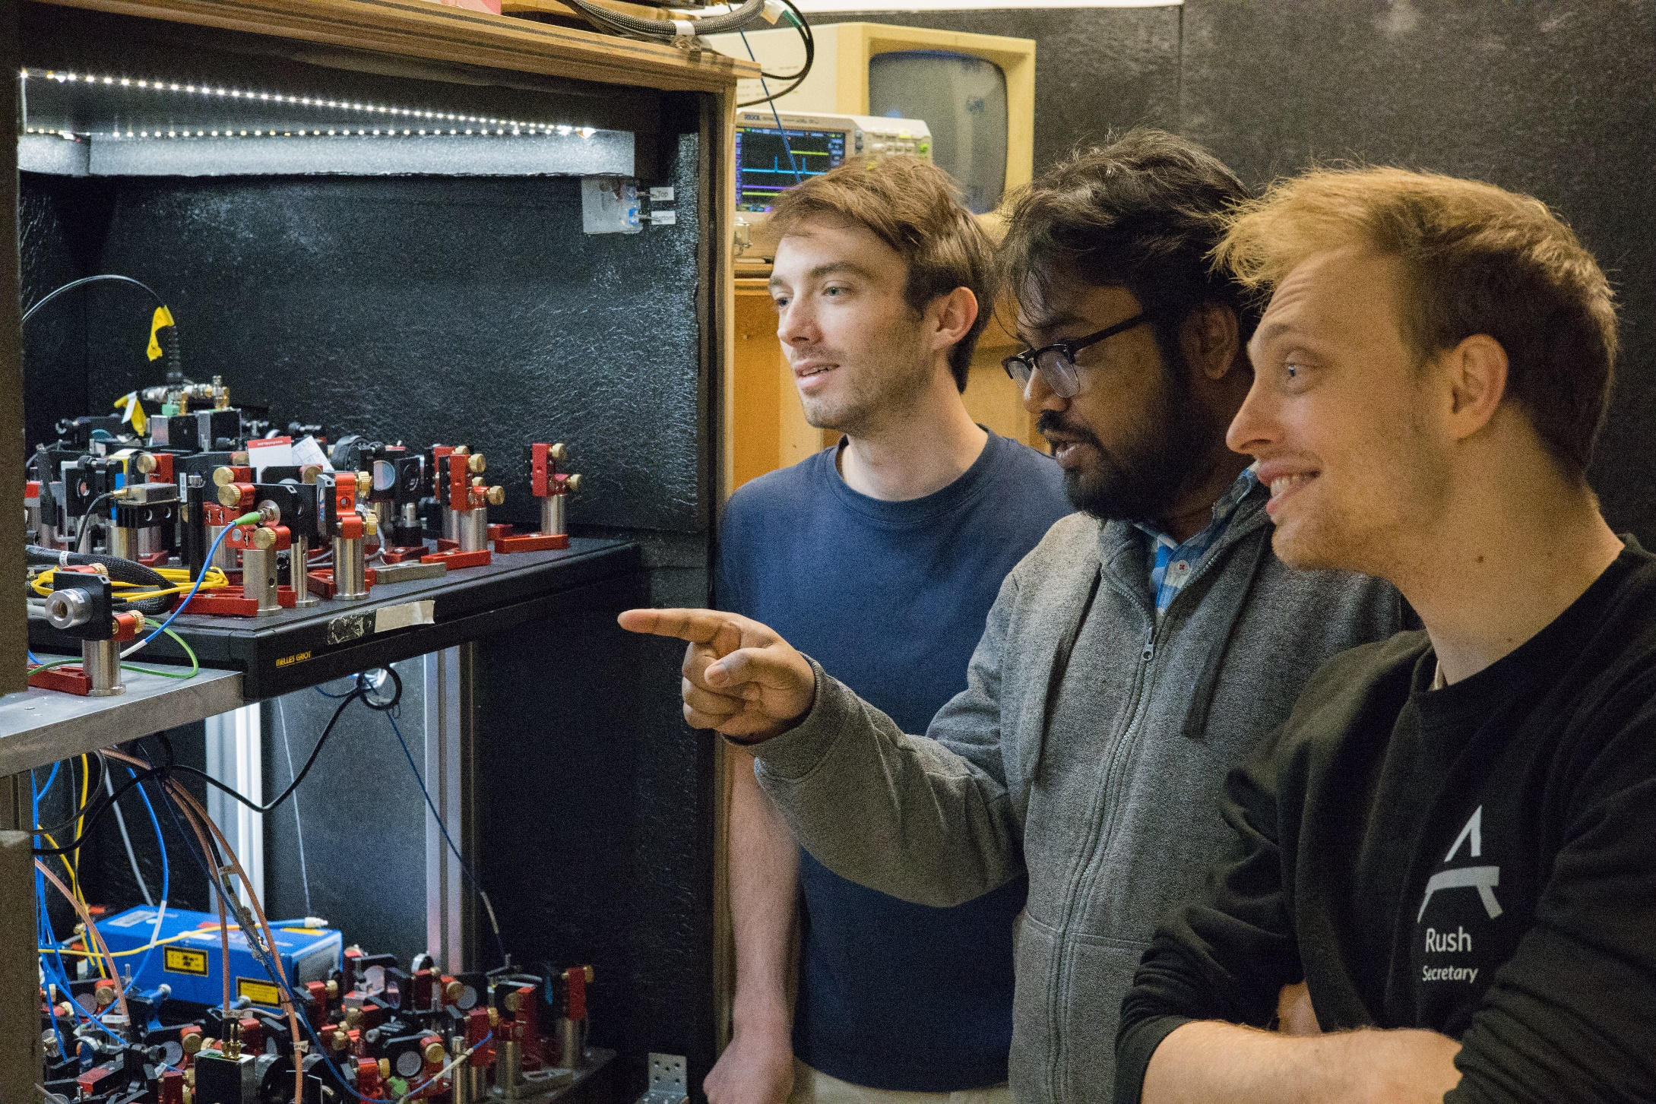
Zero-deadtime clock
Scott
Wolzak
Sumit
Sarkar
András Gácsbaranyi

Slide 38
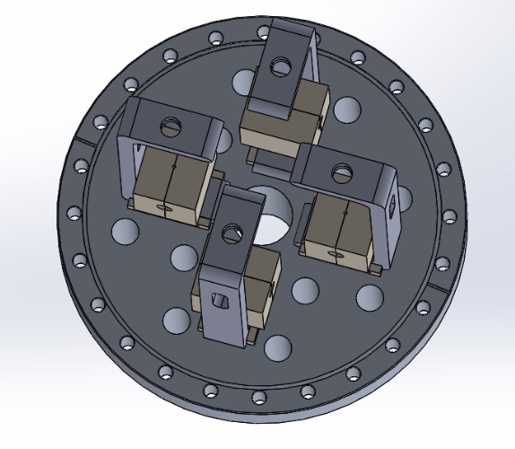

Zero-deadtime clock
So far: interlace two clocks to measure without deadtime
Ludlow group, Nature Photonics 11, 48 (2017)
Here: integrate several interrogation zones into one clock apparatus to measure without deadtime
much simpler construction, straight forward to implement four interrogation zones
steady-state ultracold atom source
4
1
2
1
2
3
Interrogation zones
Alternative schemes: continuous Ramsey spectroscopy, Hidetoshi Katori, Appl. Phys. Express 14, 072006 (2021)
continuous cavity spectroscopy, JILA clock groups, PR A 92, 053820 (2015)

Slide 39
Multi-ensemble, zero-deadtime clock operating principle
Goal: phase-lock clock laser to atoms clock precision scales as 1/(total measurement time)
Ramsey fringes of ensembles (1) and (2): fast cycling, short Ramsey time
Error free measurement range
1
1st, fast lock
large error free range
because of large Ramsey fringe period
low precision
because of finite atom number S/N and shallow slope of Ramsey fringe
Fraction
excited
atoms
0
f_{laser} - f_{atoms}
0
Ramsey fringes of ensembles (3) and (4): slow cycling, long Ramsey time
Error free measurement range
2nd , slow lock
small error free range
high precision
1
Fraction
excited
atoms
long Ramsey time with small error only possible because clock laser pre-stabilized by fast lock
0
f_{laser} - f_{atoms}
0

Slide 40
Summary
µK Sr beam in the dark
Continuous BEC
100µm
Continuous clocks
Continuous-wave atom laser
frequency & time
acceleration & rotation

Slide 41

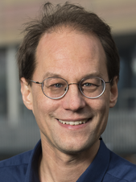
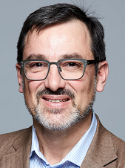
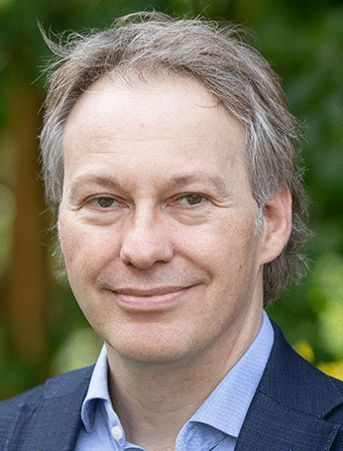


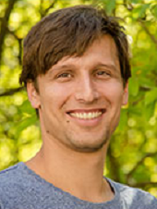
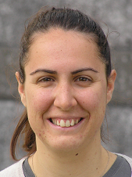




QDNL Ultracold Quantum Sensing Testbed
Mission - Bring benefits of optical clocks and atom interferometers to society
Members
Florian Schreck (UvA)
Testbed coordinator
Philippe Bouyer
(QDNL, UvA, TU/e)
QDNL Scientific Director
Jeroen Koelemeij (VU)
t+f network

Slide 42











Ultracold quantum sensing testbed
smaller
easy access
simpler

Slide 43














AQuRA Clock
AQuRA consortium
Challenge: Optical clocks are large and fragile
Goal: Build robust clock product prototype

Slide 44



UvA: optical circuit boards
Traditional approach: optomechanics
AQuRA: glued glass benches, robotically manufactured
Traditional optomechanical breadboards
Needs frequent realignment
Time-consuming construction
Bringing techniques from telecom to quantum
Ultra-low thermal sensitivity
Robustly glued
Miniature modules with complexity for quantum applications

Slide 45

























atomlaser
clocks
András Gácsbaranyi (PhD)
RbSr
Scott Wolzak (master)
Digvijay
(PhD)
Ananya Sitaram (postdoc)
Mehrdad Zarei (postdoc)
Noah Wach (master)
Davide Natale (PhD)
Sr tweezer
Rodrigo Gonzáles Escudero
(postdoc)
Ivo Knottnerus
(PhD)
Benjamin Pasquiou
(former Co-PI,
now CNRS)
Premjith Thekkeppat
(PhD)
Stefan Alaric
Schäffer
(former
postdoc)
Robert Spreeuw
(PI)
Francesca Famà
(PhD)
Benedikt Heizenreder
(PhD)
Klaasjan van Druten
(PI)
Shayne Bennetts
(PhD, postdoc,
PI in Taiwan)
Sheng Zhou
(PhD)
Junyu He
(postdoc)
Florian Schreck
(PI)
Philippe Bouyer
(PI)
Camila Beli Silva
(PhD)
Alex Urech
(postdoc)
Sumit Sarkar
(postdoc)
Chun-Chia Cheng
(former PhD/PD,
PI in Taiwan)
Yu Chih Tseng
(PhD)
Programme QuSim 2.0
Zwaartekracht QCS
Quantum Flagship
Veni & Vici
NWA Startimpuls II QuNav
Jiří Minář
(theory postdoc)
This project has received funding from the European Union’s Horizon 2020 and Horizon Europe research and innovation programmes ​​under grant agreement No 820404 (iqClock project), No 860579 (MoSaiQC project), No 101080166 (AQuRA project) and No 101070144 (EuRyQa).
Matteusz Borkowski
(research assistant)

Slide 46






Funding
This project has received funding from the European Union’s Horizon 2020 research and innovation programme ​​under grant agreement No 820404 (iqClock project).
This project has received funding from the European Union’s Horizon 2020 research and innovation programme ​​under grant agreement No 860579 (MoSaiQC project).
This publication has received funding under Horizon Europe programme HORIZON-CL4-2021-DIGITAL-EMERGING-01-30 via the project 101070144 (EuRyQa)
Notes:
Add Stefan’s funding source here

