Slide 1


SIG-TFN: Welcome
Guy Roberts
Senior Network Architect
SIG-TFN Amsterdam
16-17/10/2024

Slide 2
Agenda: Wednesday
Time (CEST) | Room L1.07, Lab42 building
12:00 - 13:00 | Arrival & Lunch at Café Neo (self-paid)
13:30 - 13:45 | Welcome and introduction - Guy Roberts, GÉANT
13:45 - 14:15 | SIG-TFN Overview - Guy Roberts, GÉANT
14:15 - 14:45 | NPL time frequency links - Jacques-Olivier Gaudron, NPL
14:45 - 15:15 | Coffee break
15:15-16:15 | Technical Working Group - Jeroen Koelemeij, Free University of Amsterdam Design of the Lille-Brussels-Amsterdam-Braunschweig link
16:15 - 16:45 | Optical clocks in Amsterdam (iqClock & QDNL clock project) - Florian Schreck, UvA https://www.iqclock.eu/university-of-amsterdam.html
17:00 - 18:15 | Lab tour - UvA
18:30 | Informal group dinner at Cafe Restaurant Polder (on UvA campus). (self-paid)

Slide 3
Agenda: Thursday
Time (CEST) | Room G3.10, Science Park G
09:00 - 09:30 | CESNET to discuss national WR network - Josef Vojtech & Vladimir Smotlacha, CESNET
09:30 - 10:00 | White Rabbit Status and Plans - Maciej Lipinski, CERN
10:00 - 10:30 | Pathfinder update - Krzysztof Turza, PSNC
10:30 - 11:00 | Coffee break
11:00 - 11:30 | Italian Quantum Backbone: time and frequency metrology, quantum communications, and sensing over optical fibers - Davide Calonico, INRIM
11:30 - 12:00 | EC discussion on future funding possibilities - Lukasz Bonenberg, EC JRC
12:00 - 12:30 | Sustainability Working Group - Richard Lui, GÉANT Update and discussion.
12:30 - 12:45 | Wrap up & closing - Guy Roberts, GÉANT
13:00 | Lunch at Café Neo (self-paid)

Slide 4
C-TFN: an update
Guy Roberts
Senior Network Architect
SIG-TFN Amsterdam
16-17/10/2024

Slide 5
Timeline
2014-16
2017-19
2020-23
Feb 2024
June2024
REFIMEVE+ frequency links. MuQuans founded
NPL-SYRTE fibre link built
CLONETS project
CLONETS-Design Study
CERN workshop
Launch SIG-TFN
2012

Slide 6

SIG-TFN
Why do we need a new Special Interest Group?
New scientific community of metrology
SIG-TFN brings together NRENs and the science of accurate time
Strong interest: 100 subscribers to sig-tfn@lists.geant.org

Slide 7

SIG-TFN
GÉANT is the coordinator of SIG-TFN
Web page: https://community.geant.org/sig-tfn/
Steering committee
  Guy Roberts (GÉANT)
  Paolo Bolletta (GARR)
  Josef Vojtech (CESNET)
  Krzyztof Turza (PSNC)
  Jacques-Oliver Gaudron (NPL)
  Christian Chardonnet (REFIMEVE)
  Coordinators: Domenico Vicinanza (GÉANT) and Nadelina Sandu (GÉANT)
There are two working groups within the SIG-TFN:
  T/F Sustainability (led by Richard Lui)
  C-TFN technical specification (Led by Guy Roberts)

Slide 8
C-TFN sustainability working group
Team
  Richard Lui (WG leader)
  Raphaël Marion
  Christian Chardonnet
  Wojbor Bogacki
  Christian Lisdat
  Davide Calonico
Objectives
Investigate a path to sustainability of the CLONETS-DS C-TFN, both for GÉANT and for participating NRENs and NMIs.
Carry out cost modelling to identify the extent of the future funding needs for fibre and flywheels.
Shepard funding through governance of GN5-2
Engage EURAMET, NRENs, GÉANT and the European Commission to find solutions to long-term funding.

Slide 9
C-TFN technical specification working group
Team
  Guy Roberts (WG leader)
  Jochen Kronjaeger
  Raphaël Marion
  Krzysztof Turza
  Jacques-Olivier Gaudron
Objectives
Expand on the CLONETS-DS architecture and integrate lessons learnt from PTB-PSNC pathfinder.
Investigate if tiers of flywheel performance are needed e.g NMI flywheel, NREN flywheel, etc.
Prepare a C-TFN architecture
Prepare a technical specification for the C-TFN flywheels.
Prepare a technical specification for the GÉANT cross-border fibre links.

Slide 10
Summary of use cases
Support the redefinition of the SI second being carried out between now and 2030+ by NPL, PTB, Syrte and INRIM and other NMIs.
Perform fundamental physics research e.g. gravity wave experiments.
Supplement GNSS with a fibre network to increase reliability of time distribution
Support European-wide commercial services such as very accurate time stamps for banks to validate high-frequency trading.

Slide 11


Services as an overlay to fibre links
NMIs
Build, own and operate the T/F equipment:
  Flywheels, counters, frequency combs
Retain ownership of time/frequency
Generate and measure time/frequency
Terminate T/F services
GEANT, NRENs
build, own and operate transport links:
  fibre, amplifiers, access points, intermediate RLS
Provide a service to NMIs to carry T/F services
RLS
Frequency service instance
RLS
WR
White Rabbit service instance
WR
NMI
Time/freq. service overlay
NMI
flywheel / frequency comb
ELSTAB
ELSTAB service instance
ELSTAB
Ch. 44
flywheel / frequency comb
Ch. 44
Ch. 45
Ch. 45
Ch. 46
Ch. 46
NMI access point
NMI access point
Transport of T/F services
GEANT C-TFN
NREN C-TFN
RLS

Slide 12
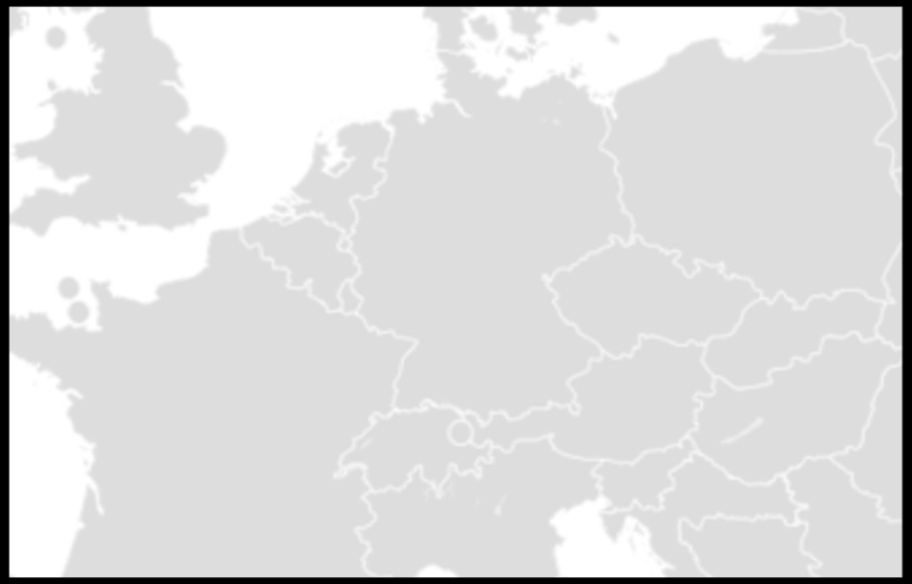




How things stand today
Frequency network:
Green links built by NRENs in collaboration with national NMIs
Blue links built by local NMIs/researchers
NMIs:
Four big NMIs are involved in redefining the SI second highlighted in red
Lithuania
UMK
Torun
PSNC
Poznan
PTB
Braunschweig
Slubice
UvA
VSL
Delft
GUM
Warsaw
NPL
London
Lille
Wroclav
OB
Brussels
IRE
Prague
Hradec
Kralove
ILNAS
Luxembourg
CESNET
Cieszyn
Karlsruhe
Ostrava
OP
Paris
ISI
Brno
Strasbourg
Munich MPI
Basel
BEV
Vienna
NMI Frequency reference
METAS
Bern
Innsbruck
Research institute
CERN
Geneva
Ljubljana
Hut for housing RLS
Grenoble
Trieste
Zagreb
Modane
INRIM
Turin
Milan

Slide 13
What is missing?
Missing:
National based networks need to be interconnected
Eastern and Western islands of frequency services are not linked
A full ring/mesh of the big four NMIs will enable them to complete definition of the SI second
Link will also be needed to Nordics, SE and SW Europe as they develop Optical clocks
Lithuania
UMK
Torun
PSNC
Poznan
PTB
Braunschweig
Slubice
UvA
VSL
Delft
GUM
Warsaw
NPL
London
Lille
Wroclav
OB
Brussels
IRE
Prague
Hradec
Kralove
ILNAS
Luxembourg
CESNET
Cieszyn
Karlsruhe
Ostrava
OP
Paris
ISI
Brno
Strasbourg
Munich MPI
Basel
BEV
Vienna
METAS
Bern
Innsbruck
Ljubljana
NMI Frequency reference
CERN
Geneva
Research institute
Grenoble
Trieste
Zagreb
Modane
INRIM
Turin
Hut for housing RLS
Milan

Slide 14
Proposed solution
Solution:
Red lines are proposed for GN5-2
These will interconnect national ‘islands’ of frequency networks
Support redefinition of the SI second
Primary users are national frequency reference providers
Secondary users are research institutes that connect via their national frequency provider
Lithuania
UMK
Torun
PSNC
Poznan
PTB
Braunschweig
Slubice
UvA
VSL
Delft
GUM
Warsaw
NPL
London
Lille
Wroclav
OB
Brussels
IRE
Prague
Hradec
Kralove
ILNAS
Luxembourg
CESNET
Cieszyn
Karlsruhe
Ostrava
OP
Paris
ISI
Brno
Strasbourg
Munich MPI
Basel
BEV
Vienna
METAS
Bern
Innsbruck
CERN
Geneva
Ljubljana
NMI Frequency reference
Research institute
Grenoble
Trieste
Zagreb
Modane
INRIM
Turin
Hut for housing RLS
Milan

Slide 15
Proposed solution
Solution:
Ring supports the four big NMIs that are part of the campaign for redefinition of the SI second
Lithuania
UMK
Torun
PSNC
Poznan
PTB
Braunschweig
Slubice
UvA
VSL
Delft
GUM
Warsaw
NPL
London
Lille
Wroclav
OB
Brussels
IRE
Prague
Hradec
Kralove
ILNAS
Luxembourg
CESNET
Cieszyn
Karlsruhe
Ostrava
OP
Paris
ISI
Brno
Strasbourg
Munich MPI
Basel
BEV
Vienna
NMI Frequency reference
METAS
Bern
Innsbruck
Ljubljana
Research institute
CERN
Geneva
Grenoble
Hut for housing RLS
Trieste
Zagreb
Modane
INRIM
Turin
Milan

Slide 16
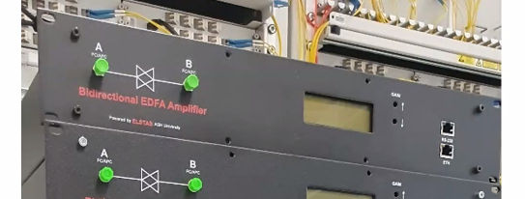
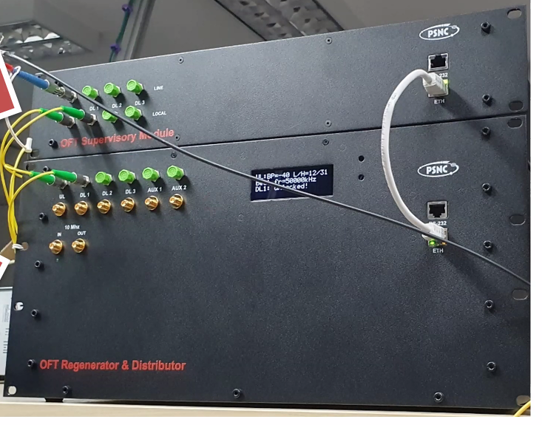
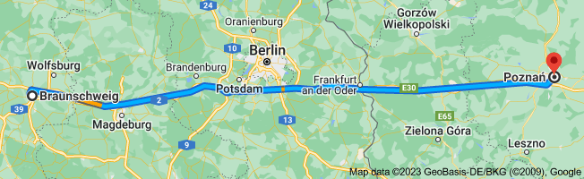
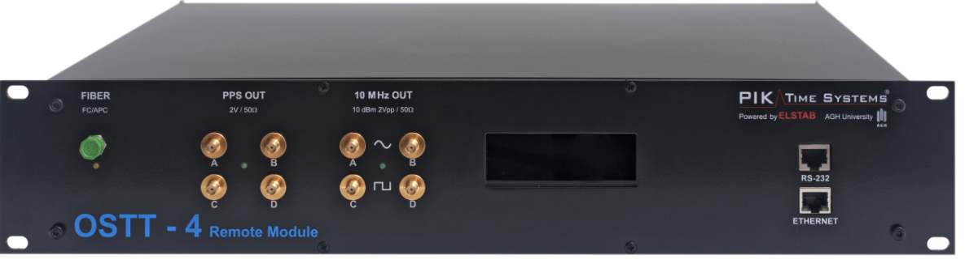
Pathfinder system
First proof-of-concept link for the CLONETS C-TFN
The purpose is to prove both frequency and time transfer
The system was successfully installed on the 23rd of Sept
Uses equipment from PIK Time Systems
Bi-directional amp
Regenerator laser station
ELSTAB

Slide 17
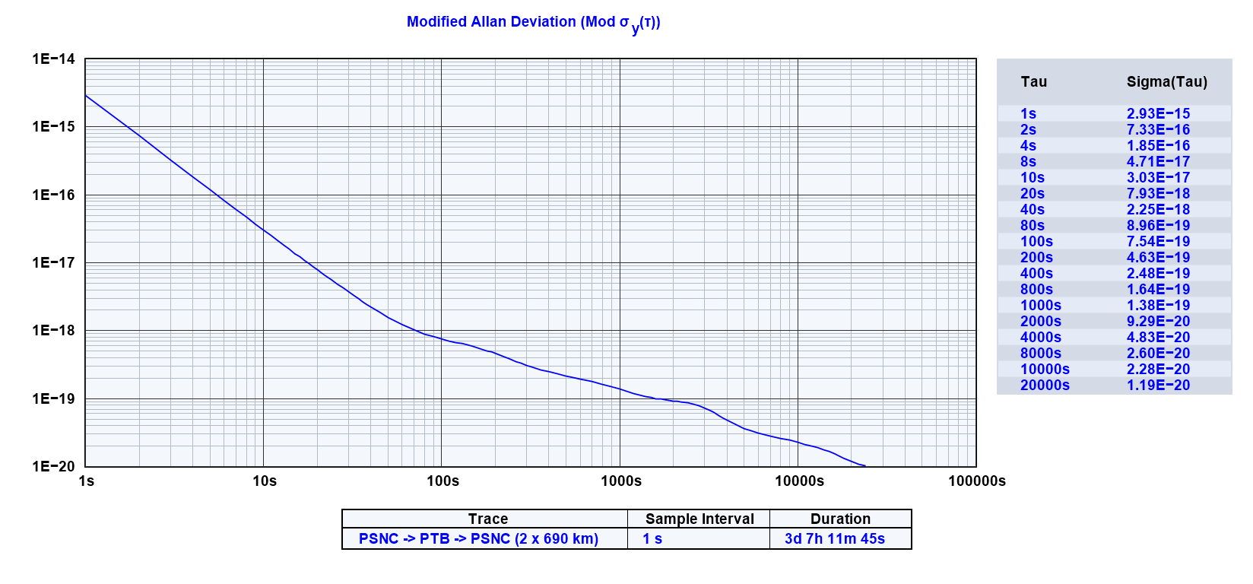
Pathfinder validation results

Slide 18
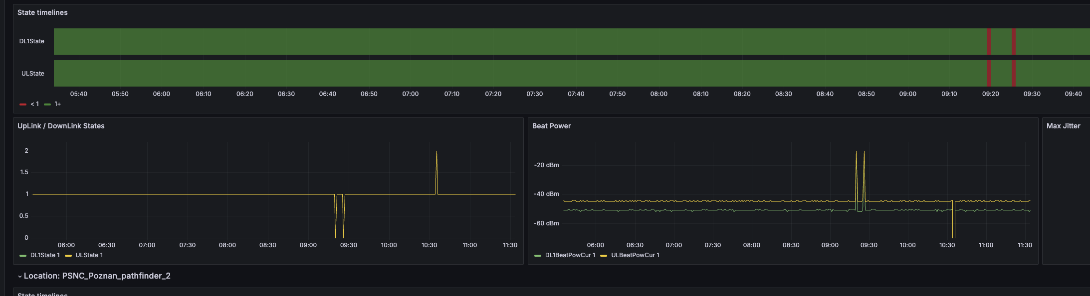
TimeMap for pathfinder
GEANT WP6 is adapting TimeMap software to support the Pathfinder
Link state and beat power are reported for each end of the link
Investigating adding frequency counter measurements

Slide 19
WDM wavelength plan for TF signals (lambdas TBD)
Closed arrows indicate
direction of optical waves
Time Grandmaster
(GM)
ELSTAB Tx
MUX
MUX
ELSTAB Rx
Time
Slave
(S)
ELSTAB Rx
ELSTAB Tx
WR Tx
Optical fiber b
WR Rx
WR Rx
WR Tx
WR Tx Cal
WR Rx Cal
WR Rx Cal
WR Tx Cal
Frequency source
CH44 ultrastable
optical carrier
Open arrows indicate direction
master → slave (time)
or source → sink (frequency)
CH44 ultrastable
optical carrier
Frequency sink
Fiber pair
Time
Slave
(S)
ELSTAB Rx
MUX
MUX
ELSTAB Tx
Time Grandmaster
(GM)
ELSTAB Tx
ELSTAB Rx
WR Rx
Optical fiber a
WR Tx
WR Tx
WR Rx
WR Rx Cal
WR Tx Cal
WR Tx Cal
WR Rx Cal
Frequency sink
CH44 ultrastable
optical carrier
WR calibration (cal) channels not needed
if deploying redundant WR links (ie. one WR
link over fiber a and one WR link over fiber b)
Frequency source
CH44 ultrastable
optical carrier

Slide 20
Time network topology
UTC(k_{N}) +
Primary frequency standard N
Pk_{N}
Signals ELSTAB (a) and WR (a) travel
through the same fiber. Likewise for
ELSTAB (b) and WR (b)
S4b
GM
4a
S4b
k_{N}
UTC(k_{N})
GM
4a
Pk₄
S3b
S4a
GM
3b
GM
4b
S4a
GM
4b
GM
3a
XN
ELSTAB endpoint
X = GM, S
S2b
S3a
k₃
GM
2b
GM
2a
S2a
k₂
S5a
GM
5b
S1b
GM
1a
S1b
k₅
XN
WR endpoint
X = GM, S
GM
5a
S5b
GM
1a
Pk₁
S1a
S6a
GM
6b
Single-fiber ELSTAB link
west, GM; east, S
includes amps, muxes,…
GM
1b
S1a
GM
1b
GM
9a
k₉
k₆
GM
6a
S6b
S9b
S9a
GM
9b
GM
8a
k₈
S8a
Single-fiber WR link
west, GM; east, S
includes amps, muxes,…
S8b
S7b
GM
7a
S7b
GM
8b
GM
7a
Pk₇
S7a
GM
7b
S7a
GM
7b
Non-WR Ethernet link
Local PPS/10 MHz/ToD

Slide 21


Optical frequency network topology
MLS
N
Multi-branch repeater laser station N
FW2b
RLS
3b
OC4
compare
compare
compare
RLS
3a
RLS
2b
RLS
4a
seed
RLS
N
Repeater laser station N
compare
OC3
MLS
4
RLS
2a
RLS
4b
compare
compare
Flywheel (ultrastable laser) N
compare
compare
compare
FW2a
RLS
5a
RLS
5b
RLS
1b
OC1
MLS
1
FW5a
FW5b
Optical clock N
seed
RLS
1a
RLS
6a
Single-fiber ultrastable link
west, source; east sink
compare
MLS
6
compare
RLS
7a
seed
OC6
RLS
6b
Local link
west, source; east, sink
RLS
7b
compare

Slide 22
C-TFN Timeline
2024: build and Pathfinder link and prepare C-TFN
2025 - 2027: Build TFN Phase 1
After July 2027: TFN Phase 2 (funding not yet identified)
2024 (GN5-1)
2025-27 (GN5-2)
Pathfinder link Poznan-Braunschweig
GN5-2 project preparation
Run procurement
C-TFN build, commissioning, operation
April GN5-2T workplan agreed
Q4 2024
GEANT gate for
procurement

Slide 23
Conclusions
GÉANT is building two fibre routes in the next 3 years:
  France-Belgium-Netherlands-Germany-Poland
  Italy-Austria-Germany-Czechia-Poland
GÉANT has created a new SIG to coordinate collaboration between metrology and NRENs
Funding in place for Jan 2025 to July 2027.
The sustainability working group is actively working with the EC to find funding after 2027

Slide 24

Thank You
Any questions?
www.geant.org

Slide 25
SIG-TFN: wrap up
Guy Roberts
Senior Network Architect
SIG-TFN Amsterdam
16-17/10/2024

Slide 26
Wrap up
Since the SIG-TFN was created we have strengthened the collaboration between metrolgists and research networking communities
Next meeting will be in spring 2025 the location will be ….
Excellent progress by the technical working group, thanks Jeroen, Rapahel, Jochen and many others.
Funding is progressing, however more work is needed ... this will be the focus of the next SIG-TFN meeting

Slide 27
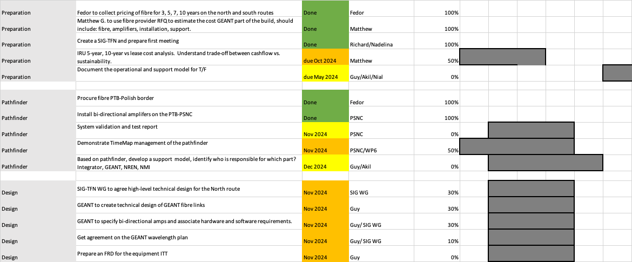
Next steps -Planning the fibre procurement and build

Slide 28
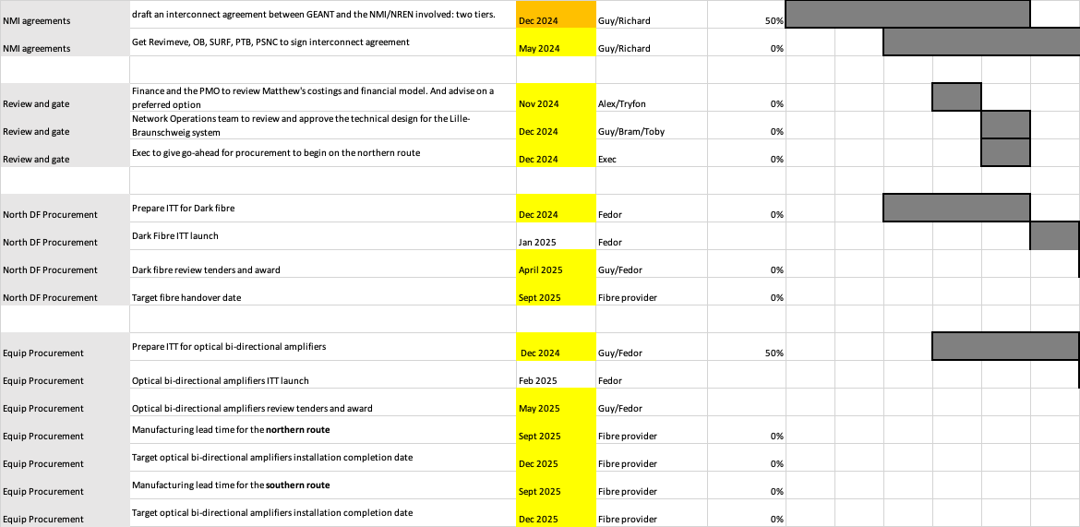
Next steps - Planning the fibre procurement and build

Slide 29
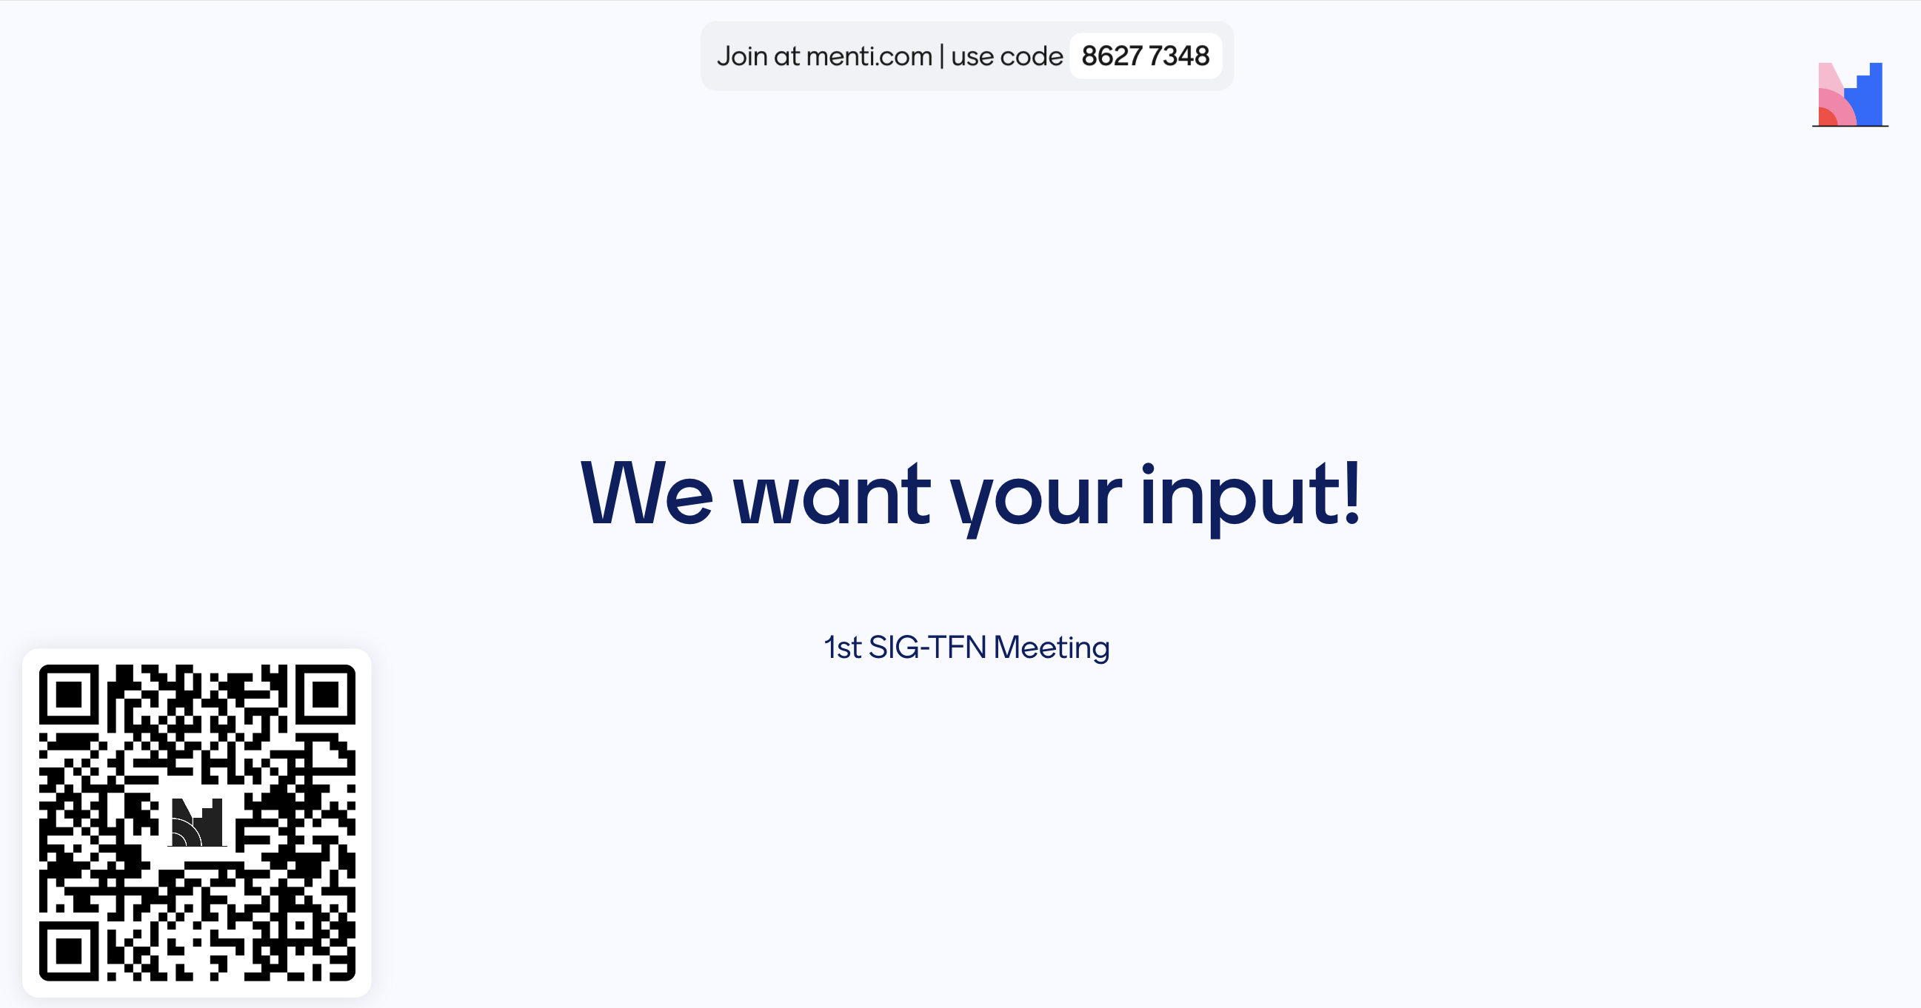
You will receive a menti survey by email
Feedback

Slide 30
Sustainability challenge
Horizon Europe
FP10 starts 2028 through to 2034
DG-CONNECT
DG-CONNECT
GN5-2 2025 to 2027
GN5-3 2027 to 2029
€2.5 - €7.5 million *
HE funded
GÉANT TF funding
NMI / NREN TF funding
DG-???
* Pending governance approval

Slide 31
Service level hierarchy
International links
GÉANT
NMIs / NRENs
Civil / Commercial / Research
General public
Metrology services
and national links
Large users of metrology services
Individuals using metrology services

Slide 32
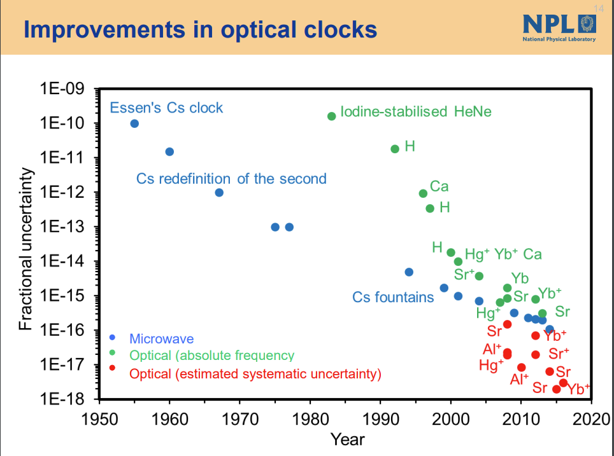
How accurate are atomic clocks?
Since 1968 the second has been defined by measurement using Cesium ‘RF’ atomic clocks.
Optical atomic clocks are now a better technology for measuring time

Slide 33
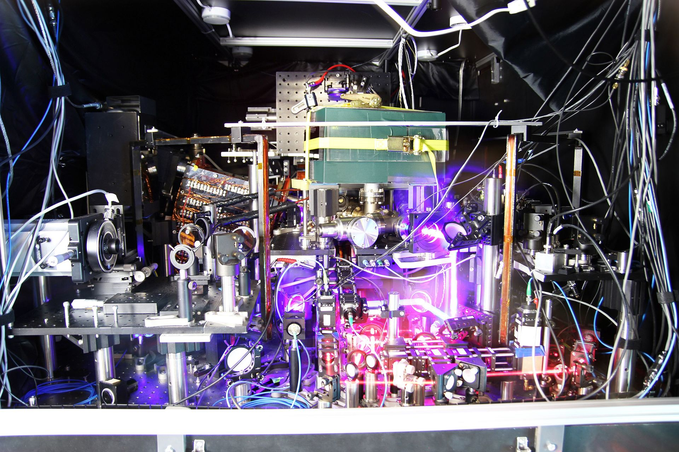
Optical clocks need fibre!
In 2022, the 27th CGPM approved Resolution 5 towards the redefinition of the second by 2030 using optical clocks
“Member States to support the development of national and international infrastructures mandatory for optical frequency standard comparisons”
“As of today, only comparisons mediated by optical fibre links provide the required instability and accuracy for comparing optical clocks”
NRENs are really good at this bit!

