Slide 1

White Rabbit
Status and plans
17 October 2024
1st SIG-TFN meeting, Amsterdam
Maciej Lipinski
WR Collaboration / CERN

Slide 2
Agenda
Quick introduction
Devices
Ongoing efforts
WR Collaboration
Conclusions

Slide 3
Quick Introduction to White Rabbit

Slide 4
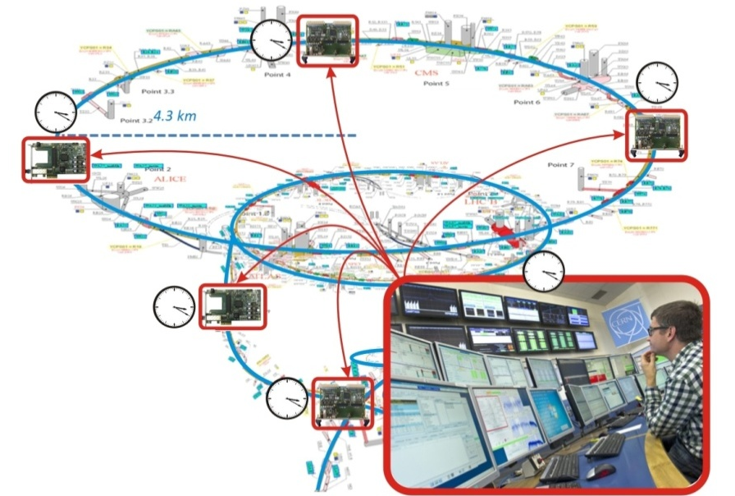
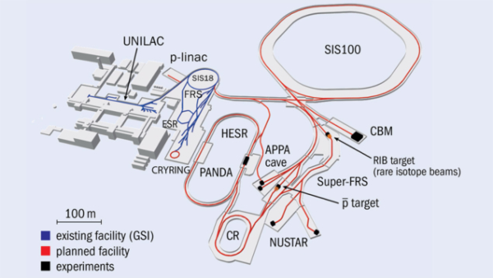

White Rabbit genesis
For High Energy Physics experiments
Next generation control & timing system
Project started in 2008 as collaboration
Initial specification:
  Based on well-established standards
  Sub-ns synchronisation
  Deterministic data transfer
  10km links and up to 2000 end stations
  Plug and play
  Open source & commercially available
CERN
GSI
KM3Net
(Nikhef)

Slide 5
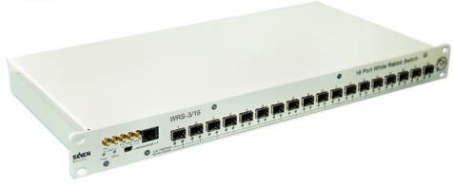
White Rabbit operation in a nutshell
White Rabbit = PTP + L1 syntonisation + phase detection + asymmetry correction
11h50m00s000000000.000ns
11h50m00s000000000.010ns
t₁
Precision Time Protocol
(PTP, IEEE 1588)
PTP limitations:
Free-running oscillators
Timestamp resolution
Symmetry assumption of
medium & hardware
t₂
(t₄ – t₁) – (t₃ – t₂)
2
t₃
Time_cor = + asym
t₄
t
Ethernet
t
Frequency
transfer
Enhance
delay measurement
thanks to common freq
Enhance
timestamp precision to ps level
by using phase detection techniques
Phase
detection
Phase offset with ps precision
Single bidirectional fiber
Link delay model
Calibration
Enhance
time corrections accuracy
by automatic medium asymmetry calculation and calibration of hardware delays
Asymmetry
corrections

Slide 6
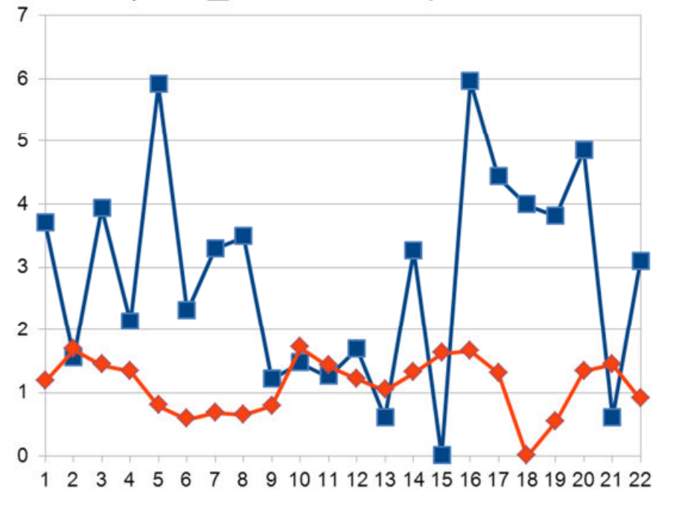
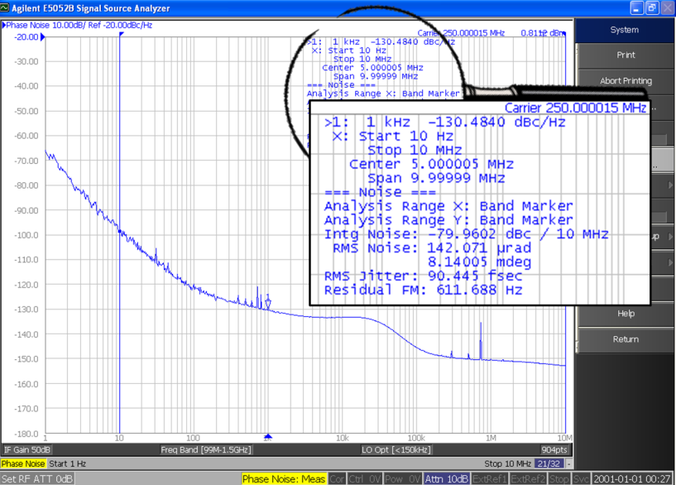
White Rabbit performance today
Time transfer performance
Network-level: < 1ns accuracy
A single link (<10km): < 20ps accuracy
Long-distance support: ~1000km
Frequency transfer performance
Standard: 11ps RMS
Low jitter: 2ps RMS
Best jitter: 100fs RMS
Synchronization over reboots
Offset [ps]
Time (1 PPS)
Clock (62.5MHz)

Slide 7
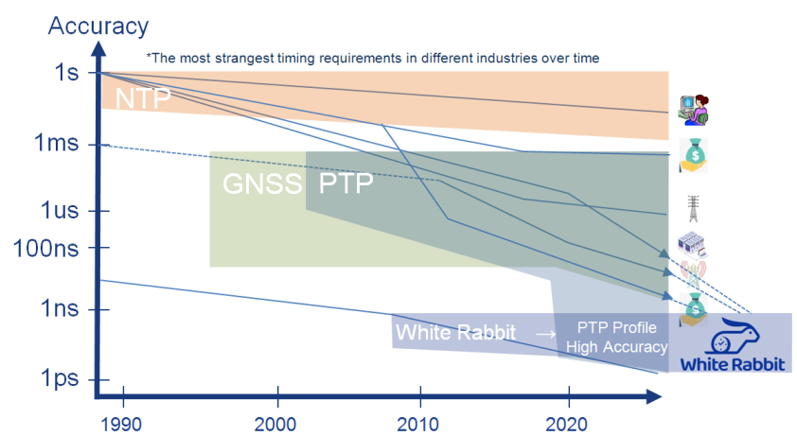
White Rabbit applications
Scientific: accelerators & detectors, quantum – CH, FR, DE, US, CH, JP, ES, MX, AU, HU, CZ, UK, NL…
National time: distribution of UTC(k) – CH, FR, US, FI, UK, IT, SE, NL, BA, CZ, BE
Telecom & Data Centers: backup for GPS – PL, US, JP, UK, …
Finance: Time as a service for HFT & backup for GPS – DE, IT, ES, US, …

Slide 8
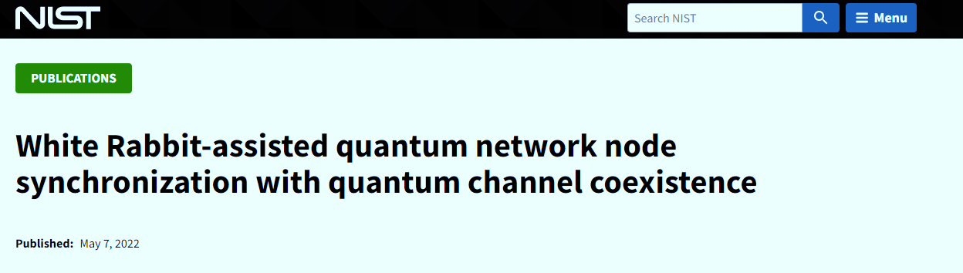
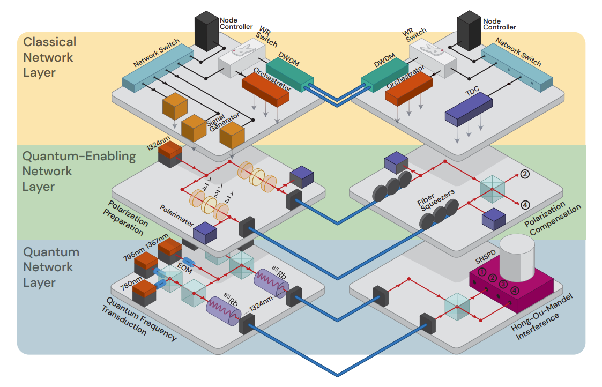
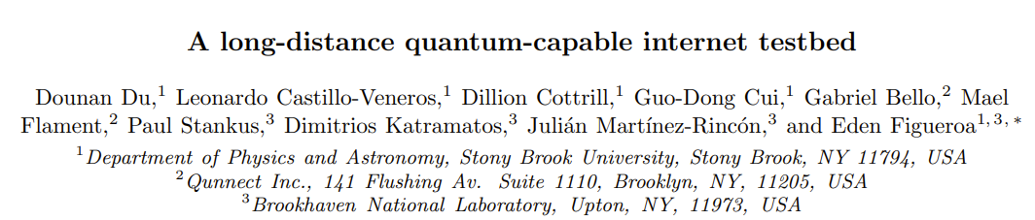
https://www.nist.gov/publications/white-rabbit-assisted-quantum-network-node-synchronization-quantum-channel-coexistence
https://arxiv.org/pdf/2101.12742v2
6 / 18

Slide 9

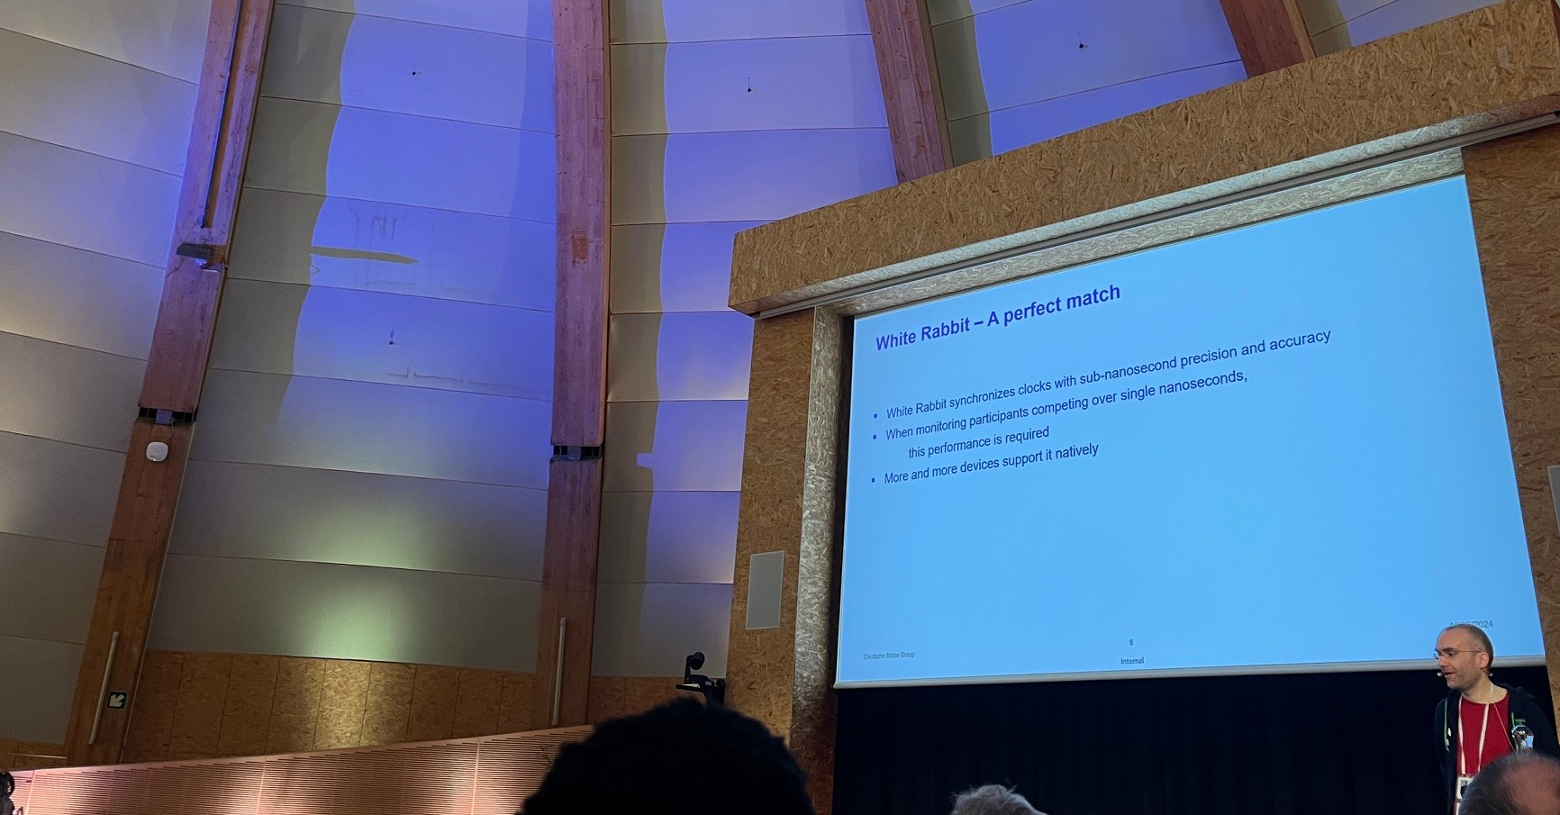
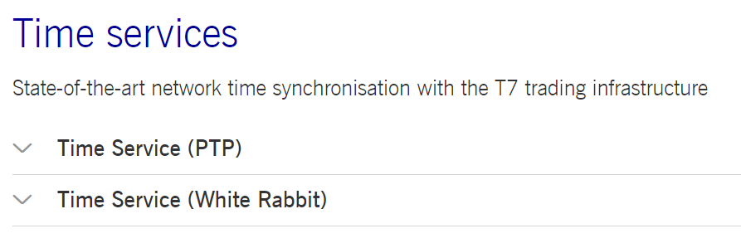
https://www.deutsche-boerse.com/dbg-en/products-services/ps-technology/ps-connectivity-services/ps-connectivity-services-time-services
https://www.white-rabbit.tech/13th_WR_workshop/

Slide 10

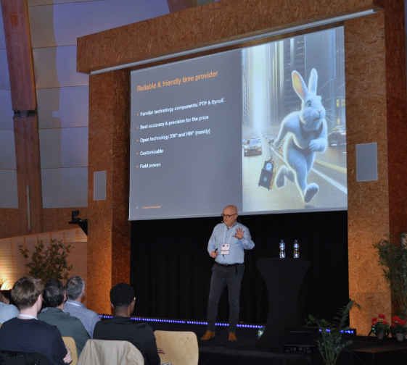
Towards Carrier Grade
White Rabbit
Marek Brawanski, Orange
www.white-rabbit.tech/13th_WR_workshop

Slide 11
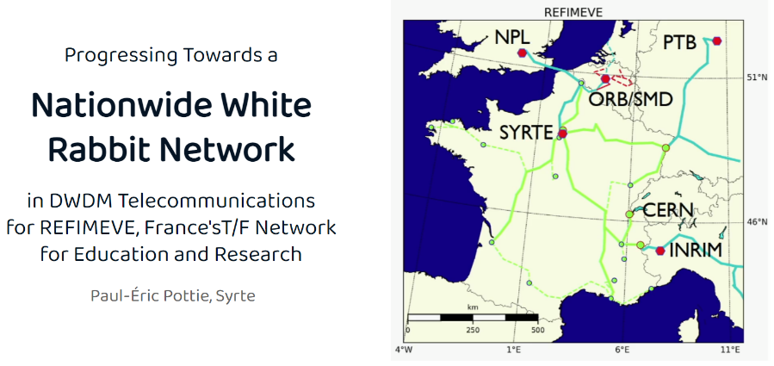
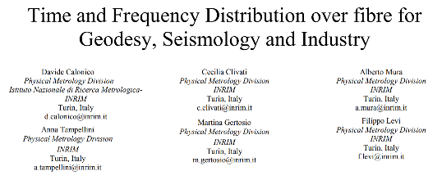

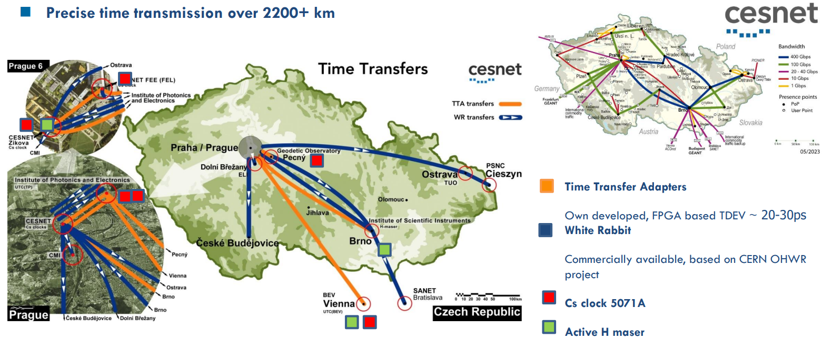

Long distance WR examples
Presently, we implemented the coherent frequency transfer on all the 1830 km, and we are upgrading the optical infrastructure to embed the White Rabbit PTP on all the backbone, too.
A WR-PTP implementation is already operational on a separate fibre from Torino to Milano.
Netnod’s White Rabbit implementation achieves sub-nanosecond accuracy in live Swedish network
https://www.netnod.se/time-and-frequency/netnods-white-rabbit-implementation-achieves-sub-nanosecond-accuracy-in-live-swedish-network
https://www.slideshare.net/slideshow/surf-hoe-laat-is-het-sander-klemann-nwd23/258638391
https://events.geant.org/event/1581/sessions/770/attachments/940/1400/Cntr_wide_WR.pdf

Slide 12
White Rabbit devices

Slide 13
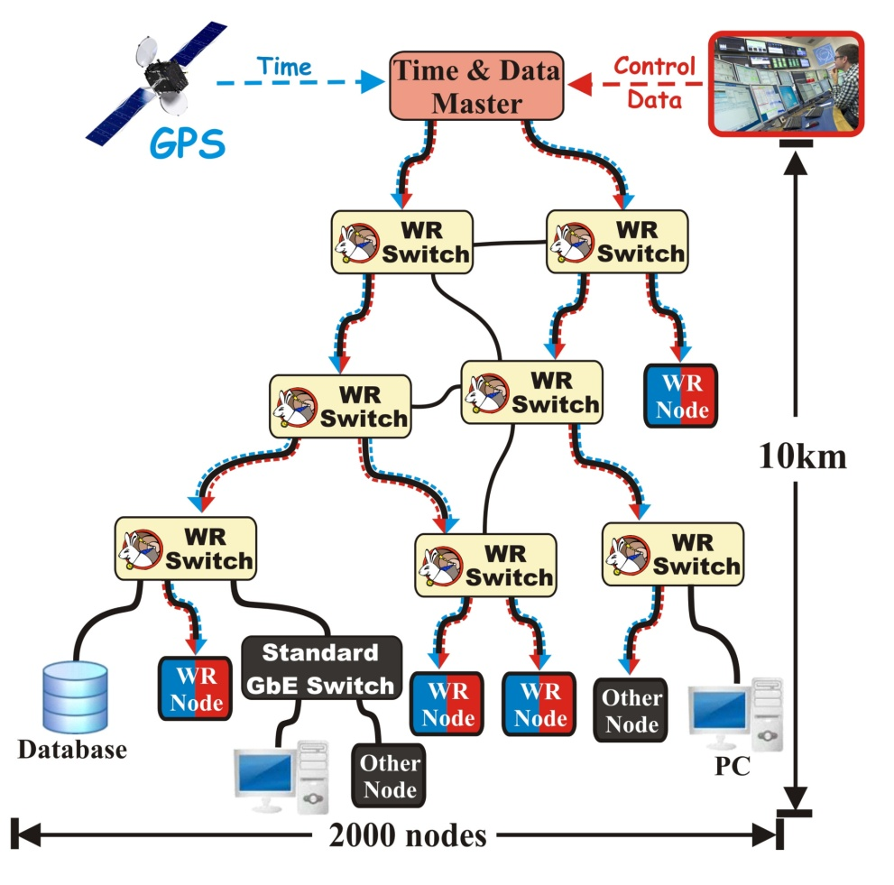

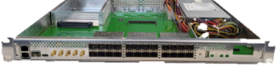
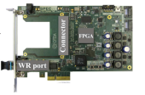
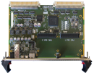


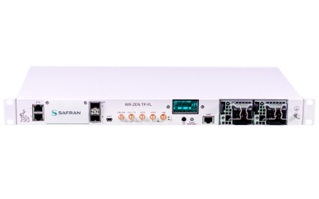
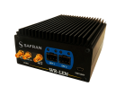
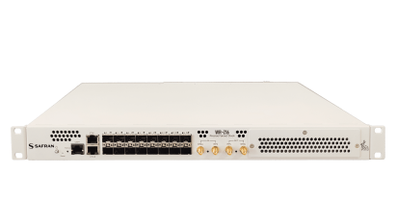
White Rabbit Devices
WR Switch (open-source)
  HW v3 – current
  HW v4 – future
WR Node
  Open source
  Proprietary
List of WR devices:
https://ohwr.org/project/white-rabbit/-/wikis/WRCompanies
* Timing fanout

Slide 14
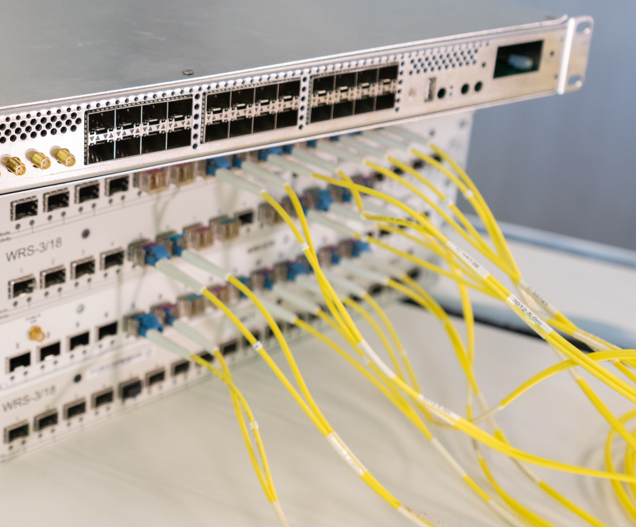
Commercially available from vendors
Safran
  www.safran-navigation-timing.com/solution/white-rabbit-solutions
SyncTechnology
www.synctechnology.cn
Creotech
www.creotech.pl/news/white-rabbit
OPNT
www.opnt.nl
GMV*
www.gmv.com
See talk at the WR Workshop this year:
https://cds.cern.ch/record/2893521?ln=en
*future vendor

Slide 15
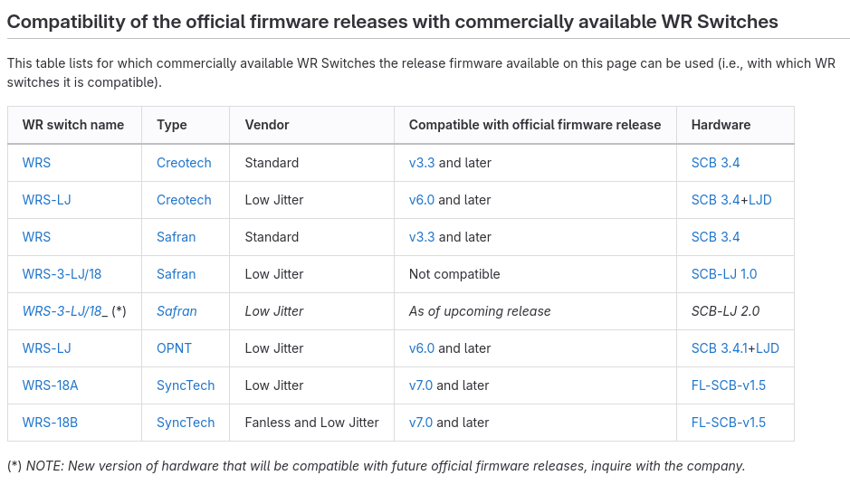
White Rabbit Switch v3
White Rabbit Switch v3
WR Switch type | Precision (sdev) |  | Accuracy (mean)
 | GM-in/out | GM-in/BC-out | Ports 1-12 (LPDC) | Ports 13-18
 | Jitter RMS (1 Hz – 100 kHz) | Jitter RMS (1 Hz – 100 kHz)
“Standard” | 9ps | 11 ps | <20ps | <200ps
“Low jitter” | 1ps | < 2 ps
Hardware:
  18 ports of 1 Gbps
  Xilinx Virtex 6 + ARM CPU
  Main types:
    Standard
    Low-jitter
Firmware (software + gateware):
  Official releases by WR Team at CERN
  Calibrated to CERN’s Golden Calibrator
  Low Phase Drift Calibration (LPDC)
    Phase repeatability over link-up/reboot
    Supported on ports 1-12
  Current release: v7.0
    Not all WRS hardware types compatible
https://ohwr.org/project/wr-switch-sw/-/wikis/home

Slide 16
White Rabbit ongoing efforts

Slide 17
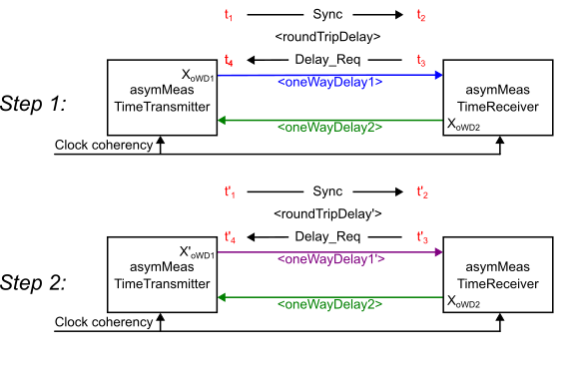
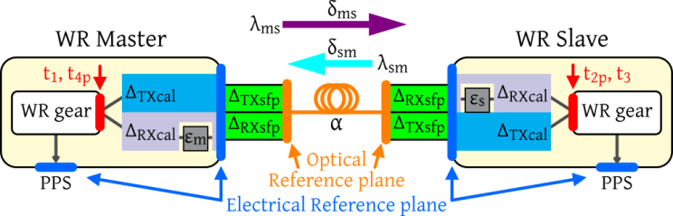
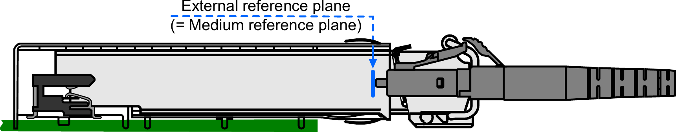
Standardisation ++
IEEE: 1588f amendment to 1588-2019 (PTPv2.1)
  In-situ calibration
    Special PTP Port mode and datasets to support calibration
    Swapping of one-way delays (SOWD) – two fibers
    Three one-way delays (TOWD) – single fiber, two wavelengths
  Absolute calibration
    Definition of reference planes and latencies specific SFPs
    Guidelines of how to perform absolute calibration
SNIA: SFF-8472 update to SFP EEPROM
  Include support for
    Latency characteristics of optical modules
    Loopback calibration module
  Parameters:
    Rx/Tx delays (avg, sdev)
    Temperature de-tuning offset/slope
    Rx power curve coefficient
Based on work by Peter Jansweijer and Hank Peek
https://ohwr.org/project/wr-calibration/-/wikis/home
Courtesy Henk Peek and
Peter Jansweijer

Slide 18
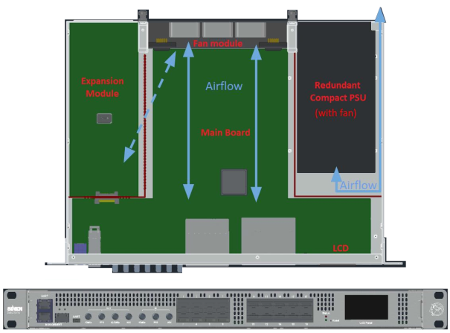
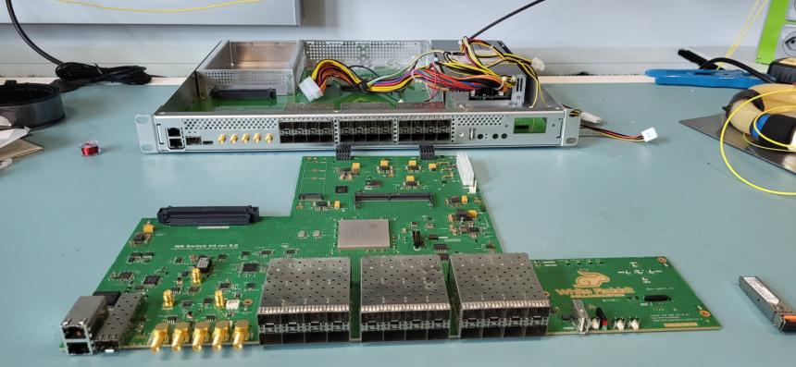
WR Switch v4
Project page
https://ohwr.org/project/wr-switch-hw-v4/wikis
Specification:
  24 ports, 1 and 10 GbE support – drop-in replacement for v3
  Redundant and serviceable fans and power supplies
  Based on Xilinx/AMD Zynq US+ System-on-Chip
  Expansion Board slot for enhancements
  (low phase noise, holdover…)
Roadmap
  Current: prototyping stage, HW prototype 1
  End of 2024: v3 functionality (1 GbE support)
  Mid 2025: firmware release with holdover support
  End 2025: 10 GbE support for timing
  End 2026: 1 and 10 GbE support for data/timing proto
  Mid 2027: Final firmware release with 1 and 10 GbE

Slide 19
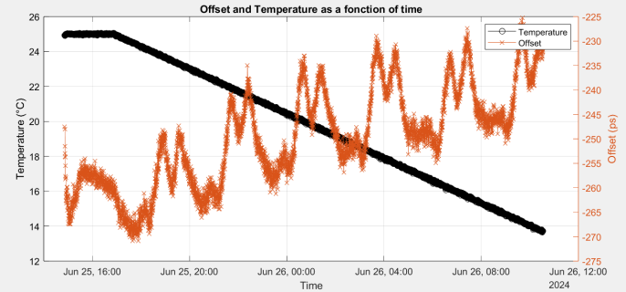
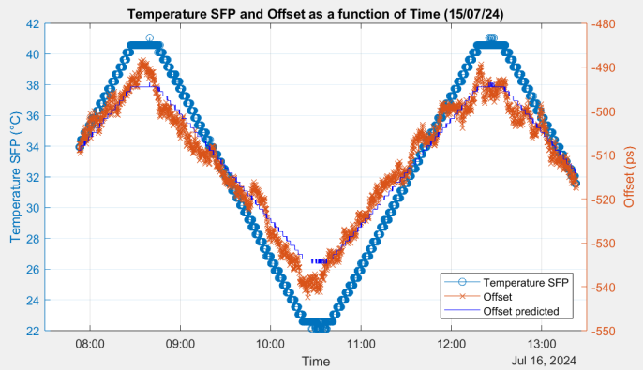
Temperature-dependence characterisation and mitigation
Sources of inaccuracy
  Link delay asymmetry
    Chromatic dispersion variation due to fiber temp
    Wavelength variation due to SFP temp
  Ingress/egress delay asymmetry
    Internal delays variation due to hardware temp
Characterization of effects
SoftPLL optimisations (mitigate M-pattern)
Mitigation methods
  Online compensation
  DWDM
  Single Fiber Single Wavelength (SFSW)
  “Minimizing the impact of asymmetry in High Accuracy White Rabbit long distance links using Single Fiber Single Wavelength transceivers”, F. Girela-Lopez (Safran), J. St. James, A. Pinales, A. Byagowi (Meta), ISPCS2024, Tokyo
10km fiber
SFP 1310/1490 nm
Fiber in varying temp
WRS Master/Slave
in stable temp
10km fiber
SFP 1310/1490 nm
WRS Slave in varying temp
Fiber and WRS Master
in stable temp

Slide 20
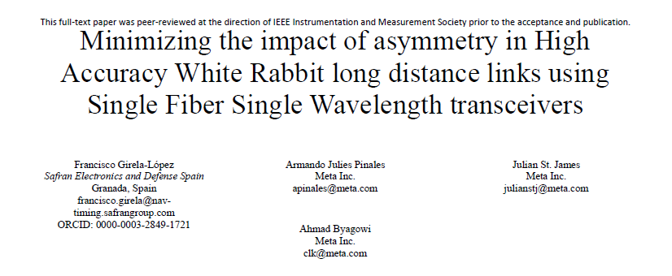
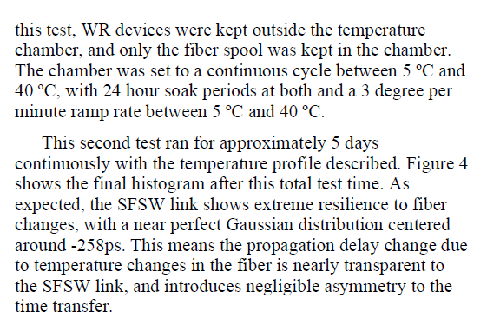
Temperature-dependence characterisation and mitigation

Slide 21
White Rabbit Collaboration

Slide 22

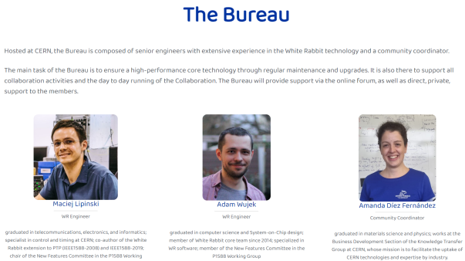
White Rabbit Collaboration (WRC)
Main goal:
Maintenance and improvement of open-source WR Technology
Foster uptake of the technology in new domains and by new actors
Stakeholders
  Companies: end users, PNT provides, measurement instrumentation
  National metrology institutes
  Universities
  Research Facilities
Activities:
  Development Plan
  Dedicated support
  Compliance and qualification
  Training and Outreach
  Loan WR devices, calibrate copy of the Golden Calibrator
  R&D Projects
Role:
  Global reference point for WR Technology
  Unified voice representing key stakeholders
  Way to coordinate efforts across countries and sectors
  A friendly and supportive community
Launched in 2024, 16 members and growing

Slide 23
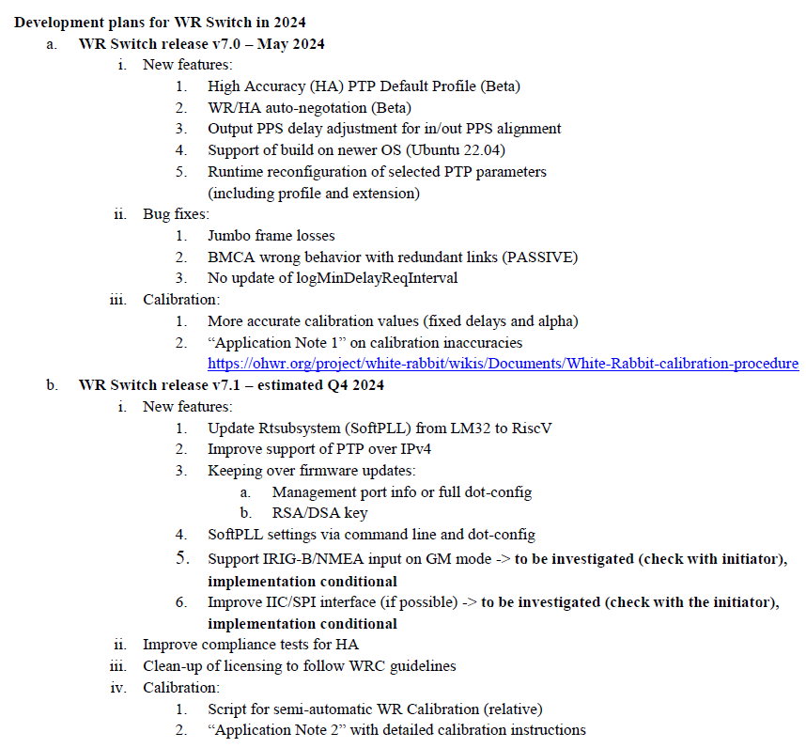
White Rabbit Collaboration (WRC)
Main goal:
Maintenance and improvement of open-source WR Technology
Foster uptake of the technology in new domains and by new actors
Stakeholders
  Companies: end users, PNT provides, measurement instrumentation
  National metrology institutes
  Universities
  Research Facilities
Activities:
  Development Plan
  Dedicated support
  Compliance and qualification
  Training and Outreach
  Loan WR devices, calibrate copy of the Golden Calibrator
  R&D Projects
Role:
  Global reference point for WR Technology
  Unified voice representing key stakeholders
  Way to coordinate efforts across countries and sectors
  A friendly and supportive community
Launched in 2024, 16 members and growing
Done
Ongoing

Slide 24
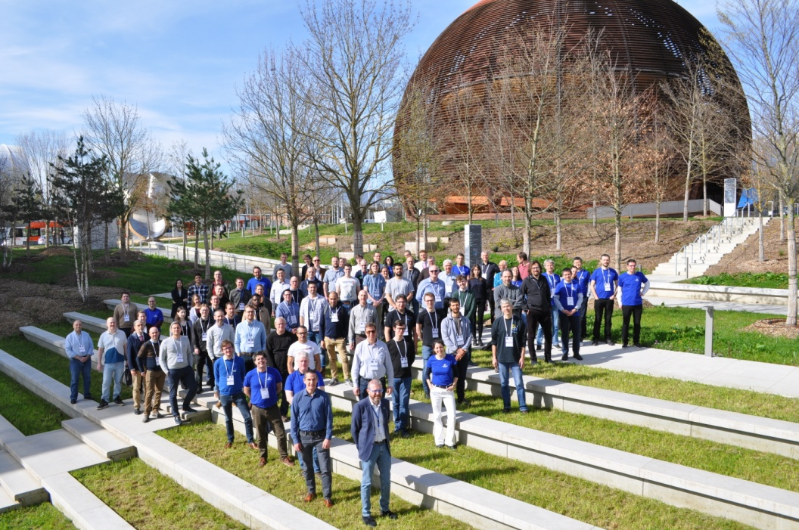
White Rabbit Collaboration (WRC)
Main goal:
Maintenance and improvement of open-source WR Technology
Foster uptake of the technology in new domains and by new actors
Stakeholders
  Companies: end users, PNT provides, measurement instrumentation
  National metrology institutes
  Universities
  Research Facilities
Activities:
  Development Plan
  Dedicated support
  Compliance and qualification
  Training and Outreach
  Loan WR devices, calibrate copy of the Golden Calibrator
  R&D Projects
Role:
  Global reference point for WR Technology
  Unified voice representing key stakeholders
  Way to coordinate efforts across countries and sectors
  A friendly and supportive community
Launched in 2024, 16 members and growing

Slide 25
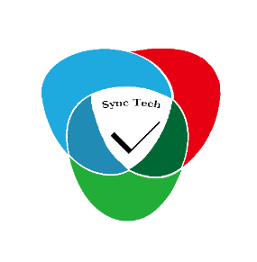















Members

Slide 26




WRC: Compliance and certification
Goal:
  Publicly defined compliance and interoperability test programs
  Network of associated labs to perform tests
  Standardised test report and datasheet
  Trademark and website listing for qualified products
  Tests and Compliance committee
    IOL – received NFS funding from US government
    IQD
    GMV
    Nikhef
    Safran
    CERN
Ongoing work on defining
  Test sets for certification
  Test equipment requirements
  Performance and qualification criteria

Slide 27

WRC: R&D Projects
First R&D projects (ongoing):
Possible projects (in discussion):
Demonstrating and facilitating the use of WR in the control plane of quantum networks as part of the CERN Quantum Technology Initiative
Support for clock ensemble in WR Switch
Seamless redundancy in WR networks
Long-distance WR for Smart Grids

Slide 28
Conclusions

Slide 29

Conclusions
White Rabbit:
Versatile and standard-based solution
for sub-ns accuracy and ps precision
Open source and commercially available
Included in IEEE1588-2019 as
High Accuracy PTP Profile
Increasing number of applications
  Science: de-facto standard
  Industry: gaining traction
WR Collaboration
  Created to facilitate uptake, maintenance and
  evolution of the WR Technology
  Reference point for the WR technology
  Friendly, diverse and welcoming community
Roadmap
2024
  Development plan 2024
  Preliminary test and compliance plan
  A day worth of trainings
  Extensive outreach
2025
  WRSv4 with 1 GbE
  Holdover expansion board
  Support for temp-mitigation
  P1588f in-situ and absolute calibration published
  SFF-8472 published
  First compliance and qualification performed
  Quantum and more R&D Projects
Thank
You !

