Slide 1
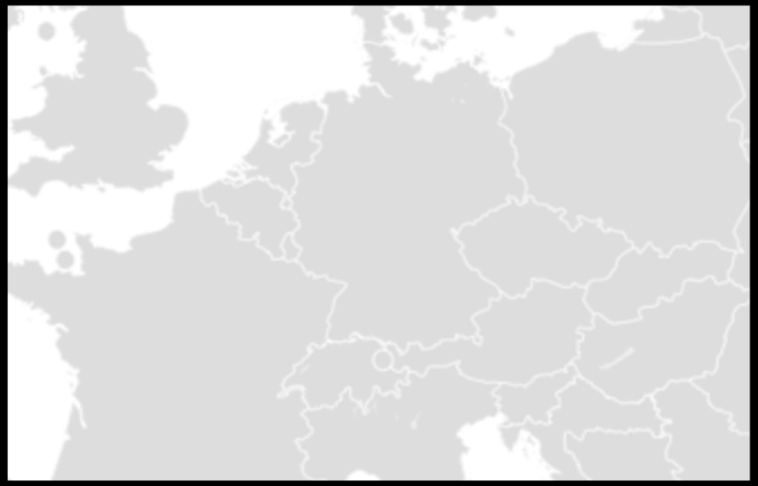




C-TFN build in GN5-2 (red lines)
Included:
10-year IRU for fibre on red routes
Bidirectional amplifiers as needed to light the fibre on the red routes
Excluded:
Green lines – fibre built by NRENs
Blue lines – fibre bult by NMIs
Dashed green – proposed future links
flywheels, counters frequency combs needed are to be funded by the national time/frequency providers
Time/Frequency overlay services
Copenhagen
Lithuania
UMK
Torun
PSNC
Poznan
PTB
Braunschweig
Slubice
SURF
VSL
Delft
TU Eindhoven
GUM
Warsaw
NPL
London
Lille
Wroclav
OB
Brussels
IRE
Prague
ILNAS
Luxembourg
CESNET
Cieszyn
OP
Paris
Karlsruhe
Ostrava
ISI
Brno
Strasbourg
Munich MPI
South-East
Europe
Basel
BEV
Vienna
METAS
Bern
Innsbruck
CERN
Geneva
Ljubljana
NMI Frequency reference
Grenoble
Zagreb
Research institute
Bordeaux
Modane
Trieste
INRIM
Turin
Milan
Hut for housing RLS
Madrid

Slide 2
C-TFN build in GN5-2 (red lines)
Included:
10-year IRU for fibre on red routes
Bidirectional amplifiers as needed to light the fibre on the red routes
Excluded:
Green lines – fibre built by NRENs
Blue lines – fibre bult by NMIs
Dashed green – proposed future links
flywheels, counters frequency combs needed are to be funded by the national time/frequency providers
Time/Frequency overlay services
PSNC
Poznan
PTB
Braunschweig
Slubice
SURF
VSL
Delft
NPL
London
Lille
OB
Brussels
Prague
CESNET
Cieszyn
OP
Paris
Ostrava
Munich MPI
Innsbruck
CERN
Geneva
NMI Frequency reference
Research institute
INRIM
Turin
Milan
Hut for housing RLS

Slide 3
Service overlay
UMK
Torun
PSNC
Poznan
PTB
Braunschweig
SURF
Slubice
VSL
Delft
TU Eindhoven
GUM
Warsaw
NPL
London
Lille
Wroclav
OB
Brussels
OP
Paris
Karlsruhe
 | London | Paris | Lille | Brussels | Amsterdam | Braunschweig | Poznan
London |  | Frequency Ch44
Paris |  |  |  | Frequency Ch44 time
Lille
Brussels |  |  |  |  | Frequency Ch44, Time for SURF/ESA
Amsterdam |  |  |  |  |  | Frequency Ch44, Time for SURF/ESA
Braunschweig |  |  |  |  |  |  | Frequency Ch44, Time
Poznan
Time service
Frequency service

Slide 4
Design discussion – fibre build
Light one or two fibres?
  NMIs standard practice is to light two fibres, so two fibres are preferred.
  If GEANT lights both fibres, then the RLS/MLS designs need to accommodate this.
  Two fibres will double the cost of amplifiers and RLS/MLS equipment
GEANT to terminate the fibre at a demarcation point which should include and MDF and a fixed DWDM filter
DWDM fixed filter: C-band with 100GHz spacing.
Ch44 for frequency and other wavelengths for time services

Slide 5




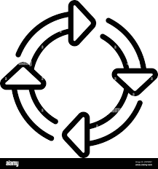

Proposed GEANT fibre buildout
Refimeve
Lille
PSNC
Slublice
To London
WR
Braunschweig
VU/UvA/SURF
Amsterdam
Exail MLS
RLS
To Paris
To Poznan
If funds are available, both fibres lit to support validation
Filters terminate fibre and form demarcation points
Terminate WR in SURF and forward Ch44 frequency to UvA lab using dedicated fibre

Slide 6
Design discussion - Frequency
Ch44 will be used across Europe as the agreed wavelength for frequency services.
A high-level design needs to be agreed among all NMIs to ensure a coherent frequency distribution strategy (note that this contrasts to the bilateral arrangements between peering NMIs for time distribution).
MLS or RLS?
  For future proofing, MLS is recommended if no flywheel is present. Deployment of MLS equipment will depend on the finance available.
  NMIs are responsible for purchasing MLS/RLS equipment.
  RLS could cost around 70k - 100k Euros
  MLS with 3 branches could cost around 200k - 300k Euros
  It is believed that the RLS/MLS equipment from PIK and Exail are compatible
Need to define the monitoring requirements which will determine the specifications MLS/RLS
RLS vs. flywheel
  PTB and Syrte will use existing flywheels
  Other NMIs (OB and SURF/UvA/VU) may prefer to use an RLS/MLS

Slide 7
Design discussion - Time
Time services should be agreed bilaterally between peering NMIs. Once the service type and technology are agreed, GEANT will allocate a separate wavelength channel for each individual time service request.
The time services should be deployed in agreement between the NMIs at each end of the link
Time services will be built on the GEANT fibre on a wavelength to be agreed between GEANT and the NMIs at each end of the time link
WhiteRabbit seems to be the preferred technology for time distribution, though PTB-PSNC will be build with equipment provided by PIK/PSNC

Slide 8
Update from NMIs
Refimeve Lille:
no current MLS, but this is in planning.
Funding has not been established?
OB Brussels:
OB would like to receive a frequency service from Paris.
OB plans to buy an MLS with 3 output direction: Paris, Amsterdam and local service.
In the future OB is considering a frequency comb to monitor the frequency links.
OB will offer a local time/frequency service.
No Belgium optical clock in 2025, when is this likely to be ready?
Network resilience is important to OB

Slide 9
Update from NMIs
SURF Amsterdam:
SURF, VU and UvA, aim to collaborate, to build a single Amsterdam site. Details to be agreed
The GEANT fibre should terminate in a rack in the InterXion colo in Amsterdam used by GEANT and SURF.
Ch44 should be broken out in InterXion and forwarded via fibre the nearby UvA lab
The priority for NL is WhiteRabbit in 2025
Frequency services will be driven by the development of an optical clock in VU/UvA, dates to be confirmed
University of Amsterdam (UvA)
Flywheel: UvA will soon have an ultra-stable resonator with 10^-16 precision at 1s in lab.
UvA already have an optical frequency comb that will be stabilized nearly 24/7 on short timescales (i.e. without absolute accuracy) to that resonator.
UvA are building a first Sr clock, which will provide the comb with absolute accuracy.
The Sr clock is a research clock and won’t be available 24/7.
If phase 3 of QDNL gets approved, we will build one additional clock that has a higher uptime than the one we are building now (frequency comb and ultra-stable resonator will still be the ones I described above).
Service: For UvA the optical frequency links to NMIs are very interesting, in particular the links to OP/SYRTE and PTB.

Slide 10
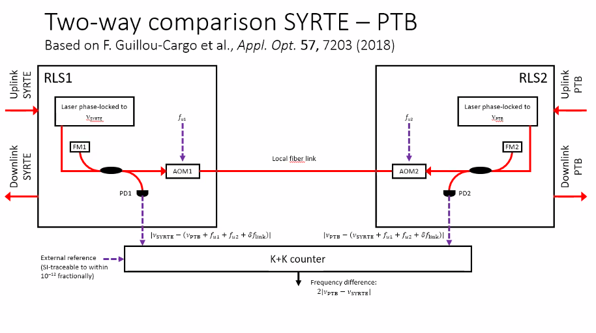

Slide 11
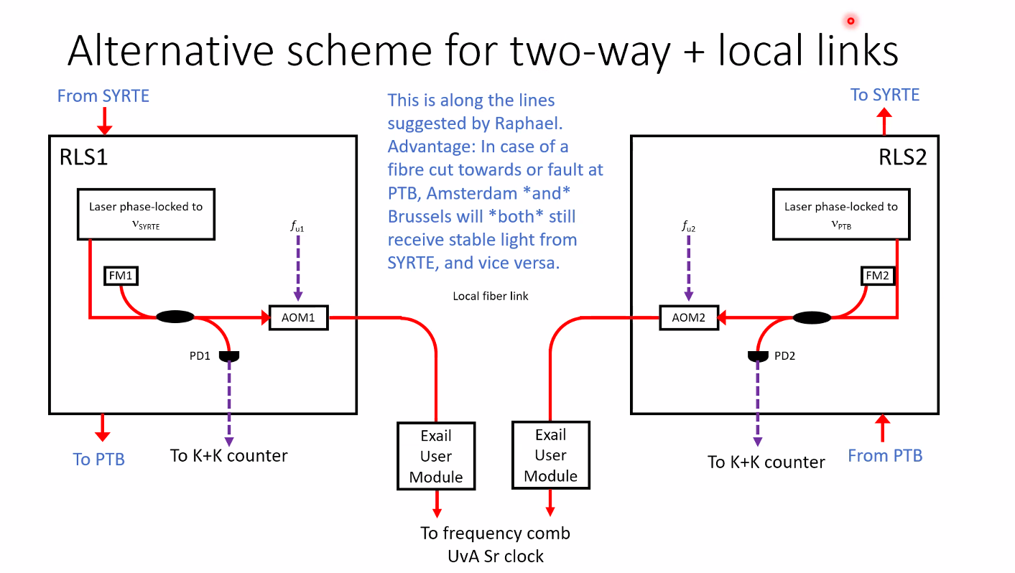

Slide 12


RLS/MLS architecture: types of sites
Site A: MLS with flywheel
Site B: MLS
no flywheel
Site C: RLS
no flywheel
Site D: 2 x RLS
with flywheel
Flywheel
(local)
Actively stabilised link
Laser lock to incoming light
MLS
MLS
RLS
RLS
RLS
uplink
downlink
RLS
Passive interferometer
Actively stabilised link
Local two-way comparison with flywheel
Possible site designs for MLS using two fibre links
Local flywheel at ends of link
Intermediate sites can use MLS to forward frequency if a local flywheel is not needed
Use of two fibres for uplink and downlink
In the case of RLS, two are needed to support the two fibres.

Slide 13
Possible link Paris-Poznan frequency link
Paris
Lille
Brussels
Amsterdam
Braunschweig
MLS
MLS
MLS
RLS
RLS
MLS
RLS
Local two-way
Poznan
In this scenario, only Amsterdam and Braunschweig would report data.
If there are insufficient funds, initially, only the ‘uplinks’ would have to be built (solid thick lines)
If Exail RLS is used, two fibres can be lit, one for frequency transfer and the second fibre for validation.

Slide 14
Possible link Paris-Poznan time link
Paris
Lille
Brussels
Amsterdam
Braunschweig
Poznan
WR
WR
WR
WR
ELSTAB
ELSTAB
 | London | Paris | Lille | Brussels | Amsterdam | Braunschweig | Poznan
London
Paris |  |  |  | Time ch? | Time for SURF/ESA Ch?
Lille
Brussels |  |  |  |  | Time for SURF/ESA Ch?
Amsterdam |  |  |  |  |  | Time for SURF/ESA ch?
Braunschweig
Poznan
Time services are to be agreed between NMIs on an ad-hoc bilateral basis.
An RF and timestamping service is needed locally where WR is deployed
A WR service in France is under construction in collaboration with RENATER. Wavelength to be confirmed.

Slide 15
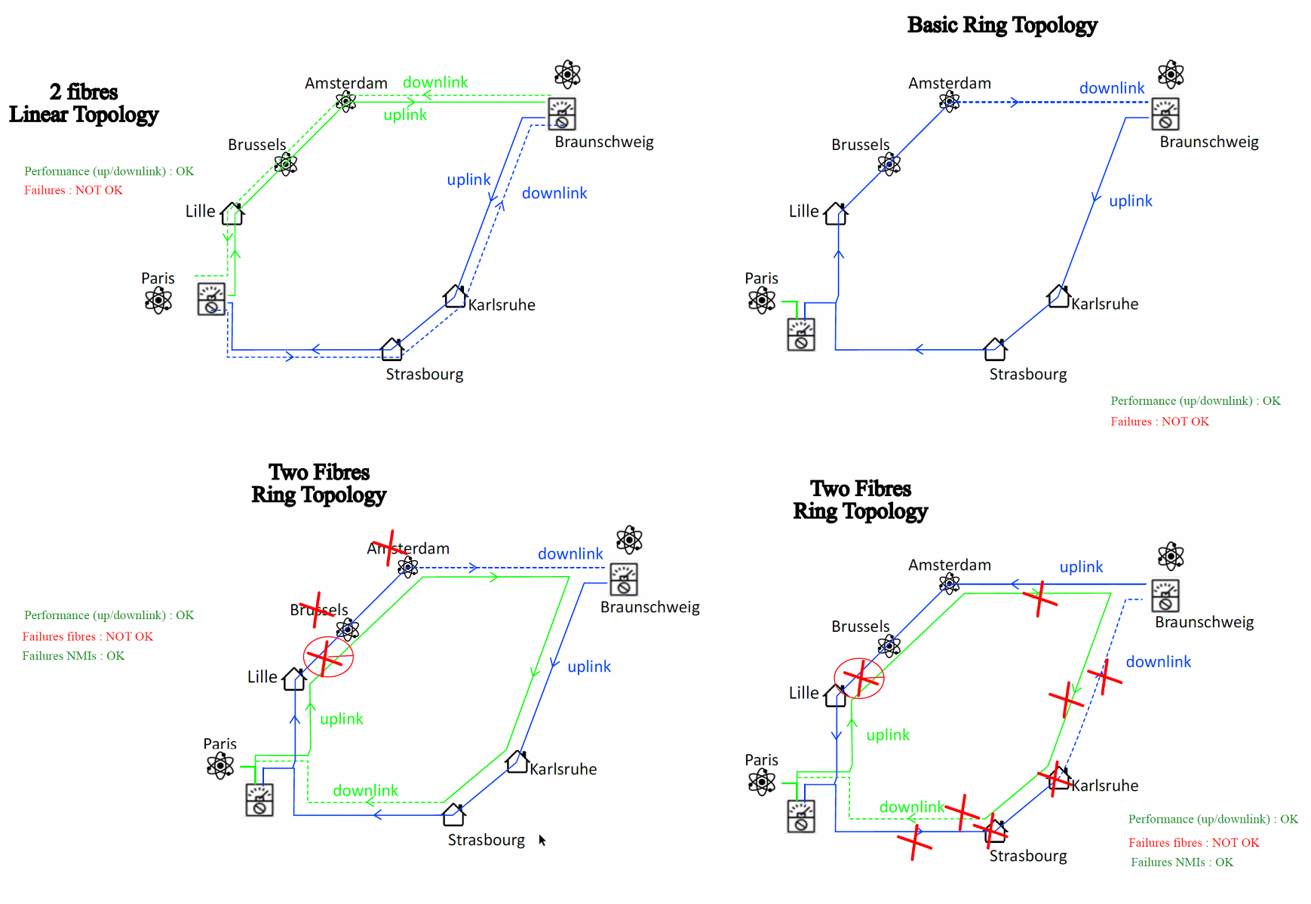
The possibility of utilizing the diverse route Paris -> Braunschweig vai Strasbourg was considered
Due to problems such as the Sagnac effect, this idea has been put aside.

Slide 16
EDFA amplifier specification
Bidirectional EDFA amplifier (no isolators)
Form factor: Two EDFA amplifiers per 1RU chassis with a depth of up to 600mm
Connectors: FC-APC
Power: two feeds of -48VDC
Amplifier gain: 25dB?
Built in optical filters:
  Management: via GE Ethernet port in the O-band
  Should we split the C-band to allow the addition of directional couplers to support higher-power WhiteRabbit signals?
Management Software: web-based browser
APIs: REST, SNMP

Slide 17
Amplifier management
The bi-directional EDFA amplifiers will require out-of-band (OOB) management.
This requires an Ethernet switch at each amplifier site and a filter to allow a 1310nm optics between switches.
Since it is likely that WR switches will be deployed, can we also use these for OOB device management?
Will the wavelength of the filters built-in to the EDFAs be suitable for WR?

Slide 18
Demarcation design and Filter specification
At the demarcation point between GEANT and the NMI a distribution frame and fixed optical filters are recommended.
C-band 100GHz spacing fixed filters
Insertion loss of less than 1.7dB, same insertion loss in each direction.
Connectors: FC-APC
Management channel: 1310nm?

Slide 19
Interconnect agreement
CLONETS C-TFN will consist of two layers, the time/frequency service layer owned and operated by NMIs and the dark fibre transport layer owned and operated by GÉANT and NRENs.
We need an interconnect agreement between NMIs and GÉANT.
Five bilateral agreements are needed:
  GEANT-Refimeve
  GEANT-Observatoire de Brussels
  GEANT-SURF
  GEANT-PTB
  GEANT-PSNC

Slide 20
Interconnect agreement
The interconnect agreements should include the following clauses:
<insert NMI name here> will operate a flywheel function in their NMI. This will include the following equipment (delete as appropriate):
  Hydrogen maser
  Frequency comb
  Frequency comparator
  Reference source (Optical/Cesium)
GEANT will operate a central operations centre on behalf of the C-TFN which will monitor the state of the fibre links and the time/frequency services. GEANT will operate and maintain the dark fibre links that form the C-TFN.
GÉANT will peer with <insert NMI name here>. During the period of GN5-2GÉANT will charge a small nominal interconnection fee will be required to connect to the GÉANT fibre. (The interconnect fee will be charged for the duration of GN5-2. Since the cost of the GÉANT C-TFN will be 100% funded by the EC, this interconnection fee will be a low nominal sum to cover administration costs and the operation of the GÉANT Operations Centre. After 2027 the interconnect fee could rise depending on whether GÉANT can get continuity funding from Horizon Europe.)
Example SLA for NMI: <insert NMI name here> commits to providing a frequency source with < 1E-16 accuracy and a flywheel with an availability of 95%.
Example SLA for GEANT: GÉANT will commit to a 98% availability of the dark fibre links in the GÉANT C-TFN.
Physical interconnection will occur on the GEANT distribution frame in <insert NMI name here> premises. <insert NMI name here> will provide GEANT with a half rack space to install the demarcation equipment: filters and fibre distribution frame.

Slide 21
Next steps
Agree commitments to be made by each participating NMI/NREN
Prepare draft interconnect agreement
Specify the C-band filter
Specify the bi-directional amplifier

Slide 22


Key to symbols
WR
White Rabbit switch
DWDM multiplexer
Research institute
Frequency comb
Flywheel
Frequency counter
NMI Frequency reference
Hut for housing RLS
Regenerator Laser Station

