Slide 1
Consensus design for the northern route of C-TFN
DRAFT – currently a living document!
Based on the discussion at SIG-TFN meeting 23/10/2024

Slide 2

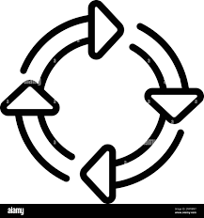
Consensus design
Braunschweig
Amsterdam
Brussels
Lille
Paris
Provided by PTB
Parity must match Karlsruhe
10 MHz from VSL via PTP-WR
Provided by UvA
Provided by UvA
Provided by ROB
Provided by Refimeve
Parity must match Refimeve
Exail MLS -76
(constraint)
or PSNC?
Exail RLS +74
PSNC?
Exail RLS +74
(proposed)
Exail MLS -76
(proposed)
Exail MLS +74
(constraint)
MLS
RLS
RLS
MLS
Data
Data
Data
Data
Link validation
Frequency comparison
Link validation
Link validation

Slide 3
Workaround option
In case or while MLS at Lille is not available
Braunschweig
Amsterdam
Brussels
RLS
MLS
MLS
RLS
Data
Data
Link validation
Link validation

Slide 4
Critical features of the consensus design
Compatible with Refimeve (MLS at Lille)
One MLS at Brussels
Choice and redundancy at Amsterdam

