Slide 1

Establishment of an optical fibre link between NPL and Birmingham University for the purpose of Time & Frequency dissemination
Jacques-Olivier Gaudron
Fibre Links Team (Wei Huang, Namneet Kaur, Reinhard Karembera, Alex Korwin)
GEANT SIG-TFN technical WG
26th July 2024

Slide 2
Agenda
Introduction & Purpose
Setup and signals on the link
Link optimisation
Link monitoring
Conclusion and future work

Slide 3
Introduction & purpose
Research: Currently NPL is developing optical atomic clocks, but these are only compared with European partners on a sporadic basis.
  > Need for more distributed development and ability to compare clocks more regularly, particularly in light of the SI second redefinition.
Infrastructure: Resilience > GNSS is vulnerable to external threats such as Jamming, Spoofing, Meaconing but also environmental changes. All these are discussed in detail in the Blackett review. Optical fibre links are one way of building resilience in T&F dissemination.
Future Industry: The current Frequency standard based on Caesium fountains has a performance that is at least 1 order of magnitude worse than Optical atomic clocks, interest in WR, PTP.

Slide 4
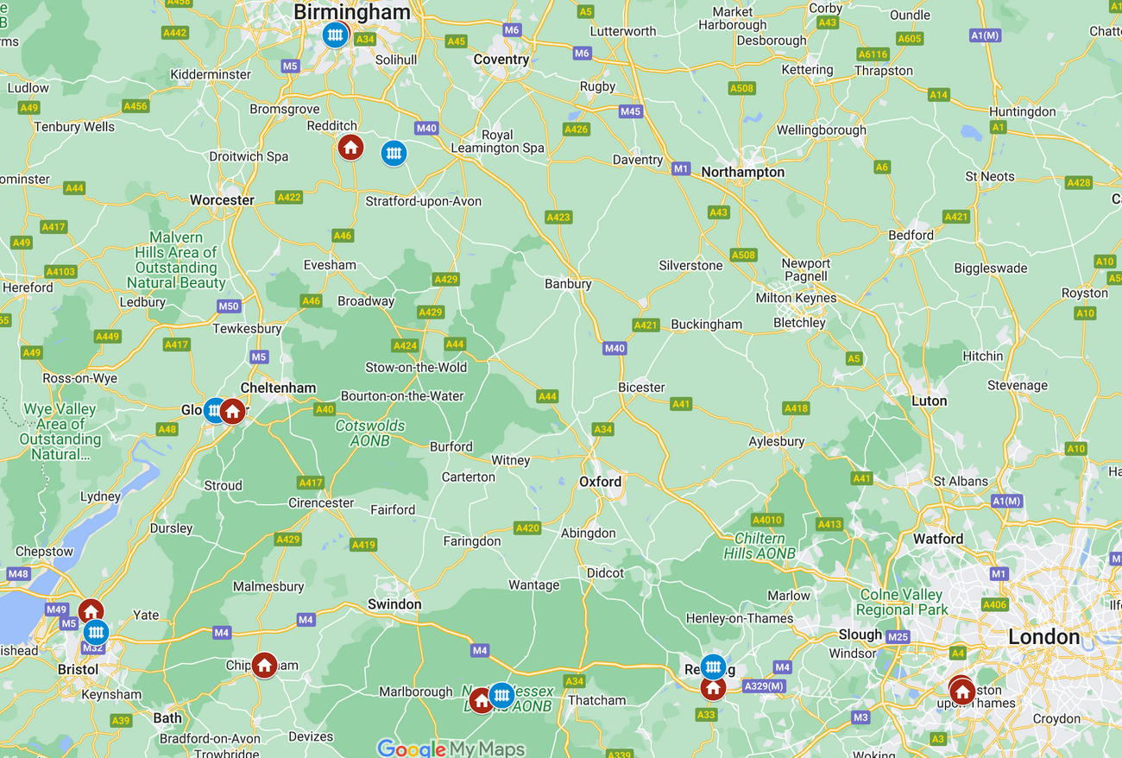
1. Geographical Overview
2 dark fibres
6 colocations sites located every 40 to 60km with selective filtering (DWDM) and bidirectional amplification
Overall fibre length: ~ 380km
CONFIDENTIAL

Slide 5
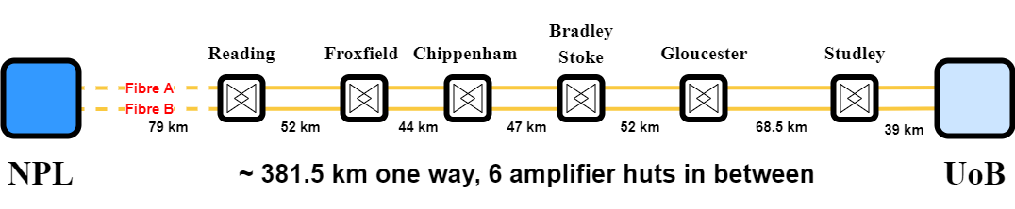
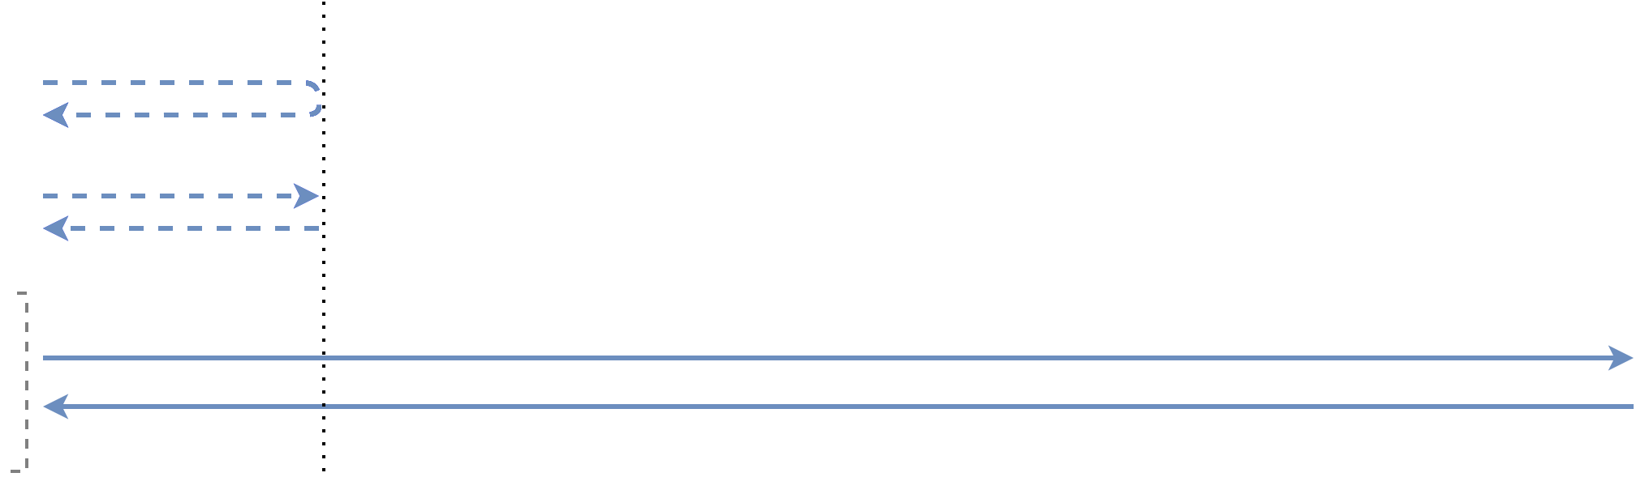
1. Signals on the link
Seismic detection & environmental
monitoring
NPLTime®
Optical carrier
UTC(NPL) 1PPS
& 10MHz
Time of day via
White Rabbit
Monitoring
Signals share a single fibre based on Dense Wavelength-Division Multiplexing (DWDM) technique.

Slide 6
1. Setup
ELSTAB 10MHz & 1pps from MASER
@channels 39 to 42
Housed
at NPL
Housed at
University
of Birmingham
REMOTE ELSTAB 10MHz & 1pps @channels 39 to 42
Spans
Co-locations
Management (control of equipment along link)
@ channels 73 to 99
Management (control of equipment along link) @ channels 73 to 99
Wavelength division
multiplexing
Network Switch & Optical amplifiers
Network Switch & Optical amplifiers
Wavelength
division DE-multiplexing
C-Band Ultra-stable laser
@ channel 44
C-Band Ultra-stable laser signal @ channel 44
L-Band
Laser source
@ channel 7
Pair of optical fibres (length c. 380km x 2)
L-Band
Laser signal @ channel 7
Note: The term channel is widely used in the telecoms industry to refer to a particular wavelength of light, it is standardised by the ITU
(International Telecommunications Union) standards

Slide 7
1. Setup (OC only)
N+1 Fibre link
Fibre A (or 1) DISSEMINATION Overall length c. 380km
T1 Laser locked to 1064nm ultrastable cavity via Comb
Fibre length c. 5m
Reading
ELSTAB
amplifier
Studley
ELSTAB
amplifier
N_In
N_+1_Out
ByPass_Out
RLS
76MHz
(NPL)
Amplifiers & spans
N_In
N_+1_Out
ByPass_In
Studley
Keopsys
amplifier
ByPass_Out
User_Out
Reading
Keopsys
amplifier
RLS
74MHz
(B’ham)
Beat_User_Out
ByPass_In
User_Out
RF Amplifier
75MHz
BP filter
Fibre B (or 2) MONITORING
Overall length c. 380km
User in Birmingham
Notes:
Here I am using RLS because I had this slide before and want to keep simple

Slide 8
2. DWDM allocation
Amplifier passband | Amplifier stopband
Beyond Reading | Fibre 1 or A | Fibre 2 or B
Ch. # / λ nm | OBA-3 | Keopsys
38 / 1546.92
39 / 1546.12 | ELSTAB Monitoring
40 / 1545.32 | ELSTAB Dissemination
41 / 1544.53 | ELSTAB Dissemination
42 / 1543.73 | ELSTAB Monitoring
43 / 1542.94 | Seismic Beppe | Seismic Beppe
44 / 1542.14 | OC Dissemination | OC Monitoring
45 / 1541.35 | White Rabbit Dissemination
46 / 1540.56 |  | White Rabbit Monitoring
47 / 1539.77
48 / 1538.98

Slide 9
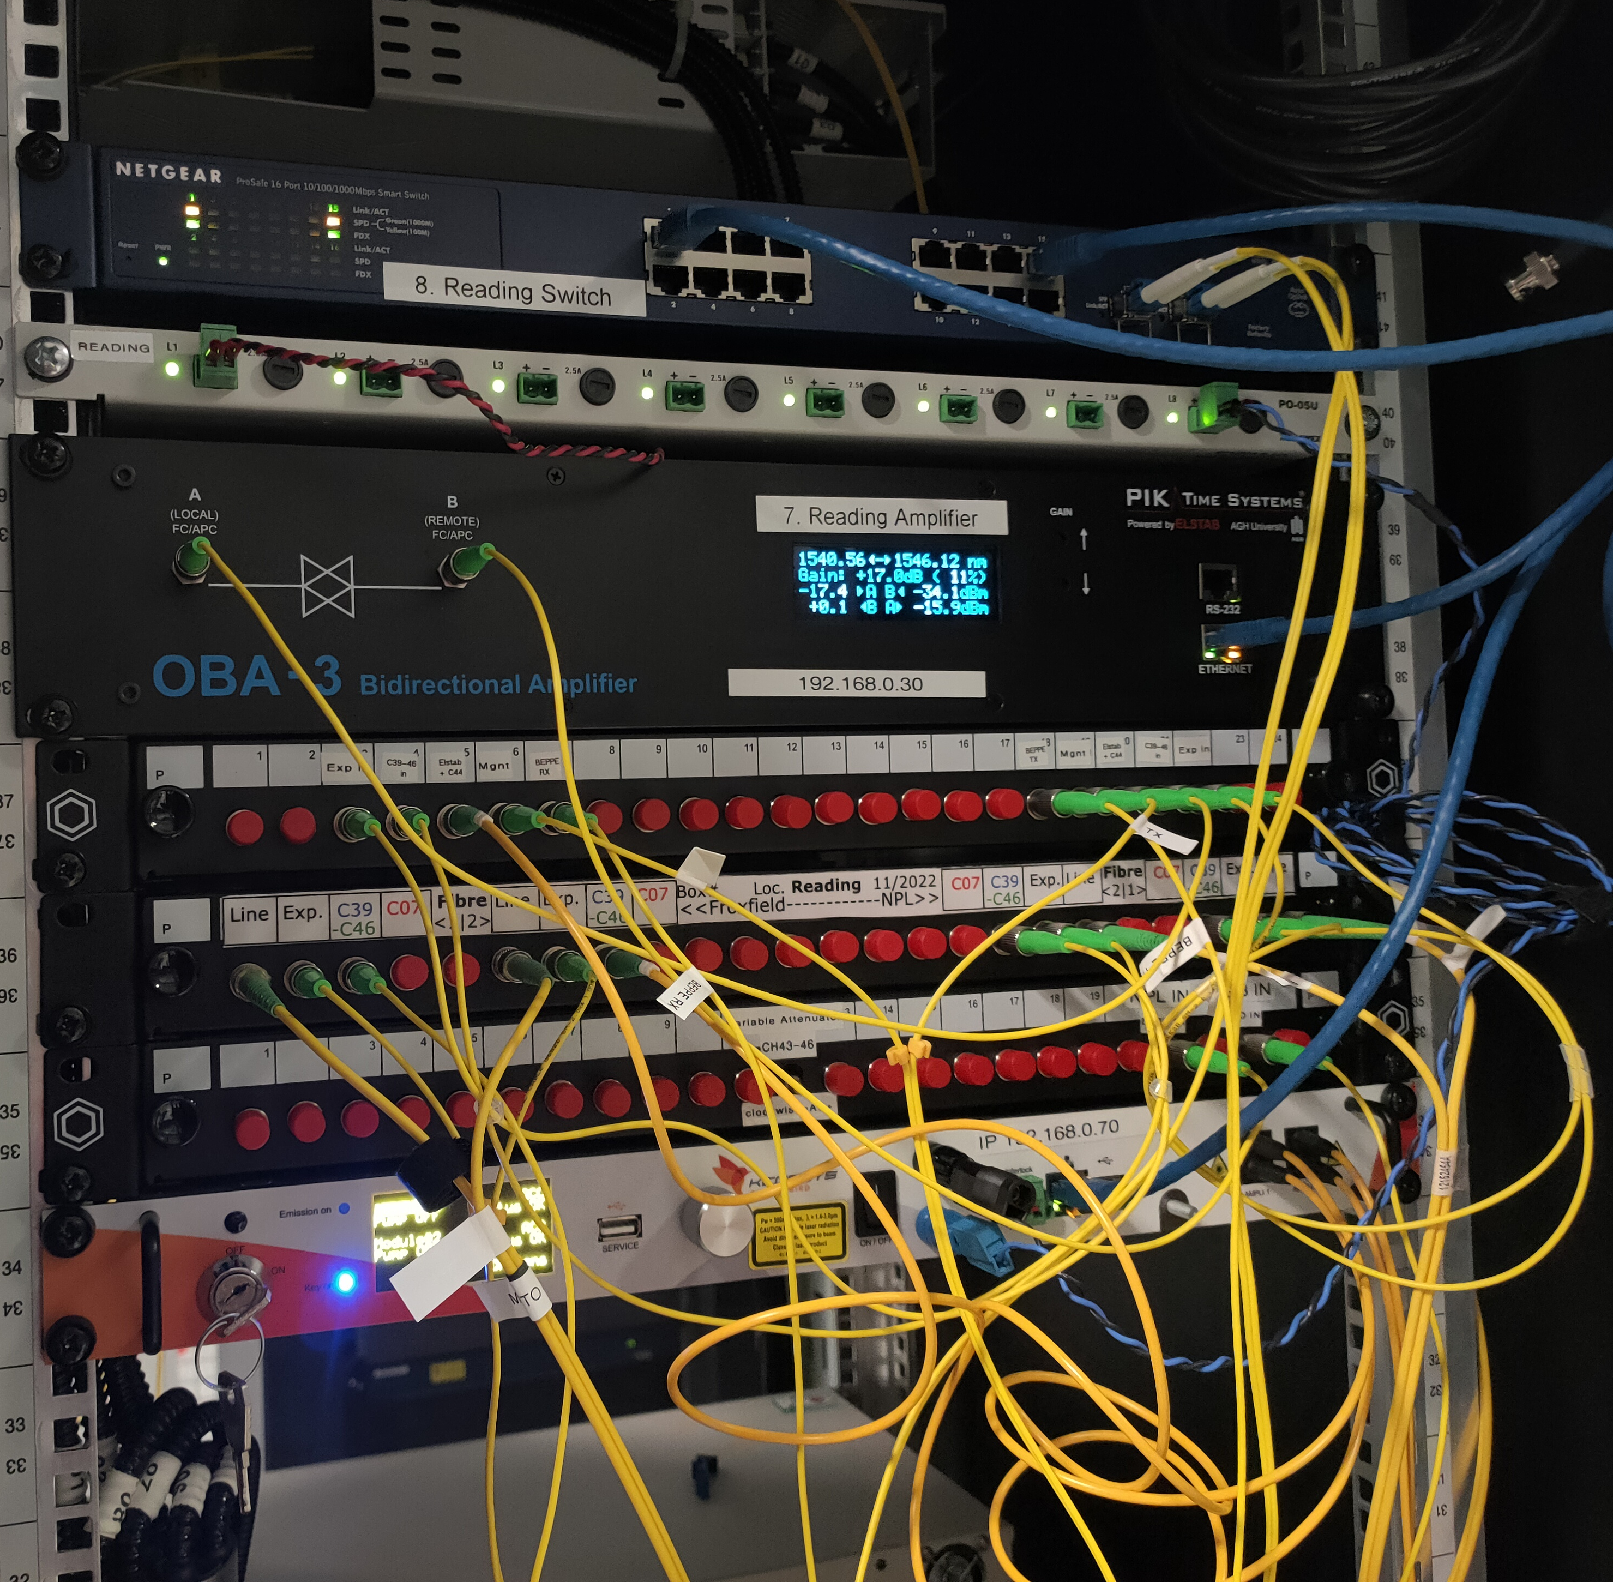
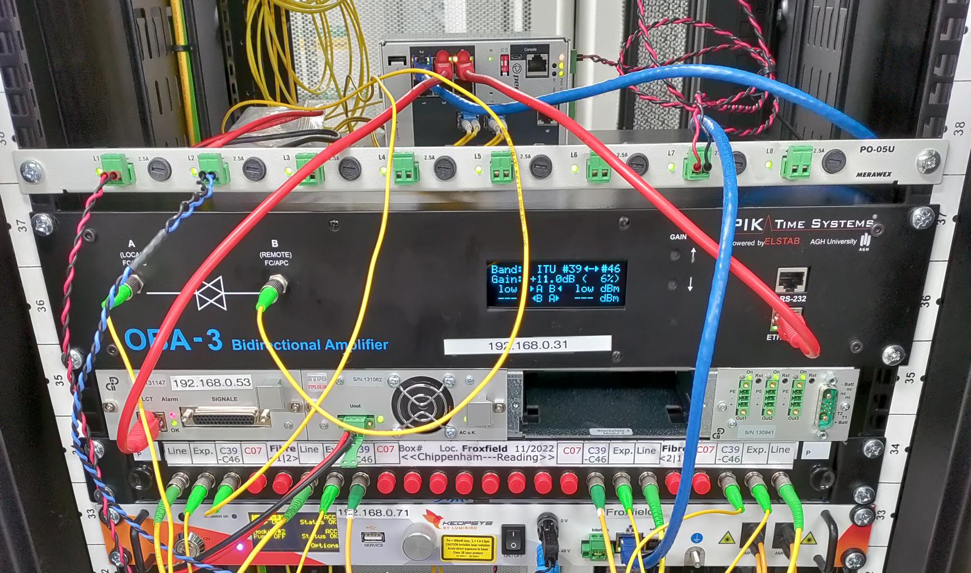
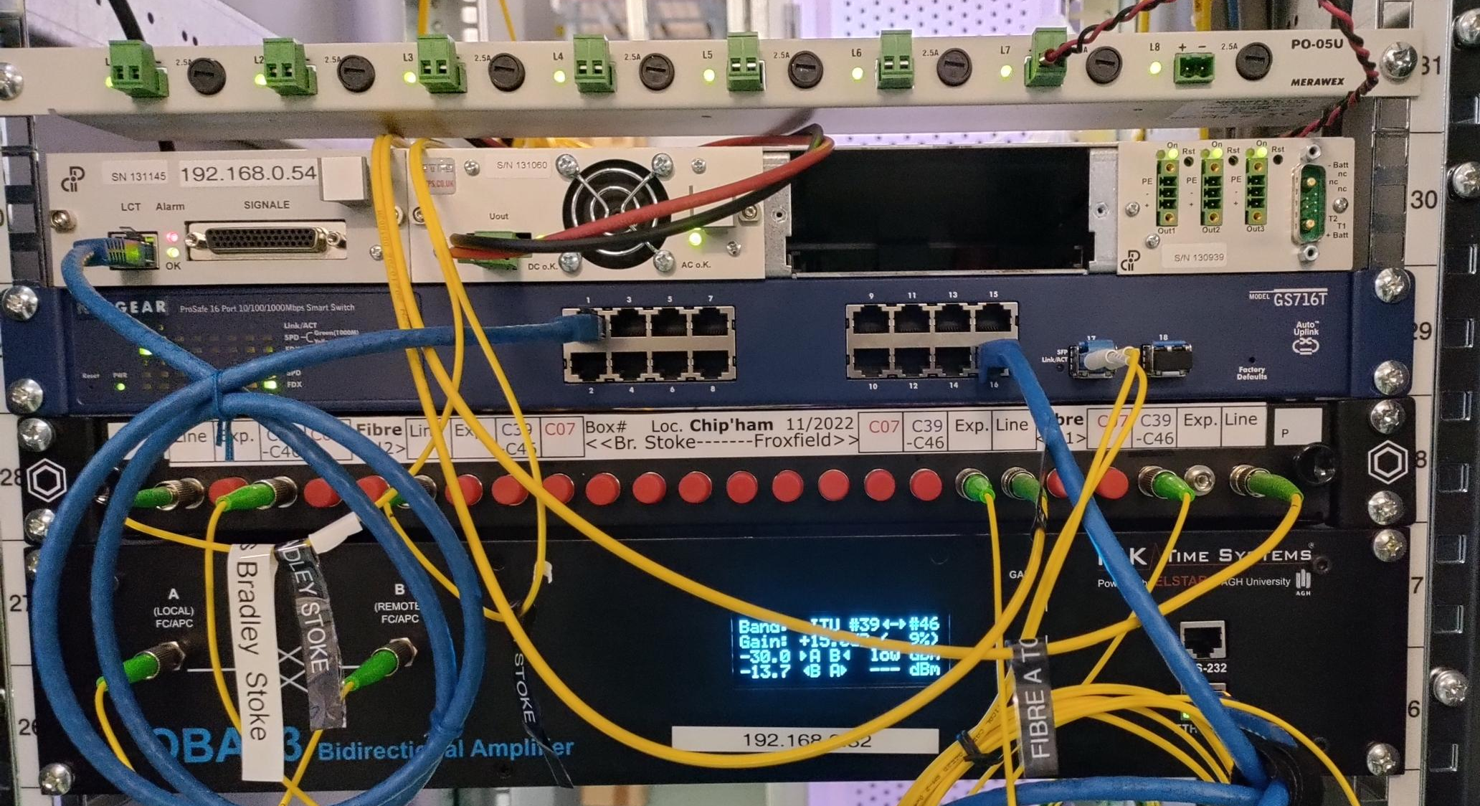
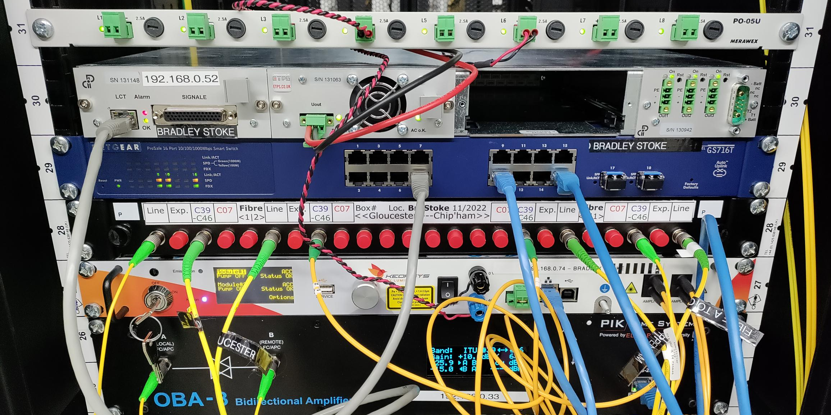
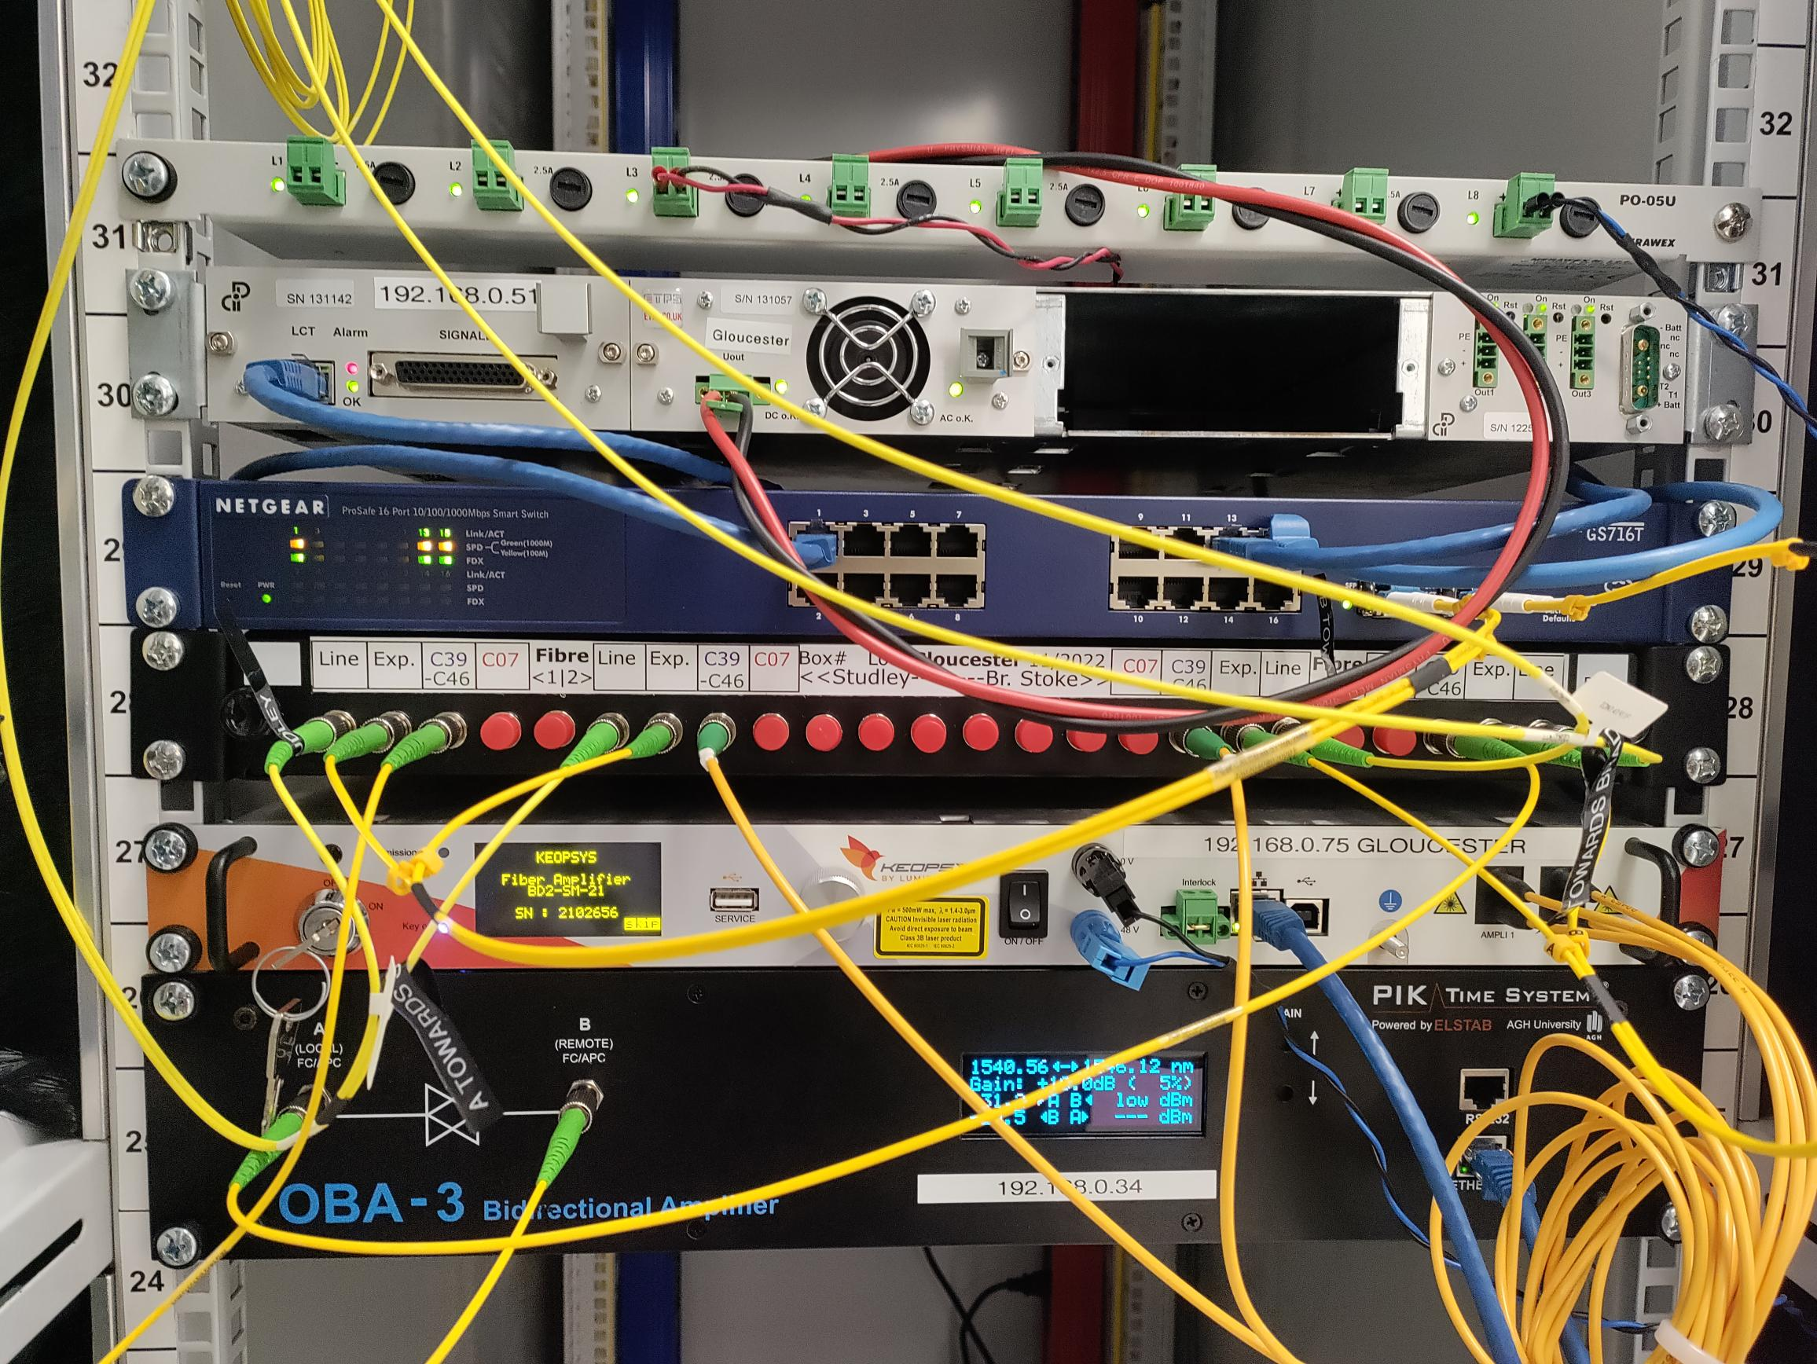
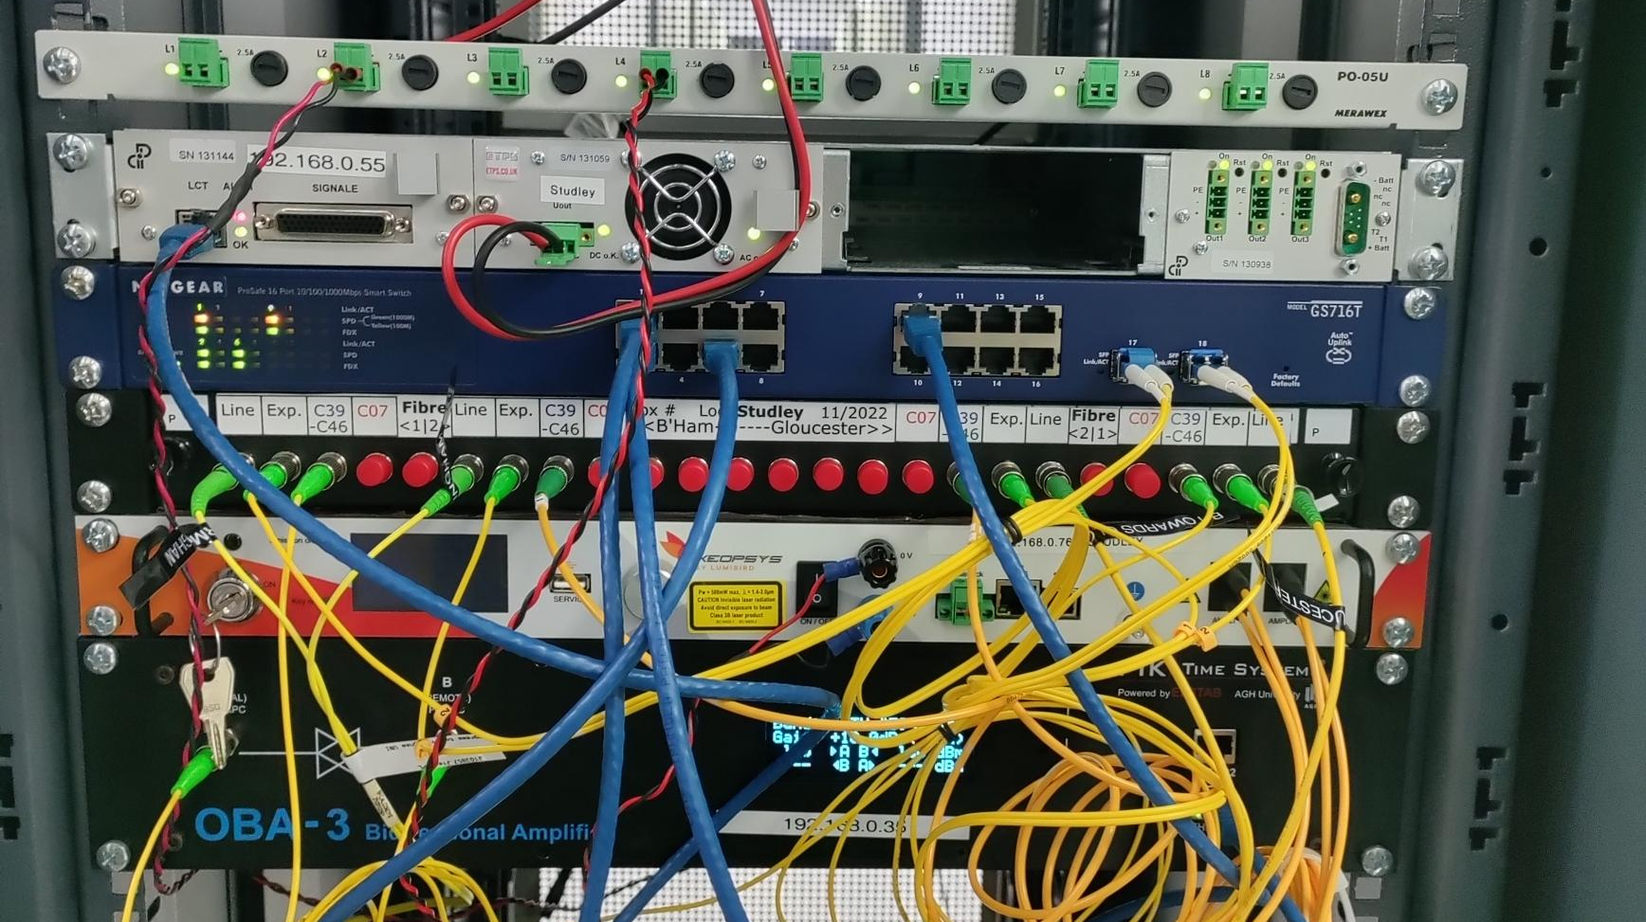
2. Installation status
NPL
Reading
Froxfield
Chippenham
B’Ham
Bradley Stoke
Gloucester
Studley

Slide 10
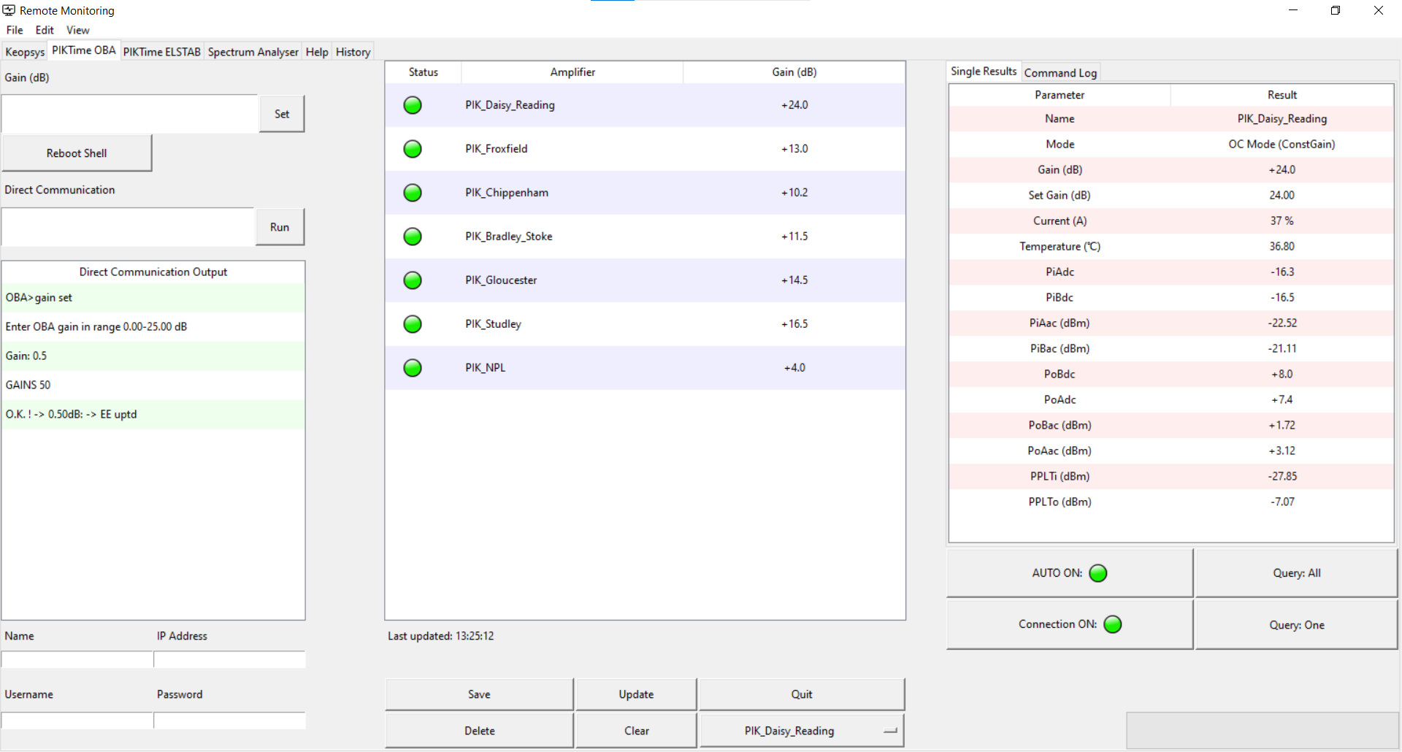
Link monitoring
Remote monitoring and control GUI for:
OBA-3 amps
Keopsys amplifier
ELSTAB modules
Spectrum Analyser
Scope to add
instruments in future.
Log file keeping a record of faults, uptime etc.
Note: All remotely connected devices are interrogated every 15 minutes, and all data is saved in the server.
In case of fault an email is sent with details of location.
!!! Recent fault (broken fibre) was detected within 3 mins and fixed the same day.

Slide 11
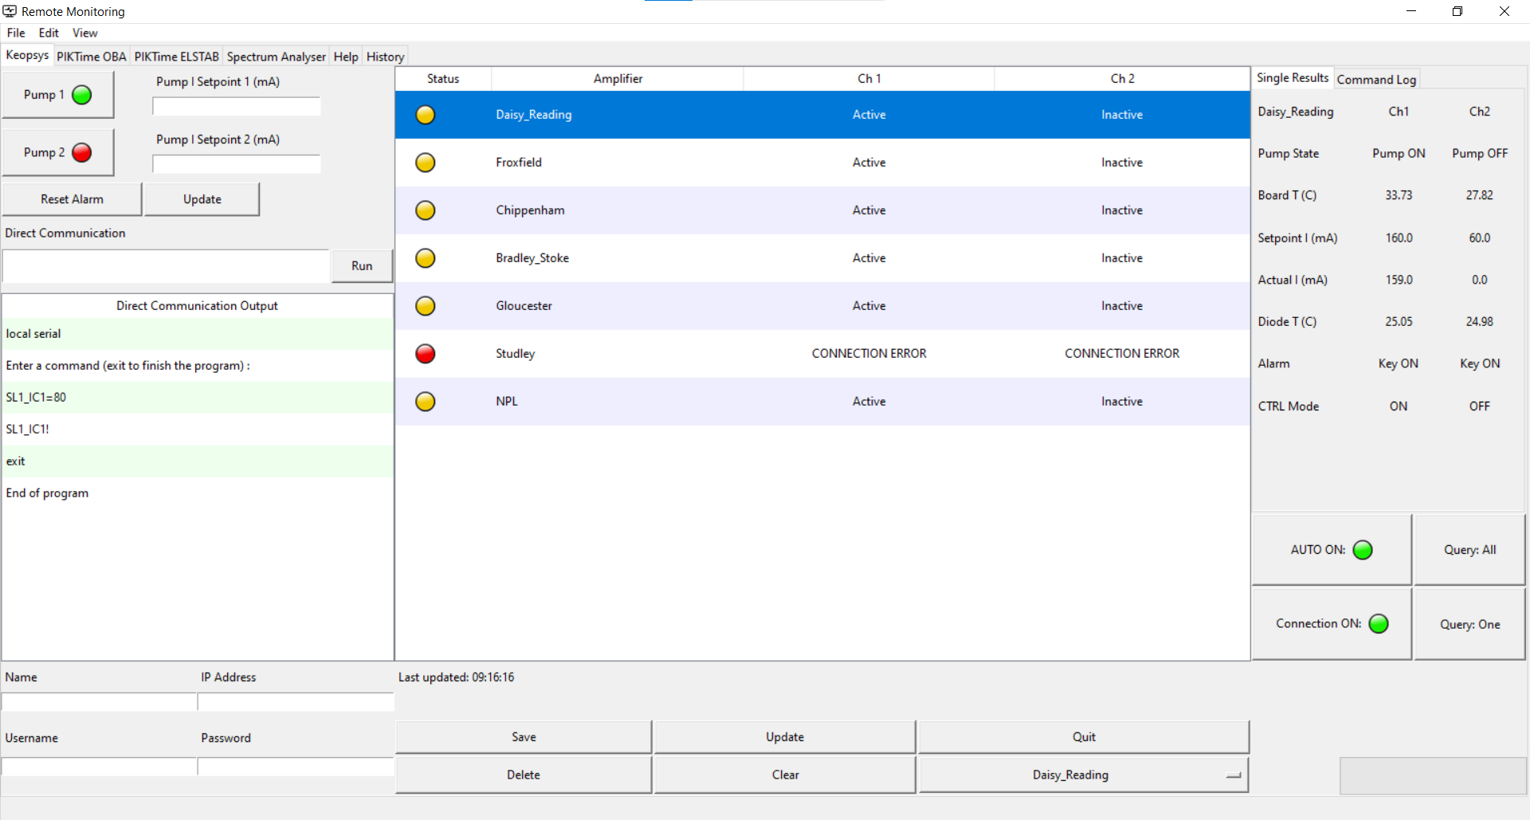
Link monitoring
Status of EDFAs on link
Amplifier parameters
Menu Bar
Tab Menu
Run commands if you INSIST on using Shell…
Time of last query for selected amplifier
Monitoring options
Close software, stop monitoring threads
Configuration options

Slide 12
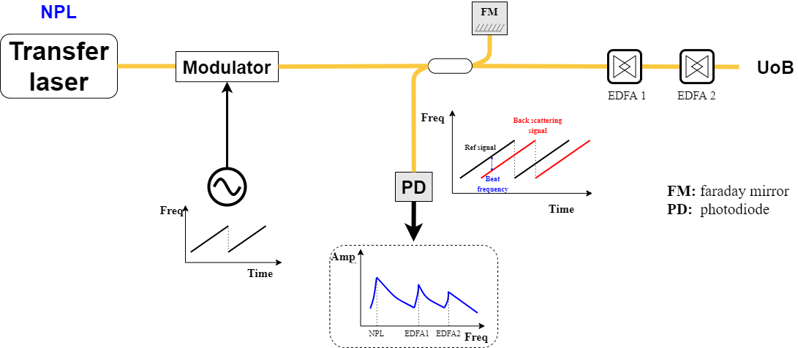
Link monitoring (OFDR*)
*Optical Frequency Domain Reflectometry
Frequency
Modulated signal
Sawtooth generator now controlled by a SDR (Software Defined Radio)
Spectrum Analyser signal
$$Distance≈\frac{freq∗2e^{8}}{2∗slope}$$

Slide 13
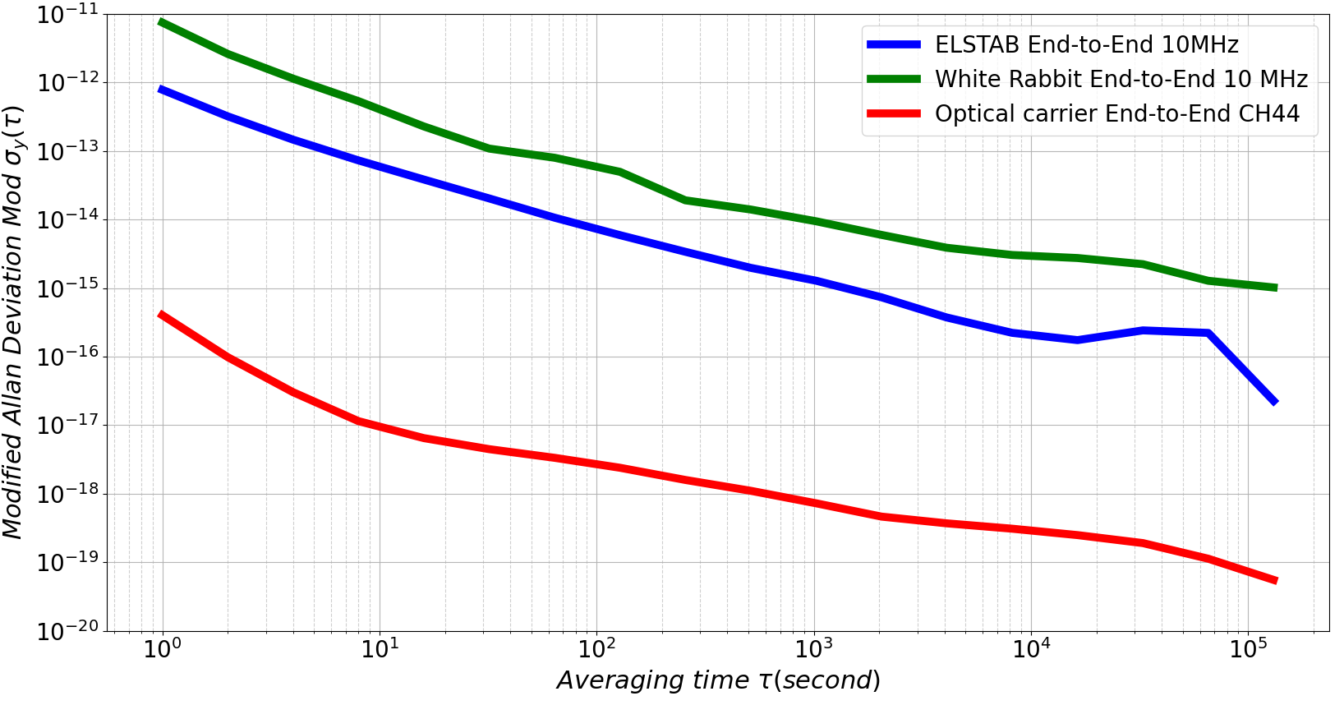


Link performance 7th to 15th June 2024
Up times
ELSTAB: 99.97%
White Rabbit: 98.63%
Optical carrier: 96.71%
$${10}^{−16}$$
$${10}^{−19}$$
Notes:
WSI for White Rabbit? Signal reflection in Fibre A? Interference?

Slide 14
Conclusion and future work
Work done: T&F signals are ready to use via London-Birmingham link:
  Optical Carrier (OC) > Syntonisation
  ELSTAB > Synchronisation once calibrated
  White Rabbit > Time of day
Future work:
  Devise method for gain optimisation for both OC & ELSTAB
  Upgrade hardware for White Rabbit
  Build a small form factor OFDR
  Real-time calibration on 1 PPS signals
  L band optical carrier distribution (on Ch7), enabling use of Dark Channels
  And more

