Slide 1
End-to-end link design
Jeroen Koelemeij, VU Amsterdam
Work in progress – open to comments
Dec 5, 2024 (v0)

Slide 2
Considerations a priori
Considering a system of integrated time and (ultrastable) frequency transfer:
What types of intermediate amplification+regeneration stages may be needed? => examples in document JHK Dec 5 (v3)
  Depends on link budget, amplifier/regenerator characteristics => see slide 6
What types of band/xWDM filters are compatible with these stages?
  Available calibration procedures (asymmetrical delays due to equipment, chromatic dispersion)
  Service independence (swap broken device/component with minimal impact on other services)
Having time links in both fibers of the pair greatly simplifies delay calibration

Slide 3
Link budget and noise figure
C-TFN may have multiple types of amplifiers/regenerators at a given site
Relevant design parameters:
  Gain
  Minimum required input power level => one of OC/WR/Elstab will be bottleneck
  Stability of cascaded WR devices (=cascaded PLLs) => constraint on number of intermediate WR devices
  Noise figure
  Rx sensitivity end node (-60 dBm RLS, -40 dBm WR)
Expectation: amplifier noise figure of lesser importance (scales sublinearly with number of amps, while link instability increases with length^{3/2}, and link instability dominates over amplifier noise for link lengths > 10 km)
WR: high ‘gain’ (close to 40 dB) if using WR repeaters or OEO repeaters ⬄ mismatch with ` 20 dB gain of bidirectional EDFAs
Can reduce WR ‘gain’, but at expense of more intermediate repeaters
  WR switches as repeaters: cascaded PLLs, access to critical time infrastructure in less controlled sites, ‘NMI gear’ in GÉANT domain
  WR OEOs: no PLLs, no access to WR network, no NMI gear but part of GÉANT infrastructure

Slide 4
Asymmetrical delays and delay calibration
Time links must have calibrated forward and backward delays, so that:
All asymmetrical equipment/component delays must be known prior to installation and stored in a read-only, digitally accessible delay register (DR)
  xWDM filters
  XskipY bandpass if one wants to allow WR or other time link to run over different XskipY bands (see slides 4/5)
  Avoid use of term ‘delay asymmetry’ – one really needs to know the asymmetrical delay (total forward and backward delays as opposed to differential delay)
  Interface between DR and WR, ELSTAB devices needed, to automatically correct for asymmetrical delays
  WR switches: absolute calibration or relative calibration (requires ‘golden calibrator pair’)?
Installed equipment & components must be traceable to DR (location, orientation)
  With adequate bookkeeping and automation, ‘mixed’ asymmetrical delays could be tolerated (e.g. ELSTAB depending on asymmetrical delays of WR repeater).
Spare equipment/components must be calibrated a priori
DR must be updated at the time of replacement of equipment/components

Slide 5
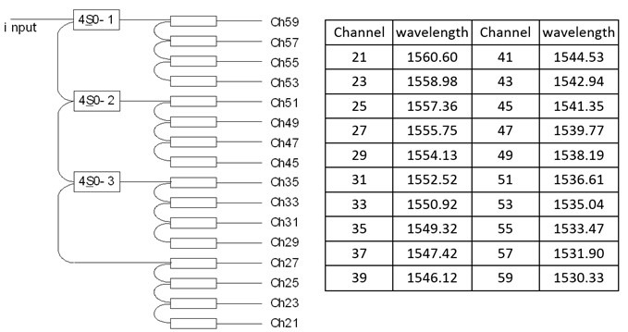
Potential asymmetrical delays XskipY filter
Example: WR 4skip0 filter (Iridian)
Can choose not to calibrate delays XskipY => allows ‘intra-band’ WR lambdas only
Asymmetrical delay of only DWDM filters needs be known
Tx
Rx
WRS
Amplifier
WRS
Rx
Tx

Slide 6
Potential asymmetrical delays XskipY filter
Example: WR 4skip0 filter (Iridian)
With calibrated delays of XskipY, ‘cross band’ time links become possible
Asymmetrical delay of DWDM and XskipY filters needs be known
Tx
Rx
WRS
WRS
Amplifier
Rx
Tx
Past experience proves that seemingly irrelevant delays may unexpectedly become relevant at a later time – see slides 7-10

Slide 7
Why total delay instead of differential delay
From: Koelemeij, Pinkert, Dierikx, Peek, Van Tour, Smets; PTTI Monterey CA, USA (2017).
Note: this is NOT a proposed method for C-TFN. It is just an example of how irrelevant delays may become relevant at some point.

Slide 8
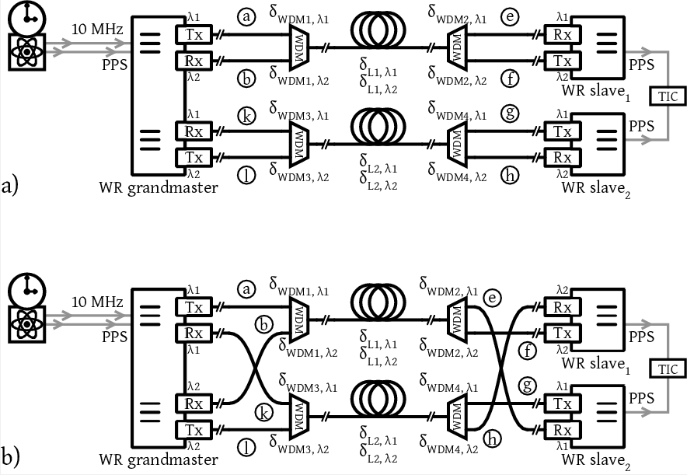
In-situ α calibration
δ_{ampl,λ1}
SOA
WDM
WDM
δ_{ampl,λ2}
SOA
δ_{ampl,λ2}
SOA
WDM
WDM
δ_{ampl,λ1}
SOA
δ_{ampl,λ1}
SOA
WDM
WDM
δ_{ampl,λ2}
SOA
δ_{ampl,λ2}
SOA
WDM
WDM
δ_{ampl,λ1}
SOA

Slide 9
In-situ α calibration
δ_{ampl,λ1}
SOA
WDM
WDM
δ_{ampl,λ2}
SOA
δ_{ampl,λ2}
SOA
WDM
WDM
δ_{ampl,λ1}
SOA
Configuration changes only needed at end nodes – leave fiber link unaltered!
δ_{ampl,λ1}
SOA
WDM
WDM
δ_{ampl,λ2}
SOA
δ_{ampl,λ2}
SOA
WDM
WDM
δ_{ampl,λ1}
SOA

Slide 10
In-situ α calibration
δ_{ampl,λ1}
SOA
Method requires total forward and backward delays amplifiers
Fractional RTT difference gives us α a
  Assumption: fibers have same dispersion properties
WDM
WDM
δ_{ampl,λ2}
SOA
δ_{ampl,λ2}
SOA
WDM
WDM
δ_{ampl,λ1}
SOA
δ_{ampl,λ1}
SOA
WDM
WDM
δ_{ampl,λ2}
SOA
δ_{ampl,λ2}
SOA
WDM
WDM
δ_{ampl,λ1}
SOA

