Slide 1
Trust & Identity Whitepaper
Ann Harding, Nicole Harris, Marina Adomeit, Licia Florio, Klaas Wierenga
T&I Meeting, Amsterdam
7/12/2017

Slide 2
Timeline for GN4-3 submission
Find out what we want to do
… - Dec 2017
Get NRENs feedback
+ NIFs for missing ideas
Jan-Feb 2018
Select the GN4-3 project elements
Mar 2018
Write the Work Packages
Apr – Jul 2018
Finalise – Submit GN4-3
Sep – Oct 2018
White Papers phase (Sep 2017 – Feb 2018)
  Write White papers, incorporating input from user requirements gathering using PLM, Quality Control and NRENs’ review
    NRENs will provide feedback to white papers mid Jan 2018 – Feb 2018 + NIFs if something is missing
    the body of each White Paper will be max 10 pages & that the assessment process will be based on short templates giving a general roadmap, budget and milestones
Selection of project elements phase (Mar – Apr 2018)
  Assess the contents of the White papers taking into account the feedback from the NRENs, based on NRENs’ levels of interest
Detailed GN4-3 Planning, Budgeting & Recruitment phase (May – July 2018)
GN4-3 Proposal writing & Submission phase (July – September 2018, to be submitted Q3 2018)
5

Slide 3
White Papers
Topic areas and main editors for initial White paper phase
1. Network
  Network Architectures & Services and Tools (including global connectivity & multi-domain services/ network monitoring, management and performance verification)
  Editors: Shaun Cairns, Ivana Golub, Afrodite Sevasti
2. Security & Privacy
  Editors: Sigita Jurkynaite, Alf Moens, Steve Kennett
3. Trust & Identity
  Editors: Klaas Wierenga, Ann Harding, Licia Florio, Nicole Harris
4. Application Services and Clouds
  Editors: Andres Steijaert, Peter Szegedi
5. General services
  Part A: Software development
  Editors: Marcin Wolski
  Part B: Operations ( i.e. general first line support), procurement, PLM, Legal, IPR, Project Management
  Editors: Toby Rodwell, Paul Rouse, Marina Adomeit
6. User, Community, Outreach (incl. open calls, other e-infrastructures) and Human Capital Development
  Editors: Cathrin Stover, Annabel Grant
7

Slide 4
Trust and Identity White Paper
High-level Areas
Consultation Plans
eduGAIN Operations
  eduGAIN Core Operations
  Discovery
eduGAIN Maturity
eduGAIN Disruptive
  OIDC
  Evolution of metadata Management
  eIDAS
Above and below eduGAIN
  eduTEAMS Service Delivery, Operations and Continuous Service Improvements
  inAcademia - Business Process development & transition to service
  Federation as a Service - Service Delivery, refocus, integration of campus IdP
  Step-up Authentication and Identity Assurance
eduroam
Certificates
Fundamental infrastructure
Carried out so far
  Post-it exercise at Symposium.
  RDA workshop
  eduGAIN & eduroam SG calls for ideas
  Session(s) at Internet2 Technology Exchange.
  AARC Meeting.
  DI4R / FIM4R.
Pending
  Consolidation at T&I leaders meeting.
  eduGAIN TownHall / REFEDS meeting.
Final editors meeting (December).
(links in whitepaper)

Slide 5
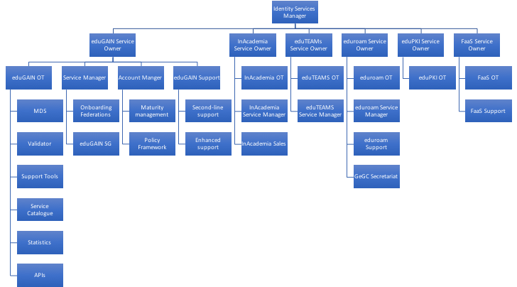
eduGAIN Operations

Slide 6
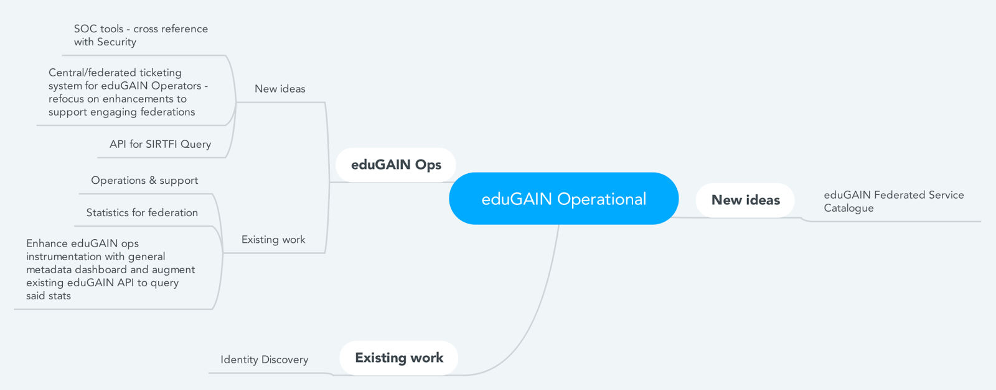
eduGAIN Operations

Slide 7

eduGAIN Maturity
Response Testing for Security Contacts.
Developing the eduGAIN technical database further to flag maturity for federations / entities based on the eduGAIN Best Current Practice documentation.
Working with external registries (such as a PEER registry?) for community-based aggregates.
Developing processes to allow MDS to select the most mature entity formulation within federations rather than simply the first submitted.
Working with eduGAIN on flagged errors and warnings.
Standardise metadata registration and publication across eduGAIN federations.
Service Catalogue.

Slide 8
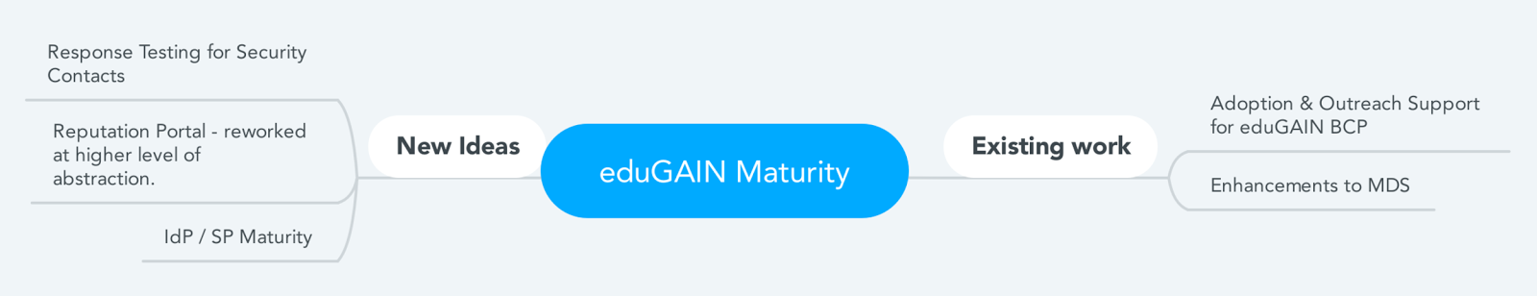
eduGAIN Maturity

Slide 9
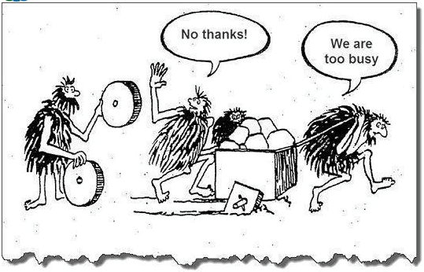
eduGAIN Disruptive
Why?
ID Feds/eduGAIN work but:
  Attribute release is still problematic
  Federated access for non-web services not really solved
  Metadata mng could be more dynamic
eIDAS – promise to deliver eIDS to all EU member states by mid 2019
  Why running an IdP if institutions can use gov eIDs?
OIDC is already the preferred choice for services:
  ID Fed are/will implement interface for it
  Expected to handle metadata more efficiently

Slide 10
eduGAIN Disruptive
What ?
What’s the impact on eduGAIN ?
If IdPs become attr prov, how do we discover them?
MDQ not sufficiently mature yet – will it be mature by mid 2019?
OIDC we need to turn it into an opportunity to gain more services that are no in eduGAIN to date.

Slide 11
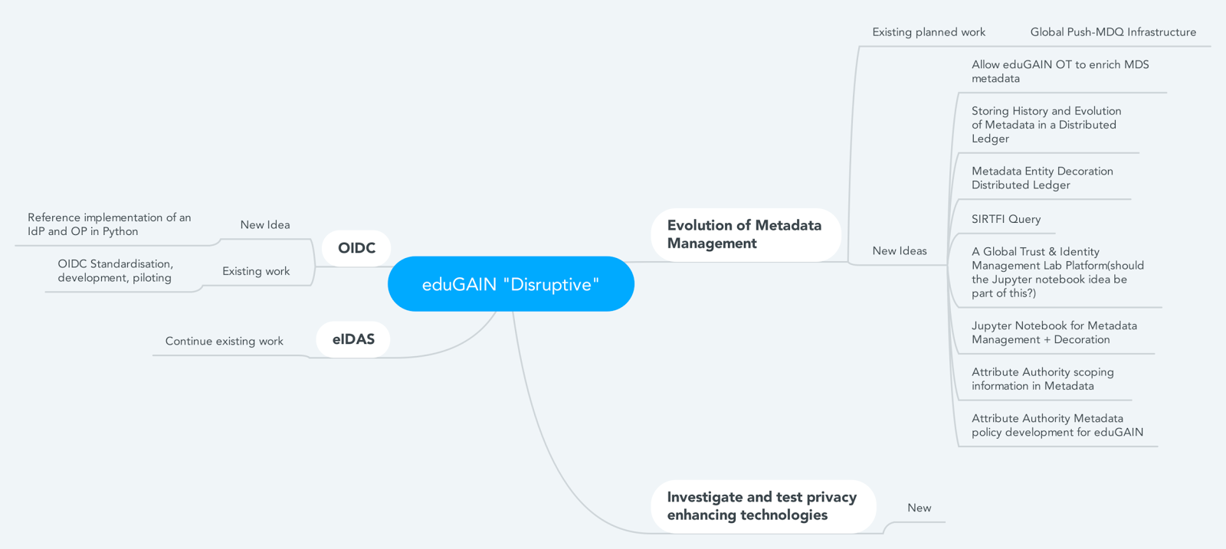
eduGAIN Disruptive
What

Slide 12

Above and below eduGAIN
Why?
eduGAIN speaks for itself
  But it is not one of these
To participate, some infrastructure is needed
  Federation
  Campus
Sometimes eduGAIN is not enough
  Additional sources of attributes
  Groups
  Assurance
Sometimes eduGAIN is too much
  Only want validation

Slide 13
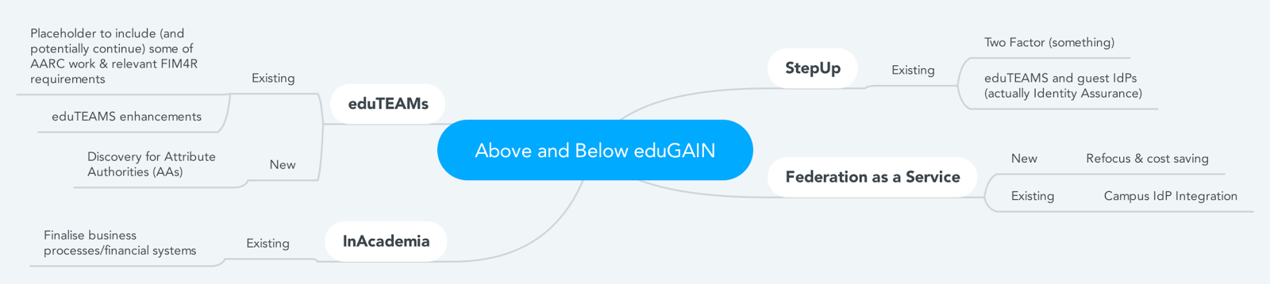
Above and below eduGAIN
What?

Slide 14
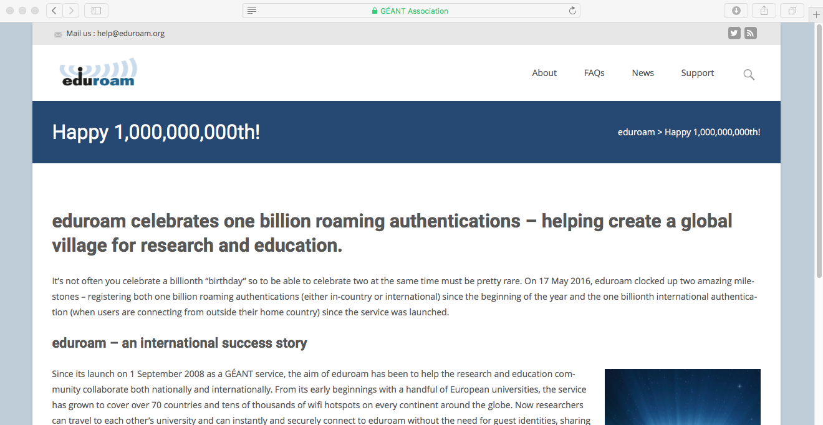
Above and below eduGAIN eduroam
Why
Continue to improve the service.
Address problems with adoption:
  End-users
  (small) IdPs
  SPs
Deal with emerging WiFi deployments
  City WiFi
  govroam
  Hotspot 2.0

Slide 15
Above and below eduGAIN
What?

Slide 16

Certificates
Why?
We do need certificates/PKI for nearly everything
GÉANT/NRENs offer certificates services for years
  TCS, eduPKI, ettc
New technologies and pilots/services:
  Certificate transparencies
  Certbot/Let’s Encrypt, letsradsec
Shouldn’t we consider this area in a more strategic way?
  Only want validation

Slide 17
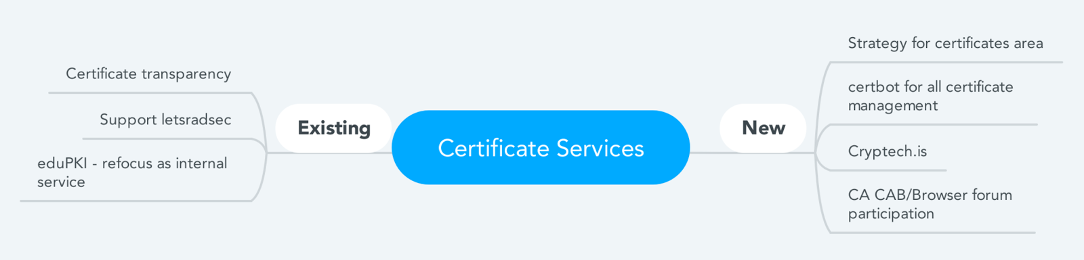
Certificates
What

Slide 18
Certificates
Proposal
Operations of existing services Y1-Y4
Formulation of strategy Y1
Complete/support completion of transition to service of letsrasec and certificate transparency Y1-2
Y2-4 Implement any changes in existing portfolio based on outcome of strategy.
Can we formulate the strategy in 2018?
  Create a task-force
  Use the result to inform the work in GN4-3

Slide 19
Fundamental infrastructure
Why?
Portfolio of T&I services is expanding to a point where establishing a set of internal core services to support the IT operations control is a necessity
Benefits of this approach are:
  Strengthens the service ownership by fostering the operational practices across different service operators and makes services more manageable.
  Lowers the burden on the service operational teams
  Enables the harmonisation and unification of services operations.
  Potential savings on the operational costs by grouping the common functions.

Slide 20
Fundamental infrastructure
What?
Resource inventory – the master repository with basic data about all infrastructure and resources used for services delivery
Platform for service monitoring - provide basic monitoring of availability and performance parameters, provides alerting function, collects history data necessary for reports and capacity management
Centralized logging targets - similar, have insight. This is more proactive rather than reactive.
Solution for backup & restore and archive – enhances the reliability of the services and underpins the SLA and OLA
Service Desk and ticketing system - support the common requirements for first level support for services;
Source code repository (non-public and public) – stores the operational data such as configurations, scripts, deployment automation recipes etc.
PKI requirements - includes eduPKI which should be rebranded as internal supporting service (mostly for eduroam now)
Key signing requirements - investigate the common requirements of FaaS, eduGAIN, Managed eduroam IdP
VMs –arrange the virtual machines for operating services in production and pilot.

