Slide 1
15th Special Interest Group on Cloud Interoperable Software Stacks
(SIG-CISS)
Mario Reale
Senior Research Engagement Officer – GÈANT
March 21, 2025 - Munich
Public (PUB)

Slide 2
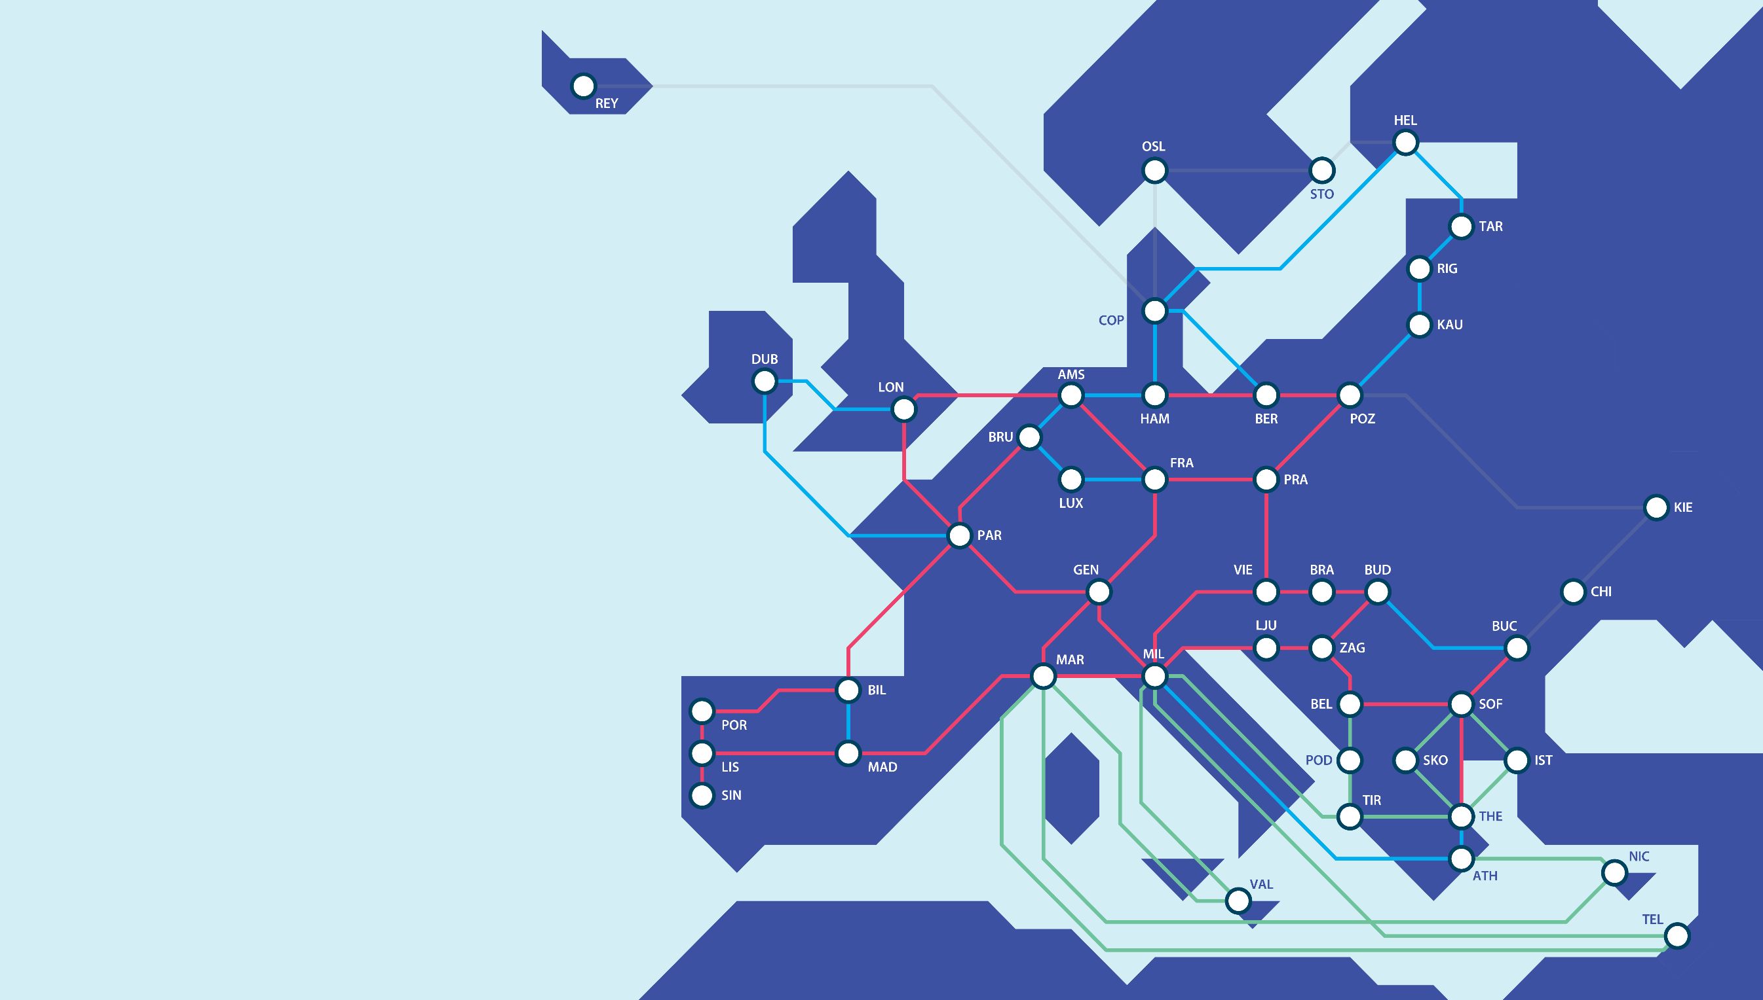
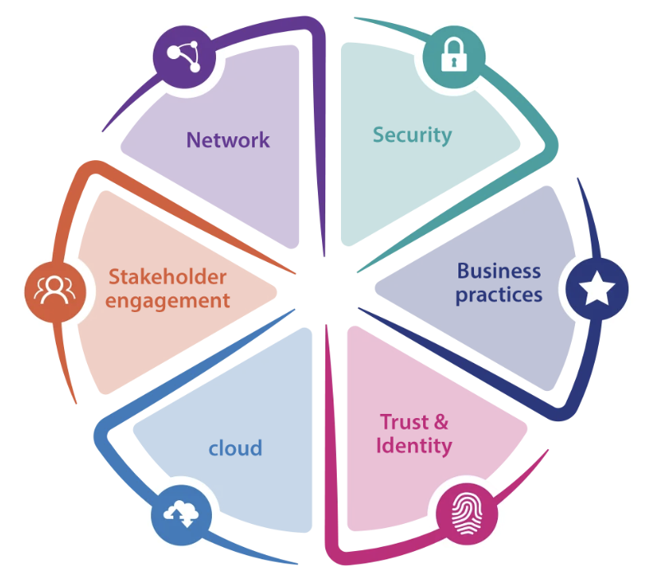
GÉANT Vision
https://community.geant.org/
To collaborate to deliver the infrastructures and services that enable the R&E community to excel.

Slide 3
What our SIG focuses on
https://wiki.geant.org/display/CISS/SIG-CISS+Home
Cloud services for the R&E community
Interoperable software stacks implementing cloud services
  OpenStack
Hybrid cloud approaches
  Integrating private and public cloud to enable flexibility and response to peak demand
User Experience
  Integration with AAI solutions and user management
New storage platforms / hardware
Integration/Interoperability with key R&E community initiatives
  EOSC Nodes
Trusted Research Environments and handling sensitive data

Slide 4
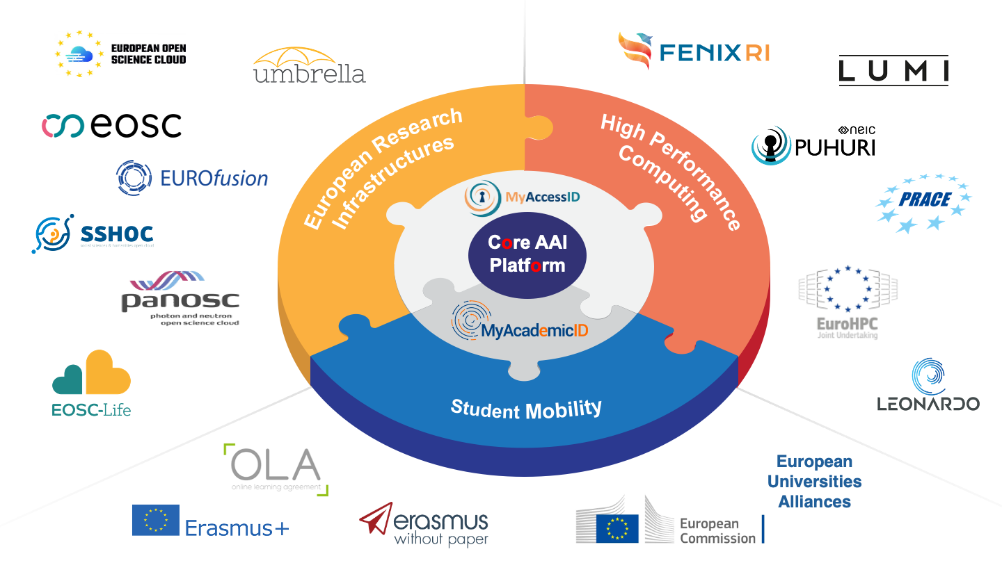
AAI landscape: EOSC Core AAI and MyAcademicID
Notes:
This puzzle diagram was designed to show connection between the Core AAI platform and the domains we are supporting through it.
The Core AAI Plattform is an implementation of the Common AAI which we are developing, and on top of this platform, MyAccessID and MyAcademicID are running to support European Research Infrastructures, High Performance Computing communities and Student Mobility.

Slide 5
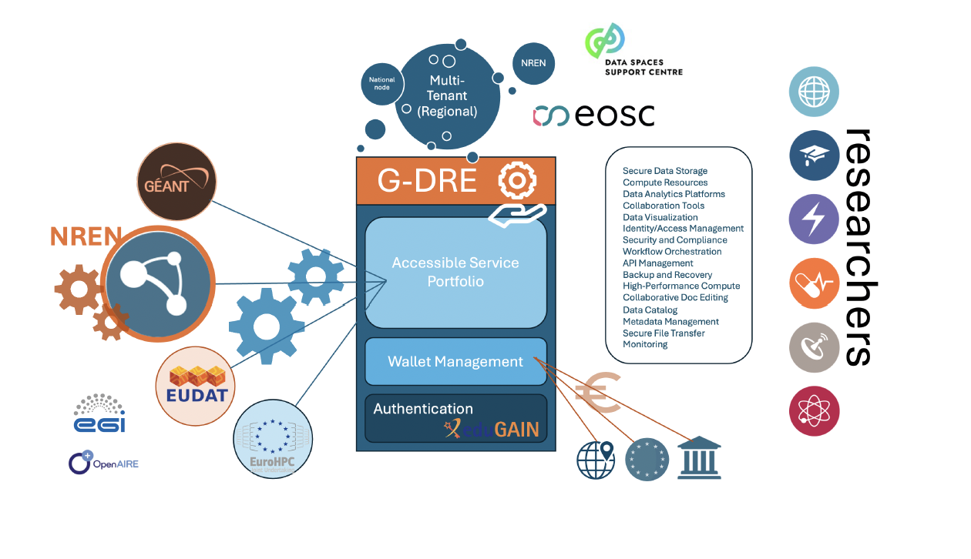

GÈANT Digital Research Environment PoC
The G-DRE PoC is a proof-of-concept on multi-tenant Digital Research Environments
Identity based authentication
(MyAccessId/eduGAIN/..)
Services portfolio management
Research project ‘wallet’ allocation
Consumption optimization and monitoring
Research project collaboration
Access to Community Services
  including those
  already supported by GÉANT, NRENs, Institutes, Research Infrastructures
NREN Trusted Digital Research Environment
National nodes of the EOSC
Notes:
To begin, it is really important to distinguish the ‘DRE’, which is an AAI based services distribution
dashboard (researcher), from a ‘TRE’ or secure, trusted storage and/or compute platform, which may
be made available as a service via the DRE. A ‘VRE’ also suggests a collection of actual bespoke
virtualised cloud services that may be available via an EOSC node (and not the node itself as a
distribution mechanism - eg Google VRE services).
This proposal will unpack a business case in support of the GÉANT Association Member NRENs
collaborating on the development of a secure research services distribution platform which facilitates
the following workflow activities-
• Identity based authentication (MyAccessId - discipline focused/eduID – other EDU)
• Services portfolio management based on researcher identity (previous point)
• Research project ‘wallet’ allocation and spend controls
• Consumption optimization and monitoring
• Research project collaboration
• Access to community services including those already supported by GÉANT; NRENs; Institutes;
Research Infrastructures
There is urgent demand for such a secure distribution mechanism for digital services in support of the
European research community based on the unprecedented rate of innovation in this sector.
Researchers fully depend on the networks provided by GÉANT and the NRENs, as well as the Trust and
Identity, and Security services supported by the association. On top of this stack, researchers are
consuming hybrid cloud-based services underpinning all research activities. Many of these services
are already supported by the NRENs and Research Infrastructures (RIs). They include –
• Data storage and management: Secure cloud storage for research data with version control
and collaboration features.
• Computational resources: Access to high-performance computing resources for data
analysis and simulations (driving the use of AI).
o Cloud-based HPC clusters for intensive computations
o GPU-accelerated computing resources
• Data analysis tools: Software and platforms for statistical analysis, data visualization, and
machine learning.
• Collaboration tools:
Confidential
o Features for sharing data, code, and results with team members or the wider
research community
o eduMEET and other GÉANT community offerings
• Secure File Transfer
• Monitoring and Logging
• Data publishing and preservation: Services for making research data FAIR (Findable,
Accessible, Interoperable, and Reusable) and for long-term archiving.
o Metadata management systems for data lineage
o Tools for documenting and discovering datasets
• Electronic lab notebooks: Digital platforms for recording experimental procedures and
results.
• Compliance and security features: Tools to ensure research adheres to ethical guidelines and
data protection regulations.
• Training and support: Resources to help researchers effectively use the platform and its
tools.
The above list constitutes what will be referred to as Above the Net services for the purposes of this
proposal.
This demand is clearly identified by various NREN fora such as the EOSC/NREN coordinating
committee. The NRENs are under pressure to respond to the concept of national nodes within the
broader European Open Science (EOSC) context. This concept could be outlined in terms of a NREN
Trusted Digital Research Environment (or DRE) that could be deployed both in a multi-tenant regional
version in the GÉANT datacenter AND/OR in a single tenant national version by an NREN.
A multi-tenant platform could be hosted by GÉANT on its AAI infrastructure and underpinned by
MyAccessId, as it supports the central EOSC EO node. This would be a compelling solution for the
lesser resourced, smaller NRENs who could simply configure their tenancy focused on their national
research community.
The technology suite could also be deployed as an on-prem solution by more technical NRENs with
robust DevOps teams in a way that mimics federated access to their other services.

Slide 6
What SIG-CISS has been focusing upon in the last years
Hybric Cloud Use Cases
OpenStack
Trusted Research Environments for handling sensitive data
NRENs building clouds
Latest Cloud / Storage hardware and software platforms (vendors)
Udates from key projects and initiatives (e.g. CS3, CS3MESH4EOSC..)
Liaising with other GN5-2 WPs and tasks about plans / strategy / goals
Today: how do NRENs implement Infrastructure as Code
Notes:
Technical approaches and NRENs services for Hybric Cloud Use Cases
OpenStack: approaches for deployment, management, operations, accounting
Providing Trusted Research Environments for handling sensitive data
NRENs building clouds reports
Invite vendors to present their latest Cloud / Storage hardware and software platforms
Udates from key projects and initiatives (e.g. CS3, CS3MESH4EOSC..)
Liaising with other GN5-2 WPs and tasks about plans / strategy / goals
Today: how do NRENs implement Infrastructure as Code

Slide 7
Next SIG-CISS (16th )
Hybrid - November or early December (likely)
Considering the possibiilty to focus on
  Federated Storage Services
  EOSC Node / Federation developments
  Any other ideas ?
  Wiling to host the next SIG-CISS ?

Slide 8
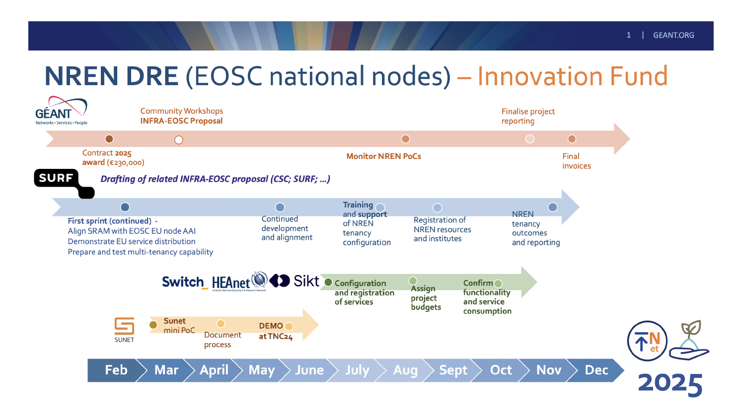
G-DRE timeline

Slide 9
sig-ciss@lists.geant.org
Thank You

