Slide 1
Our IAC journey!
SIG-CISS / Munich / March 21 2025
Notes:
…

Slide 2
James MacDonald
Joined in May 2021
Services Architecture Team

Slide 3
Where we are currently

Slide 4
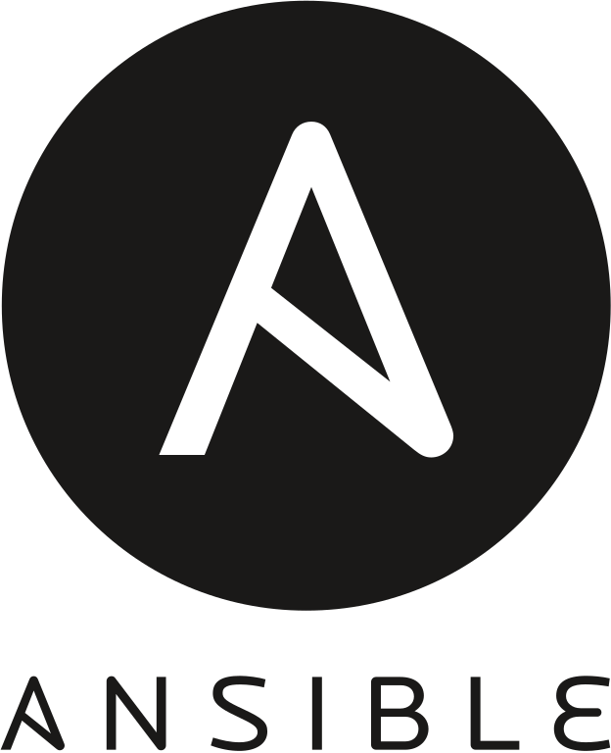
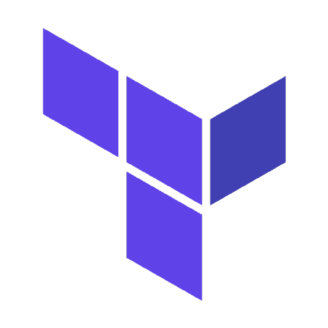
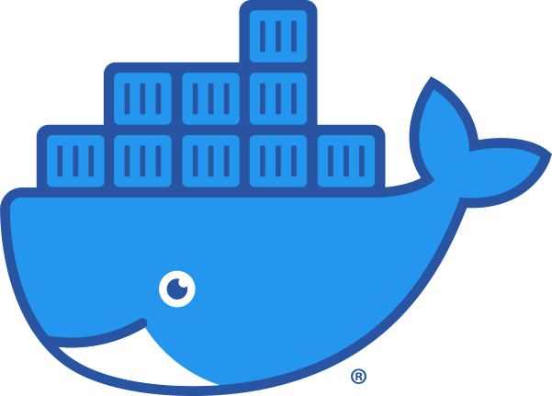

What we currently use
This Photo by Unknown Author is licensed under CC BY-SA
Notes:
Puppet
Ansible
Terraform
Docker

Slide 5

How we use it
Notes:
Gitlab
Self Hosted on AWS
Managed using Terraform

Slide 6
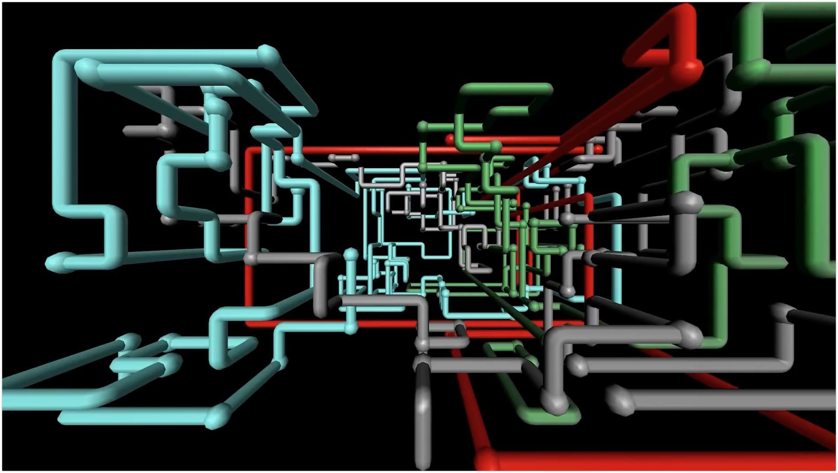
How we use it
Notes:
Pipelines!
Pipelines!
Pipelines!

Slide 7
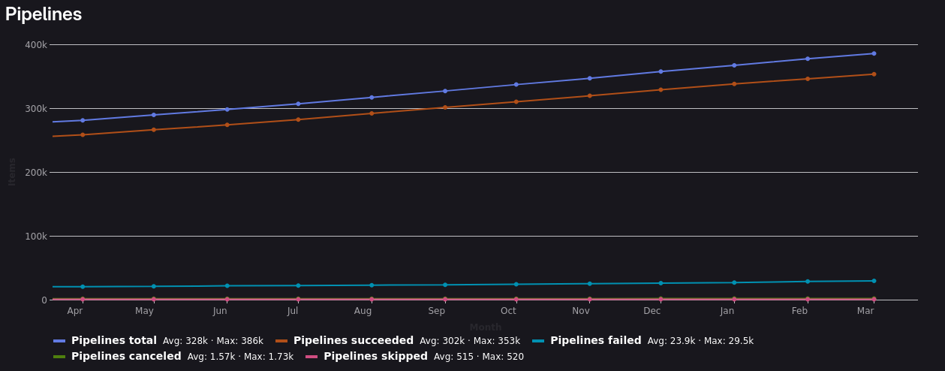
Notes:
Three Hundred and Two Thousand Pipelines Successful Pipeline Runs
What are they doing?
Building, testing and validating artifacts
Deploying / configuring something using Terraform / Ansible

Slide 8
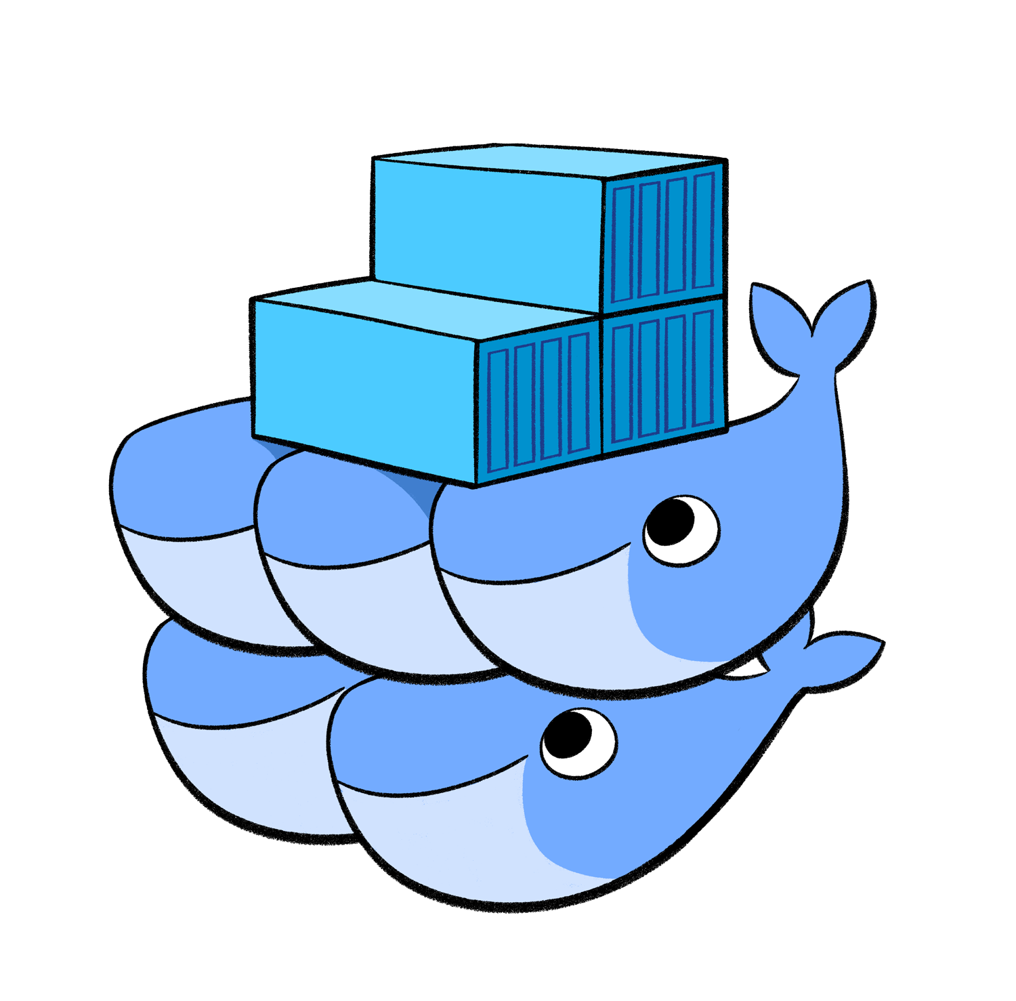
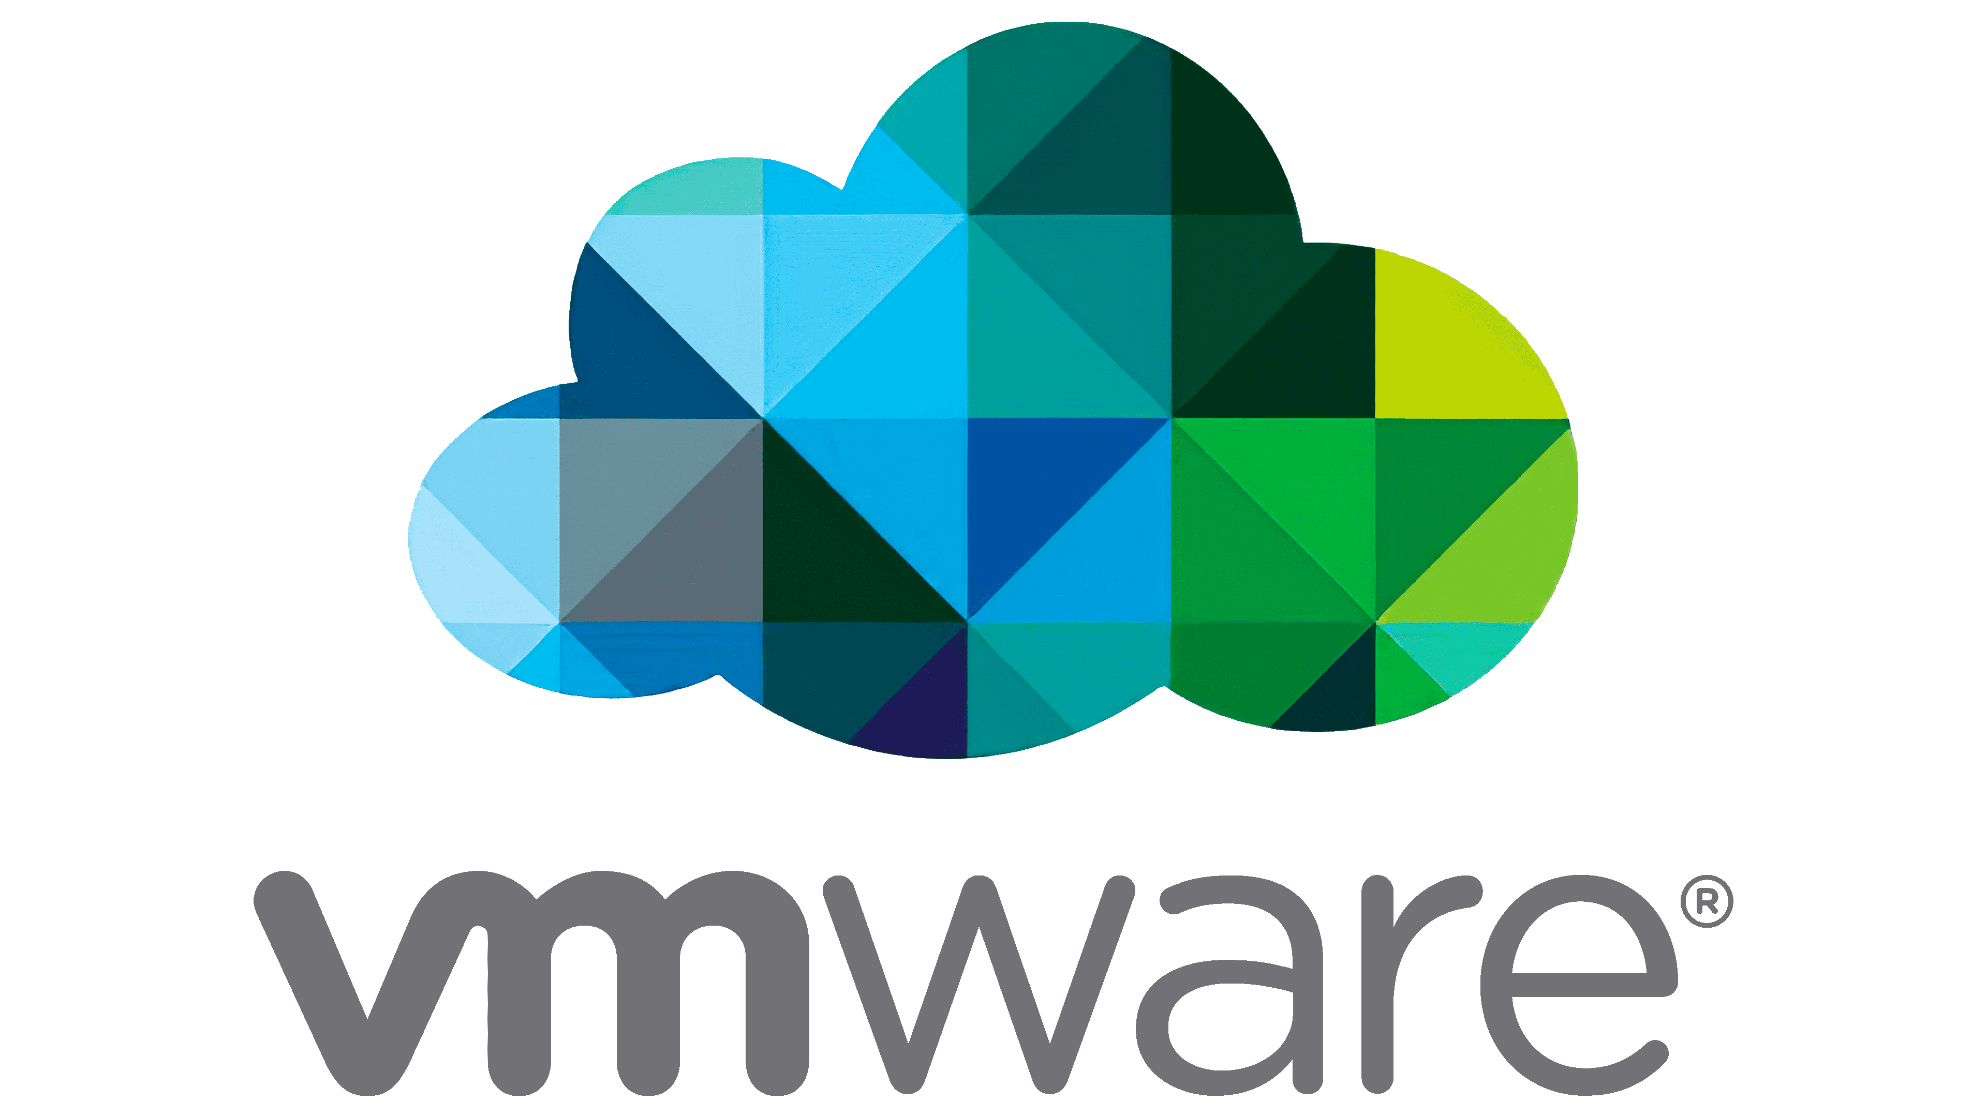
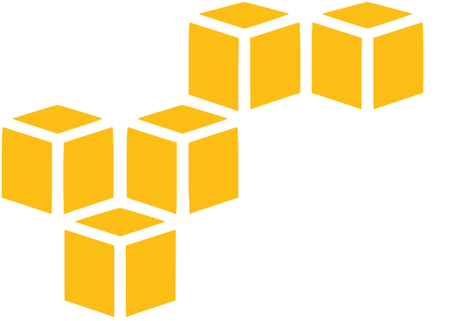

What are we managing
Notes:
AWS
Azure (Everyone becomes Multicloud in the end)
vSphere and NSX-T
Docker Swarm
And ….

Slide 9
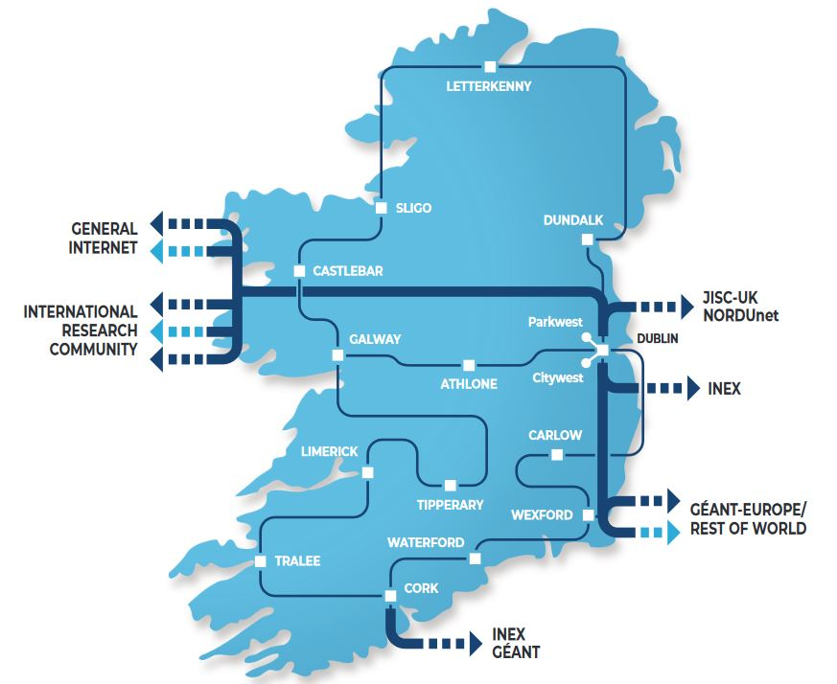
Notes:
Physical Network Infrastructure!
Lots of It.
I am not a Network Engineer

Slide 10
Where we are going next

Slide 11
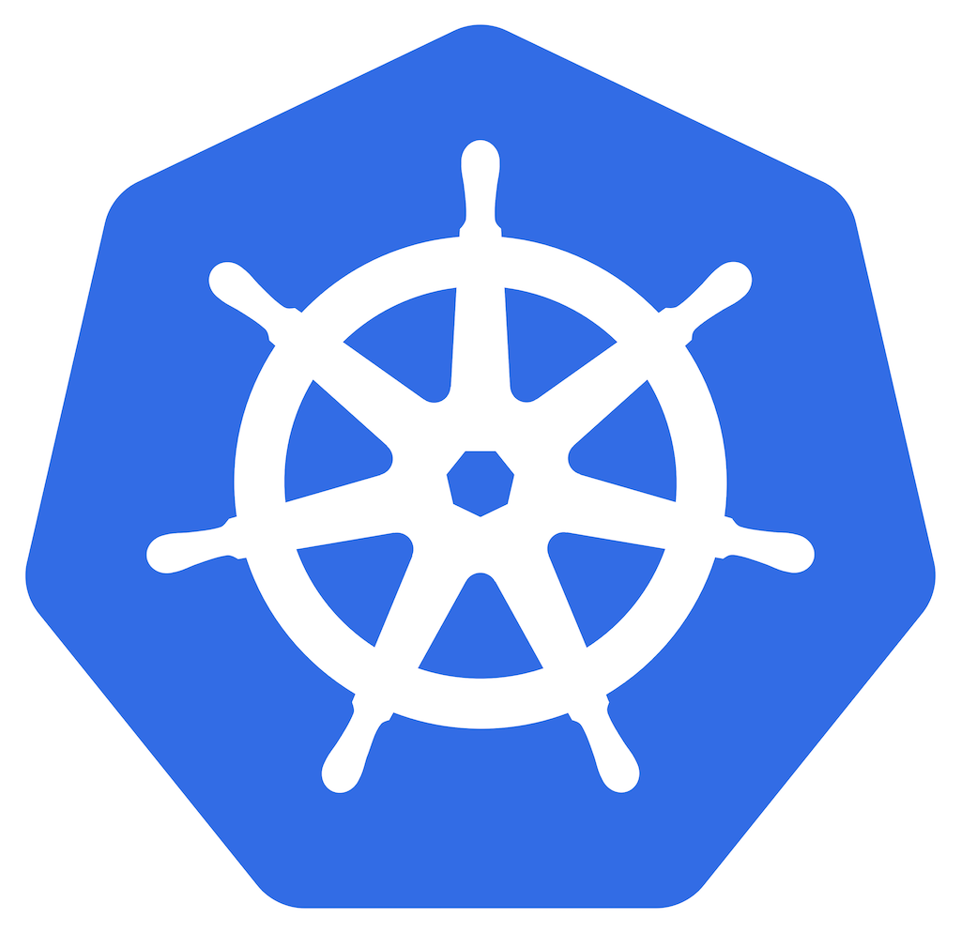
Notes:
Kubernetes.

Slide 12

More Precisely
Notes:
Rancher / RKE2
The original plan was Vmware Tanzu.
That didn’t work out for many, many reasons.
We had some experience with building "once off" clusters with K3S So Rancher was the logical next step.
Our Rancher Server is deployed to AWS EKS using eksctl
This is the only "pet" cluster.
All downstream clusters are considered "cattle"

Slide 13
Even More Precisely
Notes:
Multi Cluster!
Instead of one big cluster
Or even seperate clusters for Staging and Production
We will create individual clusters suited to individual requirements.
For instance
Dedicated monitoring cluster for prometheus federation
Similarly architectured in-house Django applications
Dedicated Vault cluster
Dedicated AWX cluster
etc
This greatly simplifes access and security boundries

Slide 14
Even More Precisely
Notes:
And limits the potential blast radius
Due to mistakes and / or configuration errors

Slide 15

Cluster Creation and Provisioning
Cluster Creation with Terraform / Rancher
Provisioning with Argo CD
Notes:
Creating and Provisioning a Cluster is a two step process
Terraform handles the bootstrapping
Argo CD handles everything in a declaritive GitOps style

Slide 16
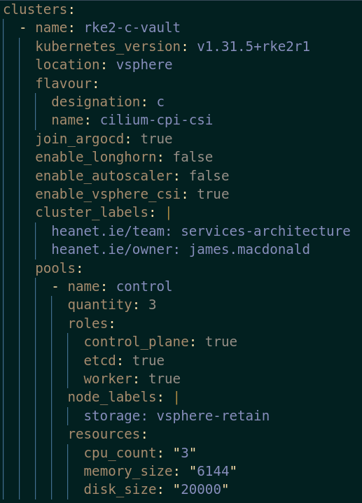
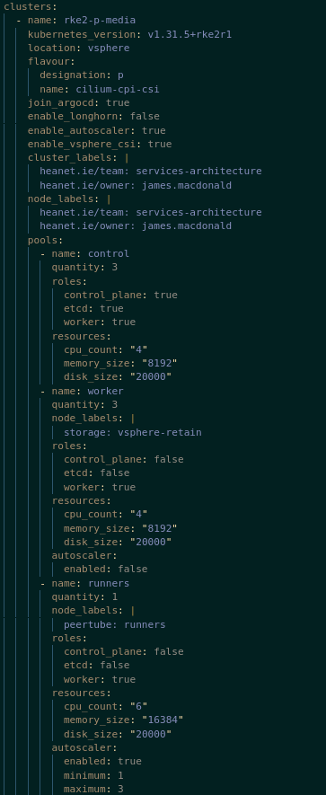
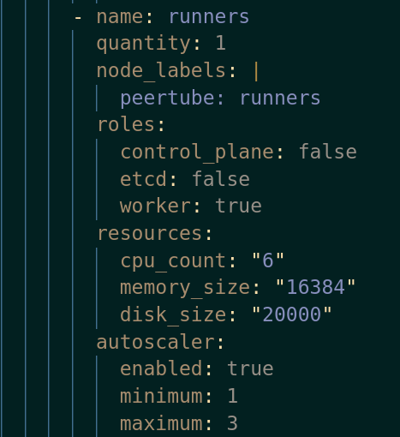
Notes:
YAML cluster definition
This is converted to JSON
Then consumed by Terraform

Slide 17
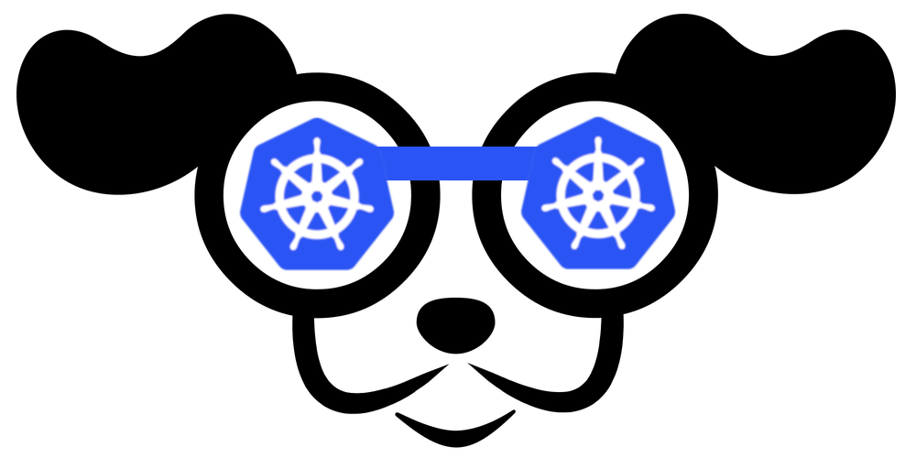
Notes:
Terraform instructs Rancher to create a cluster
Rancher creates individual VMs using the vmware API
VMs are initialized with cloud-init to install the Rancher Agent
The Agents Register with the Server and the Cluster is initialized
Cluster is available to users
This works 99.99% of the time.
Occasionally a node will fail to bootstrap.
We just delete it and Rancher will spawn a new node

Slide 18
Total Time: 8 - 15 minutes
Autoscaling Cluster
Cilium CNI
vSphere CSI
Notes:
Now you have an empty cluster
It's time to populate it using ArgoCD

Slide 19
Application Catalogue
Single git repository that contains
  ArgoCD Application definitions
  Base configurations for each application (Helm values or kustomize)
  Kustomize definition for each cluster
Notes:
Other repositories containing kustomize pacthes and helm values can be referenced.
This allows confiuration of specific applications to be delegated to other teams.

Slide 20
Django apps
Syncronise
Webhook
Syncronise
Hashicorp Vault
Syncronise
Systems Team
Notes:
The application catalogue sends a webhook to Argo which then performs a Sync
No deployment pipelines in gitlab
Blue / Green and Canary Deployments using Argo Rollouts

Slide 21
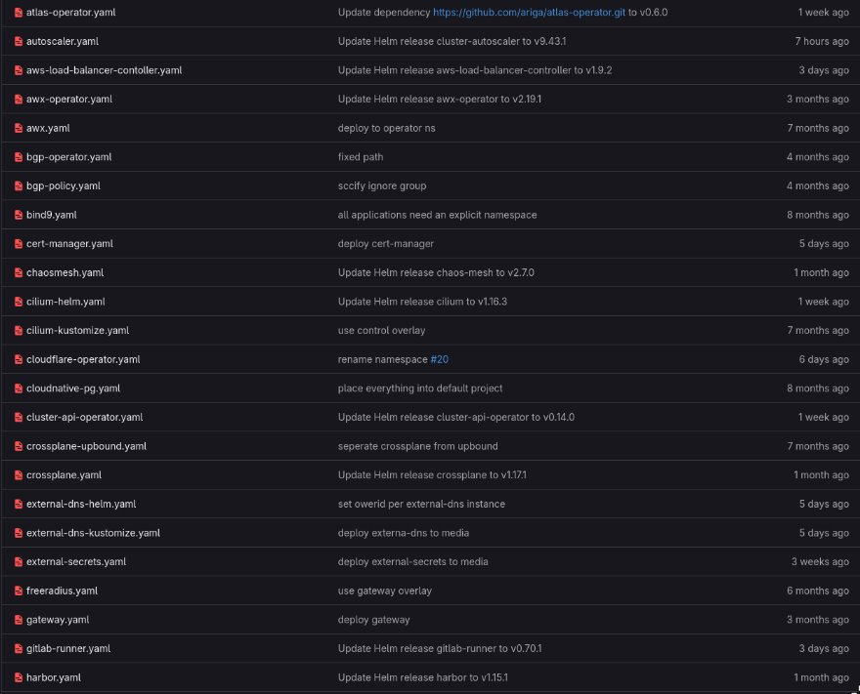
Notes:
There is about 50 applications in the catalogue that we are evaluating.
This allows cluster operators to provison a cluster in a buffet style

Slide 22
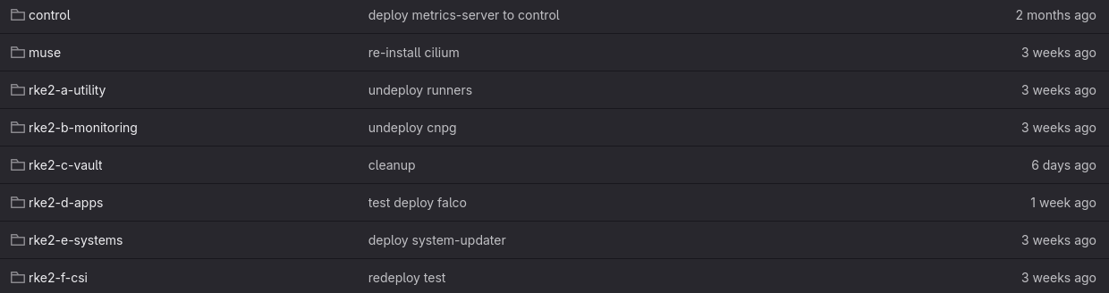

Slide 23
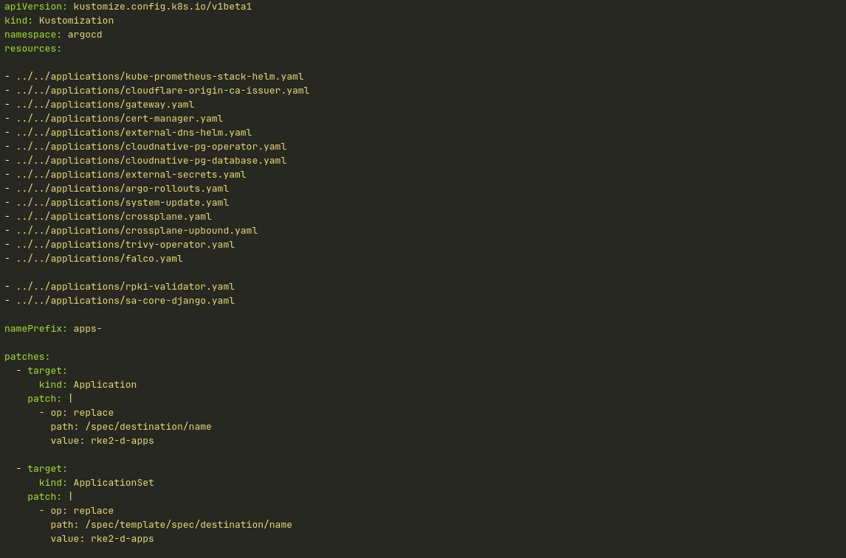
Notes:
Clusters get several applications by default such as
Prometheus
cert-manager (generates letsencrypt certs)
External-secrets (integrates with gitlab, hashicorp vault, passwordstate)
External-dns (creates dns records on cloudflare and power dns)
System-updater (for updating the underlying OS)
Cluster level refinements are applied using patches

Slide 24
Custom Resource Definitions
&
Operators
Notes:
The K8S API can be extended through the use of CRDS
With Operators used to create resources based on the CRDS.
A good Example of theis is the Cloud Native Postgres Operato

Slide 25
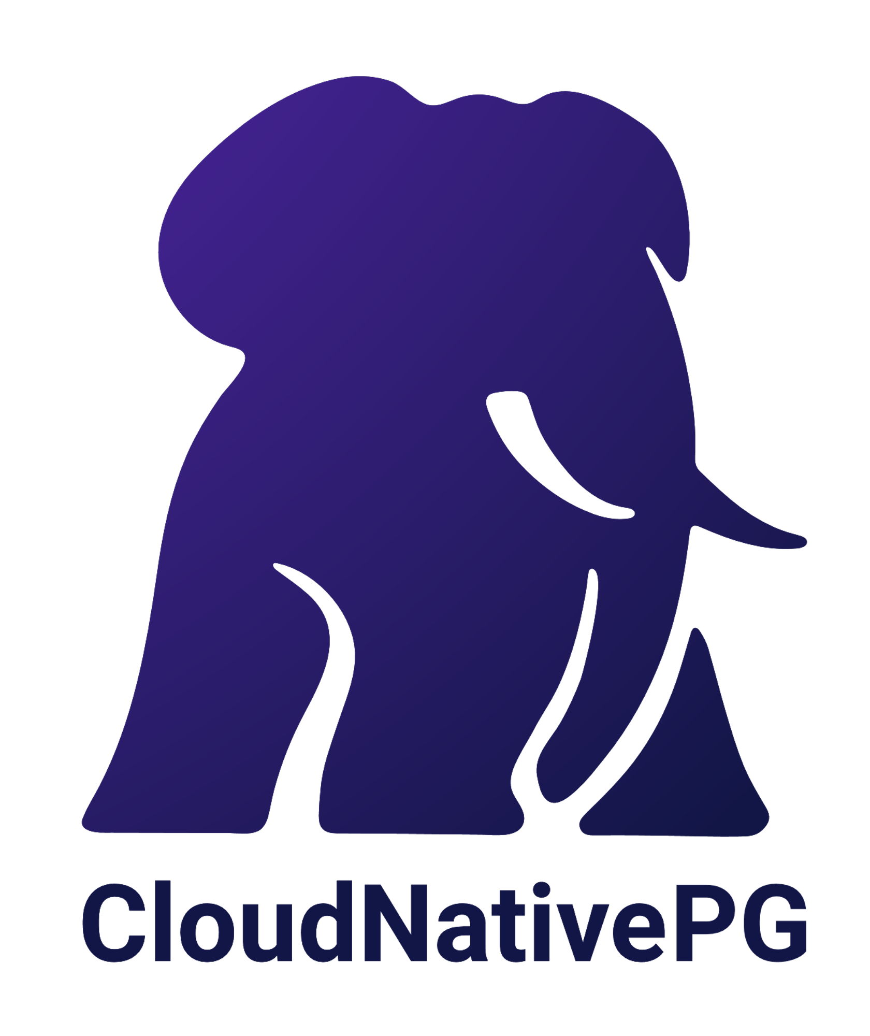
CloudNativePG
Operator for deploying and managing Postgres Clusters
CRDs for describing Clusters and Databases

Slide 26
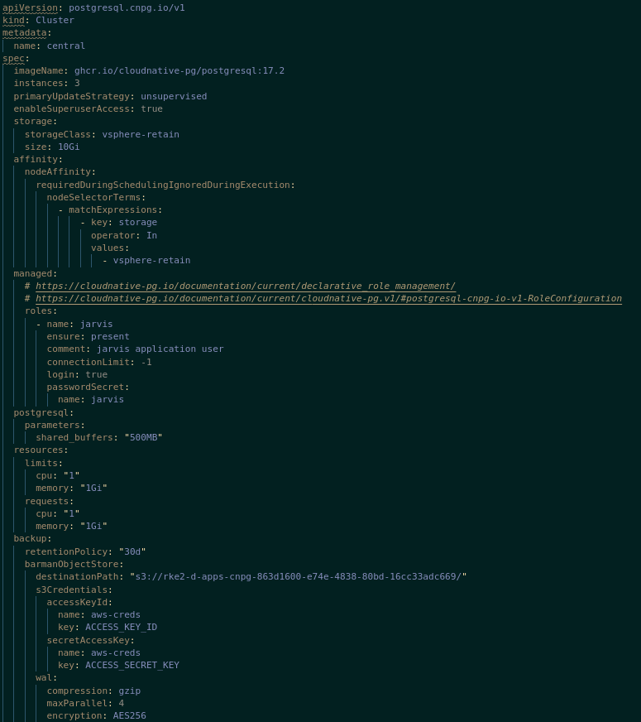
Notes:
The Cluster definition is pushed to gitlab
Gitlab triggers a webhook and begins an argocd sync
The CloudNativePG Operator detects the cluster definitions and builds a Cluster

Slide 27
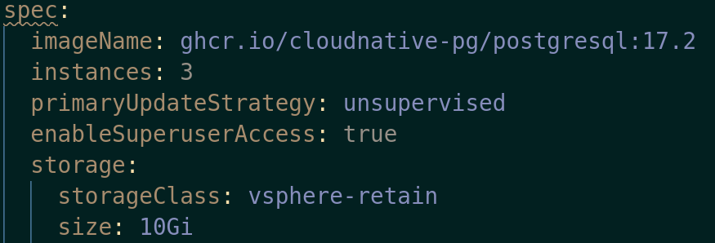

Slide 28
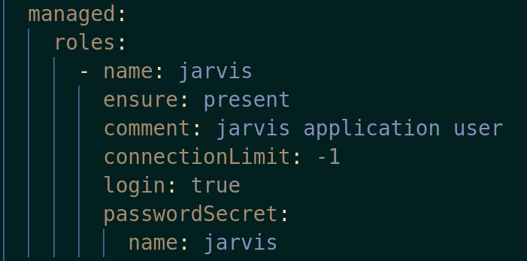

Slide 29
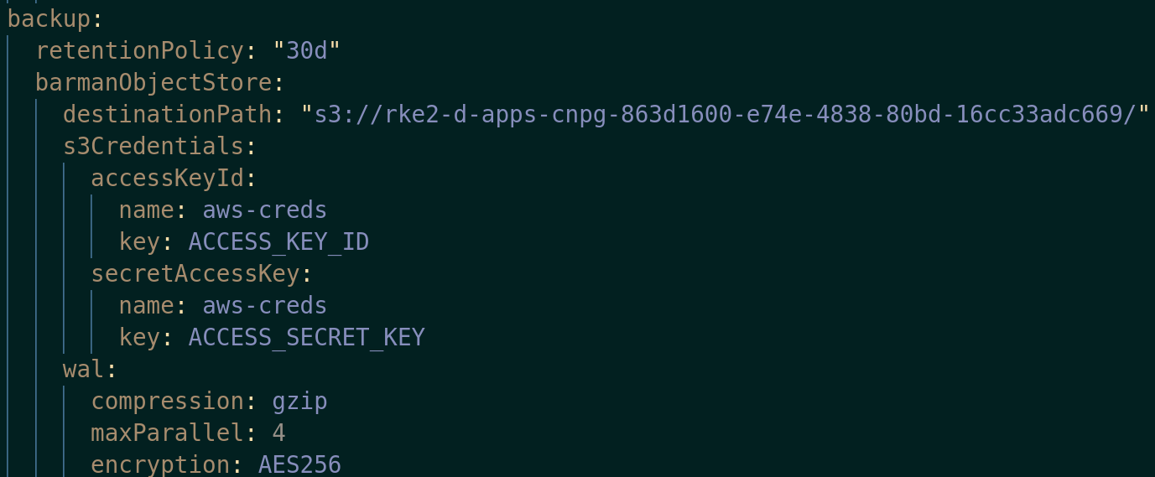

Slide 30
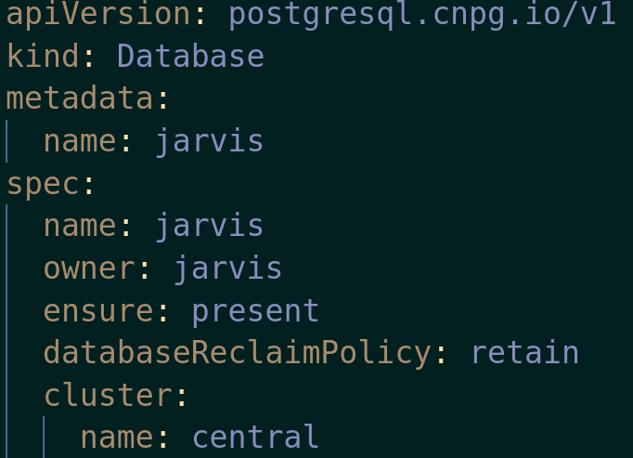
Notes:
Using this we can have a database cluster per k8s cluster or even per namespace.
Deleting the cluster or database definiton from git will remove the resources

Slide 31
What else

Slide 32

Coding Your Network
Developed by SURF
Automation Platform written in Python
HEAnet are using it to manage Network Kit

Slide 33
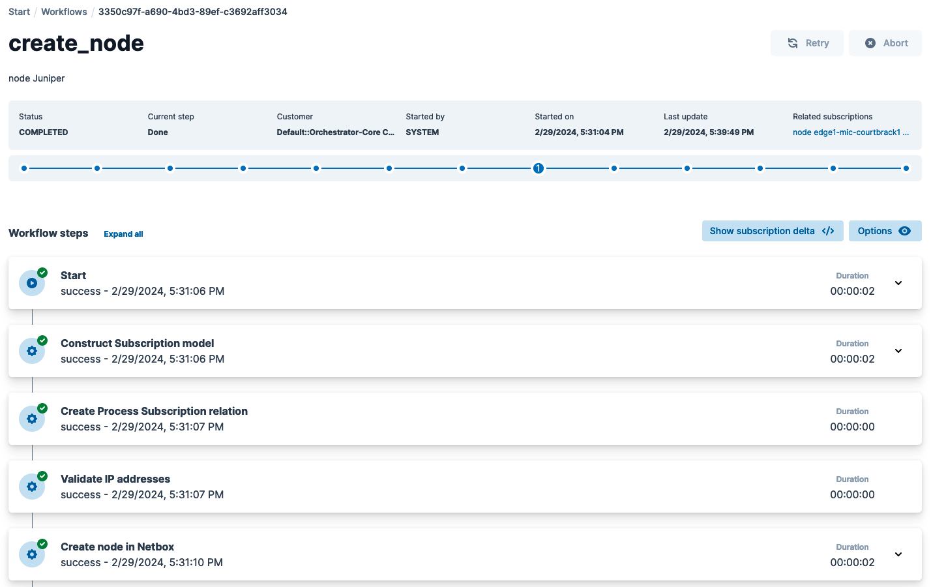
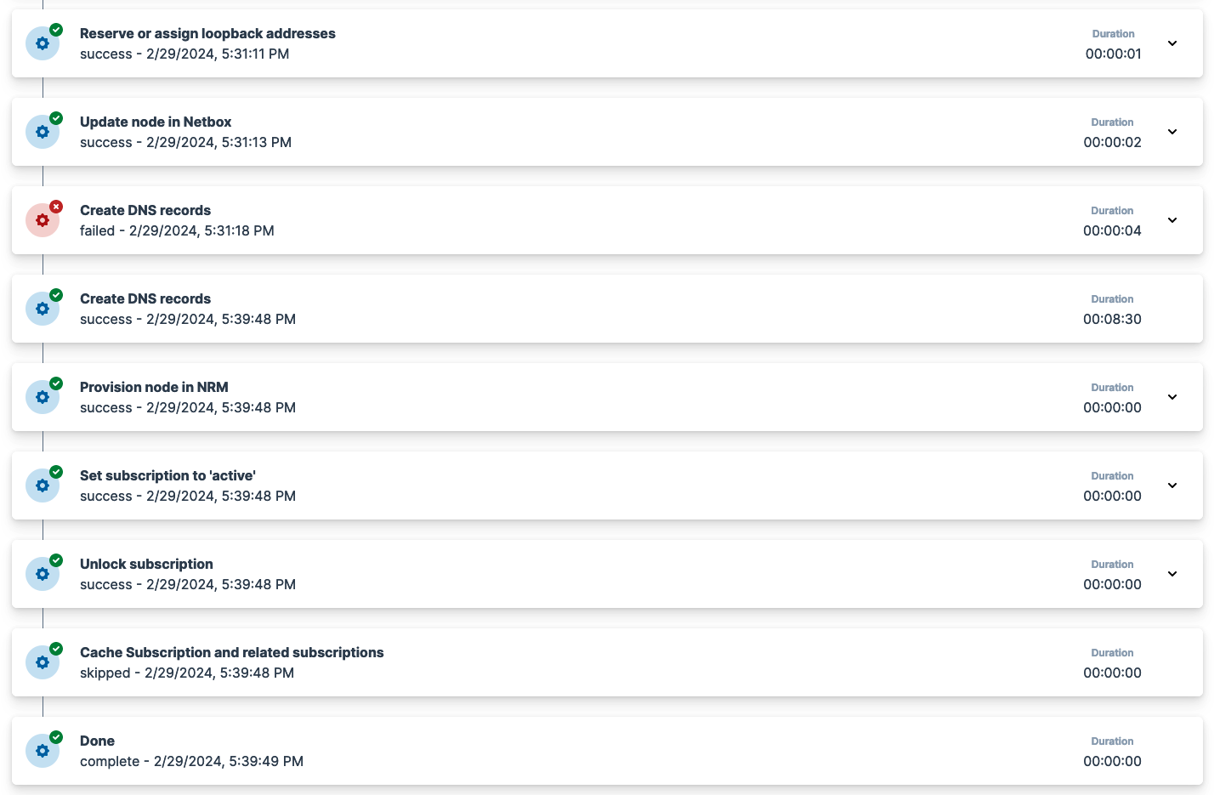
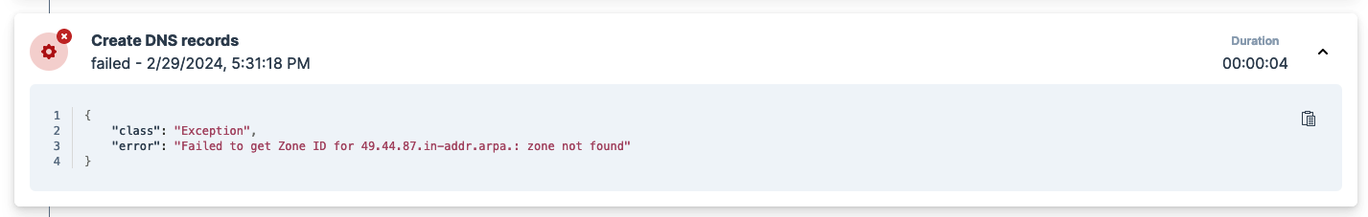
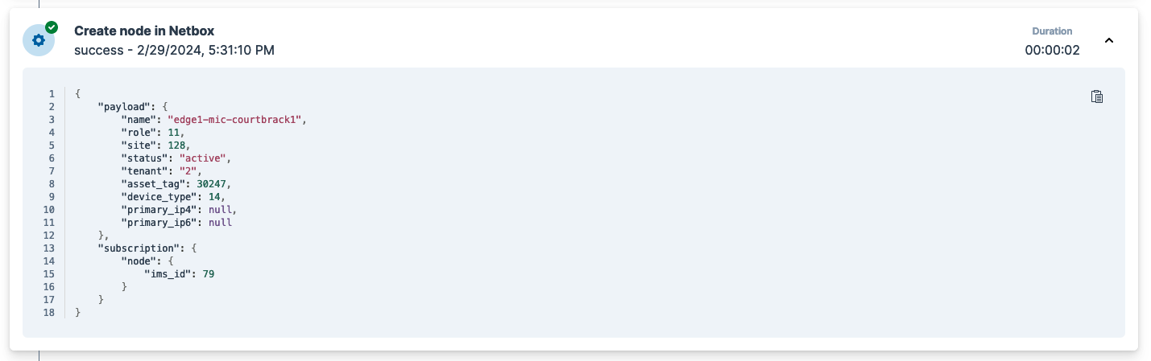
Notes:
Workflow GUI screenshots
Here’s a ‘create node’ workflow after completion. We’ve submitted the previous form, and WFO has created a node in Netbox – you can see the payload passed in here.
Doesn’t do any ‘work’, it’s pushing data around between systems and tracking responses.
[CLICK]
It failed to create DNS records, because the zone didn’t exist. The workflow stops by itself, the engineer can then go create the zone manually, and then retry for success.
Not all steps have to be automatic – you can display config and ask an engineer to confirm they have copied and pasted it onto a device, for example.
But what is a step?

Slide 34
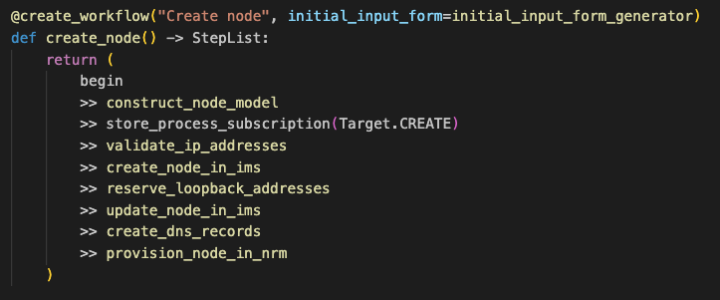
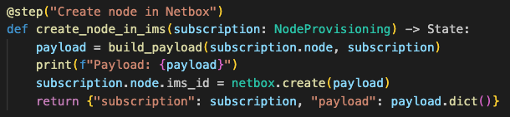
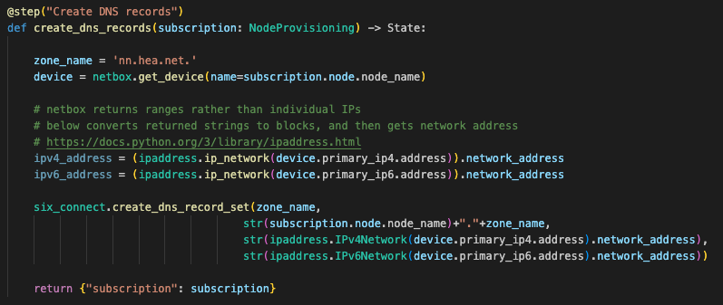
Notes:
A step is just some python!
Under the hood, this is a workflow definition – just a series of simple steps. Here’s what ‘Create Node’ looks like. Each line with double arrows is a step.
[CLICK]
The fourth step creates the device in Netbox.
The subscription object contains the data from the form. We build a payload and using pyNetbox, a third party library written by the community, the payload is sent to the Netbox API.
It stores the Netbox ID locally as the IMS ID, for when we want to modify or delete the node later
[CLICK]
Here’s it creating DNS records for the device. The Netbox IPAM has assigned it IP addresses, so first we pull the device from the Netbox and get its IP addresses.
Then we make a call to create the DNS records. This is a call to a library we’ve written for interacting with 6connect API.
Use third party python libraries (pyNetbox) or write your own. You can make direct HTTP calls or MySQL updates to database. Or you can just display a message to the user with instructions, whatever you can code.
Which is fine in theory. Mick is going to show it to us in action.

Slide 35
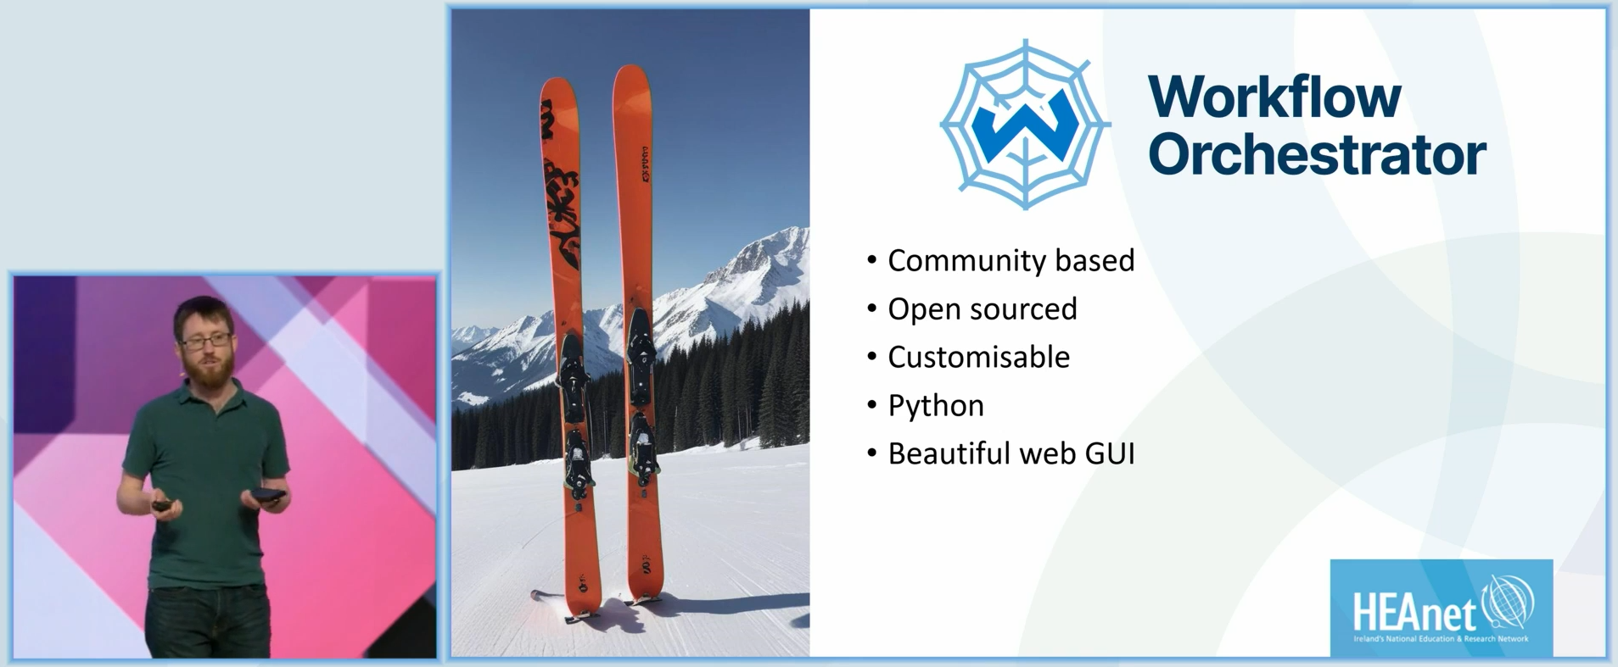
Notes:
My Collegues Brian McArdle
And
Mick O' Donovan
Gave a talk an TNC 2024 on our implementaion of it

Slide 36


