Slide 1
SIG-CISS
21 March 2025

Slide 2
Who are we?

Slide 3

SWITCH
  The Swiss NREN
    National Research and Education Network
  Provides services to schools and universities
    Cloud
    Network
    Security
    Legal
    Procurement
  Registry for .ch and .li top-devel domains (OFCOM)
    On behalf of the Swiss Confederation

Slide 4





CURE – Cloud and Undercloud Reliability Engineering
Storage
Compute
Network
One team. Eleven people.
Divided in three sectors:
  Compute:
    VMs, GPUs, etc
  Storage:
    Block storage, S3
  Network:
    Connectivity and redundancy at every layer, load balancers, etc

Slide 5
The products

Slide 6
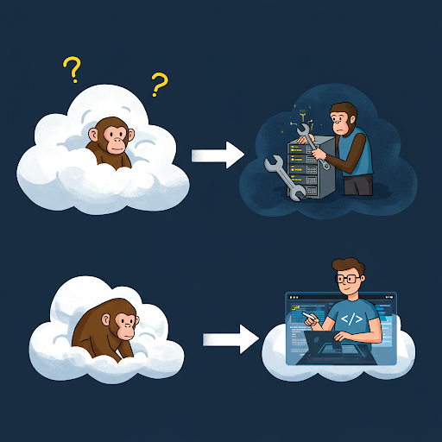
SwitchEvolution: SwitchEngines to SwitchCloud
SwitchEngines
  Ansible-led deployment
  Limited IPv6
  Traditional networking (CVR with 3 network nodes)
  Traditional Load Balancer (Amphora)
  Integrated S3/Swift
  Tightly integrated dashboard features
SwitchCloud
  GitOps with FluxCD
  Modern networking - Full IPv6 (Default)
  Enhanced networking – OVN
  OVN & Amphora LB
  Separate S3 (SCS3)- dedicated service managed via Portal
  Streamlined Dashboard: Focus on core functionality; SCS3 via Portal

Slide 7
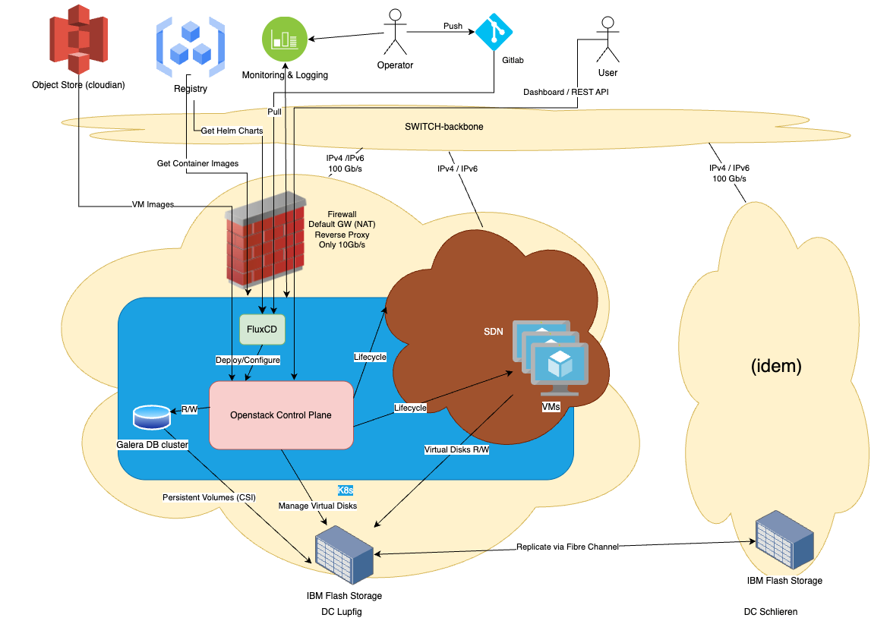
SwitchCloud - The Big picture

Slide 8
How we deploy

Slide 9


The old way – ansible from laptop
The idea
  Multi-repos
  Ansible deployment from employee laptops:
    Kubernetes manifests
    Misc operations (OS config, etc)
The pro
It worked!
Rather easy workflows
It was cutting-edge 10 years ago (when Engines started)
The cons
No reconciliation -> drift
No regular run -> led to broken playbooks
Weak audit trace -> who did what and when?
In the end
Did not scale so well
Increasing config drift / broken playbook / tech debt and team size
=> unmaintainable

Slide 10


The mixed way – Ansible + pipelines
The idea
Combine both approaches described before:
  Run Ansible in a pipeline
  Executed need commands (OS config)
  Deploy needed resources (Cephadm)
The pros
  Regular pipeline runs limited drift
  Easier to audit
The cons
  Pipelines can become a single point of failure (multi cluster)
  Infrastructure running pipelines is needed
  A lot of work involved in creating pipelines that work
In the end​
Requires substantial work but a lot more flexible.

Slide 11
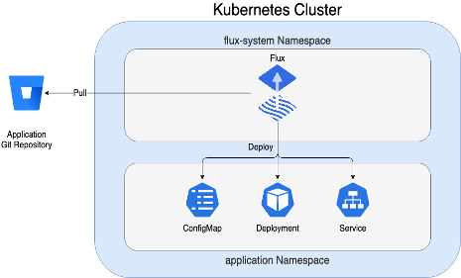
The `pull scc:latest` way – GitOps with FluxCD
The idea
GitOps with FluxCD
FluxCD with OpenStack-Helm
Automated Testing
Monitoring
The pros
Consistent state in target environment -Continuous reconciliation
Declarative State Management
Reducing the risk of errors
Improved Scalability, Auditability (Git History)
The cons
Higher complexity to release new features and customize deployment
Higher dependence on community
Higher complexity in integration with other tools in SwitchCloud

Slide 12
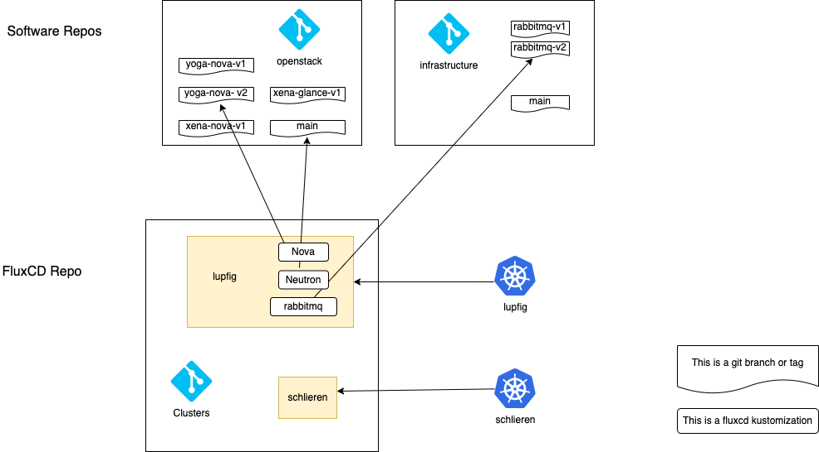
Organizing code and managing environments
Three Core Repositories
    clusters: what gets deployed where
    openstack: all OpenStack components
    infrastructure: everything else (ingress, MetalLB, core-monitoring, exporters).
Branching
    production: stable, released code, and releases use tags (e.g., antelope-v01)
    stage: main integration branch, for pre-production testing
    test: development and experimentation.
    <feature-branches>: isolated development.
  General principle - branched from stage, merged back via Merge Requests.

Slide 13

The bash way – when you need quick coffee NOW
What do you do when you need to create your default Openstack resources consistently and you need it before your morning coffee?
You approach your BASHista !
Pros:
You have programmatic way to deploy any resource you need
You can automate it via CI/CD pipeline
Cons:
Does not scale that fast
Target configuration can drift between runs

Slide 14
The future: coffee shop across the street
Coffee shop across the street has expended offering:
Option 1 - OpenTofu:
Infrastructure-as-Code (IaC): declarative configuration leveraging existing APIs (Openstack, K8S)
External Management: controller within K8s, manages resources via OpenTofu engine
Mature & Extensive: large Terraform community, battle-tested, wide provider support
Declarative state
Option 2 - Openstack Operator:
Kubernetes-Native Operator: Extends Kubernetes API with CRDs
Openstack-Focused: Specifically designed for OpenStack services on Kubernetes
CURE did a PoC and has in mid-term roadmap willingness to move in this direction.

Slide 15

Other challenges
Current Challenges:
  Enhancing monitoring and alerting:
    Fine-tuning monitoring and alerting: defining and implementing precise set of alerts and dashboards
    Abstracting alert creation: using K8S-libsonnet, a library for jsonnet fluxcd controller, that enables very simple and quick creation of alert-related objects in K8S)
  Supply chain hardening:
    Image and code scanning
    Software supply chain attestation
    Inventory (Software bill of Material)
  ISO standardization

Slide 16

Q&A
CURE4Switch
Nemanja Jevtic Cloud Engineer CURE Team nemanja.jevtic@switch.ch Werdstrasse 2 8004 Zürich
Bernard Landon Cloud Engineer CURE Team bernard.landon@switch.ch EPFL Innovation Park 1015 Lausanne

Slide 17
Thank you!

