Slide 1
EURAMET Introduction to SIG-TFN
Mikko Merimaa
General Secretary
March 13th, 2025

Slide 2
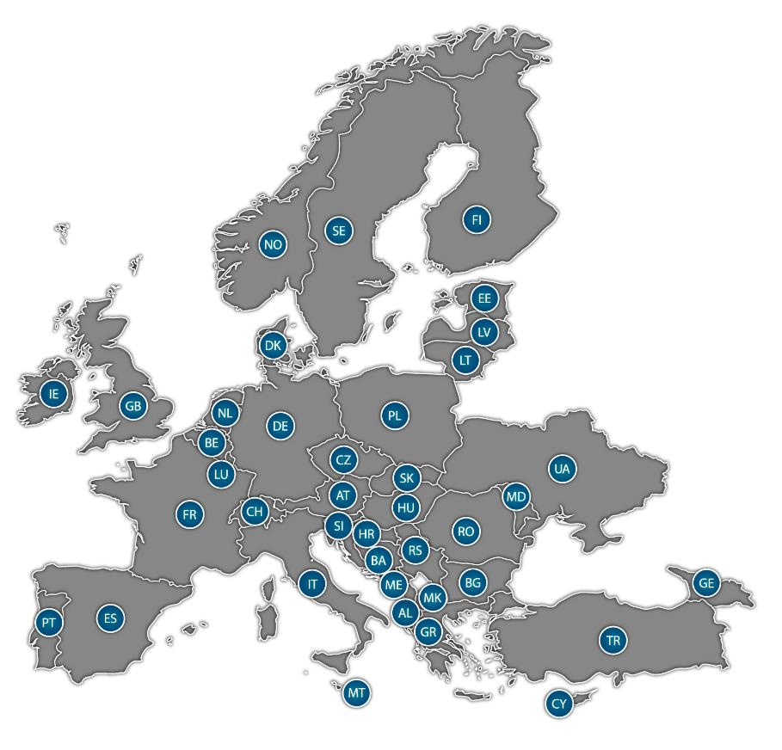
EURAMET e.V.
The European Association of National Metrology Institutes
39 National Metrology Institutes
75 Designated Institutes
16 international Liaison Organisations (e.g. other RMOs, BIPM, OIML, IAEA, WELMEC, Eurolab, Eurachem, EA)
Providing stakeholders with traceability of measurement results to the SI units under the Metre Convention and world-leading measurement solutions
Securing world-wide trust and acceptance of measurements
Implementing Metrology Research Programmes
Providing Capacity Building
2
Notes:
New DI: National Institute of Airborne Acoustic Metrology
We welcome UA and GE in EURAMET.

Slide 3
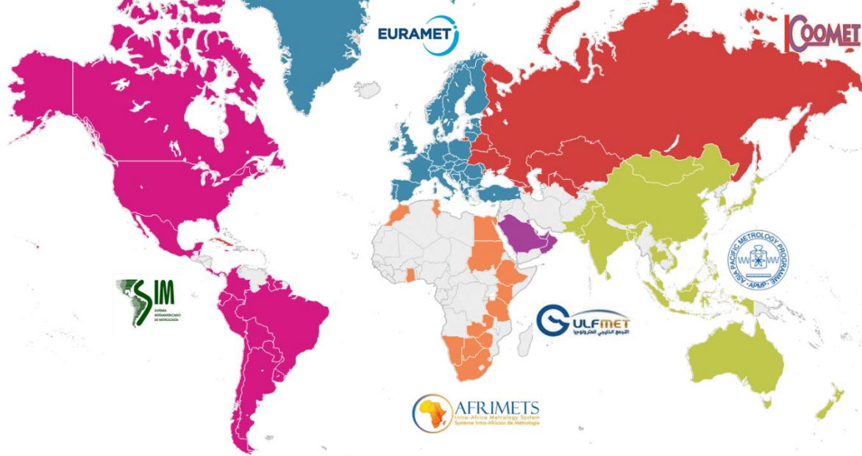
What EURAMET does?
The core mission of National Metrology Institutes (NMIs) is to ensure traceability to the SI under the Metre Convention and equivalence of national standards. This is a permanent task, usually assigned by national law.
EURAMET is the Regional Metrology Organisation of Europe coordinating NMI efforts regionally and supporting member NMIs to meet the requirements of the Metre convention.
UTC(k) at NMI
National Standards
International
comparisons,
acceptance
of QMS
National Metrology Institute
Distribution
NREN?
Reference Standards
Accredited Calibration Laboratory
Infrastructures
Working Standards
In-Plant Calibration Laboratory
Point of use
Products
EURAMET is an implementation body of European Partnerships in Metrology.

Slide 4
EURAMET and Time
European NMIs contribute in the keeping of the UTC (with BIPM and NMIs worldwide)
Larger European NMIs operate primary standards that are used to steer the UTC
  Definition of the SI second
NMIs disseminate the local realization of the UTC for use in society
  This is usually the national legal time, defined in the national legislation
  Selected European NMIs provide the synchronization of Galileo System Time with UTC
  Dissemination of frequency for scientific applications
European NMIs work together to
  Develop new technologies for time and frequency dissemination
  Lay the foundation for the redefinition of the Second
  Create common procedures for calibration of devices (EURAMET Guides)
  Develop new technologies
The EURAMET Technical Committee on Time and Frequency (TC-TF) coordinates these activities
  To meet the requirements of the Mutual Recognition Agreement: Comparisons, QMS and technical peer reviews, reviews of Calibration and Measurement Capabilities (CMCs)
  To implement research projects
  To provide capacity building
These activities
are funded by
the NMIs,
according to the
strategy of each
NMI!
Research is
supported through
Metrology
partnerships

Slide 5
Need for European Time and Frequency Network
Scientific Needs (frequency and time)
Application Needs (primarily time)
Space
  Positioning, Navigation and Timing
  Synthetic aperture radars
Fundamental Scientific Applications
  Fundamental constants
  Tests of relativity
  Geodesy
  …
Large instruments
  VLBI
Earth Science
  Climate change geodesy
  For some applications 1x10⁻¹⁸ in frequency
Appliances ~100 ms
Finance (MiFID II)
Power industry / Electricity Grids
Data Centers
Telecom
High Frequency Trading <100 ns
Time is often obtained through a GNSS with a flywheel clock to mitigate disruptions.
For resilience and security, redundant time dissemination is needed! (alt: monitoring & verification e.g. time-stamps)
Requirements are becoming increasingly stringent.

Slide 6
Need for the Redefinition of the Second
CIPM consultative committee for time and frequency has established a roadmap for the redefinition of second
This includes conditions to change the definition
TF comparison and dissemination:
  Availability and sustainability of T/F links with uncertainties < 5x10⁻¹⁸ in frequency between NMIs operating optical frequency standards, on a national / continental basis
  At least three independent measurements of all optical clocks of (I.1) were compared in different institutes (e.g. Dn/n< 5x10⁻¹⁸) either by transportable clocks, advanced links, or frequency ratio closures
  T/F links TRL> 6 (to be confirmed) and continuous operation capability over durations > 30 days (to be confirmed)
  Availability of T/F links with uncertainties < 5x10⁻¹⁸ in frequency at national / continental / worldwide scale for TF comparisons and dissemination
Must be achieved
Can be in progress
Progress in comparisons was given in presentation by Davide Calonico on Wednesday

Slide 7
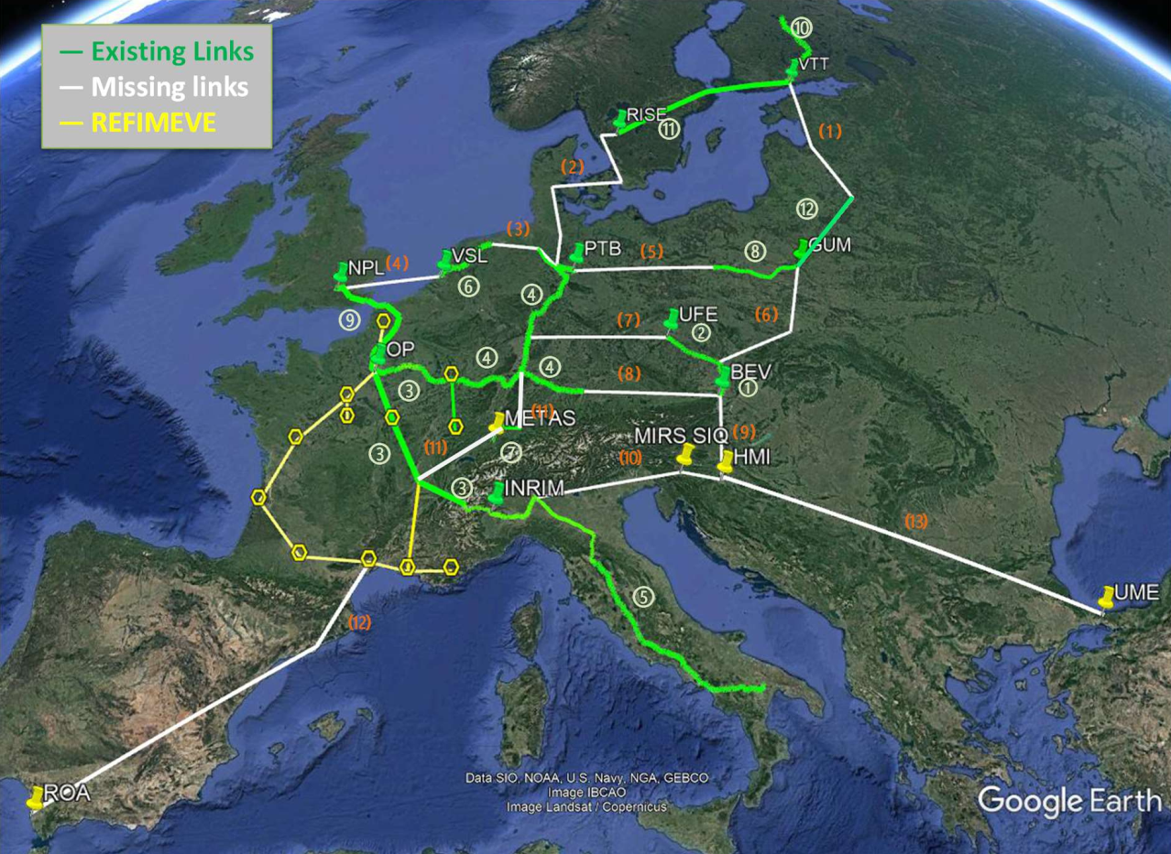
Action: The Metrological Time and Frequency Backbone Network for Europe
“CLONETS intends to create a European infrastructure to provide a pan-European time and frequency reference system for the European scientific community”
The mapping dates from the end of 2022.
Additional developments:
  the REFIMEVE link to CERN was installed in March 2023
  the first link of the GEANT C-TFN project, between PSNC, Poznan and PTB, Braunschweig, was installed in September 2024
REFIMEVE and FOREST ESFRI proposal were presented by Christian Chardonnet on Wednesday
Image: Observatory of Paris / CONETS-DS Project

Slide 8
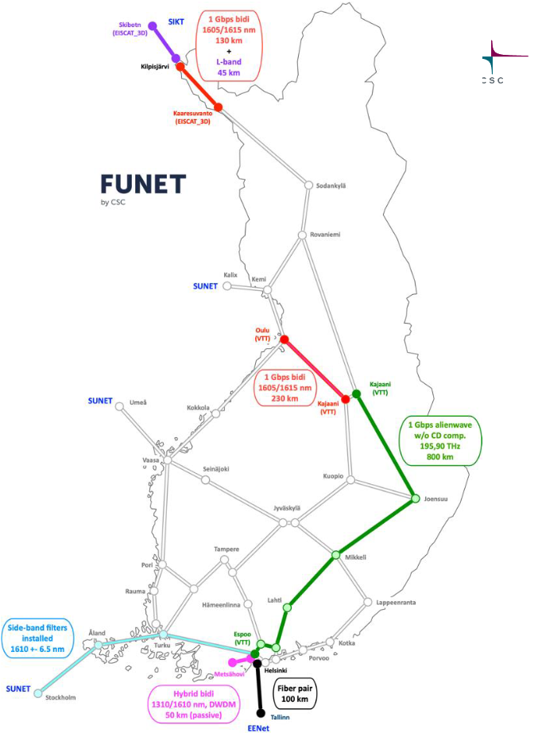
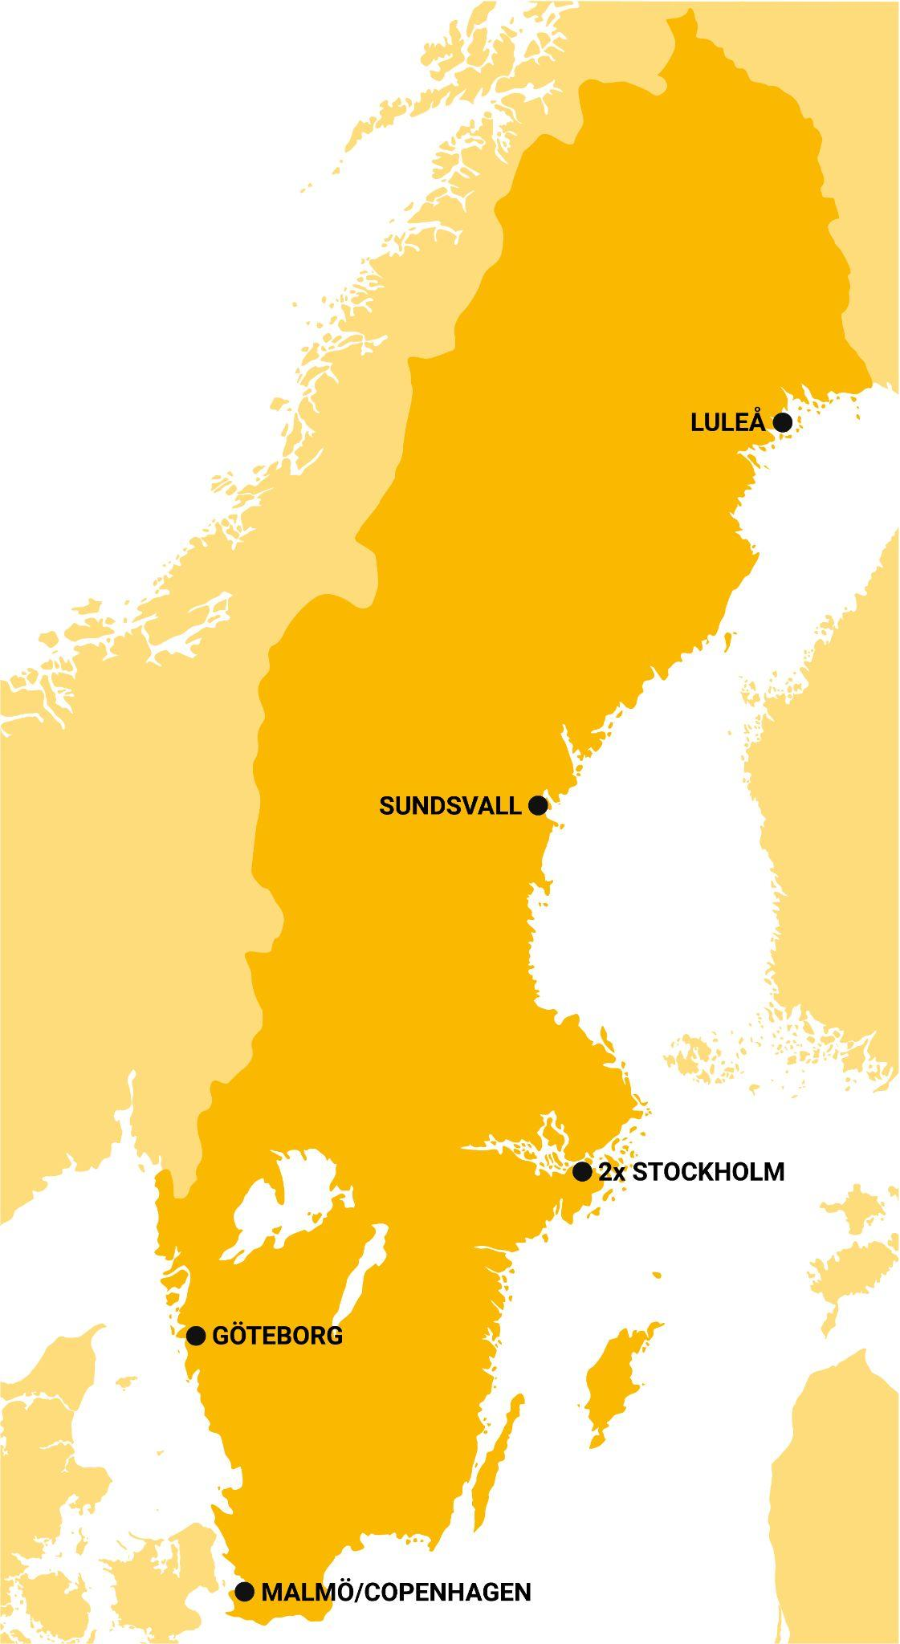
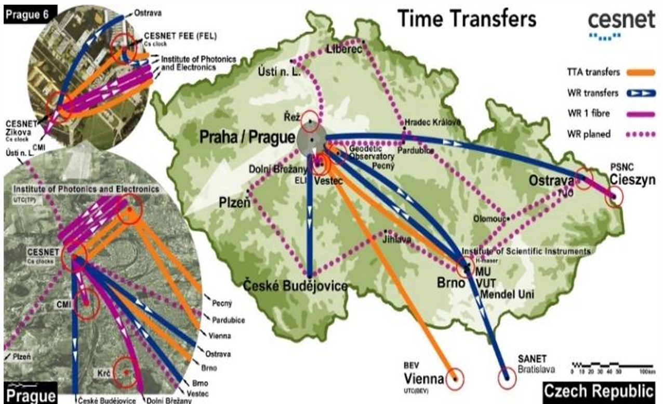
Examples of Time Dissemination
Nordic Timing Network
UTC(SP) Distributed by Netnod
Financed by Swedish Post and
Telecom Authority
6 time nodes in secure locations
Image: FUNET
Distribution of National time UTC(k) via PTP-White Rabbit to applications: France, Finland, UK, Italy, Sweden, Netherlands, Bosnia, Czechia, Belgium, Switzerland…
(disclaimer: non-exhaustive list)
UTC(JV)
UTC(MIKE)
UTC(SP)
UTC(SP)
Image: Cesnet
Image: Netnod

Slide 9

European Partnership on Metrology
Call plan:
(Thematic Programmes)
2021 Green Deal
2022 Health, Integrated European
Metrology, Digital transformation
2023 Fundamental, Industry
2024 Green Deal, Digital transformation
2025 Health, Integrated European
Metrology
2026 Fundamental, Industry
2027 Green Deal, TbD
• Normative call each year
• Research Potential
More: http://metpart.eu/
Metrology Partnership:
  Aims to bring together the measurement science community and stakeholders
  Addresses global challenges such as health and climate, supporting the European Green Deal
  Fosters innovation in industry through collaborative research.
Objectives:
  Supports the transition to a green, climate-neutral, and digital Europe
  Strengthens the resilience, competitiveness, and economic growth of European industry
Funding and Impact:
  Co-funded by Member States and the European Union
  Anticipated impact spans policies, commerce, and the advancement of European challenges

Slide 10
Metrology Partnerships have supported time and frequency research (by call year)
Time and Frequency Dissemination:
Clocks:
2018: Advanced time/frequency comparison and dissemination through optical telecommunication networks
2015: Optical frequency transfer - a European network
2015: Time Synchronisation Impact Enabling Future Network Communication
2011: Accurate time/frequency comparison and dissemination through optical telecommunication networks
Applications:
2017: Precision Time for Industry
2021: Metrology for digital substation instrumentation
2023: Controlled confinement to reduce the inaccuracy of clocks based on optical lattices
2023: High-accuracy ion-based optical clocks
2022: Transportable optical clocks for key comparisons
2020: Two-species composite atomic clocks
2020: Next generation ultrastable lasers: reducing thermal noise limit and overcoming technical limitations with new materials and technologies
2018: Robust Optical Clocks for International Timescales
2015: Optical clocks with 1E-18 uncertainty
2012: Compact and high-performing microwave clocks for industrial applications
2012: International timescales with optical clocks
2011: High-accuracy optical clocks with trapped ions
And more! (TC-TF projects are covered in presentation by Joseph Achkar)

Slide 11
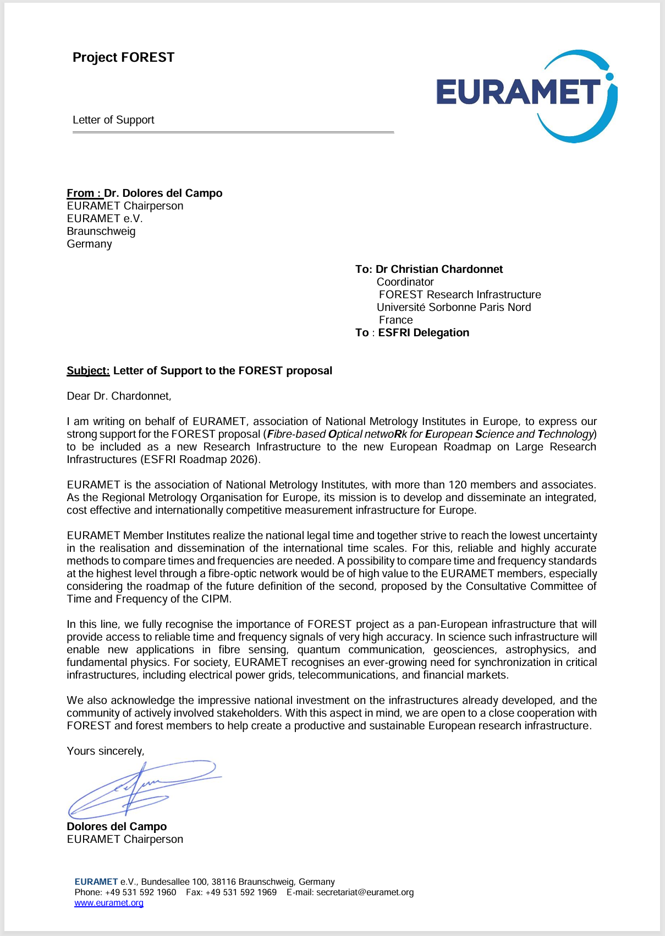
In Conclusion
EURAMET supports further European integration, and acknowledges the work done in CLONETS(-DS) project coordinated by GÉANT to develop a European infrastructure to provide a pan-European time and frequency reference system
EURAMET supports the FOREST (Fibre-based Optical Networks for European Science and Technology) ESFRI proposal to further operationalize this plan
EURAMET welcomes collaboration with GEANT and Commission / JRC on research and technology infrastructures, including time and frequency links
European Metrology Partnerships implemented by EURAMET have supported research on time and frequency (clocks and time/frequency links) through competitive calls
  EURAMET cannot support the operational costs of fibre network
EURAMET would be happy to join SIG-TFN to promote coordination of efforts in European NMIs – a contact point for GEANT and Commission/JRC to coordinate with the NMIs

Slide 12

Questions

