Slide 1
TC – Time and Frequency
Overview of activities and highlights
Joseph Achkar
TC-TF Chair
13 March 2025

Slide 2
OUTLINES
General information
  TC-TF Projects
  TC-TF CMCs - status across RMOs
  TC-TF time labs - UTC realization
EPM Projects in time and frequency
Events to highlight with TC-TF involvement
  Contributions to TC-TF meetings related to TFN
  BIPM-EURAMET training course in TF
Upcoming TC-TF meeting

Slide 3
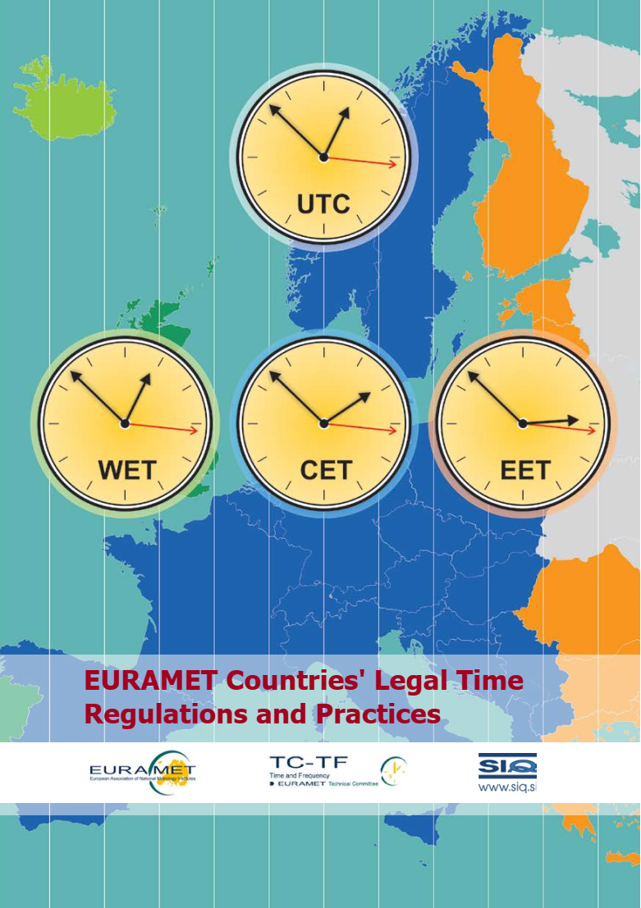
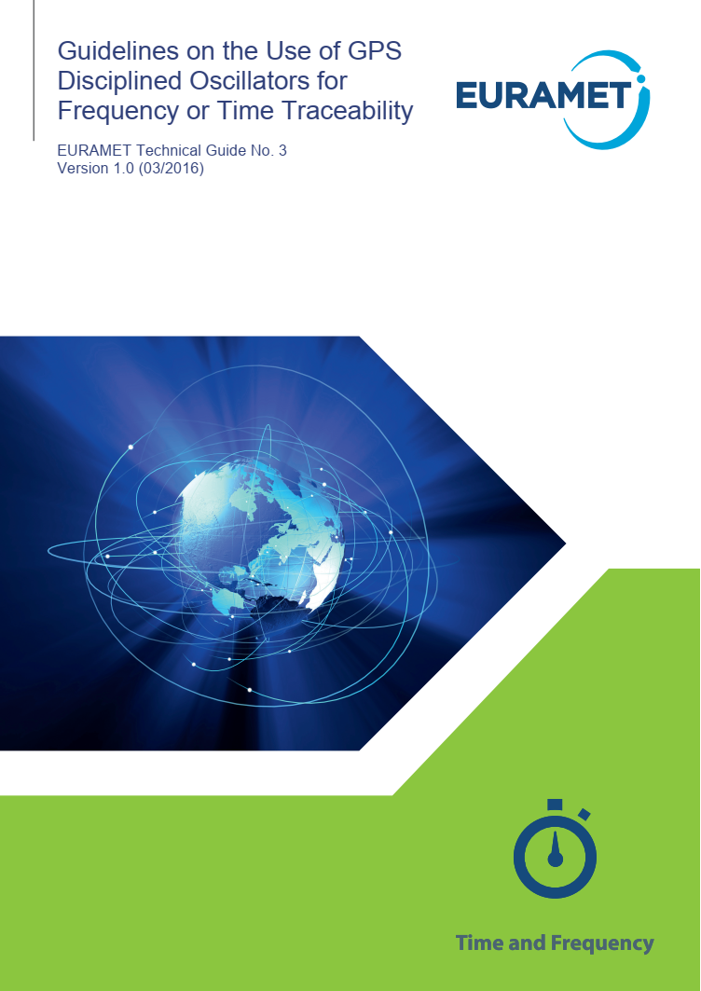
TC-TF GENERAL
Current status:
  32 contact persons
  2 contacts with observer status
  No sub-committees
  Working group for CMC reviews (8 members)
    BEV, GUM, ILNAS, LNE-OP, PTB, RISE, ROA, VSL
  A representative from TC-TF (IPQ) in TC-IM project 1448 on DCC
  TC-TF Communication Working Group (TC-TF/CWG) to liaise with the EURAMET communication department (NPL, LNE-OP)
  TC-TF Reference contact (INRiM) for Mathmet

Slide 4
TC-TF Projects
  The meeting approved in April 2024 the TC project on the key topic:
    White Rabbit on Wavelengths Division Multiplexing Networks
    Coordinating Institute: LNE-OP
NEW

Slide 5
TC-TF Projects
Approved by TC-TF in 2024
White Rabbit on Wavelengths Division Multiplexing Networks
Motivations
  Alternative and Complementary PNT
  Dissemination to industry, defense, space, radio astronomy
  Support to quantum telecommunication
Objectives
  Comparisons of UTC(k) time scales via wired technologies
  Pushing scientific exploitation
  Accelerating acceptance of the new definition of the SI second
Activities
  Coordinate efforts and help to find funding and accelerate deployment of fiber links
  Forum to discuss technology, stimulate collaborations,
  and develop synergies

Slide 6
TF CMCs - status across RMOs
Source JCRB
CCTF acting on 828 CMCs in total
EURAMET leads with 405 CMCs
accounting to 50% of the total TF CMCs in the KCDB

Slide 7
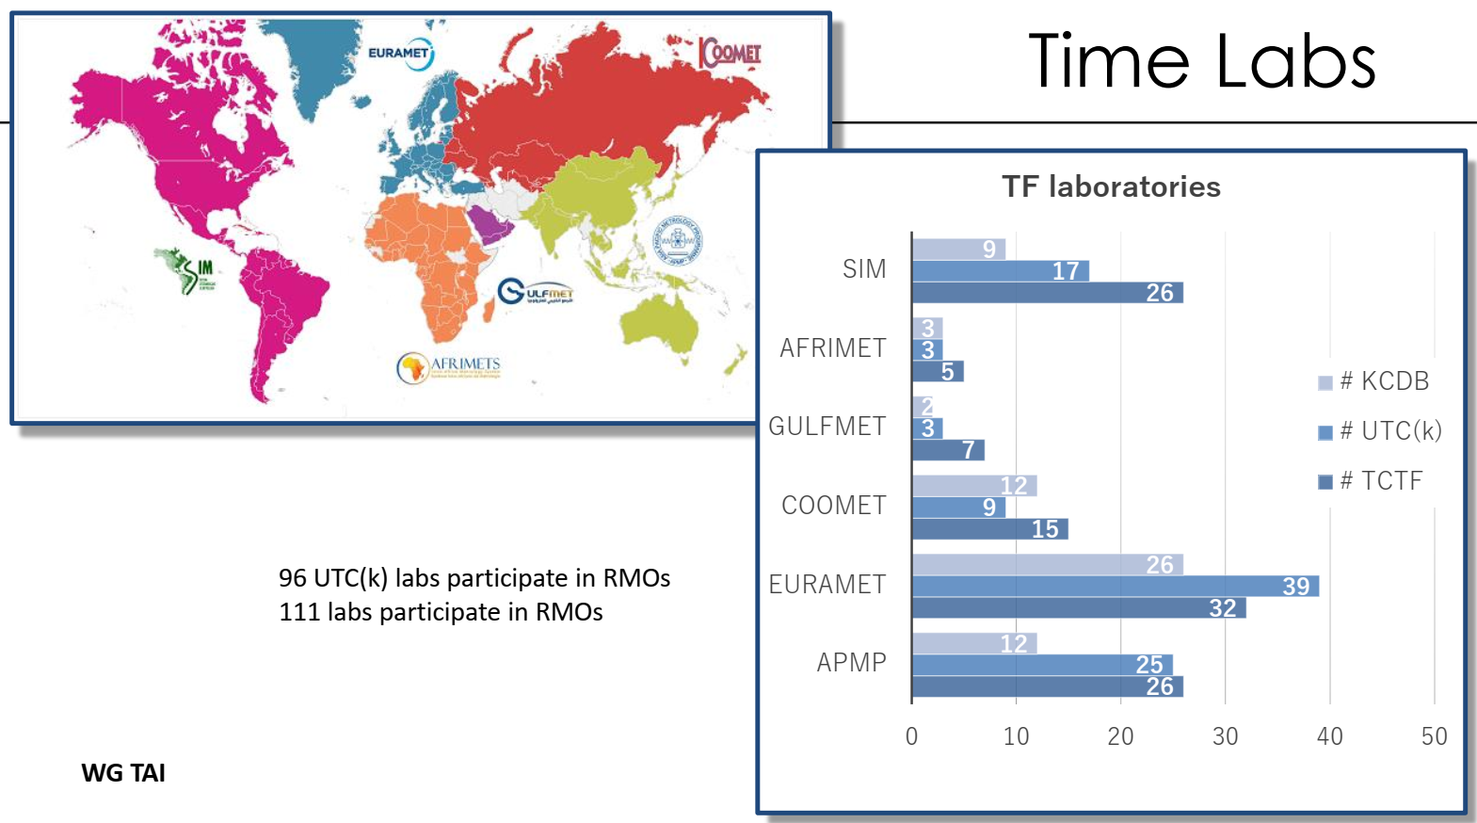
Source CCTF WGTAI

Slide 8
EPM projects
In progress
New
21NRM02 Digital-IT Metrology for digital substation instrumentation (MIKES)
➔ Timing activities
22IEM01 - TOCK Transportable optical clocks for key comparisons (PTB)
23FUN02 - CoCoRICO Controlled confinement to reduce the inaccuracy of clocks based on optical lattices (LNE-OP)
23FUN03 - HIOC High-accuracy ion-based optical clocks (PTB)
23FUN04 - COMOMET Fundamental physical metrology with cold molecules – Developing the next generation of frequency standards (INRiM)

Slide 9
Events with TC-TF Involvement
Events worth highlighting (1/3)
Update (2024) on roadmap towards the redefinition of the second
The CCTF Task Force (invol. EURAMET TF members) is preparing several documents to illustrate
  the possible redefinition options,
  the status of the redefinition candidates,
  the fulfillment of the mandatory criteria,
  and the educational activities.
Source BIPM

Slide 10

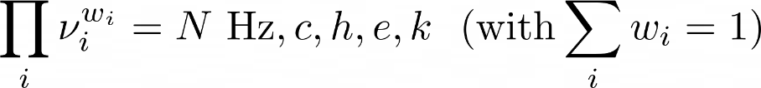
Events with TC-TF Involvement
Option 1
Option 2.1
Option 2.2
  CIPM can update w_{i}, N and the ensemble of chosen transitions following a set of predefined rules
  Option 2.2 is initially identical to option 2.1, and include option 1 as special case
Source BIPM
static definition
dynamic definition

Slide 11
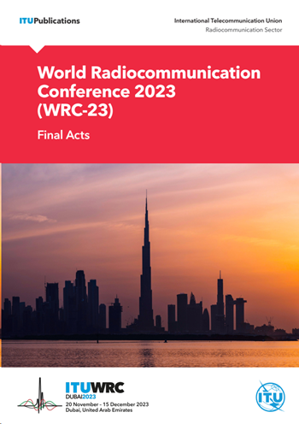
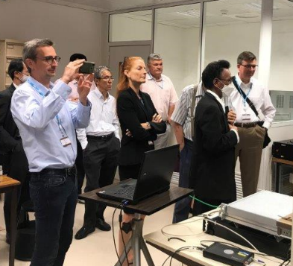
Events with TC-TF Involvement
Events worth highlighting (2/3)
Endorsement at WRC-23 of the decision by the BIPM to adopt continuous UTC as the time reference
The CEPT position at WRC-23, prepared jointly with members of the TC-TF, was one of the influencing factors contributing to the WRC-23 decision
BIPM hosted a meeting of ITU-R WP 7A in June 2023
CCTF TG (incl. TC-TF chair) on continuous UTC ➔ Draft Res. for CGPM 2026

Slide 12
Events with TC-TF Involvement
Events worth highlighting (3/3)
GEANT: C-TFN project
Acknowledge and welcome the support of GEANT to the infrastructure
GEANT should play a significant role in facilitating interconnections between national-level networks (such as REFIMEVE), adhering to the principle of subsidiarity
Funding mechanisms aside of GEANT initiative
  long-term renting of dedicated fiber would engage financially beyond a 3-year project cycle
  Sustainability and financial viability of the initiative?
Project Governance
  Decision processes seems to be under GEANT project team
  Governance structure of the C-TFN and liaison with existing bodies?
Cost-effectiveness: Given the significant cost of dedicated fibre, we need to consider whether it's truly necessary for the success of the project, or whether there are more cost-effective alternatives that can achieve our goals
The scientific scope of a EU infrastructure must go well beyond TF metrology

Slide 13
Contributions to TC-TF meetings
TC-TF meeting in 2024
Upcoming TC-TF meeting in 2025
C-TFN, how GEANT plans to build the first stage of the CLONETS-DS time/frequency network
The JRC proposal on the UTC terrestrial time backbone
WR on xWDM network at European level
Fiber-based Optical netwoRk for European Science and Technology FOREST

Slide 14
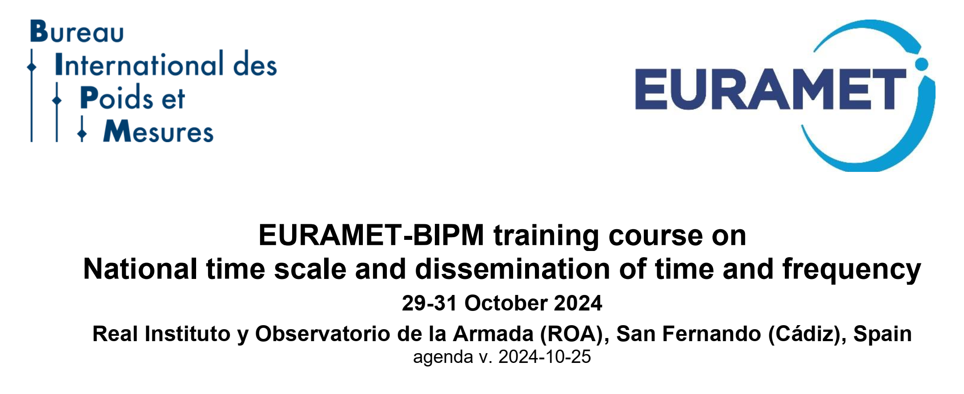
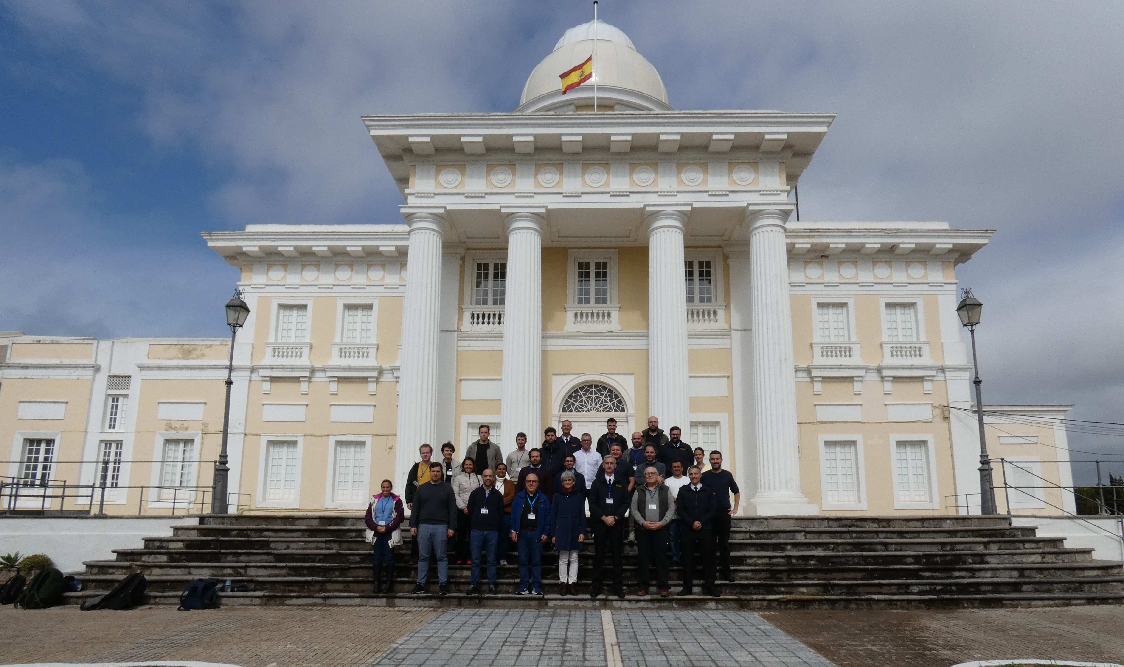

Slide 15
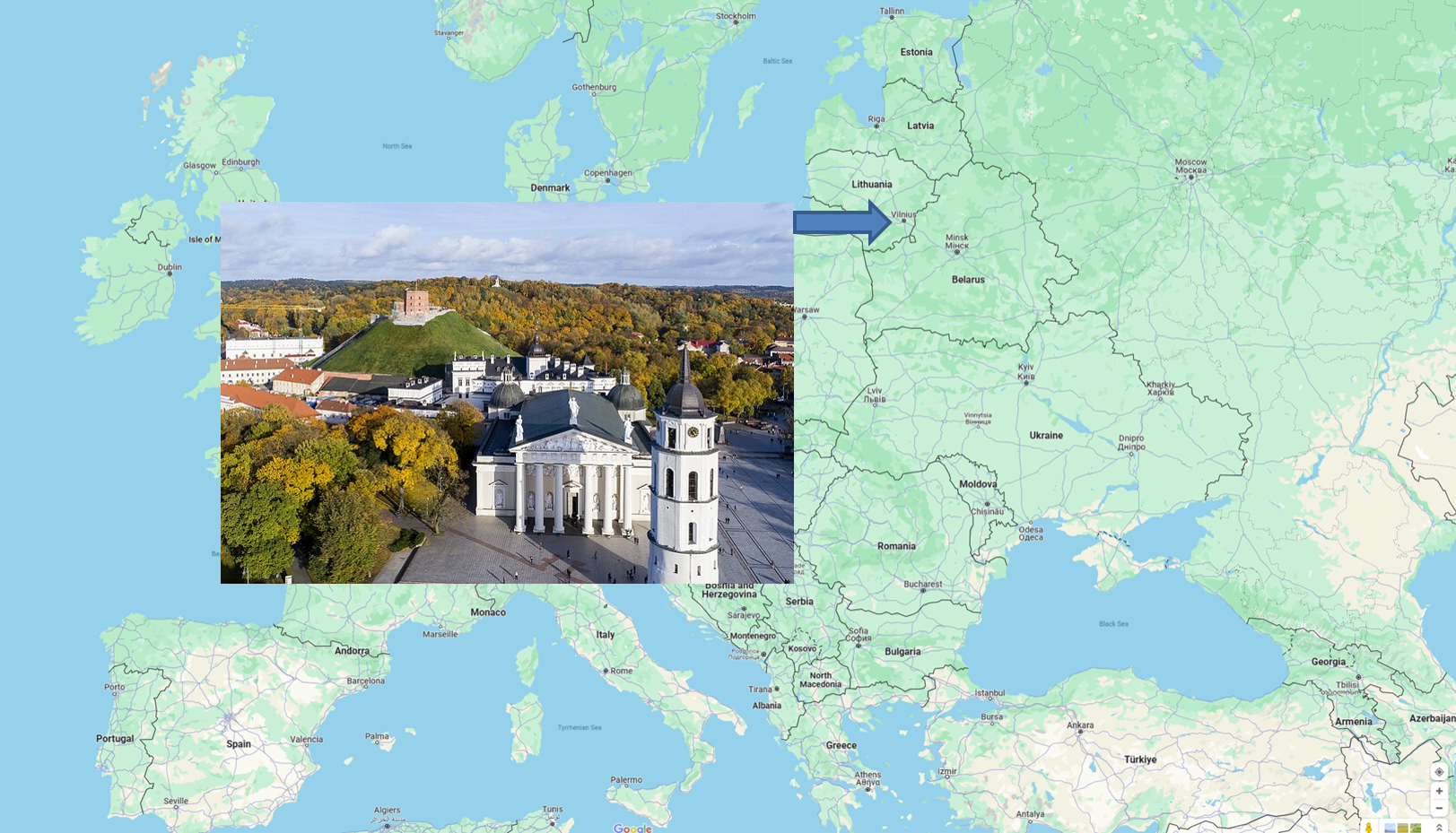
Next TC-TF meeting at FTMC Vilnius (Lithuania) on 25-26 March 2025
Thank you!

