Slide 1
The Switch CommunitySOC an Overview
10.03.2025 – Geert Hoevenaars

Slide 2

Challenge
A journey in an increasingly complex landscape

Slide 3


Customer Personas
Anna
Lars
CISO
Security
Challenges
Future budgets cuts (cantonal and state)
Dealing with the imbalance between decreasing resources and increasing scope of work packages
Rapidly increasing threat level
Challenges
Very limited resources and high pressure ("Survival-Mode")
Keeping up to date while maintaining a high pace of development
Restrictions in a university environment and no access to commercial solutions
Solution wanted:
  Lower investment than FTE with external support team
  Dedicated services make efficient use of limited resources
  Access to experts to monitor the state of security in the institution and get insight into state-of-the-art responses.
Solution wanted:
  A simple Solution that considers the limitations of the research and education field
  High Flexibility: Finetuning, adjusting, configuration on every level
  Support to handle the overload, backing of a strong partner to help with the complexity of the task at hand

Slide 4
Services up until Q3 2024
Operations
Services
Intelligence
Services
Custom
Engineering
SOC Services
Switch
SOC Advanced
Service Team
24/7 Pikett
Advanced Threat Hunting*
S
Service Module
*
Service in Development
SOC Sentinel
(custom Defense)
S
Red Teaming*
Security Engineering
→ All Services available individually
SOC Basis
Available as a package
(cost advantage)
SOC Light
(All-in-one-Defense)
Threat Intelligence
S
Use Case Management
Operational Support
Threat Hunting
S
Patch Management*
S
Vulnerability Management
S
SOC Access
Mandatory licence fee
(costs depending on size of institution)
SOC Community Module
(General SOC Access)
🔑
Notes:
Switch started several years ago with a basic community offering, in which our customers can exchange experiences
On top of that, Switch developed 2 additional offerings, based on the client’s environment and customised to the client’s needs.
But these are less transparent for both production as well as invoicing and do not enable maturity level scoring.

Slide 5
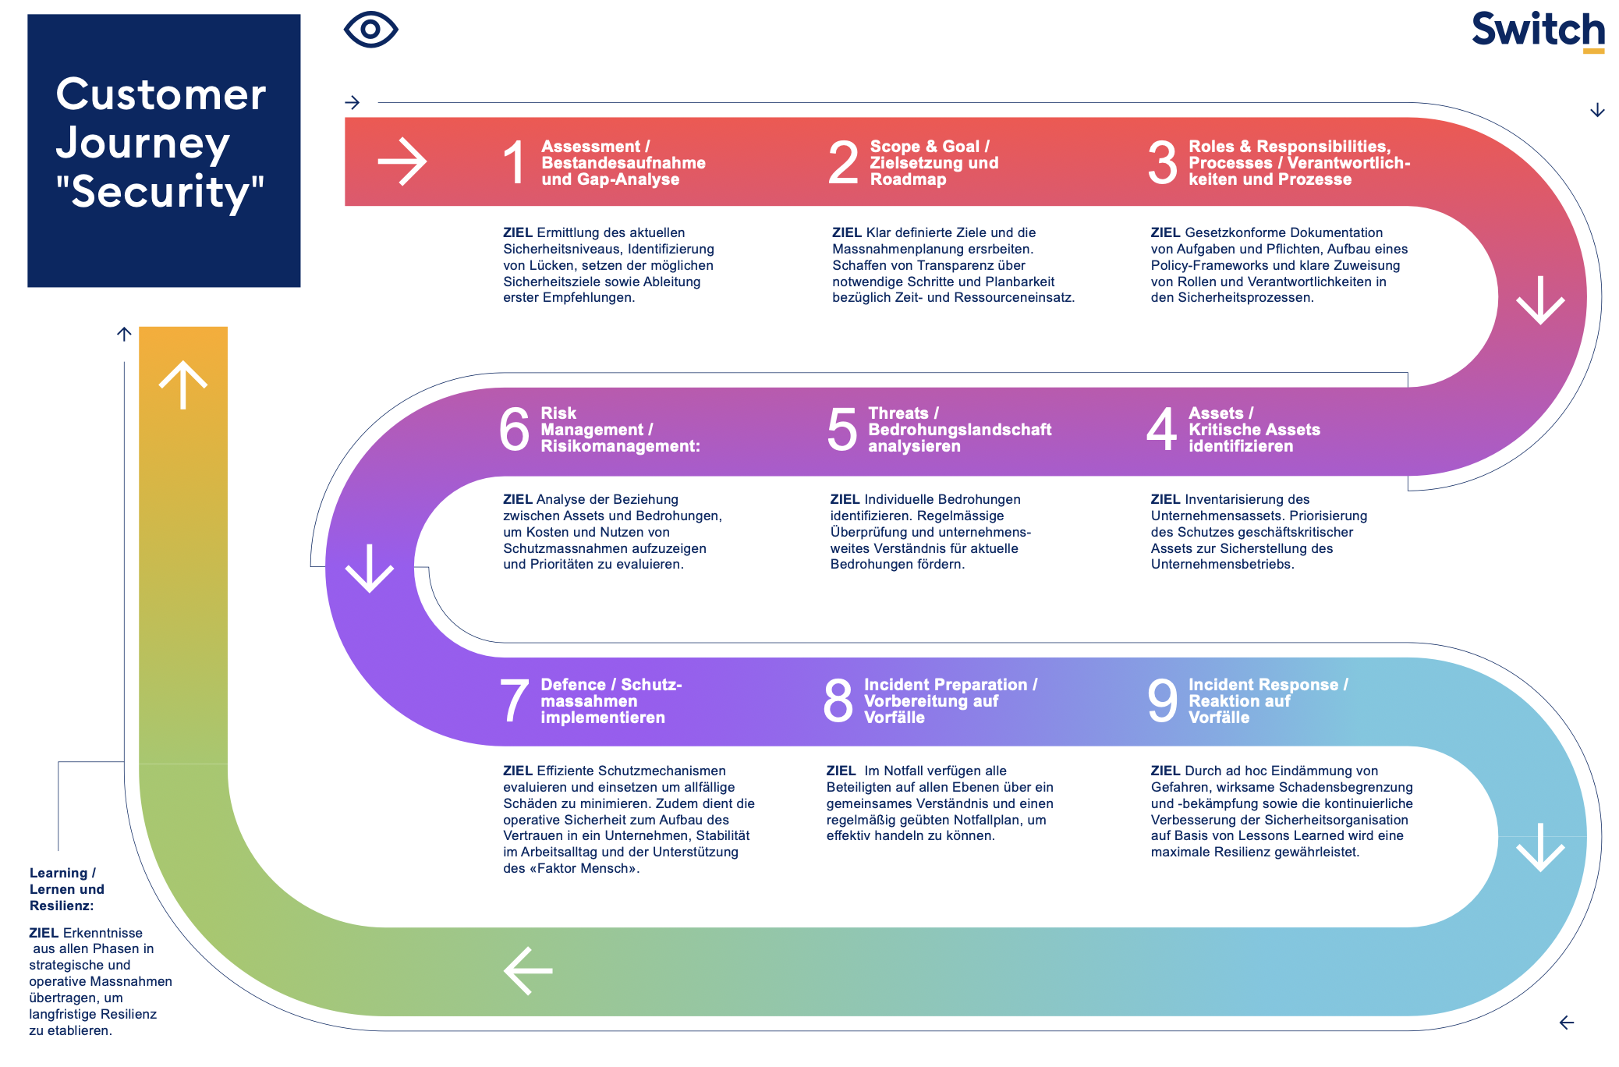
Notes:
Switch has created a new standard “Customer Journey” along which we guide the customer; this enables for us the role of consultant.
Each step of the journey is connected to one or more modules in our security portfolio (these range from preventative security awareness courses, organisational and process consulting, SOC functionality such as threat intelligence and vulnerability management, to incident response). We call that las tone “when the monster does attack”.
This enables us to determine the customer’s security maturity on a regular basis and an optimal transparency on individual measures.

Slide 6

Advanced Threat Hunting*
Mature Security Operations
Red Teaming*
Journey
24/7 Pikett
SOC Sentinel
(custom Defence)
S
SIEM
3rd party log sources
Security Engineering
Advanced Maturity Level
Threat Intelligence
S
Threat Hunting
S
Situational Awareness
Custom Solutions
Security Engineering
Organisational Maturity Security Level
Use Case Management
Intermediate Maturity Level
SOC Light
(All-in-one-Defence)
Endpoint Protection
Vulnerability Management
Vulnerability Management
S
Operational Support
Patch Management*
S
Basic Security Hygiene
Power BI Dashboard*
Basic Maturity Level
🔑
SOC Services
Switch
Operational Services
Intelligence Services
Custom Engineering
SOC Community Module
(General SOC Access)
Service Team – rotation between all team members
S
Service Module – relying on few specialists
*
Service in Development
SOC Customer Journey
→ All Services available individually
Notes:
According to the customer journey for general security, we have created a more detailed SOC customer journey.
Here we use the same principle: transparency, modularity, consultancy, maturity.
We are currently prioritising, planning, defining and pricing each module and linking it to the maturity level.
These modules also enable a clear capacity planning for the team.

Slide 7
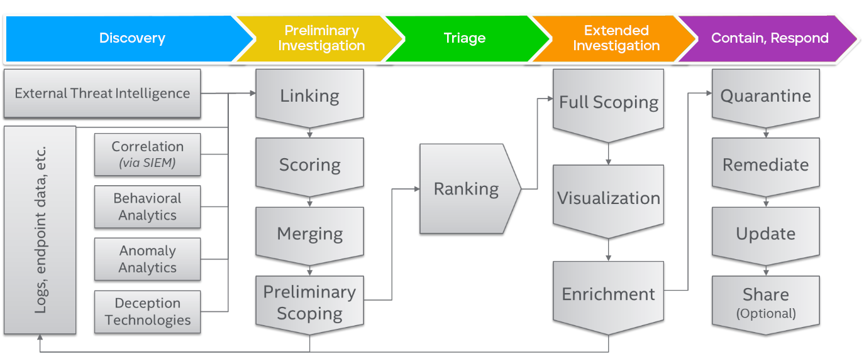
Switch SOC Light Portfolio
Based on MS Defender
Incident Management
& Response
24/7 SLA
Vulnerability Management
Threat Intelligence
SOC Light
Collect data
Critical Incidents
Threat Hunting
Detect threats
Customer MS Defender
Investigate threats
Medium/critical incidents
Respond to incidents
Use Case Management
Patch Management
Power BI Dashboard
Notes:
SOC Light may be called SOC Defender in future.
It is based on MS Defender running on the customer’s infrastructure (workstations, servers, …) and supplying event logs.
Switch adds several general modules such as Threat Intelligence and Common Threat Hunting, which can be added to any SIEM.

Slide 8
Switch SOC Sentinel Portfolio
Based on MS Sentinel
Red Teaming
24/7 SLA
Vulnerability Management
SOC Sentinel
Adv. Threat Hunting
Collect data
Threat Intelligence
Detect threats
Threat Hunting
Customer MS Defender & Sentinel
Investigate threats
Respond to incidents
Non-MS + custom connectors
Use Case Management
Patch Management
Power BI Dashboard
Notes:
SOC Sentinel is based on MS Defender running on the customer’s infrastructure (workstations, servers, …) and supplying event logs to & MS Sentinel.
Switch adds several general modules such as Threat Intelligence and Common Threat Hunting (compatible to any SIEM).
It is also possible to added non-MS and custom connectors.

Slide 9
Values
Switch Services
Operations
Services
Intelligence
Services
Engineering
Services
Community
Value
  A growing community leads to more synergy effects
  Feedback cycles for constant improvement
  Long-term commitment
  Appropriate cost model (FTE)
  From Co-existence to
  Co-creation for the common benefit
Value
  Scalability – from critical incidents to 24/7 operations
  Large Team of experienced analysts, always available
  Low-cost entry and advanced solutions are market-oriented
  Guaranteed emergency assistance
Value
  Professional curation, filters the unimportant = Less data + better quality
  Provides leads from practitioners for faster search for incidents
  External experts regularly assess the improvement of your overall security posture
Value
  Extended Engineering and Development Skills on demand
  Custom made solutions with a smooth integration into your environment
  Reduce costs of Azure Services

Slide 10
Current Community SOC Members
  20 Swiss universities
  1 non-profit tertiary education
  Switch
Security Services
  8 Swiss universities
  Switch

Slide 12
Advanced Threat Hunting*
Mature Security Operations
Red Teaming*
Journey
24/7 Pikett
SOC Sentinel
(custom Defence)
SIEM
3rd Party Logsources
Security Engineering
Advanced Maturity Level
Threat Intelligence
Threat Hunting
Situational Awareness
Custom Solutions
Security Engineering
Organisational Maturity Security Level
Use Case Management
Intermediate Maturity Level
SOC Light
(All-in-one-Defence)
Endpoint Protection
Vulnerability Management
Vulnerability Management
Operational Support
Patch Management*
Basic Security Hygiene
Power BI Dashboard*
Basic Maturity Level
🔑
SOC Services
Switch
SOC Community Module
(General SOC Access)
Customer Engineering
Intelligence Services
Operations Services
SOC Customer Journey
*
Service under development
Notes:
According to the customer journey for general security, we have created a more detailed SOC customer journey.
Here we use the same principle: transparency, modularity, consultancy, maturity.
We are currently prioritising, defining and pricing each module and linking it to the maturity level.
These modules also enable a clear capacity planning for the team.

