Slide 1

HEAnet SOC Overiew
GÉANT SIG-MSP
Paris, March 2025
Robert Hackett

Slide 2
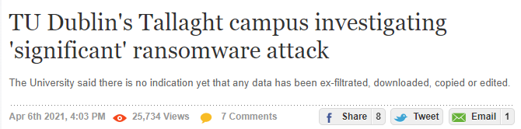
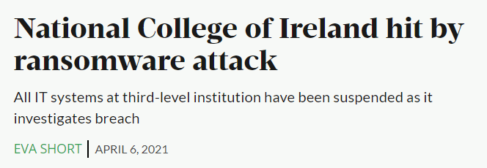
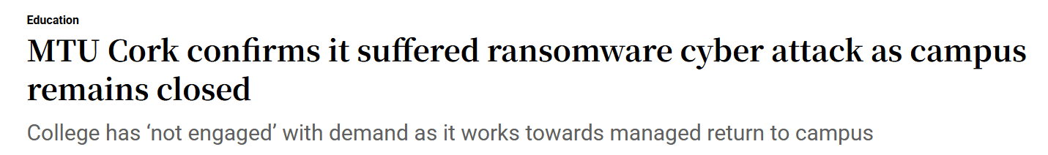
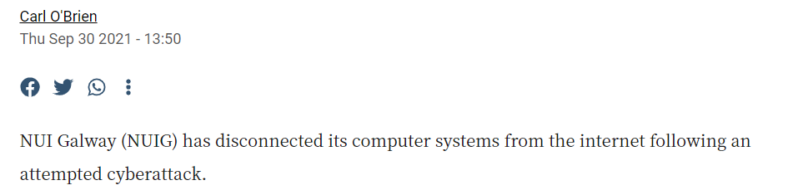

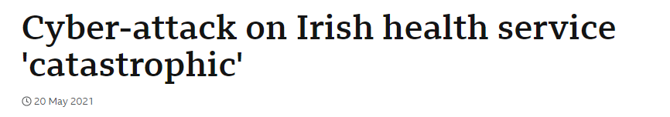
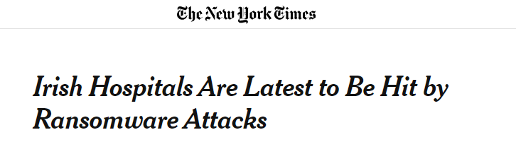
We don’t need a SOC !
Notes:
Lots of breaches
Never waste a good crisis

Slide 3
Key Decision Points & Challenges
Security as a future service development area
  What to delivery – CSAG
  How to do it
  Client expectations
  Resources
  Security is expensive ! - Funding
  Legal
Client security need – SOC is #1
SOC is a big undertaking
Notes:
Security now part of strategy – presentation later
HEAnet value central to delivery of the service, adjacent to other services
Benefit of experience of other NRENs – especially SURF

Slide 4
Key Decision Points & Challenges
HEAnet strengths & value proposition
Sectoral approach
Feasibility Study
Benefits of other NREN experience
Shared service or bespoke
Delivery model – Inhouse / Managed (HEAnet service)

Slide 5

HEAnet SOC Timelines
Cyber Attacks
CSAG
Shortlisting
Board
Feasibility Tender
2021
Funding
/Brokerage
Feasibility Study / Business Case
Award Contract
Procurement
2022
Build
Production
Development
2023

Slide 6
Summary
SOC is a big undertaking & high cost
Highly valued by Clients
Need clear Client demand
Client readiness & resources a challenge
Underestimated legal complications
Outsourced MSSP Model works
SOC is not the answer to everything – defense in depth is
Lots of potential for NRENs and GÉANT to play a role

