Slide 1

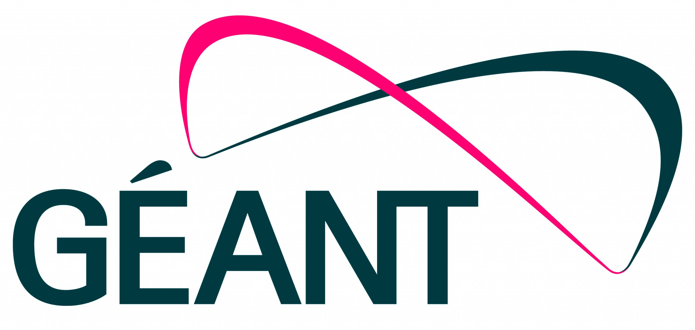
OCRE2024 update
GÉANT
24 March 2025, SIG-MSP Paris
Michel Wets

Slide 2
Key benefits for R&E institutes
Access to broad set of national, European and US cloud platforms
Ready to use contracts & without having to tender
Fully compliant with the right conditions of use
Win – Win: Easy to use & creating a route to market
Enabling acceleration of cloud transformation in R&E
Supported by NRENs and GÉANT

Slide 3
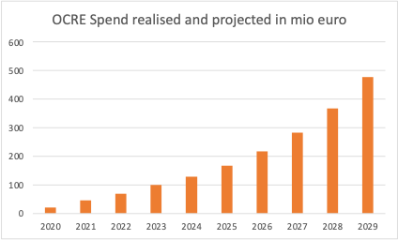
OCRE2024 recap
3rd iteration of pan-European cloud tender | IaaS+
Currently used by 1000+ institutes in 28 countries
Spend 2024: 125M Euro, > 25% growth YoY
Contract value over 5 years: 1.8 B Euro

Slide 4
Timeline and planning
Tender actions | Days | Start | Finish
Publish OJEU notice & ITT (Open Procedure) incl. Contract terms | 0 | 20 March 2024
Webinar | 14 | 3 April 2024 – 15:00 CET
Period that questions can be sent in | 30 | 20 March 2024 | 19 April 2024- 12:00 CET
GÉANT will answer questions continuously. Final notice released | 11 | 30 April 2024
Bidder response time | 54 | 20 March 2024 | 13 May 2024
Deadline for sending in Offers | 54 | 13 May 2024 11:00 CET
Evaluate submitted Offers* | 158 | 13 May 2024 | 18 October 2024
Intent to Award Letter(s) sent out & debrief failed Bidders via correspondence* | 30 | 21 October 2024 | 22 November 2024
Standstill term from date sent out correspondence | 20 | 22 November 2024 | 12 December 2024
Contract production and completion* | 50 | 12 December 2024 | 31 January 2025
Start Date Framework Agreements* |  | 3 February 2025 | 3 February 2030
Jan.–Mar. 2023
Establish procurement task force
Mar.– Oct. 2023
Dec. 2023
Jan. - Feb. 2024
Finalizing ITT documents
March 2024
Launch the procurement
Dec. 2024
Contracts signed
May 2024
Tender closure & evaluation
PIN creation and Market Analyses
Commitment & Scoring team

Slide 5
Next steps
OCRE 2024 launch event 8-9 May
Assist NRENs in adoption
Strategic Vendor management
Compliance checks
Assist NRENs in adoption
Increase visibility European platforms
Can we take this global?

Slide 6
Investment
Investments | FTE | No years | Total over FW duration
Tender incl. PIN, scoring, awarding | 8 | 1 | 8
Contract Management (CMG) | 3 | 5 | 15
Strategic Vendor management | 1 | 5 | 5
NREN cloud community | 2 | 5 | 10
Total FTE (ManYears) |  |  | 38
Costs per FTE |  |  | € 150.000
Total FTE costs |  |  | € 5.700.000
Travel costs |  |  | € 400.000
Marcom, Events etc |  |  | € 200.000
Total OCRE2024 investment |  |  | € 6.300.000
Notes:
Not taking into account that part of these activities are carried out under the GN5-1 and GN5-2 programs and are partly funded by the EC

Slide 7
Projected savings
year | no institutes | savings on tenders | savings due to no individual tenders | total consumption | savings on discounts | savings discounts
2024 | 1000 |  |  | € 125.000.000
2025 | 1100 |  |  | € 156.250.000 | € 19.703.125 | € 19.703.125
2026 | 1210 |  |  | € 195.312.500 | € 24.628.906 | € 24.628.906
2027 | 1331 | € 42.592.000 | € 42.592.000 | € 244.140.625 | € 30.786.133 | € 30.786.133
2028 | 1464 |  |  | € 305.175.781 | € 38.482.666 | € 38.482.666
2029 | 1611 |  |  | € 381.469.727 | € 48.103.333 | € 48.103.333
Total |  | € 42.592.000 | € 42.592.000 |  | € 161.704.163 | € 161.704.163
10% | annual growth of consuming institutions
25% | growth total consumption year over year
40% | institutes consuming which would have to run own tender
€ 80.000 | cost of running a European tender
13% | average discount under OCRE 2024
3% | average NREN CRF
Total OCRE2024 savings |  |  | € 204.296.163
Total investment: 6.3 Mio
Total savings: 204 Mio
Tender effectiveness:
32x

Slide 8
Thank you for your support!
Monique Pellinkhof, GÉANT
Garvan McFeeley, HEAnet
Michel Wets, SURF

