Slide 1
RedIRIS
Connecting Spanish universities and R&D since 1988
www.rediris.es
STRATEGIC PLAN 2025 - 2028
GÉANT SIG-MSP, Paris, 25.03.2025

Slide 2

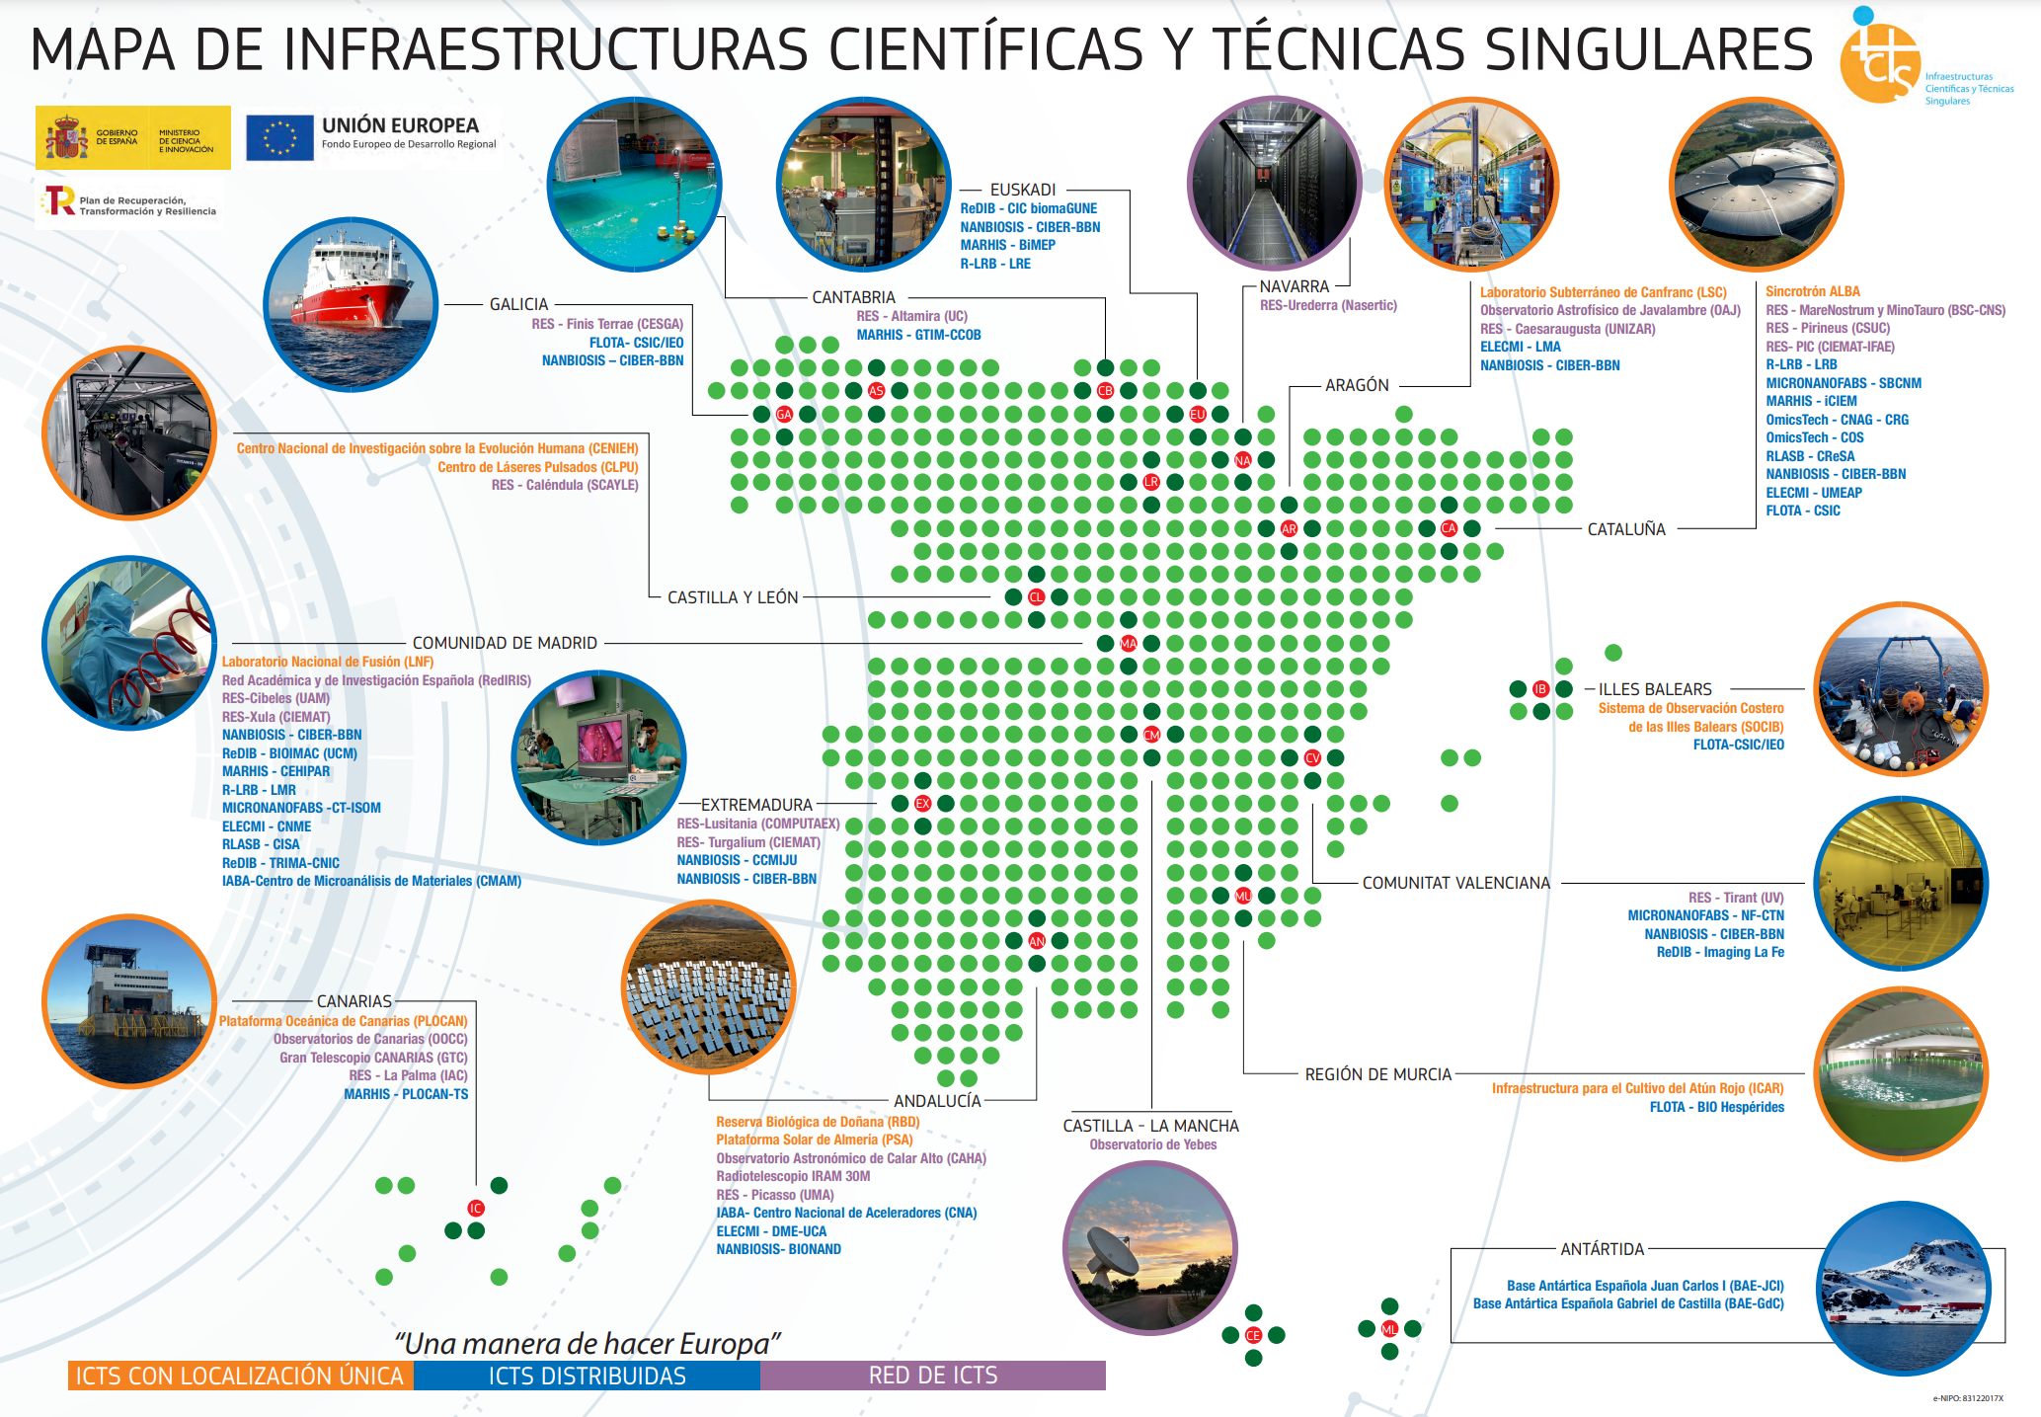
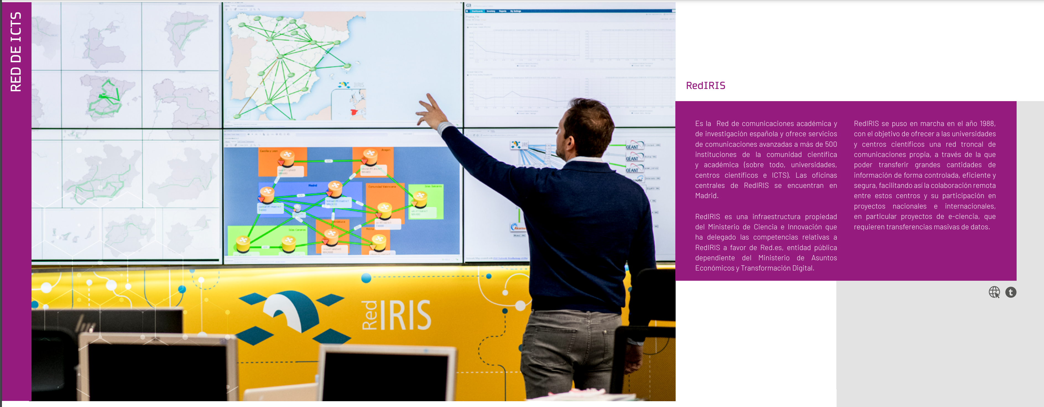
Servicios de RedIRIS | Evolución
RedIRIS as ICTS
ICTS: Infraestructura Científica y Técnica Singular
(Unique Scientific and Technical Infrastructure)
  Infrastructure (not other kinds of scientific resources)
  Unique
  Goals aligned with R&D policy
  Significant investments (> 10 M€)
  Open Access [specific rules for RedIRIS]
  Publicly owned
  External Advisory Committee
  Strategic Plan (in English – assessed by international experts)
RedIRIS: It is already included in the current Map of ICTSs of the Ministry of Science – now ICTSs are asked to provide the required documentation to remain on that Map (UPDATE EVERY 4 YEARS)
Strategic Plan 2025-2028 (successor to the Strategic Plan 2021-2024)
(Sent to the Ministry of Science for external assessment in February 2025)

Slide 3
Servicios de RedIRIS | Evolución
  Index of the ICTS Strategic Plan 2025-2028
INDEX ESTABLISHED BY THE MINISTRY OF SCIENCE FOR THE STRATEGIC PLANS OF ALL ICTSs (UNIQUE RESEARCH INFRASTRUCTURES)
Fulfilment of the previous Strategic Plan
Mission and vision
3. SWOT analysis
3.1. Context analysis
3.2. SWOT
4. Objectives of next four-year period
4.1. Description of the objectives
4.2. Strategies for achieving the objectives
4.3. Execution of the strategies (actions)
4.4. Resources
5. Timeline and monitoring
5.1. Timeline
5.2. Monitoring indicators

Slide 4
Servicios de RedIRIS | Evolución
  Mission and Vision
Mission
Provide excellent connectivity and other ICT services to Spanish educational and research institutions, in close cooperation with these institutions and with regional and international research and education networks, in order to facilitate collaboration between them and their access to e-infrastructures, on a national and international scale.
Vision
To be the preferred partner in ICT services for Spanish educational and research institutions, promoting cooperation between them, and providing them with connectivity services and other ICT services of the highest quality, managed or acquired centrally, that promote e-Science and advanced learning.

Slide 5
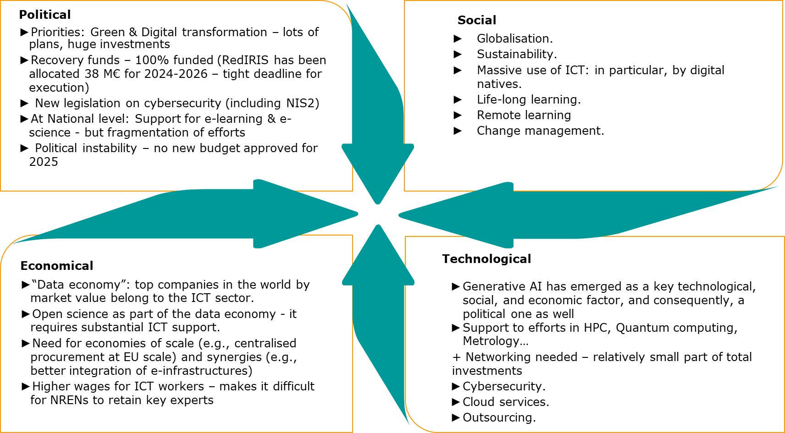
Servicios de RedIRIS | Evolución
  PEST Analysis

Slide 6
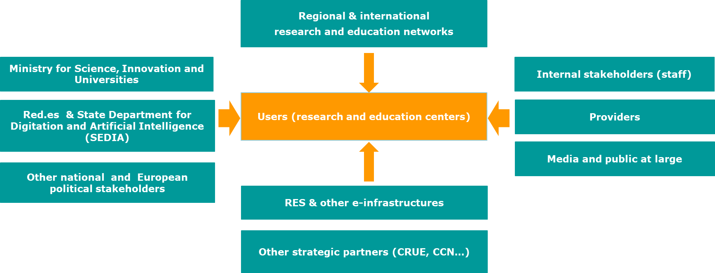
Servicios de RedIRIS | Evolución
  Stakeholders Analysis

Slide 7
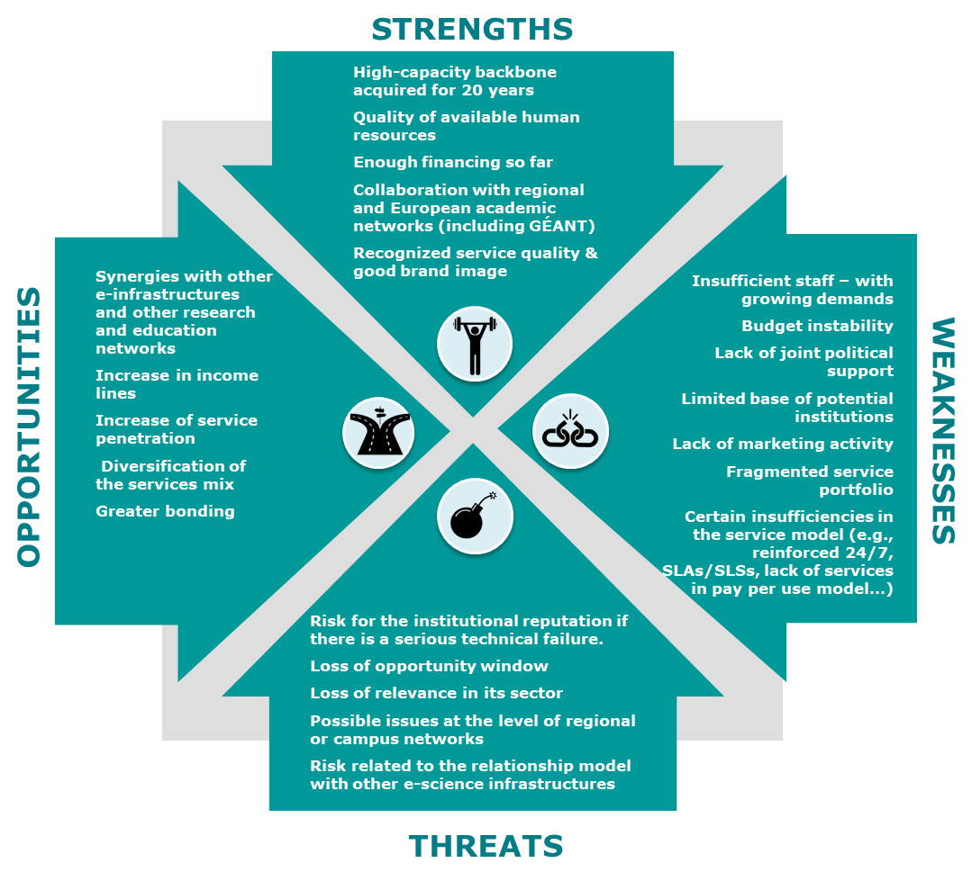
Servicios de RedIRIS | Evolución
  SWOT Analysis

Slide 8
Servicios de RedIRIS | Evolución
Objectives for 2025 – 2028
Objective 1 | Progress towards consolidation of the infrastructure
Objective 2 | Excellence in the delivery of secure, reliable services which provide significant added value
Objective 3 | Embrace a user-centric approach in the management of the services lifecycle, in order to increase service usage and user satisfaction

Slide 9
Servicios de RedIRIS | Evolución
Objetives for 2025 – 2028 – Strategies to achieve the objectives (I)
Objective | Strategy | Description
O1. Progress towards consolidation of the infrastructure | S1.1. Improve RedIRIS infrastructure | Deployment of new fiber for RedIRIS (Mallorca, closing some rings), plus launching some tenders for equipment replacement where needed
 | S1.2. Extend the RedIRIS-NOVA fibre footprint | In order to bring the full benefits of the RedIRIS model to additional relevant research and education centres – PERTE CHIP (45 M€)

Slide 10
Servicios de RedIRIS | Evolución
Objetives for 2025 – 2028 – Strategies to achieve the objectives (II)
Objective | Strategy | Description
O2. Excellence in the delivery of secure, reliable services which provide significant added value | S2.1. Reinforce the IT security of RedIRIS and its users | Deployment of new security equipment and services and implementation of security procedures and standards.
 | S2.2. Increase the reliability of the services | Audit of possible points of failure, increased redundancy, strengthened service support.
 | S2.3. Ensure the operational sustainability of RedIRIS | Stable budget; appropriate administrative arrangements; improved knowledge management; staff policy that tackles the current severe shortage and keeps staff motivated and up to date.
 | S2.4. Constant improvement of the value proposition of RedIRIS services | Implementation of a roadmap of upgrades of the existing services; keeping track of new trends (AI, quantum networking, time and frequency; blockchain, etc) through cooperation with relevant stakeholders (research networks, advanced users, providers).
 | S2.5. Improved offering of IT services for open science | Focus on the services that have been identified, at an EU and national level, as most important for E-Science: data transfers; security; trust & identity; collaborative tools and shared cloud services.

Slide 11
Servicios de RedIRIS | Evolución
Objetives for 2025 – 2028 – Strategies to achieve the objectives (III)
Objective | Strategy | Description
O3. Embrace a user-centric approach in the management of the services lifecycle, in order to increase service usage and user satisfaction | S3.1. Enhanced collaboration with key stakeholders to improve user outreach | Collaboration with regional research networks, and other organisations (CRUE-TIC, RES, CCN-CERT, ICTSs consortiums) that can help RedIRIS to reach its users. This might include implementation of new tools (CRM); joint surveys to improve knowledge about users’ needs; and joint dissemination campaigns and events.
 | S3.2. Improvement of RedIRIS business intelligence | Updated information about users’ data and views; new internal tools; review of KPIs; RedIRIS and users dashboard; BI reports.

Slide 12
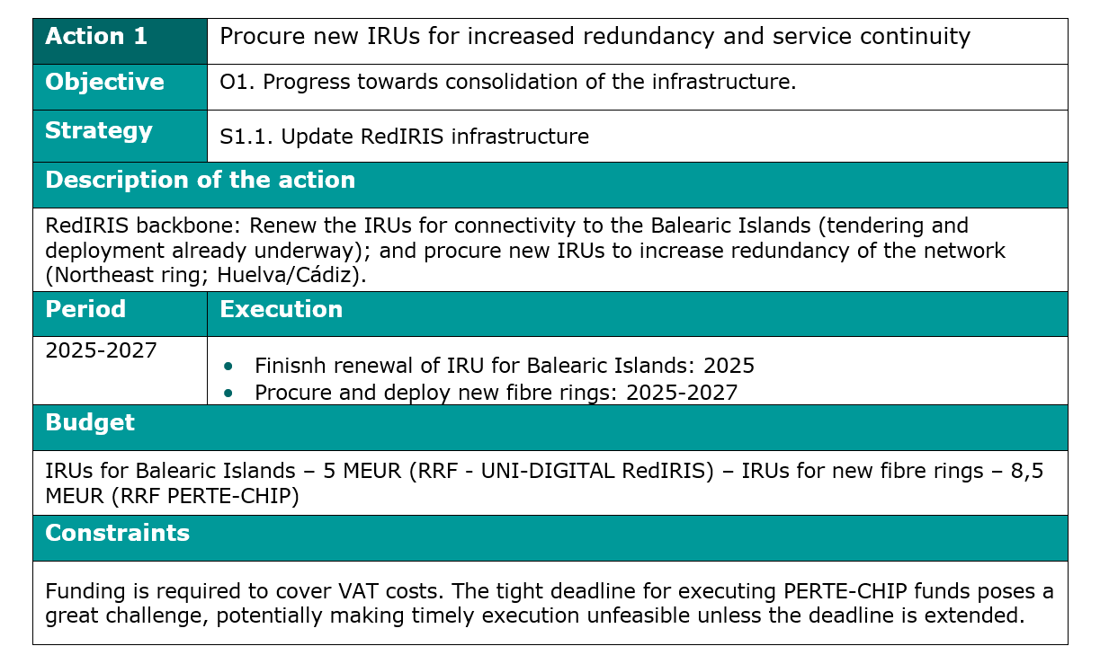
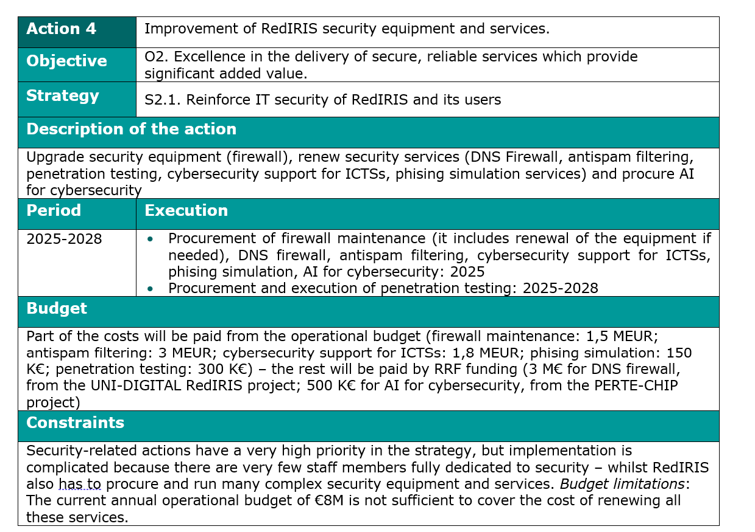
Servicios de RedIRIS | Evolución
  Actions (examples)

Slide 13
Servicios de RedIRIS | Evolución
  Timeline
Actions to be carried out 2025-2028
A1
Procure and deploy new IRUs for the RedIRIS backbone
A2
Procure maintenance or renewal of network equipment
A3
Procurement of IRUs and/or network equipment for other entities
A4
Procurement fw, DNS fw, antispam filtering, pentesting, vSOC, phising simulation, AI for cybersecurity
A5
Dynamic filtering; EDR
A6
ENS (intermediate level) & ISO 27001 for more RedIRIS services; NIS2 Directive
A7
Deploy high-availability systems
Additional service support
Various preventive measures to increase reliability
A8
Policies about key organizational issues and HR policies
A9
Launch new services – blockchain, e-science, e-administration, blended learning
Provision of those new shared ICT services and procurement of their maintenance
A10
Improvement of services related to e-science (data transfer; Trust & identity; new OCRE cloud Framework Agreement)
A11
New projects (Quantum networking; Time & Frequency; AI; automation)
A12
Reach new agreements: RRENs, CRUE, CCN, RES and ICTSs
Implement concrete measures proposed in action plans
A13
Improvements of internal tool to manage user information
Review KPIs, new BI and RedIRIS and user dashboard
Q1
Q2
Q3
Q4
Q1
Q2
Q3
Q4
Q1
Q2
Q3
Q4
Q1
Q2
Q3
Q4
2025
2026
2027
2028

Slide 14
Thank you!

