Slide 1
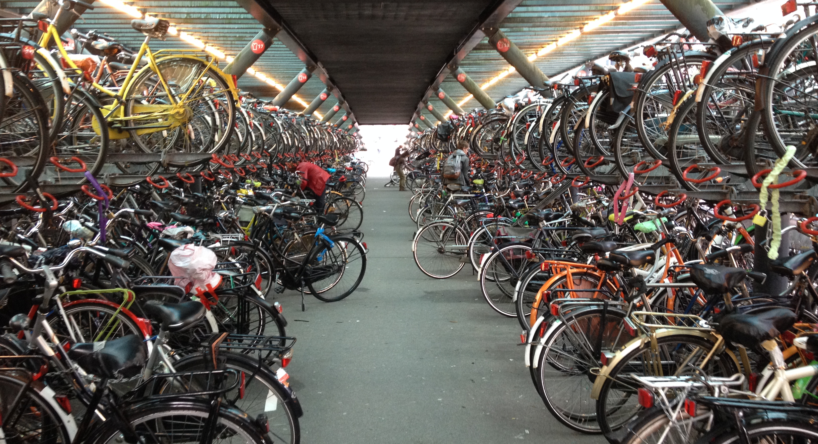
geteduroam update
Paul Dekkers
9 Jun 2025, Mobility Day @TNC25

Slide 2
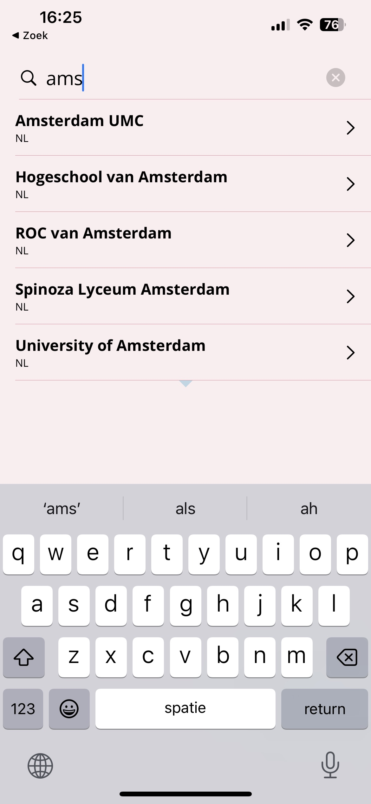
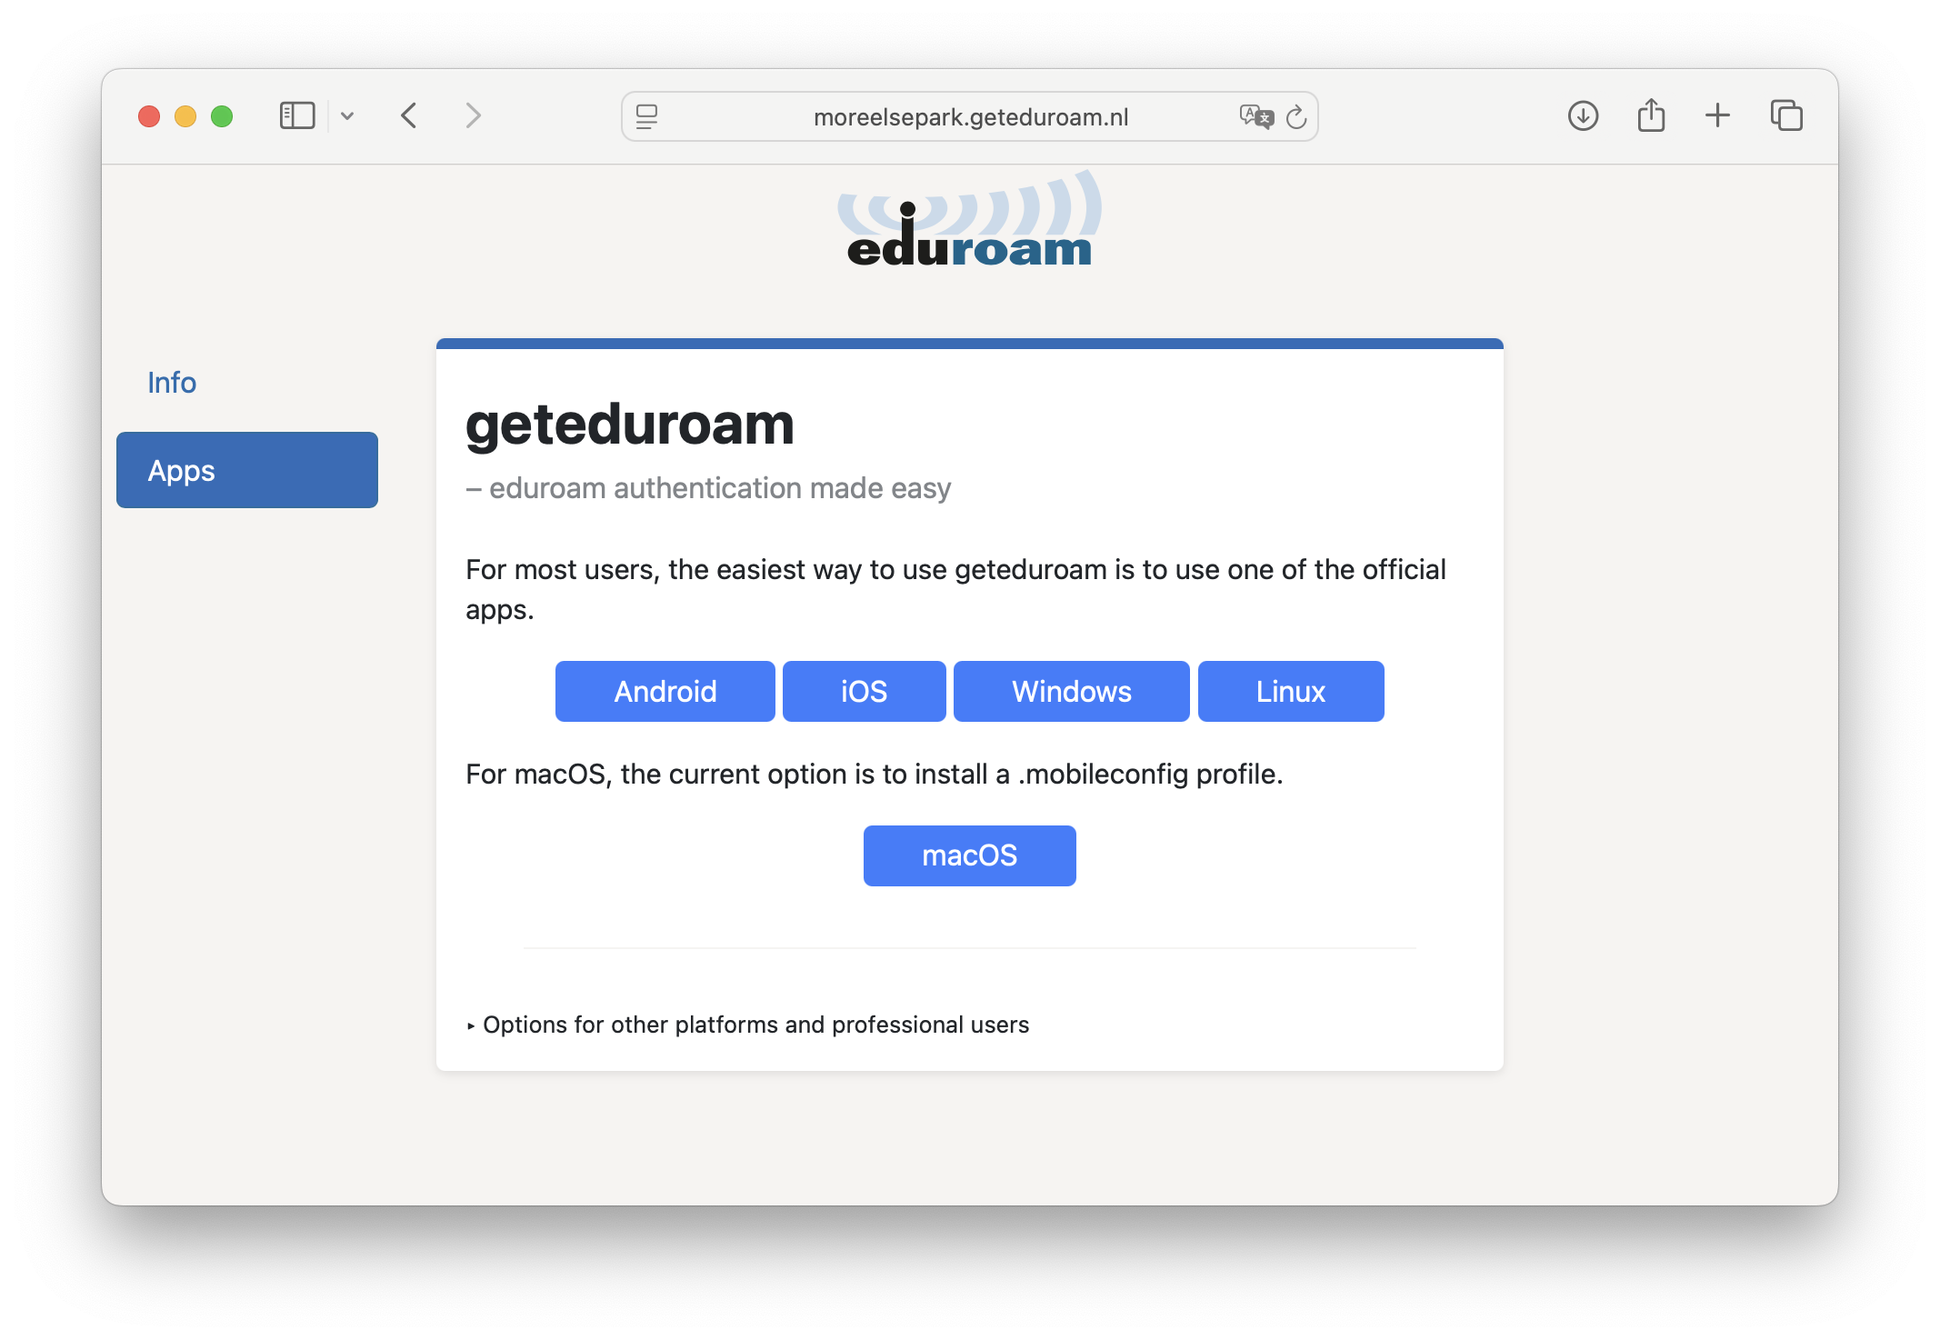
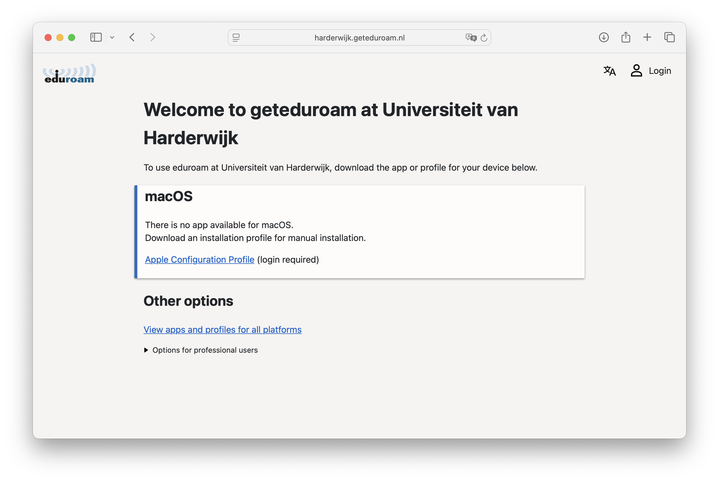
geteduroam basics
Help all eduroam users to easily and securely connect to eduroam
(and other/Passpoint networks)
  Apps to help set up eduroam correctly (for all platforms)
  Server software to create client certificates (EAP-TLS)
Made by & for eduroam community
sneak peek

Slide 3
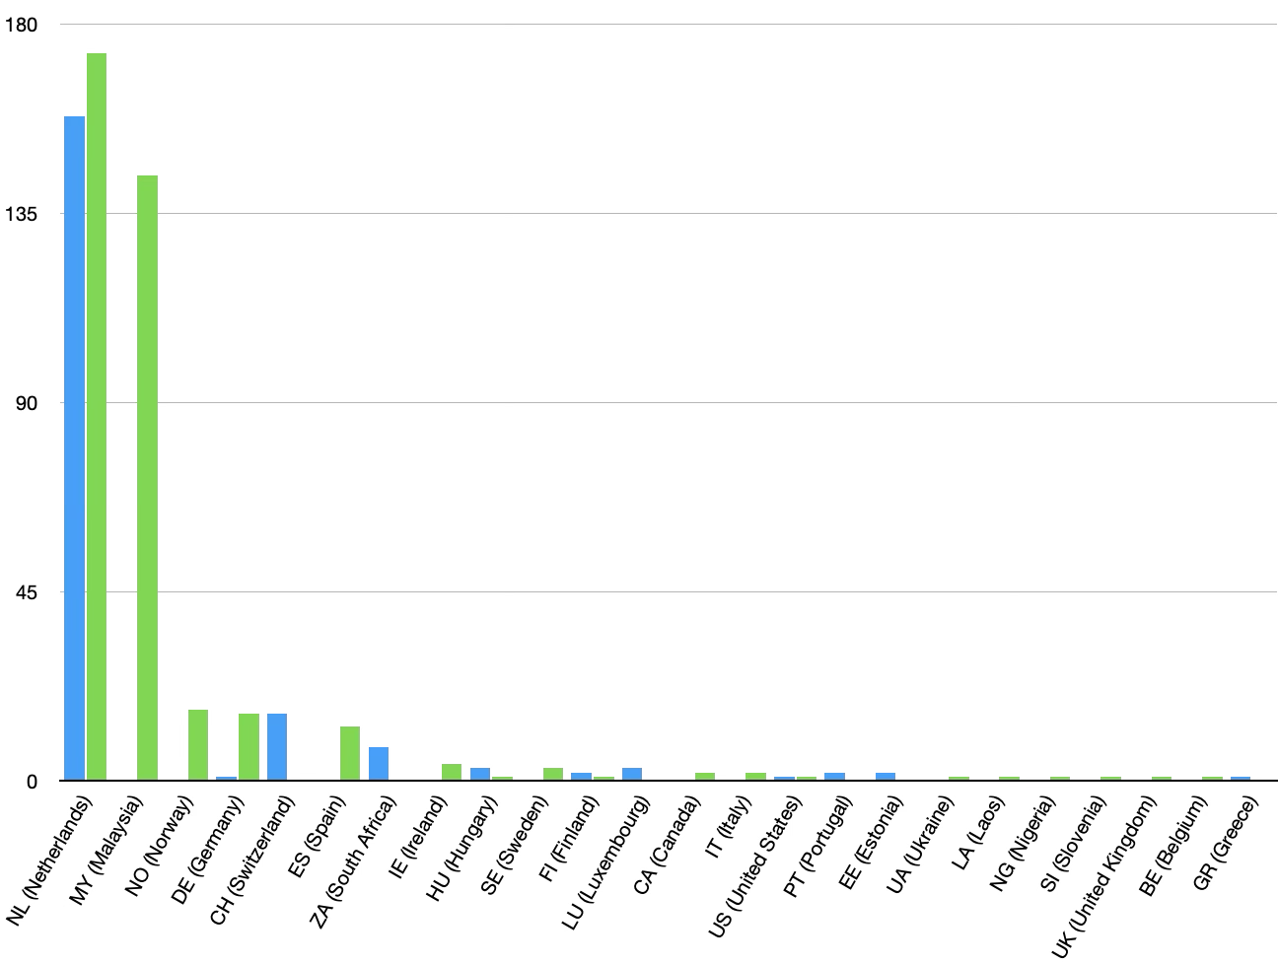
geteduroam
Apps available to all 4762 IdPs in eduroam CAT with 5804 profiles (2025-06)
412 (585 inc. govroam) of these profiles are EAP-TLS hosted on a portal
(letswifi-portal, “geteduroam pseudo accounts”), in 24 countries

Slide 4
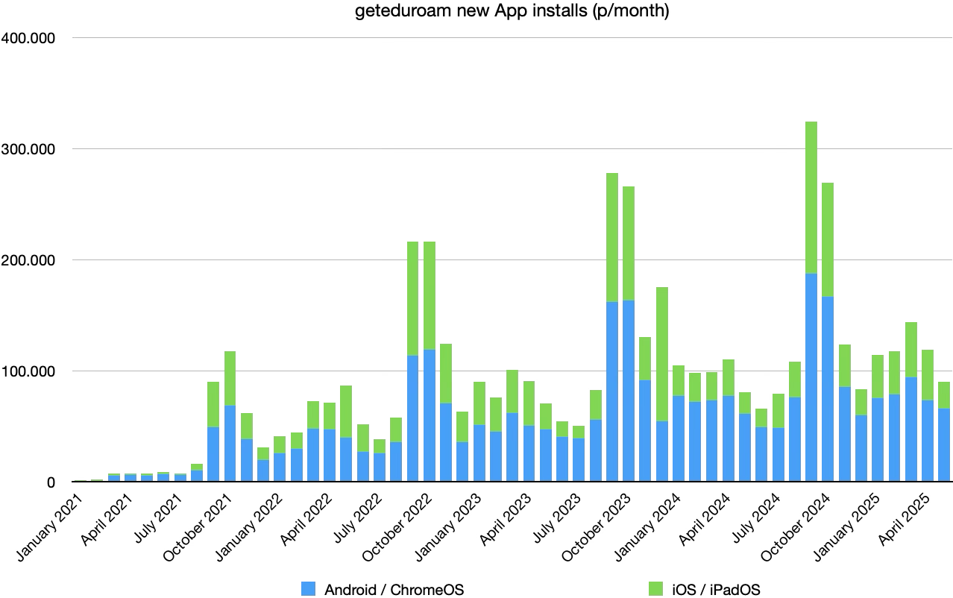
5+ million
new Apps installs

Slide 5
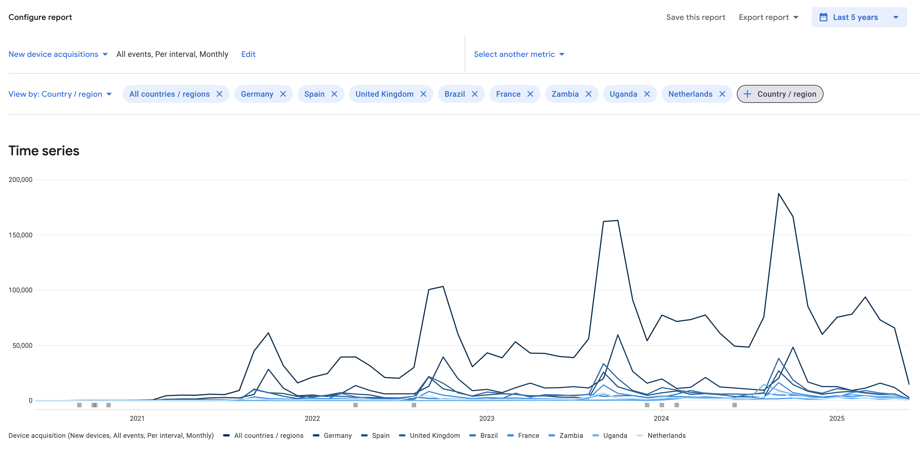
Store report metrics

Slide 6
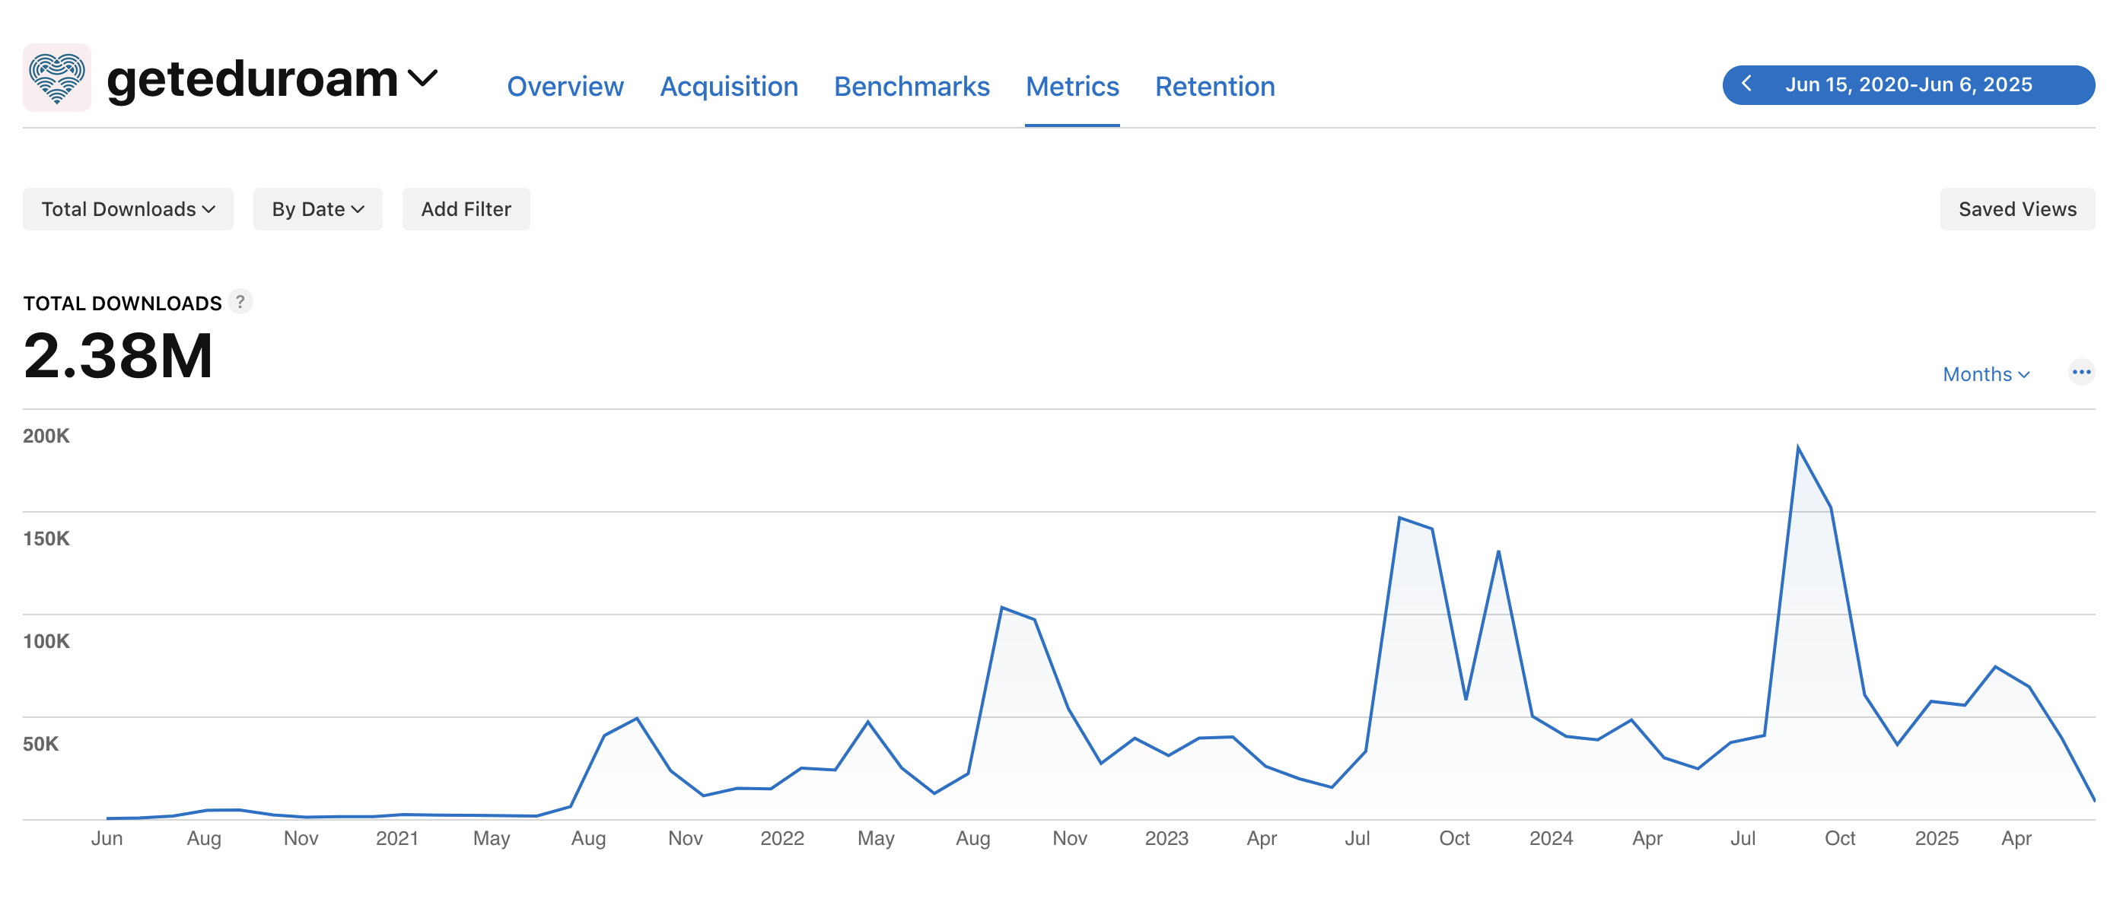
Apple metrics (1)

Slide 7
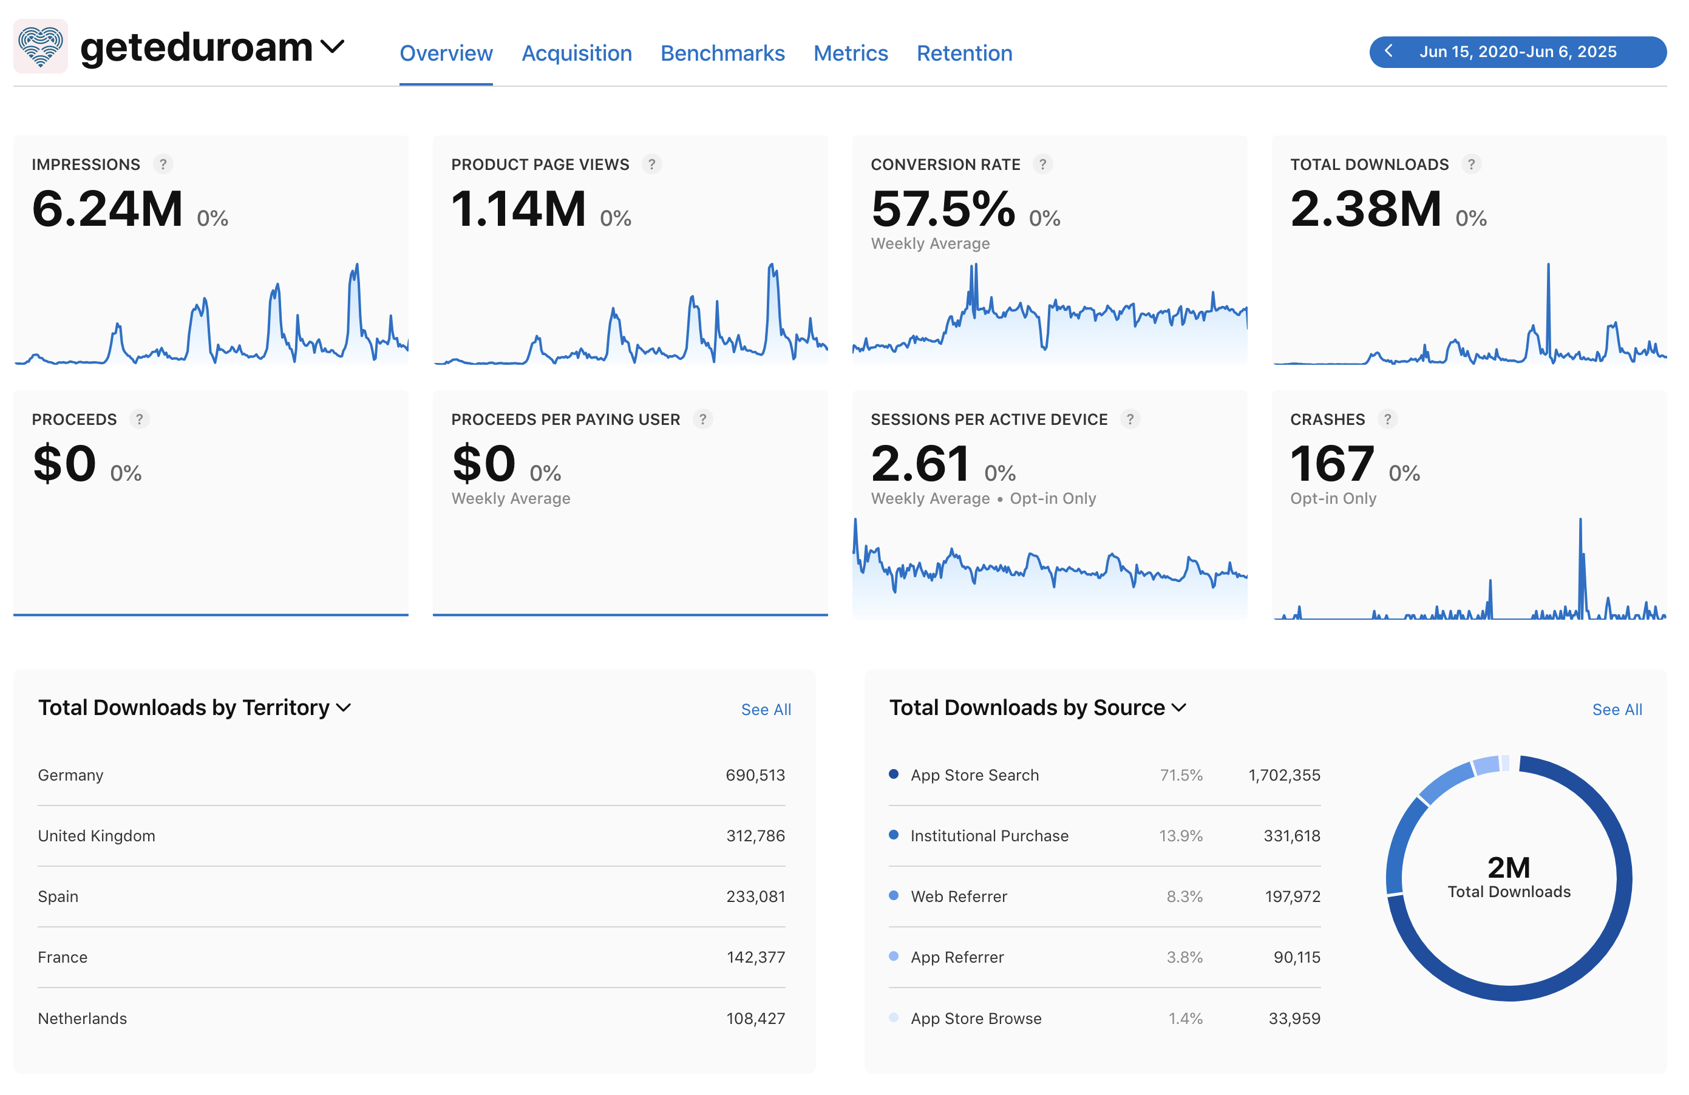
Apple metrics (2)

Slide 8
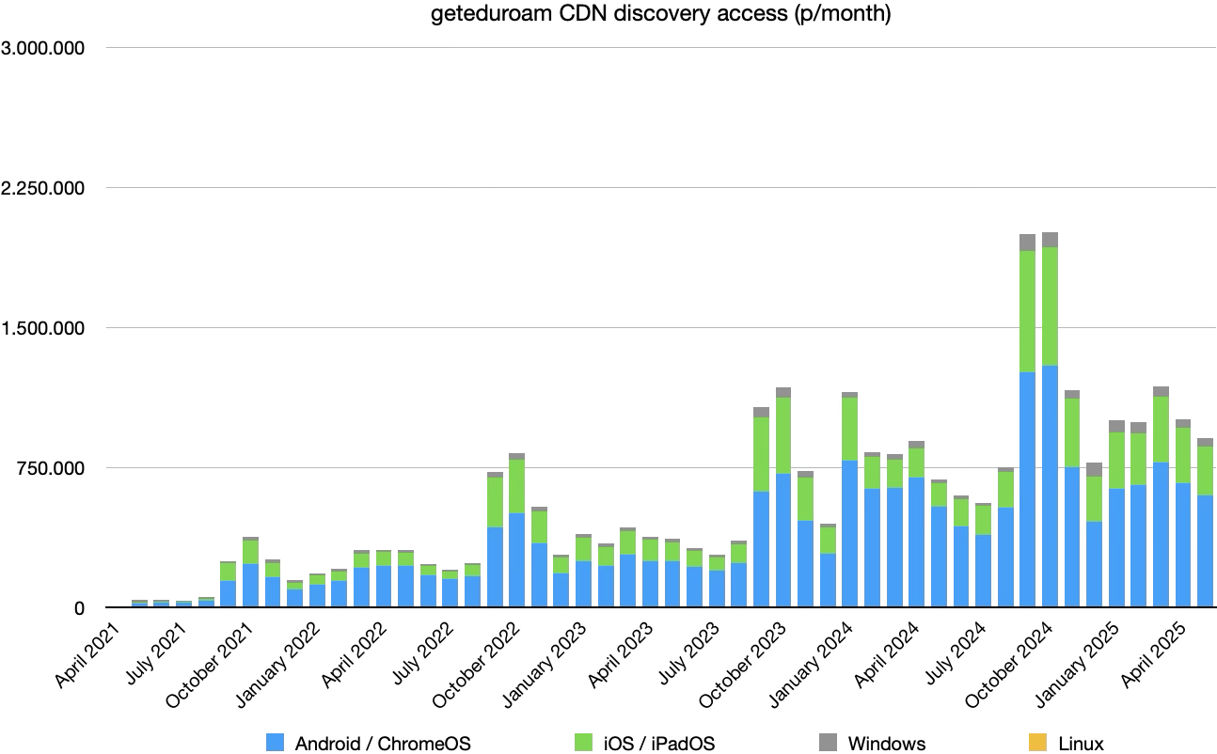
30 million
Apps accessed
discovery

Slide 9
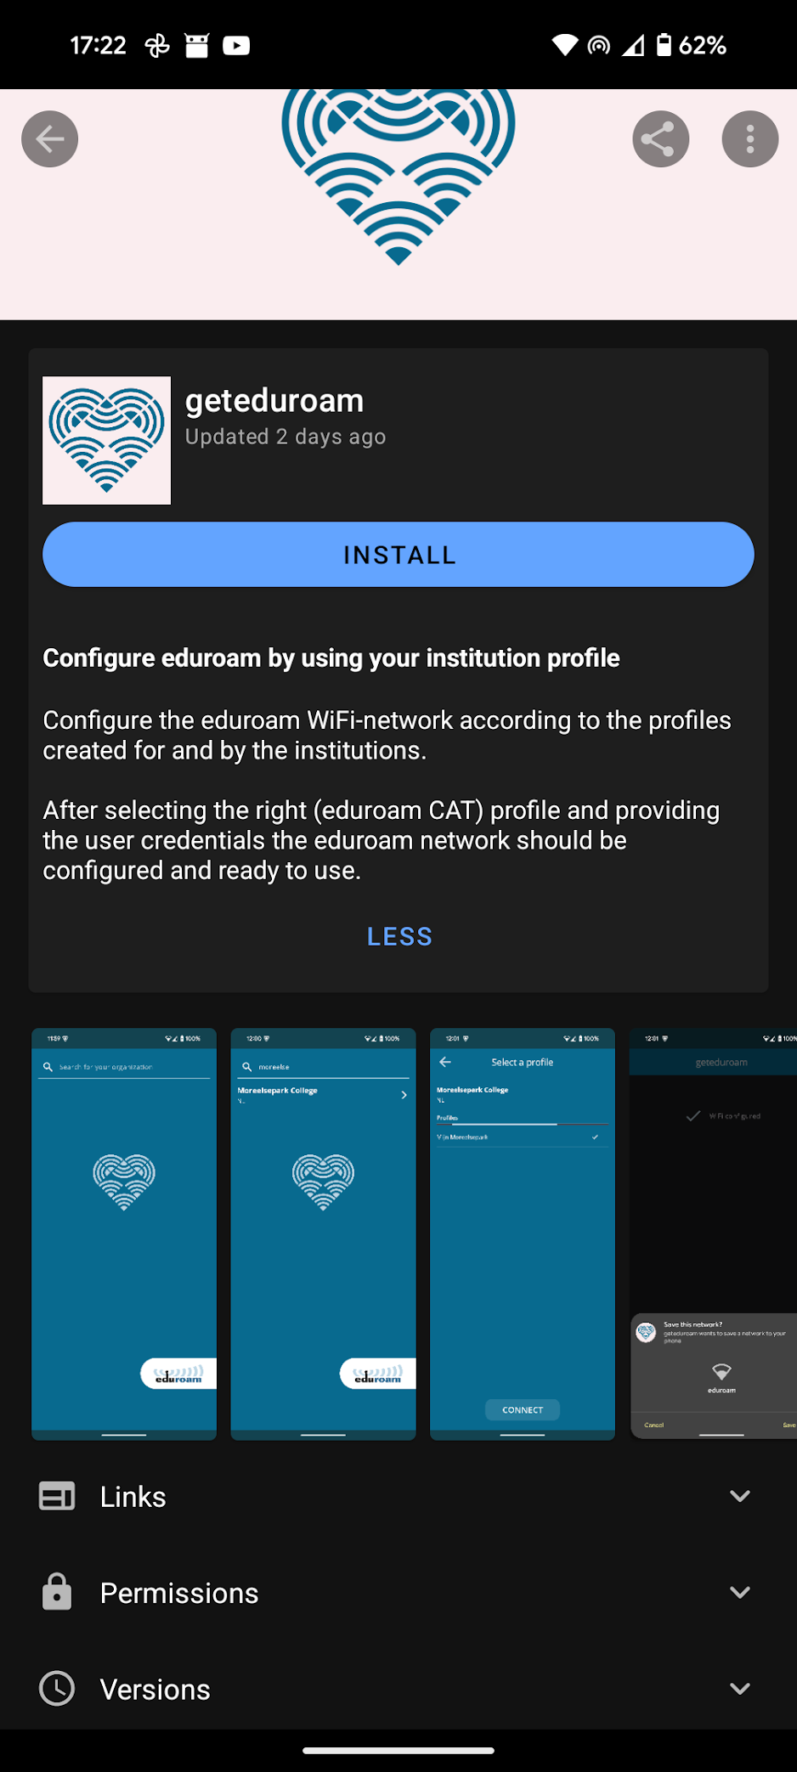
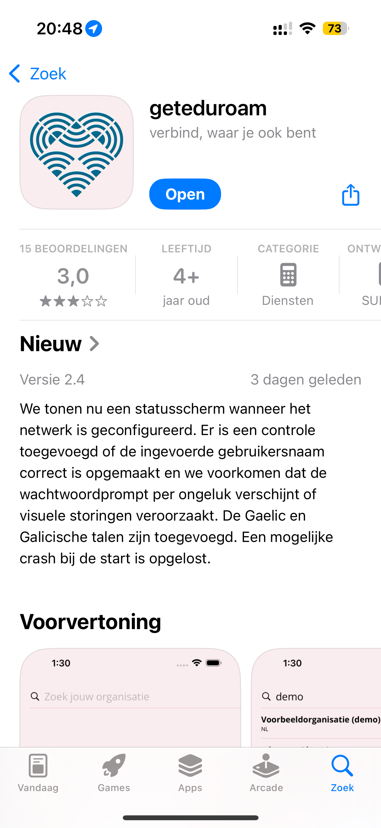
Store presence
Android:
  F-Droid
    Offers .apk downloads on website
  Google Play
  AppGallery
iOS
Linux FlatPak
Working on:
macOS
Windows

Slide 10
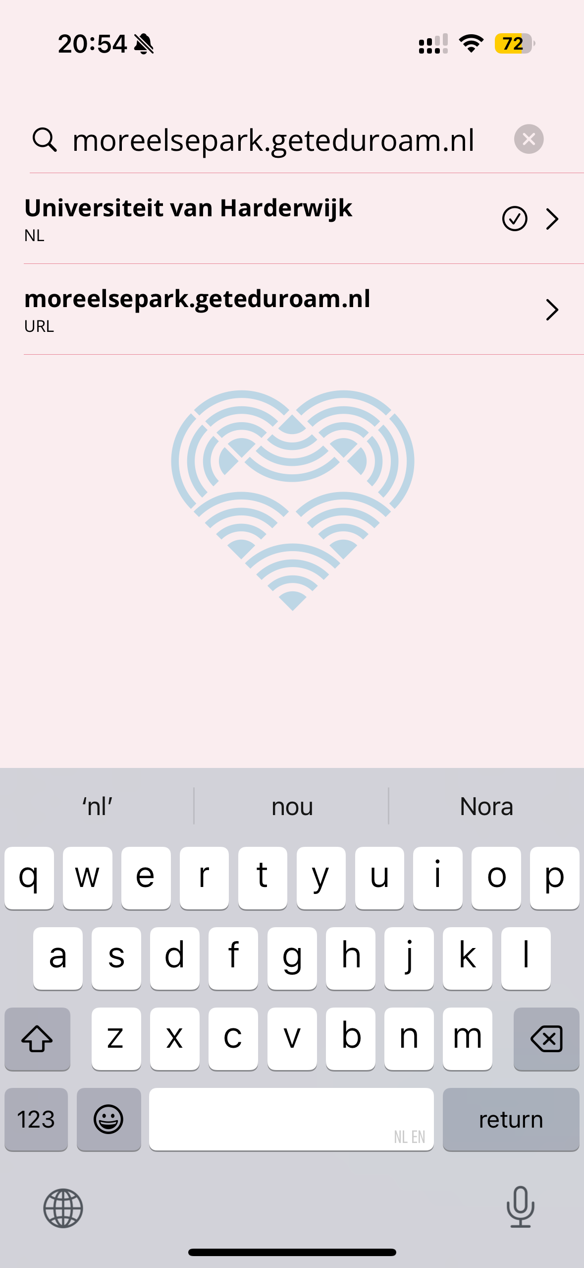
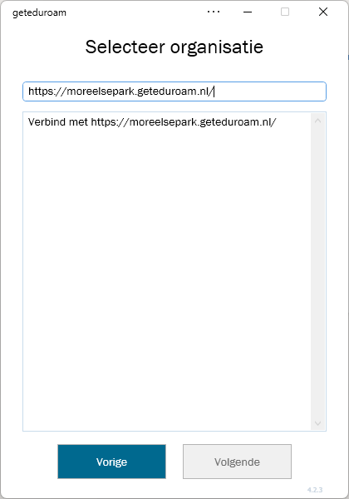
App updates last year (1)
Lots of updates to keep the Apps
working on all OS-es
Backend / discovery improvements
(ie. multiple languages)
App Translations! 🙏
Windows
  Auto-update
  URL to test before publication
  Architecture detection
  New CA fingerprint feature

Slide 11
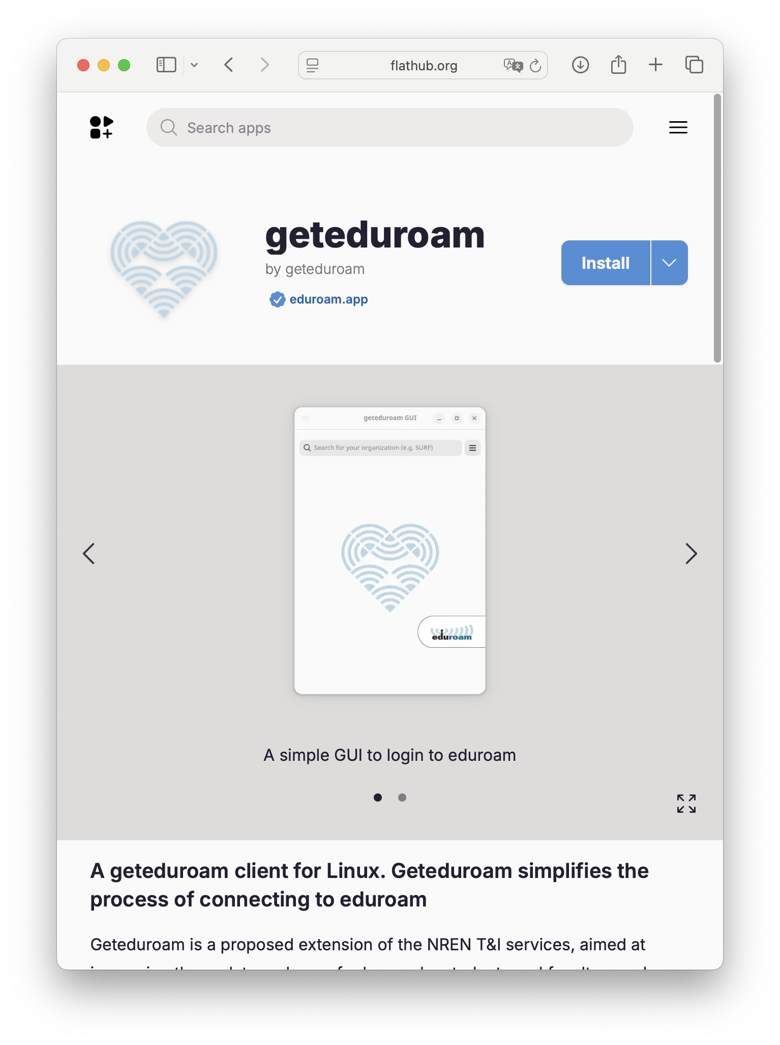
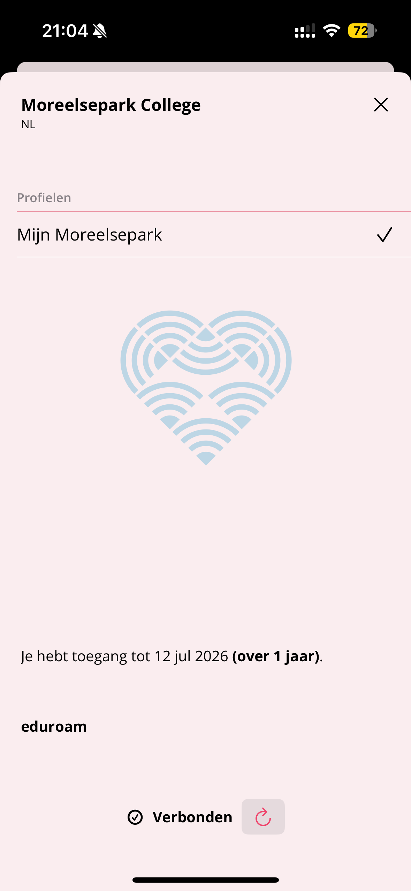
App updates last year (2)
Linux
  GUI now available in FlatPak
  Multiple SSIDs
  Multiple CA certificates
  Reports via GitHub 🙏
iOS, Android
  Show status of configuration
  Check usernames better (iOS)
  Improved device support (A)
  Reported errors 🙏

Slide 12
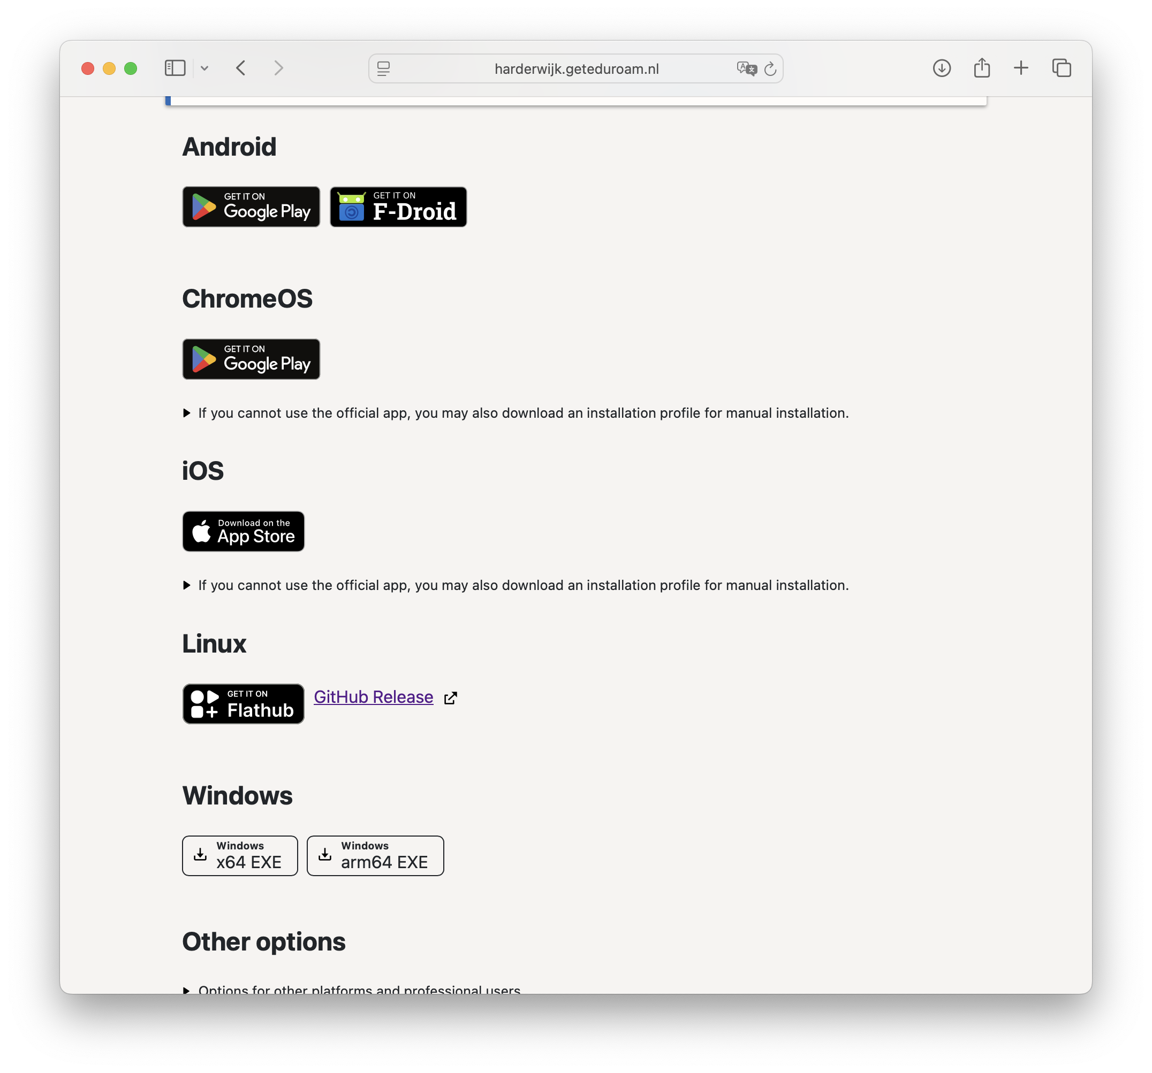
New portal (1)

Slide 13
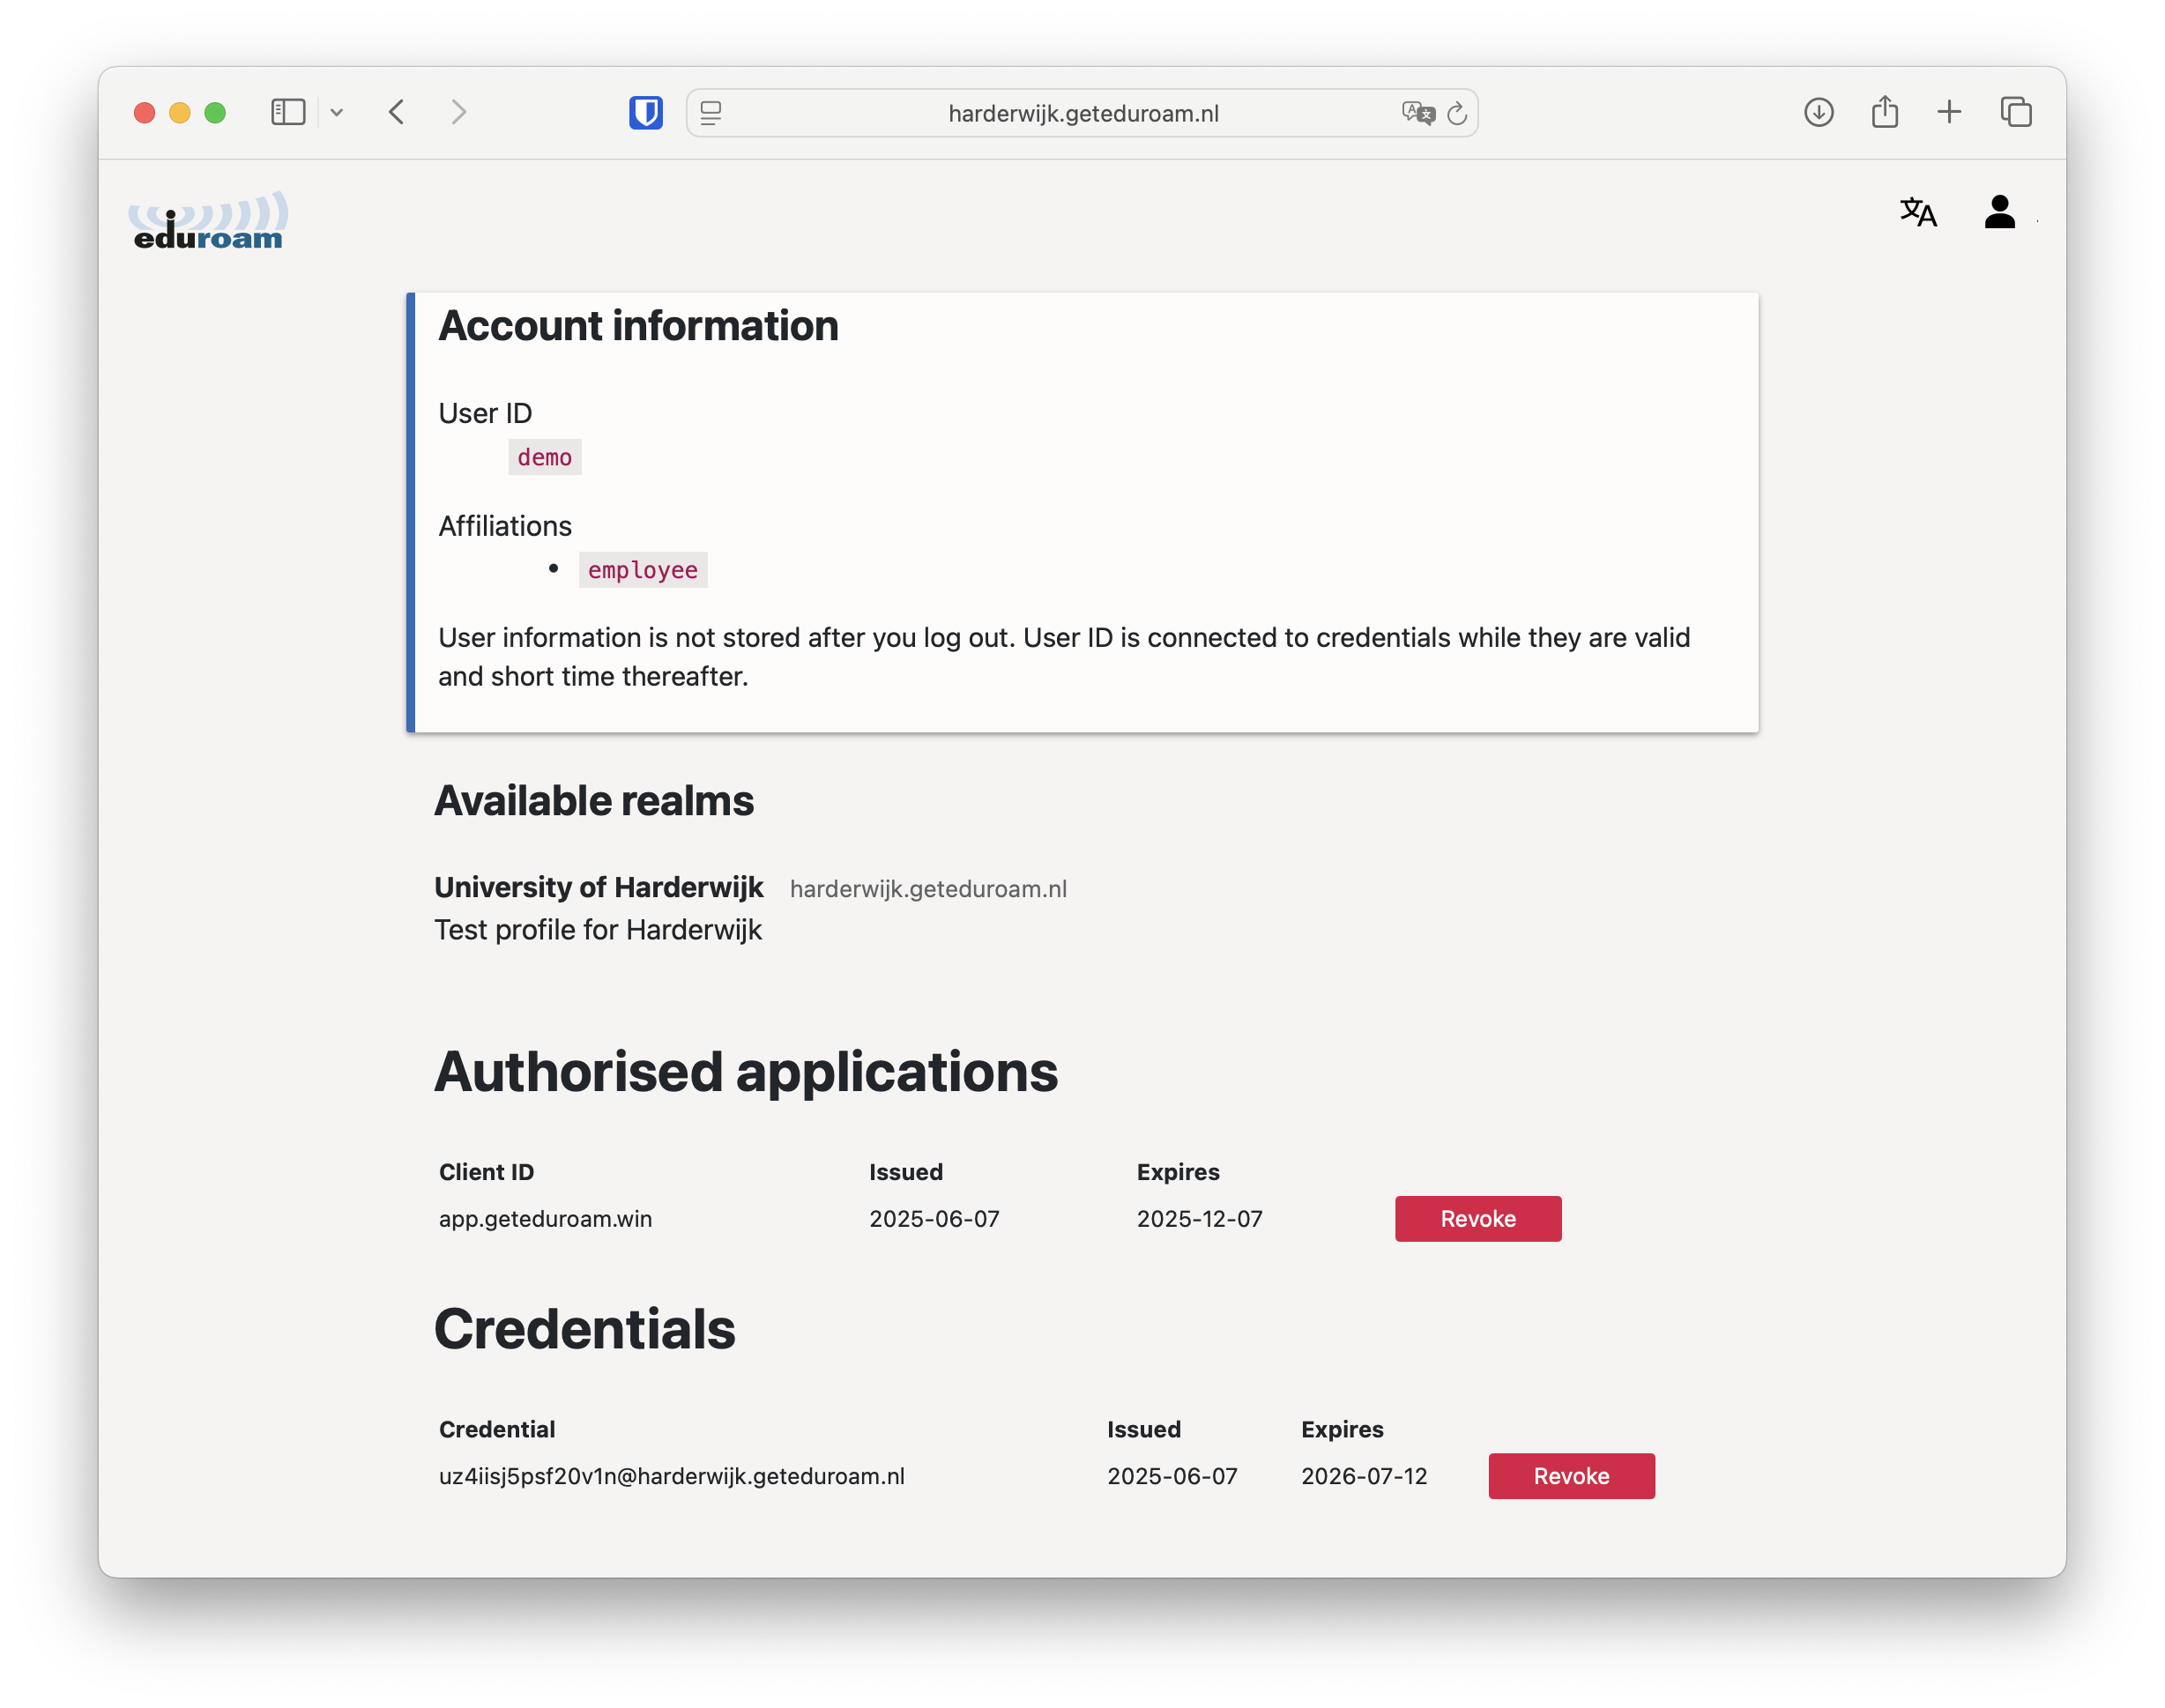
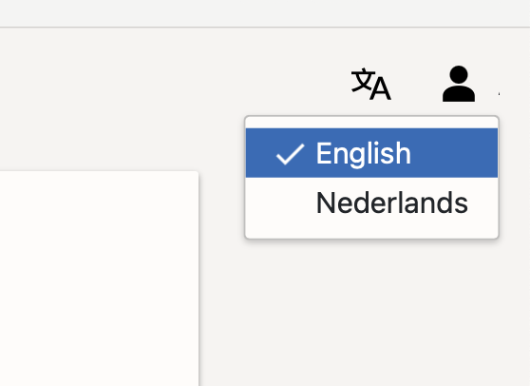
New portal (2)
Fresh look,
integrates well in Apps
Translations
User login
  Credential revocation
Institution/profile info
(ie. helpdesk)
Integrated admin function
More documentation

Slide 14
Admin portal, virtually unchanged (but maintained)

Slide 15


Slide 16
🐓🥚
ideas
QR code for provisioning (like eSIM)
Transfer profile from phone to laptop via bluetooth or QR
more
Get in touch!
On the eduroam Slack workspace, there are:
  #geteduroam (generic, client)
  #geteduroam-portal (ca, portal)
https://github.com/geteduroam
https://www.geteduroam.app/

Slide 17

Paul Dekkers
paul.dekkers@surf.nl
@pauldekkers

