Slide 1
Mobility Day
Welcome and introduction
Leonardo Hotel
9 June 2025

Slide 2
Agenda
Time | Topic | Presenter
14:00 - 14:05 | Welcome
14:05 - 14:20 | eduroam Principles / Operational overview | Nicole Harris
14:20 - 14:50 | eduroam Security | Nicole Harris
14:50 - 15:30 | Some new vulnerability (TLP:AMBER+STRICT) | Janfred Rieckers
15:30 - 16:00 | Afternoon break
16:00 - 16:20 | Reducing the service location mapping effort v2 | Hideaki Goto, Hiroyuki Harada
16:20 - 16:35 | eduroam hosted services, Managed SP new version, a short glance at usage of MSP and MIdP | Maja Górecka-Wolniewicz
16:35 - 16:55 | eduroam CAT new features update | Tomasz Wolniewicz
16:55 - 17:15 | geteduroam update | Paul Dekkers
17:15 - 17:30 | eduroam Visitor Access, govroam, iotroam, wireless-as-a-service (and beyond), international collaboration | Maurice van den Akker
17:30 | End

Slide 3



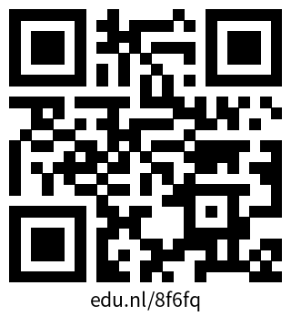

Traffic Light Protocol
TLP CLEAR
Unlimited – no restrictions
TLP GREEN
Community-wide, not public
TLP AMBER
In-house (organization + clients), need-to-know distribution
TLP AMBER+STRICT
In-house (organization ONLY), need-to-know distribution
TLP RED
Personal, for named! recipients! only!
More information: https://www.first.org/tlp

