Slide 1

Beyond eduroam
Progress @ SURF of mobile related developments

Slide 2
Spin-offs talk @ mobility day
Goal: to share our ideas quickly and activities, find ground to collaborate:
Private 5G
IoT stuff
eVA
govroam
From eduroam to SURFwireless to CNaaS

Slide 3

Title slide
Private 5G

Slide 4
What is private 5G? And why should NRENs care?
What:
Dedicated Spectrum: Runs on licensed, unlicensed, or shared spectrum
depending on country regulations.
Self-owned and controlled RAN: Institutions can install their own radio access
network (RAN), operated independently or in collaboration with a telecom provider
Why:
Improved availability of the access network
Enabling specific use cases: critical communications, specific demands
Use the SIM to grant access to eduroam (couple 5G core to RADIUS)
Data sovereignty
Economical alternative for indoor cellular solutions of public telecom providers

Slide 5



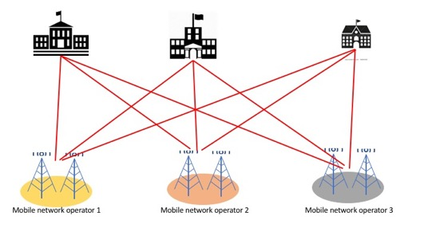
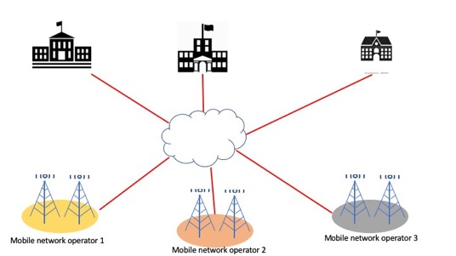

Multi-operator & multi-campus solution for indoor 5G

Slide 6
5G and Wi-Fi access networks at a glance
Wi-Fi
Uses unlicensed spectrum in 2.4, 5, 6 GHz; little coordination; expect interference
Restricts to an access network facility
Client devices decides on all radio actions
Focus on indoor usage with a range of 100m
Easy deployment in homes and offices; eduroam subscription service
Authentication: password or username+password
Implemented in every home, office and institution
5G
Uses licensed spectrum in 0.7, 0.9, 1.8, 2.1, 2.6, 3.5, 60 GHz; NO interference
Includes both access and core facilities
Network instructs devices what to do
Focus on outdoor usage with a range of 2-10 km
High cost for setup; requires a mobile plan with a data subscription
Authentication : SIM card
Offered limited operators per country
(Private 5G may change this)

Slide 7
Private 5G: Current situation & next steps
SURF’s private 5G network: operational in open source ‘extended lab setting’
Multiple implementations of radio access networks & core networks
Use the SURF 5G infrastructure to explore:
  Possibilities to integrate private and public 5G networks
  Using the SIM to authenticate to eduroam

Slide 8
RAN sharing with telecom providers
Key challenges:
  Radio Resource Management and Orchestration
  How to manage radio resources (e.g., spectrum, power, scheduling) across multiple administrative domains
  Coordination between different domains to ensure fairness, security, and performance
Considerations:
  RAN slicing
  Spectrum sharing, dynamic resource adaptation, use slices for separate adminstrative domains
  Sharing of virtual network and compute functions in the RAN
  Apply multi-tenant containerization technologies in the RAN to separate administrative domains
  Abstract virtualized RAN services and offer to each domain via a set of APIs or orchestrated service offerings
  Edge computing and local breakout for each domain
  Solution depends on desired level of isolation, operational flexibility, and cost-efficiency

Slide 9
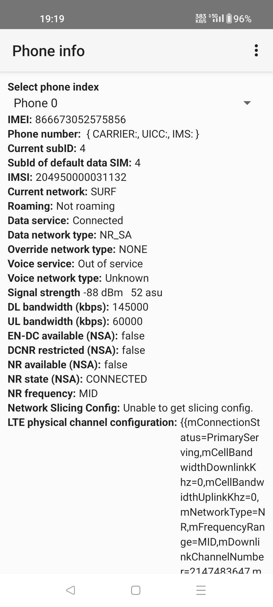
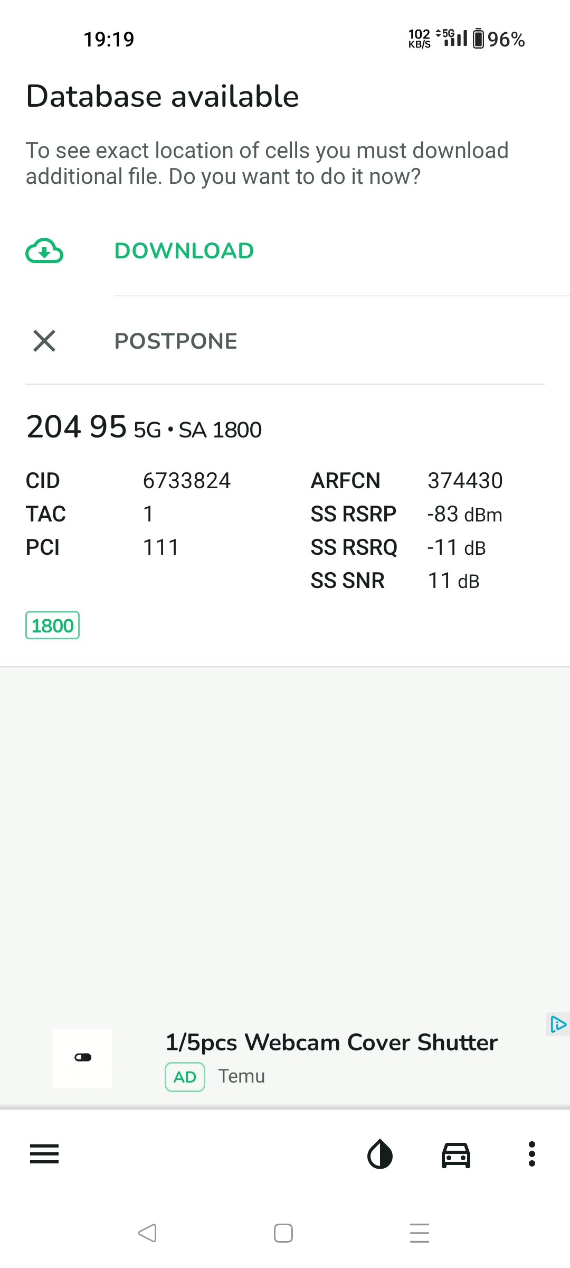
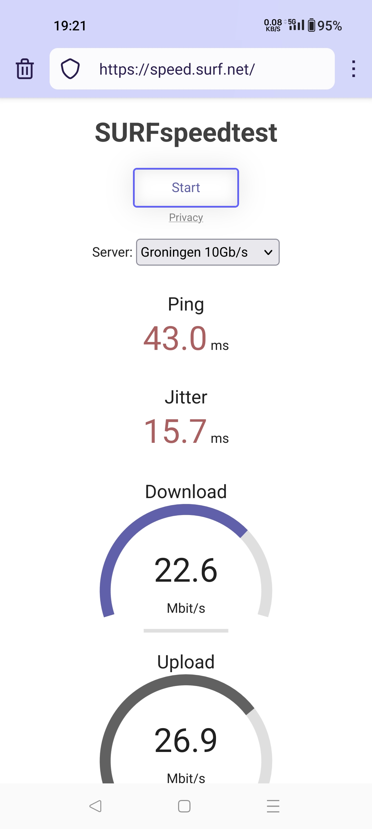
Screenshot of phone connected to SURF’s 5G network
Mobile
country
code NL
Mobile
network
code SURF
5G radio details
Private frequency used for 5G
Stand alone 5G (no 4G legacy)

Slide 10
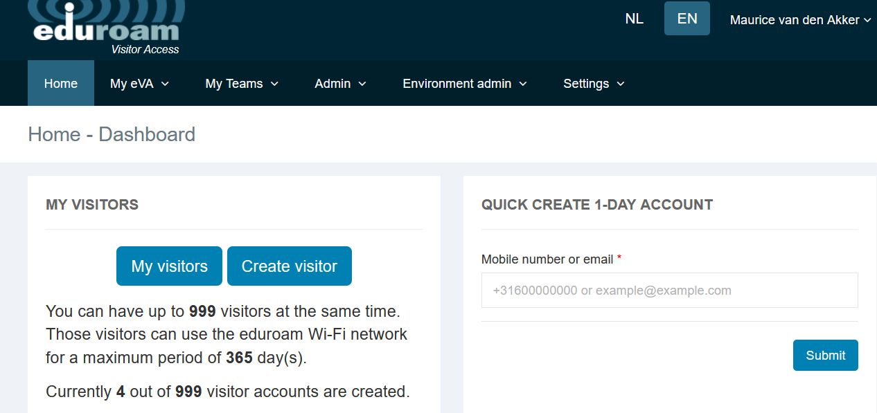
eVA
What about all those campus visitors without eduroam?
Service: eduroam Visitor Access is now “the standard” in NL-education for visitors;
Developments:
  We provide eVA to a few other NRENs “as a service”
  Bug fixing
  SMS reliability also for outside numbers

Slide 11
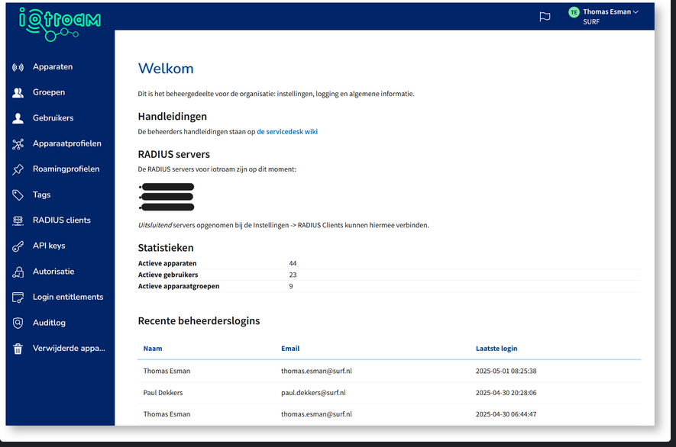
iotroam
What to do with Wi-Fi devices that cannot do 802.1x (or user’s don’t want to use their credentials on shared iot devices)
This means paperwork for the network administrator ☹
Request for solution: an eduroam for iot devices
Vendor neutral solution is preferred (to prevent vendor lock in)
iotroam: self-built software that couples MAC addresses with unique credentials
Operational since January 1st 2025. Included in the basic tariff.

Slide 12
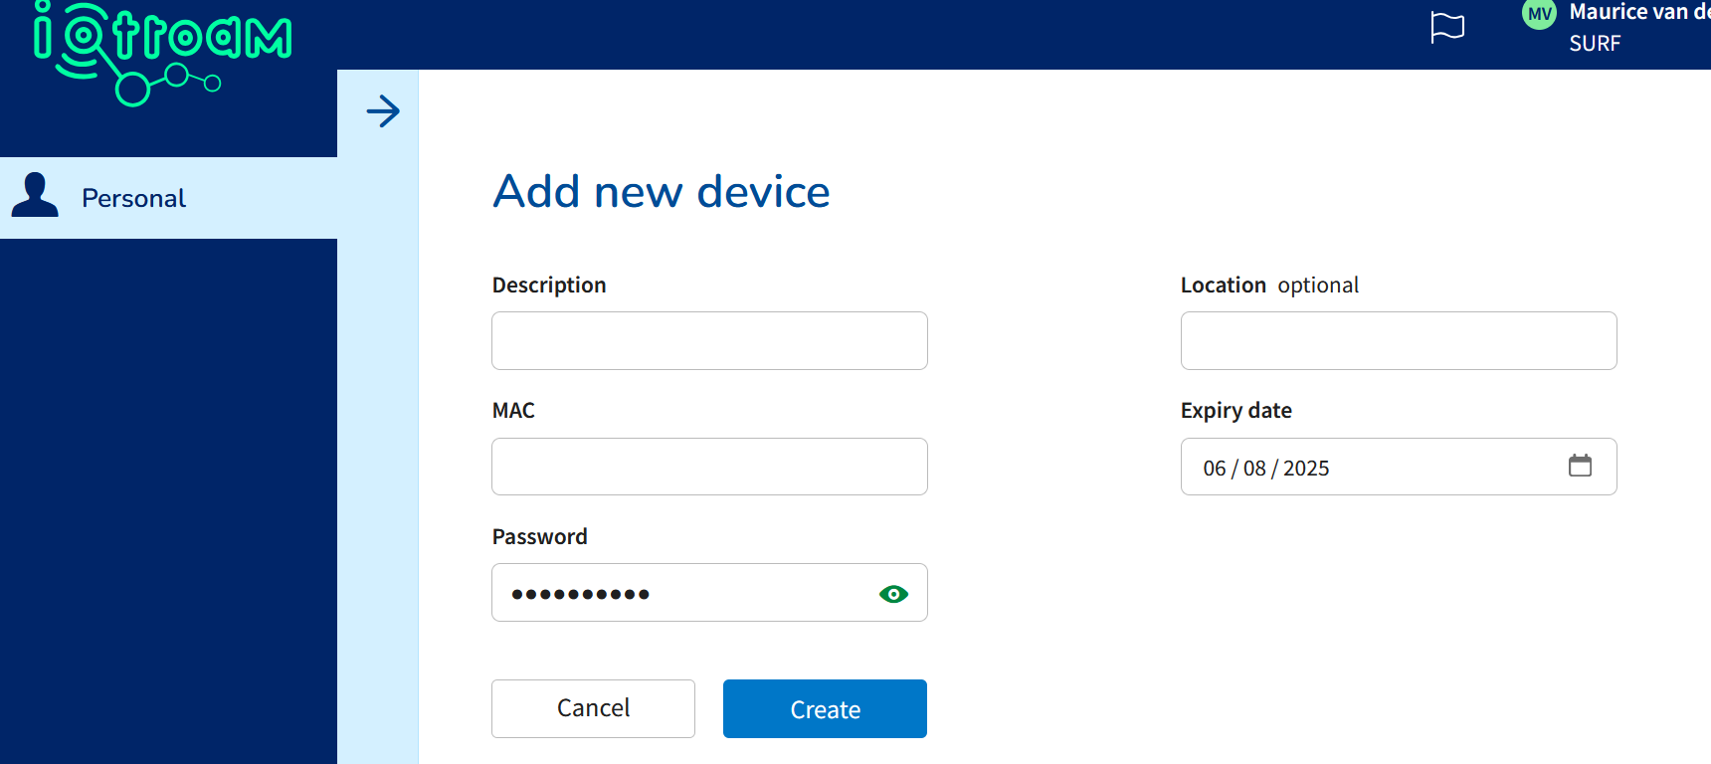



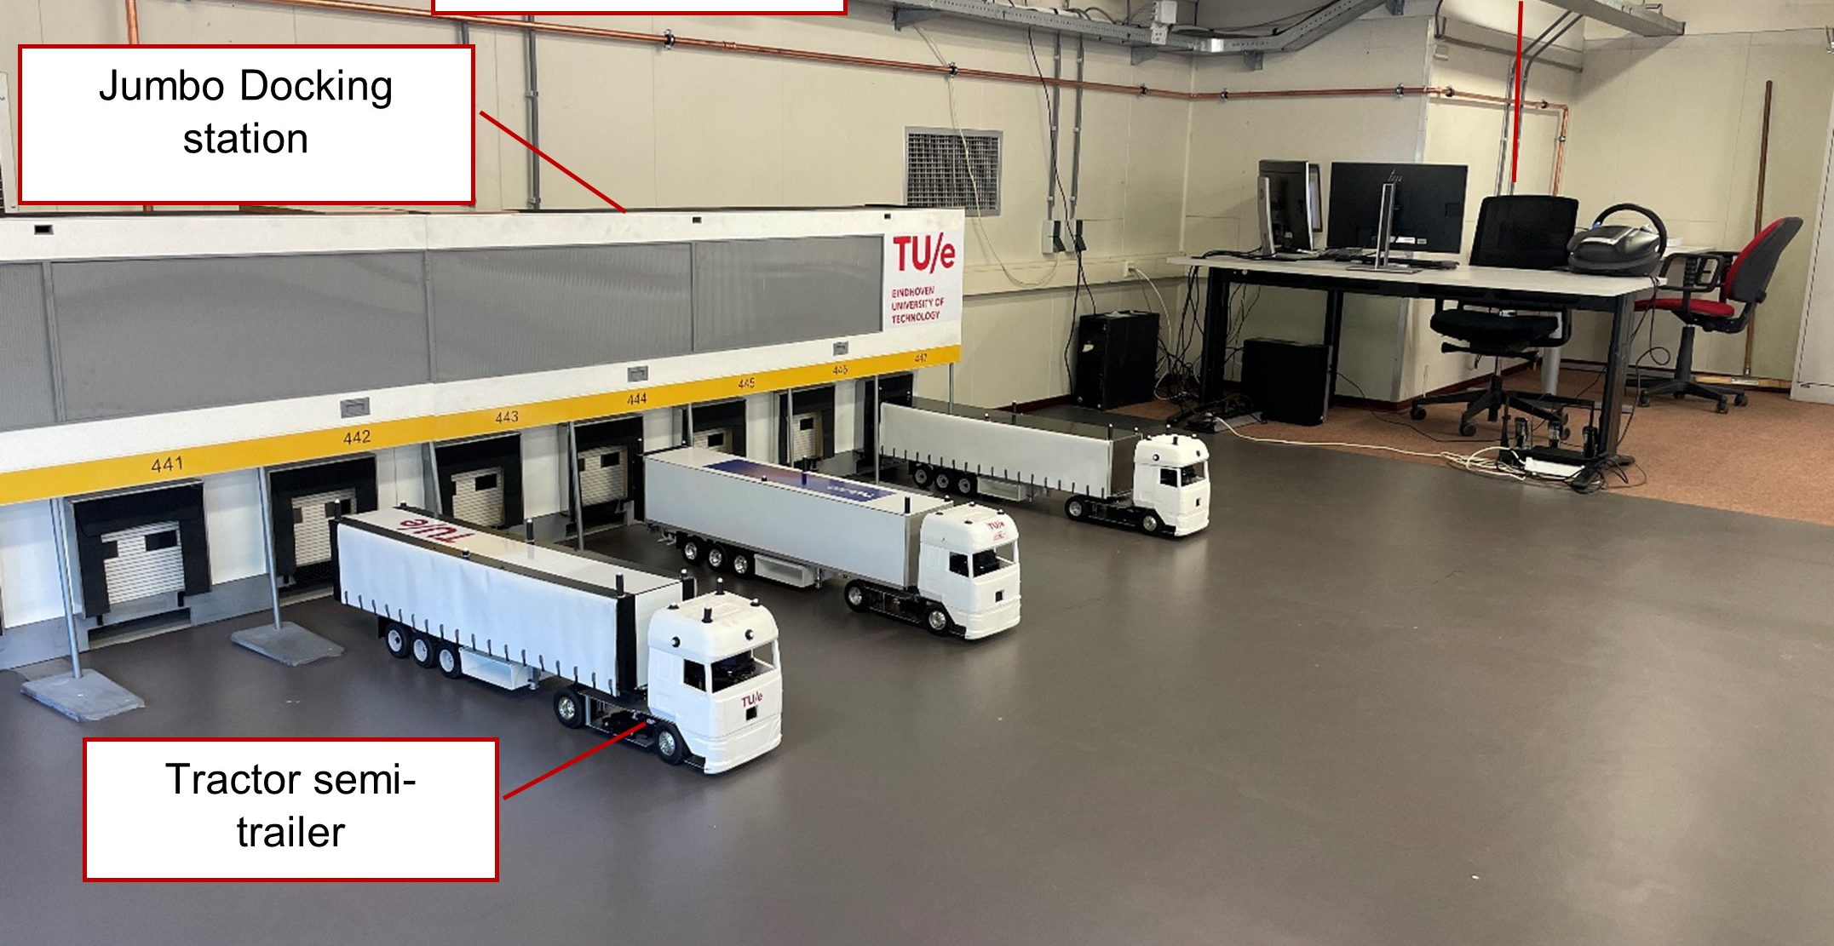

iotroam

Slide 13
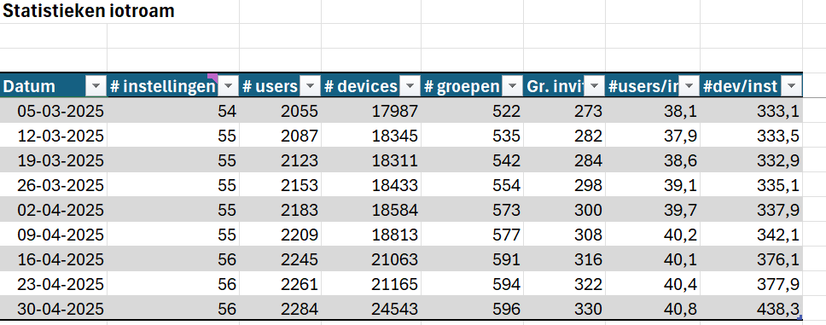
Fast growth…

Slide 14
But… what with sensors without wifi?
Users: “We want something like eduroam for non-wifi low powered devices”
… and something to store their data, visualize it, etc.
Idea: to provide managed LoRaWAN on each institute.
Why? Cooperation between institutes to embrace techology and develop use cases on a similar manner
Use ChirpStack LoRaWAN server
Optional: provide storage, visualization

Slide 15









LoRaWAN + SURF Research Cloud
Sensors
LoRaWAN
Gateways
Network
server
SURF service in development
Catalogue item in SURF Research Cloud
Other networks, like SkyNet or TTN

Slide 16
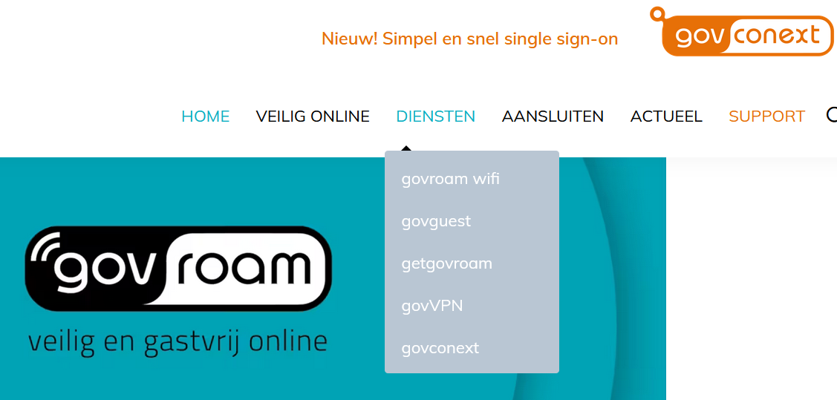
Govroam NL
In 2014, govroam foundation NL was started to provide govroam to Dutch governments
Now, In 2025, the govroam foundation delivers:
  govroam almost all big government institutes (and many of the smaller)
  getgovroam
  govguest
  govVPN
  govGain

Slide 17

SURFwireless: a success story leading to disruptive innovation?
SURF
Wifi as a Service
Since 2016
Current status (2025):
30 institutes
300+ locations
Approx 11.000 AP’s

Slide 18

Developing Campus as a Service portfolio (CNaaS)
Wi-Fi as a Service successful, but additional services are required to be useful for institutes
SURF strategy: creating a CNaaS service portfolio, connecting users and (their) devices in a secure and user-friendly manner to local or worldwide resources.
Connection type: wired, wireless, low powered,
mobile, cloud, …
What we do: Managing wireless, wired, router, firewall, DHCP, DNS, NAC, ...
All-inclusive: Procurement, installation, management,
support, maintenance. Directed by SURF, together with
market and institute
BoF session about CNaaS cooperation: Wednesday at 11!
18
Notes:
18

Slide 19

NRENs should cooperate more in campus infrastructure
(agree or disagree?)

Slide 20

Thanks
Maurice van den Akker
www.surf.nl

